Slide 1
AWS Three-Tier Architecture Implementation
Technical Exercise Demonstration
Presenter: Ryan McVey
Date: July 28, 2025
Duration: 45-minute technical presentation
Technologies Demonstrated:
🏗️ Terraform Infrastructure-as-Code
☁️ AWS EKS, EC2, S3
🔄 GitHub Actions CI/CD
🐳 Container Orchestration
💰 Cost Optimization

Slide 2
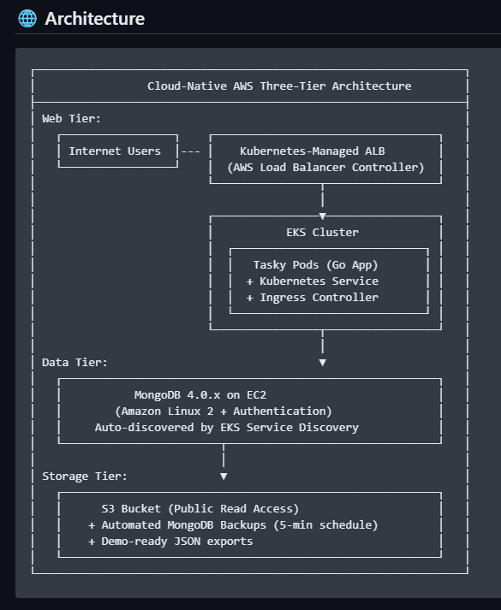
Project Overview & Technical Exercise Requirements
https://github.com/rmcveyhsawaknow/tasky-pivot-for-insight
Technical Exercise Objectives:
- Three-Tier Web Application on AWS
- MongoDB 4.0.x on EC2
- S3 for MongoDB Backups
- Public Access via ALB
- Terraform Deployment
Architecture Compliance:
- Web: EKS Cluster
- Data: EC2 MongoDB with Auth
- Storage: S3 Public Backups
Success Metrics:
- Deployment in 15-20 min
- Real-time 5-min backups
- $270/month burn rate
- 16 development iterations, cost = $32 over 2 weeks

Slide 3
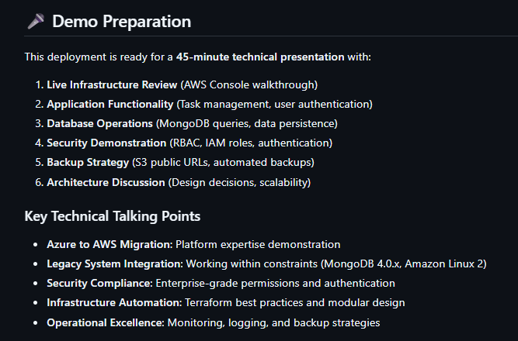
Live Demo
✅ Success Summary:
- 3-Tier on AWS, Full Automation
- 5-min backup, public access
- CI/CD & Infra as Code
🌐 Demo Ready:
- Live App URL = http://k8s-tasky-taskying-a6d84ac7c6-849035372.us-east-1.elb.amazonaws.com/
- Real-time Backup = https://tasky-dev-v16-mongodb-backup-arisw1uz.s3.amazonaws.com/backups/latest.tar.gz
- GitHub Actions in Motion = https://github.com/rmcveyhsawaknow/tasky-pivot-for-insight/actions

Slide 4
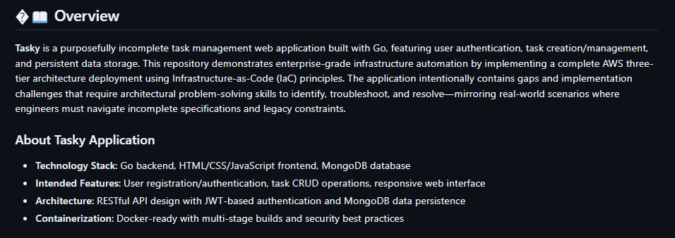
Go App & Legacy MongoDB

Slide 5
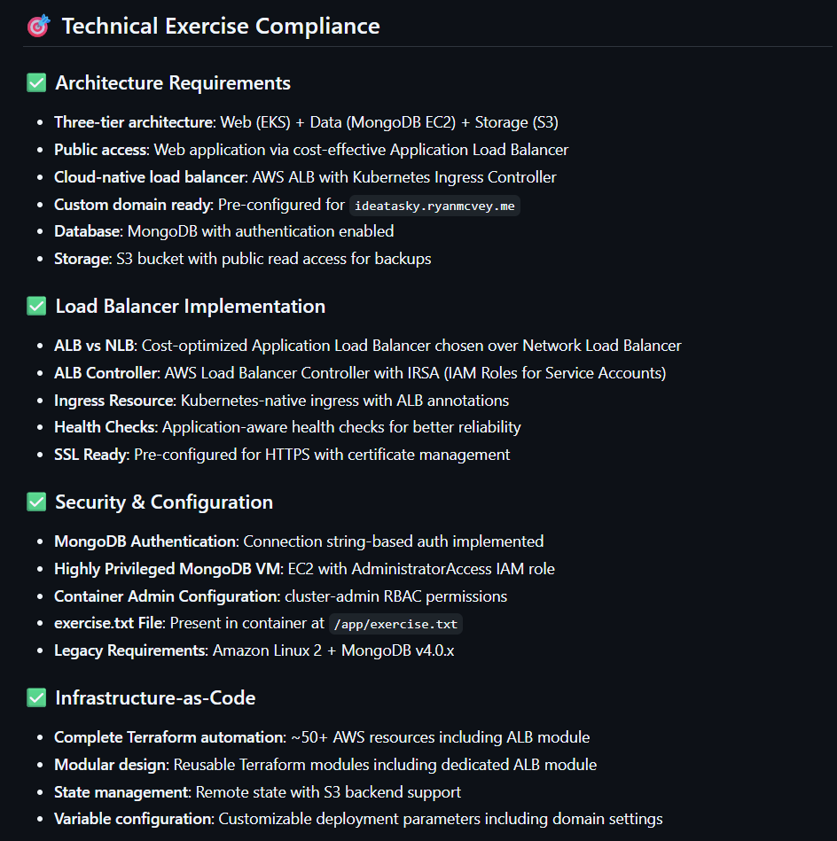
AWS Replatforming with Terraform

Slide 6
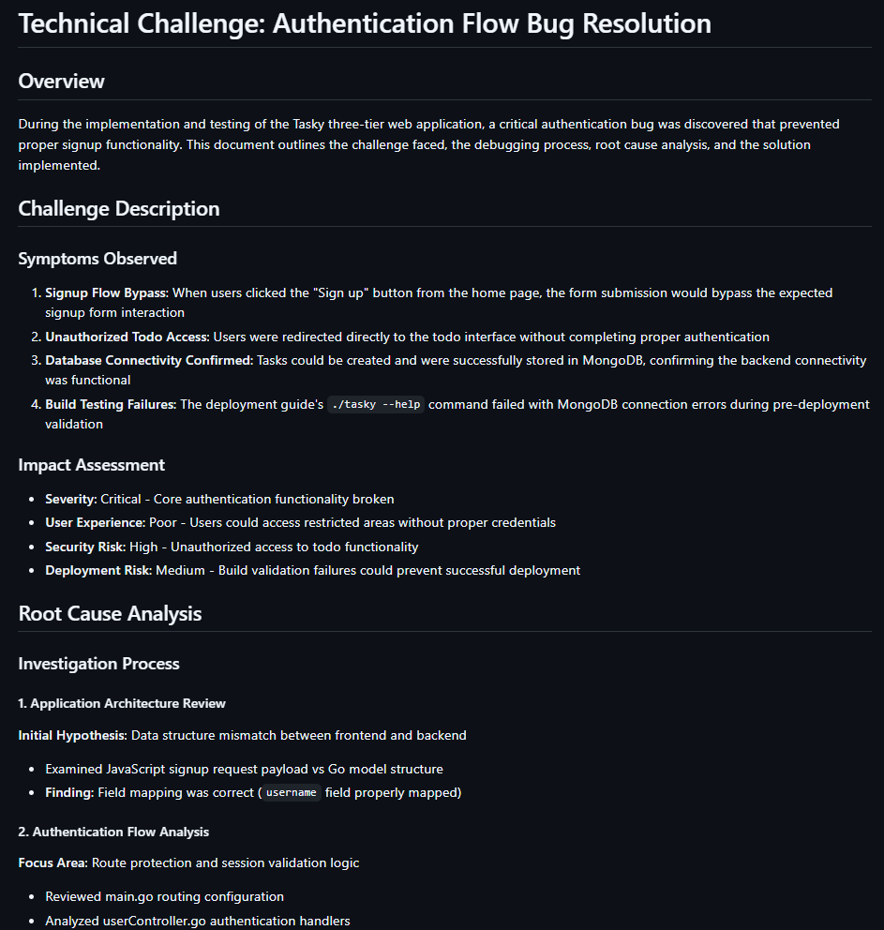
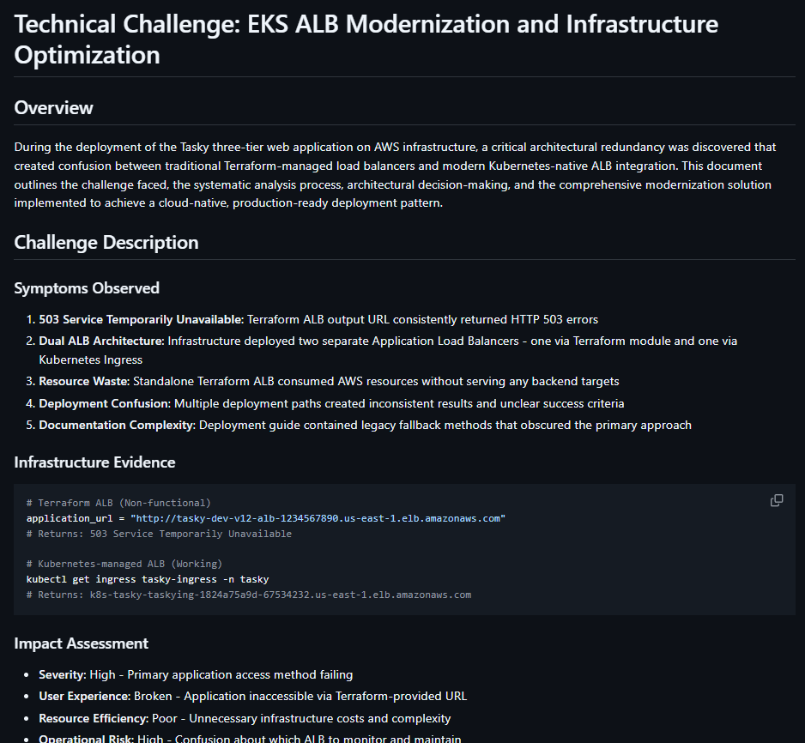
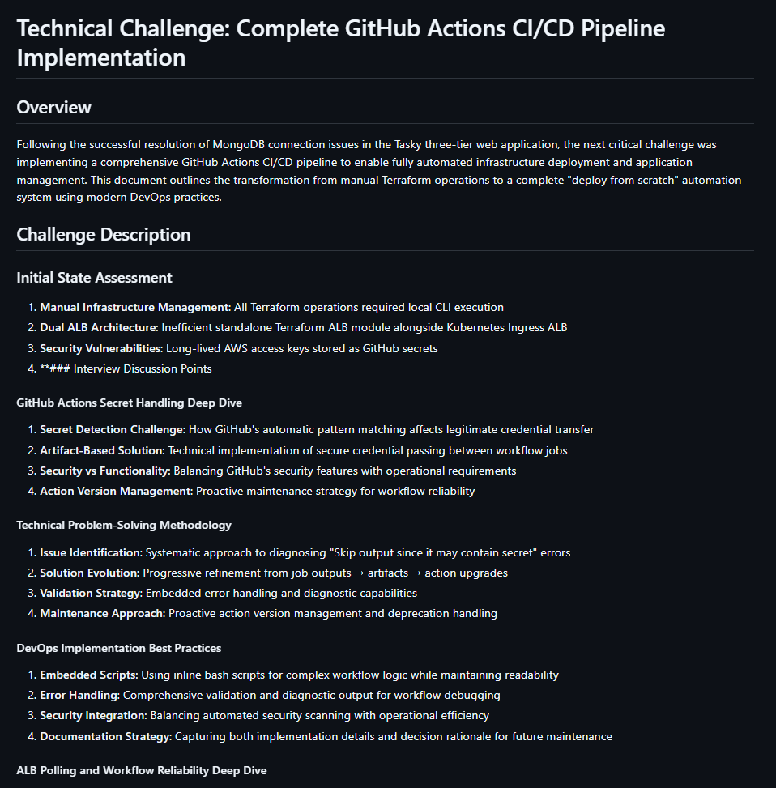
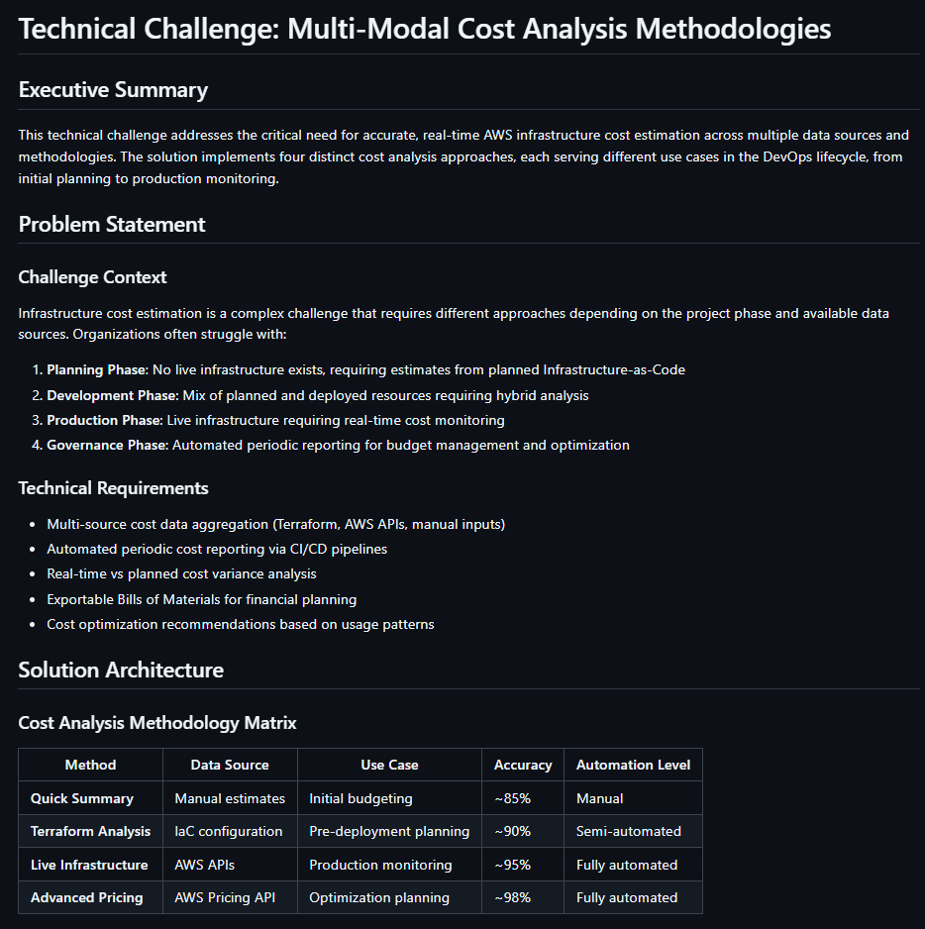
Top 5 Challenges: (click for link)
1. Auth Bug → Middleware fix
2. Mongo Timeout → Pool Tuning
3. Dual ALB Conflict → K8s-Native LB
4. Cost Estimation → 4 Methods
5. GitHub Actions → Secure CI/CD

Slide 7
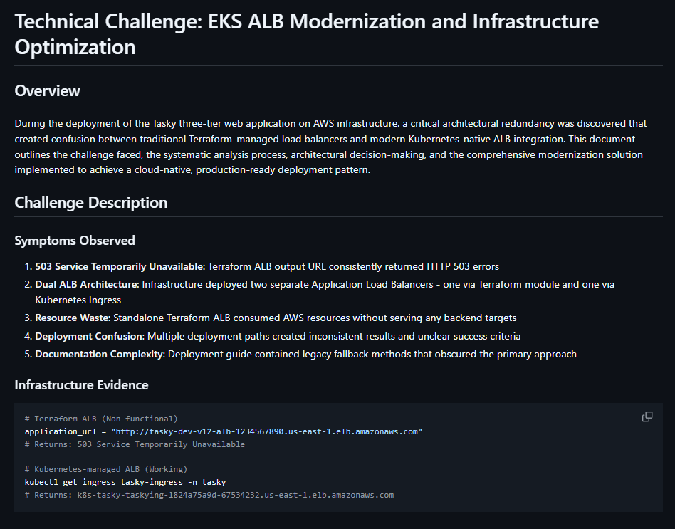
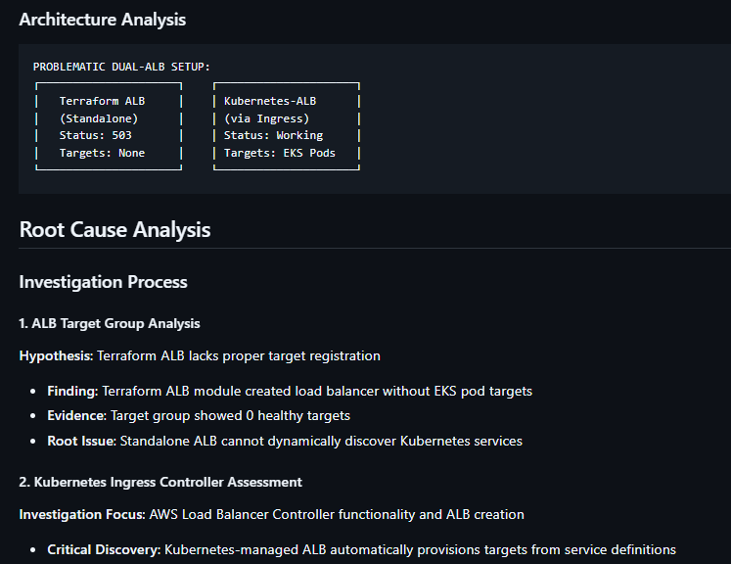
EKS & ALB Integration

Slide 8
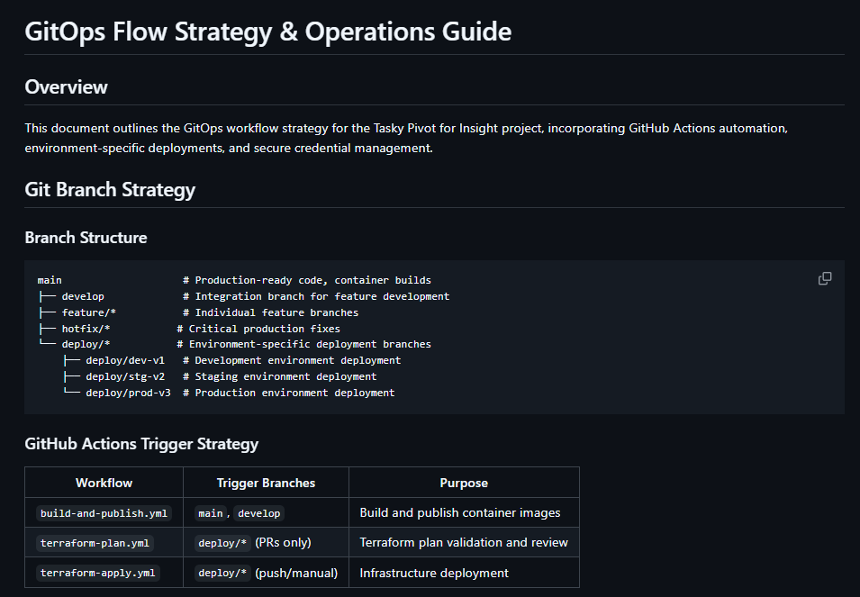

Slide 9
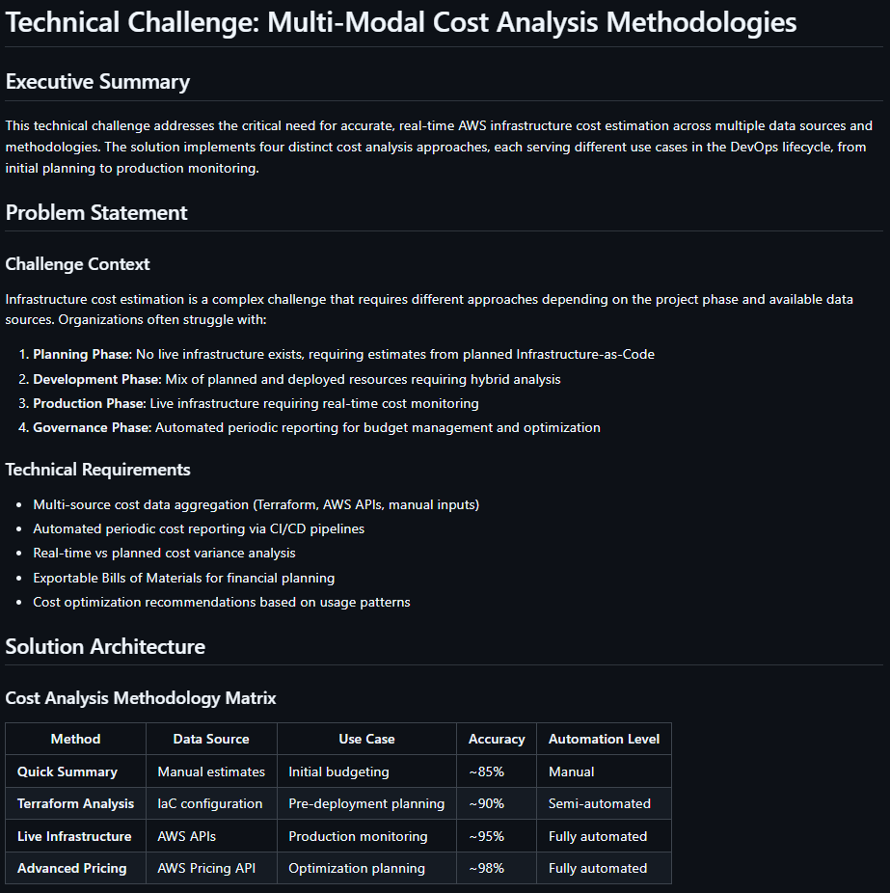
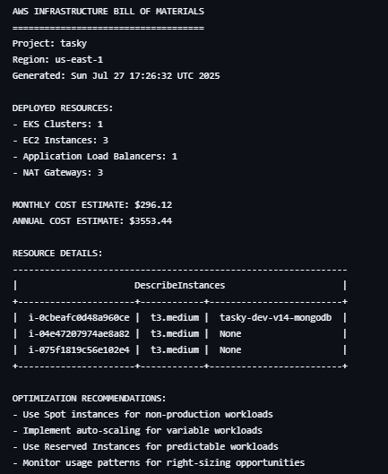

Slide 10
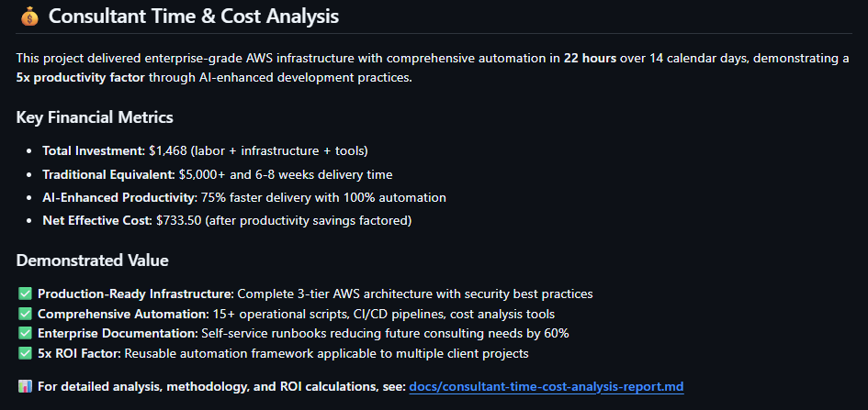

Slide 11
