Slide 2
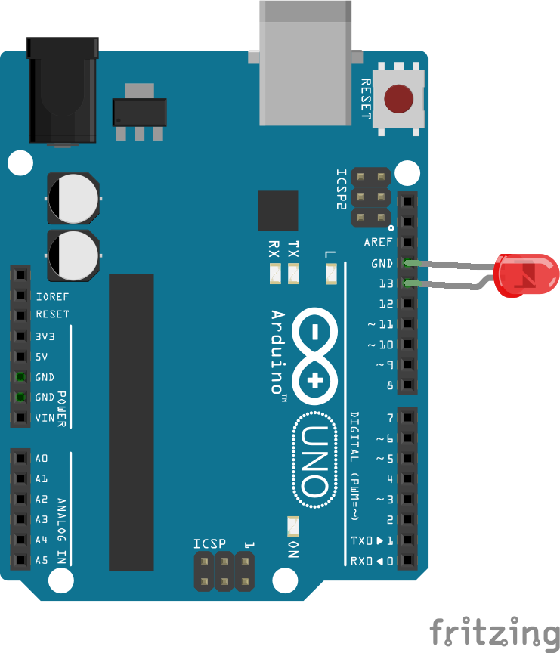

Slide 3
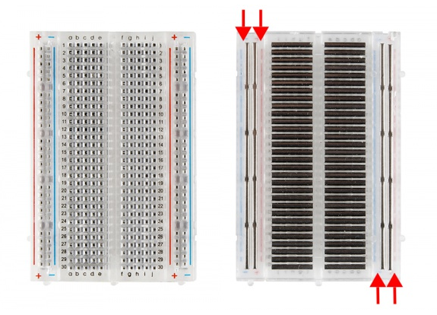
Breadboard
making temporary circuits and prototyping, and they require absolutely no soldering.
Prototyping is the process of testing out an idea by creating a preliminary model from which other forms are developed or copied, and it is one of the most common uses for breadboards. If you aren’t sure how a circuit will react under a given set of parameters, it’s best to build a prototype and test it out.
For those new to electronics and circuits, breadboards are often the best place to start. That is the real beauty of breadboards–they can house both the simplest circuit as well as very complex circuits. As you’ll see later in this tutorial, if your circuit outgrows its current breadboard, others can be be attached to accommodate circuits of all sizes and complexities.

Slide 4
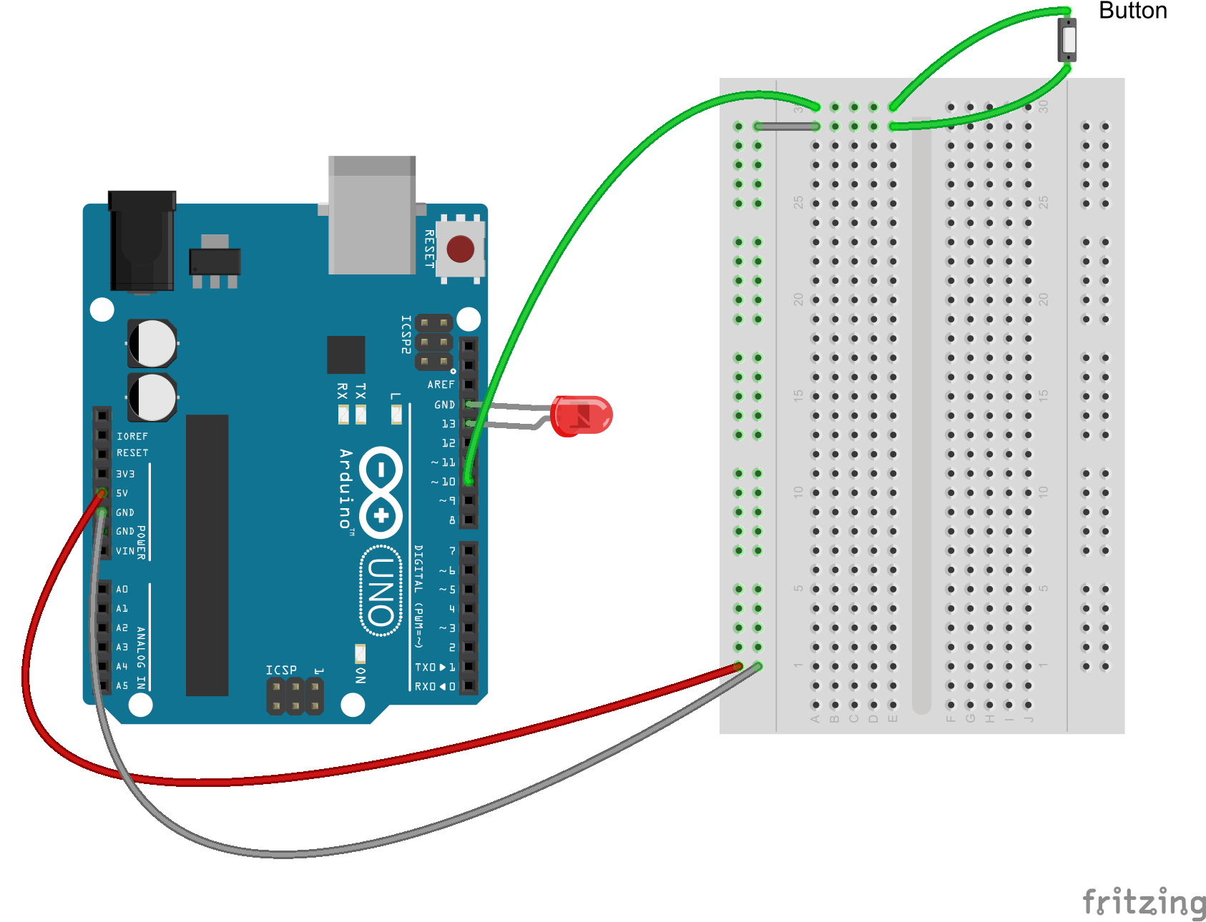

Slide 5
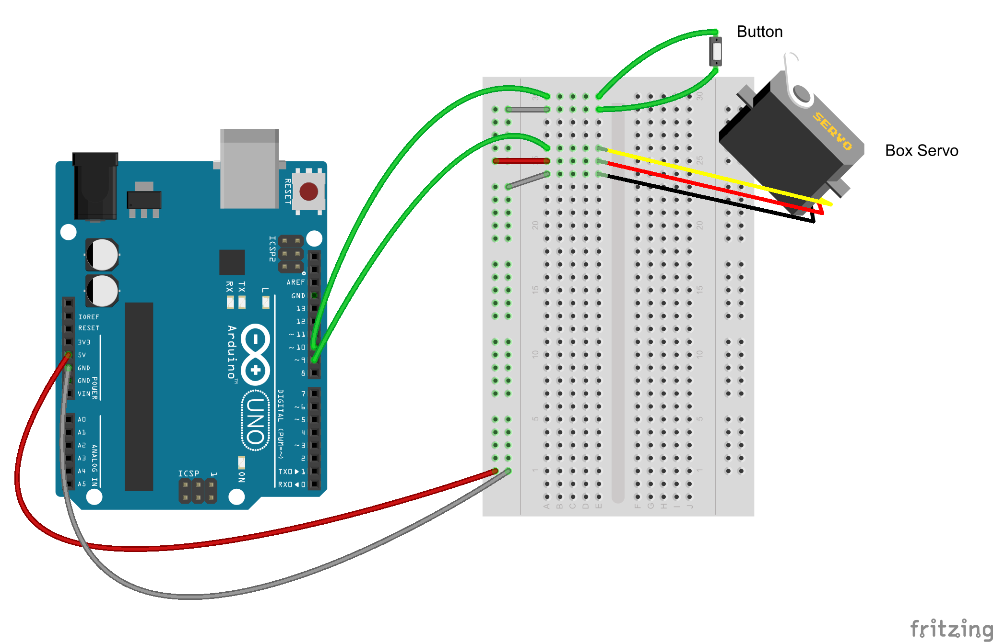

Slide 6
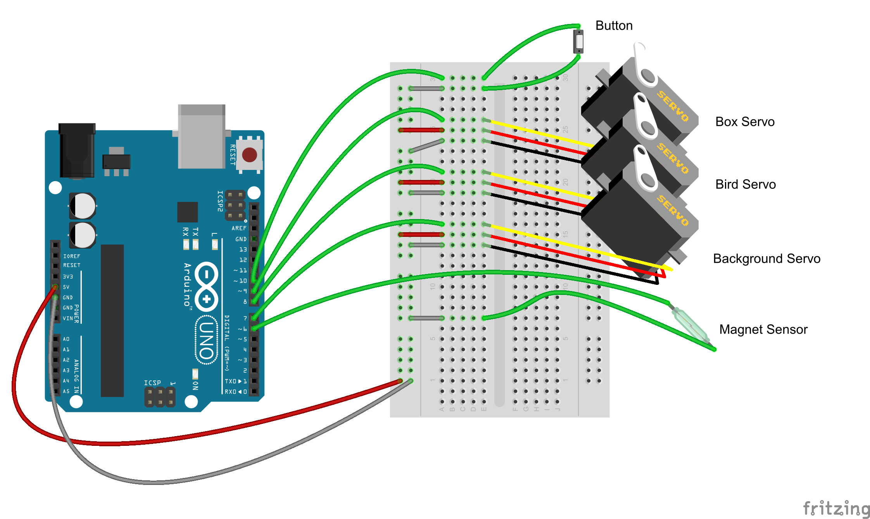

Slide 7
