Slide 1

Databases Illuminated
Chapter 4
The Relational Model

Slide 2
Advantages of Relational Model
Provides data independence-separates logical from physical level
Based on mathematical notion of relation
Can use power of mathematical abstraction
Can develop body of results using theorem and proof method of mathematics–apply to many different applications
Can use expressive, exact mathematical notation
Theory provides tools for improving design
Basic structure is simple, easy to understand
Data operations are easy to express, using a few powerful commands
Operations do not require user to know storage structures used

Slide 3
Data Structures
Relations are represented physically as tables
Tables are related to one another
Table holds information about entities (objects)
Rows (tuples) correspond to individual records
Columns correspond to attributes
A column contains values from one domain
Domains consist of atomic values

Slide 4
Properties of Tables
Each cell contains at most one value
Each column has a distinct name, the name of the attribute it represents
Values in a column all come from the same domain
Each tuple is distinct – no duplicate tuples
Order of tuples is immaterial

Slide 5
Example of Relational Model
Student table tells facts about students
Faculty table shows facts about faculty
Class table shows facts about classes, including what faculty member teaches each class
Enroll table relates students to classes

Slide 6
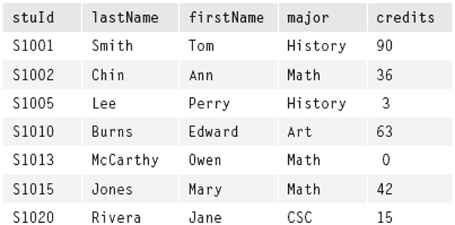
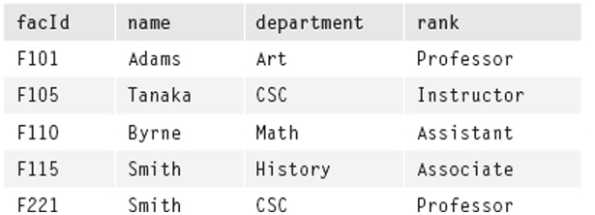
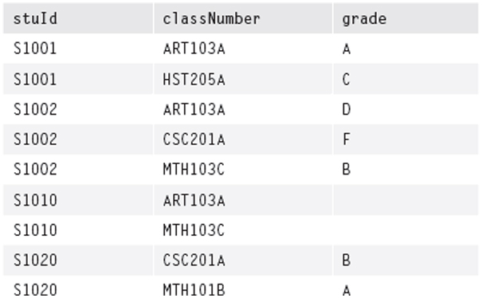
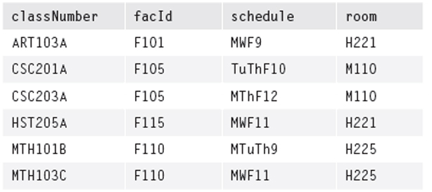
Figure 4.1B The Faculty Table
Figure 4.1A The Student Table
Figure 4.1C The Class Table
Figure 4.1D The Enroll Table

Slide 7
Mathematical Relations
For two sets D₁ and D_{2,} the Cartesian product,
D₁ X D₂ , is the set of all ordered pairs where the first element is from D₁ and the second from D₂
A relation is any subset of the Cartesian product
Could form Cartesian product of 3 sets; relation is any subset of the ordered triples so formed
Could extend to n sets, using n-tuples

Slide 8
Database Relations
A relation schema, R, is a set of attributes A₁, A₂,…,A_{n} with their domains D₁, D₂,…D_{n}
A relation r on relation schema R is a set of mappings from the attributes to their domains
r is a set of n-tuples (A₁:d₁, A₂:d₂, …, A_{n}:d_{n}) such that d₁ϵ D₁, d₂ ϵ D₂ , …, d_{n} ϵ D_{n}
In a table to represent the relation, list the A_{i} as column headings, and let the (d₁, d₂, …d_{n}) become the n-tuples, the rows of the table

Slide 9
Properties of Relations
Degree: the number of attributes (columns)
  2 attributes - binary; 3 attributes - ternary; n attributes - n-ary
  A property of the intension – does not change unless database design changes
Cardinality: the number of tuples (rows)
  Changes as tuples are added or deleted
  A property of the extension – changes often
Keys
Integrity constraints

Slide 10
Relation Keys
Relations never have duplicate tuples, you can always tell tuples apart; implies there is always a key (which may be a composite of all attributes, in worst case)
Superkey: set of attributes that uniquely identifies tuples
Candidate key: superkey such that no proper subset of itself is also a superkey (i.e. it has no unnecessary attributes)
Primary key: candidate key chosen for unique identification of tuples
Cannot verify a key by looking at an instance; need to consider semantic information to ensure uniqueness
A foreign key is an attribute or combination of attributes that is the primary key of some relation (called its home relation)

Slide 11
Integrity Constraints
Integrity: correctness and internal consistency
Integrity constraints-rules or restrictions that apply to all instances of the database
Enforcing integrity constraints ensures only legal states of the database are created
Types of constraints
  Domain constraint - limits set of values for attribute
  Entity integrity: no attribute of a primary key can have a null value
  Referential integrity: each foreign key value must match the primary key value of some tuple in its home relation or be completely null
  General constraints or business rules: may be expressed as table constraints or assertions

Slide 12
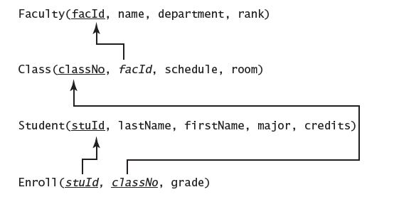
Representing Relational Database Schemas
Can have any number of relation schemas
For each schema, list name of relation followed by list of attributes in parentheses
Underline primary key in each relation schema
Indicate foreign keys (We use italics – arrows are best)
Database schema includes domains, views, character sets, constraints, stored procedures, authorizations, etc.
Example: University database schema

Slide 13
Types of Relational Data Manipulation Languages
Procedural: proscriptive - user tells system how to manipulate data - e.g. relational algebra
Non-procedural: declarative - user tells what data is needed, not how to get it - e.g. relational calculus, SQL
Other types:
  Graphical: user provides illustration of data needed e.g. Query By Example(QBE)
  Fourth-generation: 4GL uses user-friendly environment to generate custom applications
  Natural language: 5GL accepts restricted version of English or other natural language

Slide 14
Relational Algebra
Theoretical language with operators that apply to one or two relations to produce another relation
Both operands and results are tables
Can assign name to resulting table (rename)
SELECT, PROJECT, JOIN allow many data retrieval operations

Slide 15
SELECT Operation
Applied to a single table, returns rows that meet a specified predicate, copying them to new table
Returns a horizontal subset of original table
SELECT tableName WHERE condition [GIVING newTableName]
Symbolically, [newTableName = ] σ _{predicate} (table-name)
Predicate is called theta-condition, as in σ_{θ}(tablename)
Result table is horizontal subset of operand
Predicate can have operators
<, <=, >, >=, =, <>, ∧(AND), ∨(OR), ¬(NOT)

Slide 16
PROJECT Operation
Operates on single table
Returns unique values in a column or combination of columns
  PROJECT tableName OVER (colName,...,colName)
  [GIVING newTableName]
Symbolically
  [newTableName =] Π _{colName,...,colName} (tableName)
Can compose SELECT and PROJECT, using result of first as argument for second

Slide 17
Product, A x B
Binary operation – applies to two tables
Cartesian product; cross-product of A and B; A TIMES B, written A x B
  Concatenates all rows of A with all rows of B
  Columns are the columns of A followed by the columns of B
  Degree of result is deg of A + deg of B
  Cardinality of result is (card of A) * (card of B)
Can be formed by nested loops algorithm

Slide 18
Theta Join and Equijoin
Theta join is Product followed by a Select with predicate, theta (Θ)
A |x|_{θ} B = σ_{θ}(A x B)
Equijoin can be formed when tables have common columns, or columns with same domains
For equijoin, select rows of the product where the values of the common columns are equal

Slide 19
NATURAL JOIN
Same as Equijoin, but drop repeated column(s)
symbolized by |x| as in
  [newTableName = ] Student |x| Enroll
  or
  Student JOIN Enroll [GIVING newTableName]

Slide 20
Semi Join
Left-semijoin A |x B
  take the natural join of A and B and then project the result onto the attributes of A
  result is just those tuples of A that participate in the natural join
Right-semijoin A x| B
  Projection onto B of the natural join A|x|B

Slide 21
Outer Join
Left outer join of A and B
  Form natural join, but add rows for all the tuples of A with no matches in B
  Fill in the B attributes for those unmatched tuples with null values
Right outer join of A and B
  Add unmatched B tuples to natural join, filling in null values for the A attributes
Full outer join of A and B
  Add unmatched tuples for both A and B, filling in null values for unmatched tuples on both sides

Slide 22
Set Operations
Tables must be union compatible – have same schema
A UNION B: set of tuples in either or both of A and B, written A ∪ B
A INTERSECTION B: set of tuples in both A and B simultaneously, written A ∩ B
Difference, or A MINUS B: set of tuples in A but not in B, written A - B

Slide 23
Views
External models in 3-level architecture are called external views
Relational views are slightly different
A relational view is constructed from existing (base) tables
Can be a window into a base table (subset)
Can contain data from more than one table
Can contain calculated data
Can hide portions of database from users
External model may have views and base tables

Slide 24
Mapping ER Diagrams to Relational Schemas
Each strong entity set becomes a table
Non-composite, single-valued attributes become attributes of table
Composite attributes: either make the composite a single attribute or use individual attributes for components, ignoring the composite
Multi-valued attributes: remove them to a new table along with the primary key of the original table; also keep key in original table
Weak entity sets become tables-add primary key of owner entity
Binary Relationships:
  1:M-place primary key of 1 side in table of M side as foreign key
  1:1- use either key as foreign key in the other table
  M:M-create a relationship table with primary keys of related entities, along with any relationship attributes
Ternary or higher degree relationships: construct relationship table of keys, along with any relationship attributes
Recursive relationship-use foreign key if 1:M; use relationship table if M:M

Slide 25
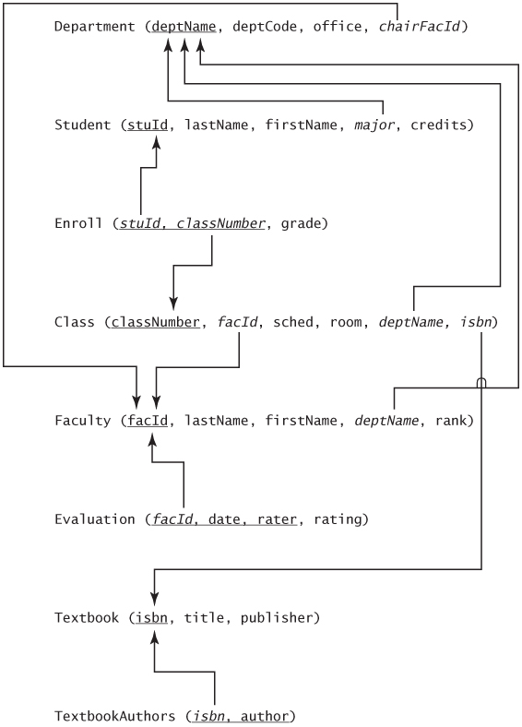
ER to Relational Schema Examples
University Example
Figure 4.7

Slide 26
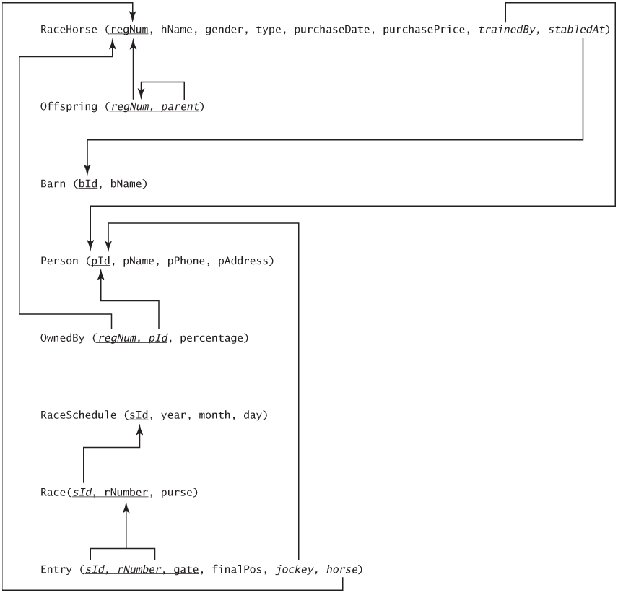
Horse Racing Example
Figure 4.8

Slide 27
Mapping EE-R Diagrams to Relational Schemas
Non-hierarchical entities-map as in ER
Hierarchies-3 methods
    Create a table for the superset and one for each of the subsets. Placing primary key of the superset in each subset table
    Create tables for each of the subsets, and no table for the superset. Place all attributes of the superset in each of the subset tables
    Create a single table with all the attributes of the superset and all the attributes of all subsets

Slide 28
Mapping Unions
Create table for the union, and individual tables for each of the supersets, using foreign keys to connect them
If superset keys are different types, create a surrogate key for union

Slide 29
Extended University Example
Faculty(facId, lastName, firstName, rank, deptName)
AdjunctFac(adjFacId, coursePayRate)
FullTimeFac(fullFacId, annualSalary, companyName, contractNo)
Pension(companyName, contractNo, contactPerson)
Evaluation(facid, date, raterName, rating)
Class(classNo, className, schedule, room, labNo, labSched, facId, gradStuId)
Student(stuid, firstName, lastName, credits, deptName)
Undergraduate(undergradstuId, major, thesisAdvisor, resType, address)
Graduate(gradStuId, program, tuitionRemission, fundingSource, facId)
Sponsor(sponsorId, sponsorType)
Department(deptName, deptCode, office, sponsorId, chairFacId)
Club(clubName, president, numberOfMembers, sponsorId, moderatorFacId)
CampusEvent(eventName, eventType, sponsorId)
Team(teamName, coach, sport, sponsorId)
Fair(eventName, date, time, theme, charity)
Concert(eventName, date, time, performer)
Enroll(stuId,classNo)
PlaysOn(stuId, teamName)
BelongsTo(stuid, clubName

