Slide 1

Databases Illuminated
Chapter 6
Normalization and Denormalization

Slide 2
Objectives of Normalization
Develop a good description of the data, its relationships and constraints
Produce a stable set of relations that
    Is a faithful model of the enterprise
    Is highly flexible
    Reduces redundancy-saves storage space and reduces inconsistency in data
    Is free of update, insertion and deletion anomalies

Slide 3
Characteristics of Normalized Schemas
Each relation has a “theme”, relaying facts about a single subject
The subject can be either an entity or a relationship
Each cell of the table contains a single fact about that subject

Slide 4
Anomalies
An anomaly is an inconsistent, incomplete, or contradictory state of the database
  Insertion anomaly – user is unable to insert a new record when it should be possible to do so
  Deletion anomaly – when a record is deleted, other information that is tied to it is also deleted
  Update anomaly –a record is updated, but other appearances of the same items are not updated

Slide 5

Anomaly Examples: NewClass Table
NewClass(courseNo, stuId, stuLastName, fID, schedule, room, grade)
Figure 6.1 The NewClass Table

Slide 6
Update anomaly: If schedule of ART103A is updated in first record, and not in second and third – data is inconsistent
Deletion anomaly: If record of student S1001 is deleted, information about HST205A class is lost also
Insertion anomaly: It is not possible to add a new class, for MTH101A , even if its teacher, schedule, and room are known, unless there is a student registered for it, because the key contains stuId

Slide 7
Normal Forms
First normal form -1NF
Second normal form-2NF
Third normal form-3NF
Boyce-Codd normal form-BCNF
Higher normal forms
Each is contained within the previous form – each has stricter rules than the previous form

Slide 8
Types of Dependencies
Functional dependencies
Multi-valued dependencies
Join dependencies
Others
All can cause problems in relational design

Slide 9
Functional Dependency-FD
A functional dependency (FD) is a type of relationship between attributes
If A and B are attributes or sets of attributes of relation R, B is functionally dependent on A if each A value in R has associated with it exactly one value of B in R.
Alternatively, if two tuples have the same A values, they must also have the same B values
Write A→B, read A functionally determines B, or B functionally dependent on A
FD is actually a many-to-one relationship between A and B

Slide 10
Example of FDs
Let R be
NewStudent(stuId, lastName, major, credits, status, socSecNo)
FDs in R include
{stuId}→{lastName}, but not the reverse
{stuId} →{lastName, major, credits, status, socSecNo, stuId}
{socSecNo} →{stuId, lastName, major, credits, status, socSecNo}
{credits}→{status}, but not {status}→{credits}

Slide 11
Trivial Functional Dependency
The FD X→Y is trivial if set {Y} is a subset of set {X}
Examples: If A and B are attributes of R,
{A}→{A}
{A,B} →{A}
{A,B} →{B}
{A,B} →{A,B}
are all trivial FDs

Slide 12
Keys
Superkey – functionally determines all attributes in a relation
Candidate key - superkey that is a minimal identifier (no extraneous attributes). An attribute that is part of any candidate key is called a prime attribute
Primary key - candidate key actually used
Primary key has no-null constraint and uniqueness constraint
Should also enforce uniqueness and no-null rule for candidate keys

Slide 13
First Normal Form-1NF
A relation is in 1NF if and only if every attribute is single-valued for each tuple
Each cell of the table has only one value in it
Domains of attributes are atomic: no sets, lists, repeating fields or groups allowed in domains

Slide 14
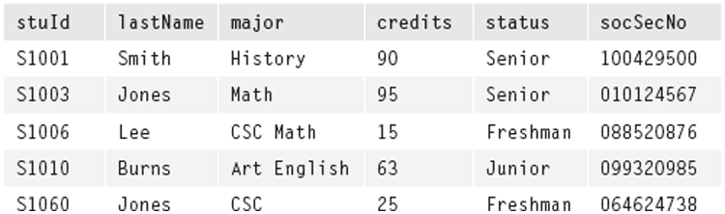
Counter-Example for 1NF
NewStu(StuId, lastName, major, credits, status, socSecNo)
Figure 6.3A NewStu Table (Assume students can have double majors)

Slide 15
Assume students can have more than one major
Assume stuId is the primary key
The major attribute is not single-valued for each tuple. For a given stuId, there may be more than one value for major

Slide 16
Ensuring 1NF
Best solution: For each multi-valued attribute, create a new table, in which you place the key of the original table and the multi-valued attribute. Keep the original table, with its key
Ex. NewStu2(stuId, lastName, credits,status, socSecNo)
Majors(stuId, major)

Slide 17
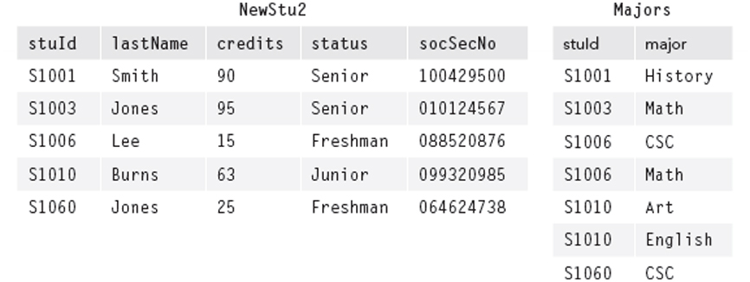
Figure 6.3B NewStu2 Table and Majors Table

Slide 18
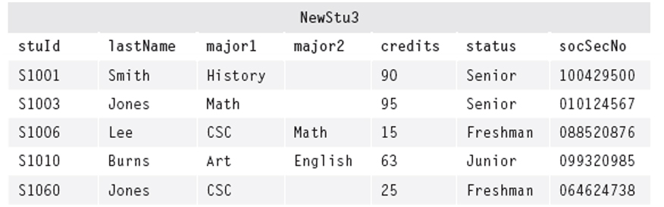
Another Method for 1NF
If the number of repeats is limited, make additional columns for multiple values
Student(stuId, lastName, major1, major2, credits, status, socSecNo)
Figure 6.3C NewStu3 Table with Two Attributes for Major
Complicates querying

Slide 19
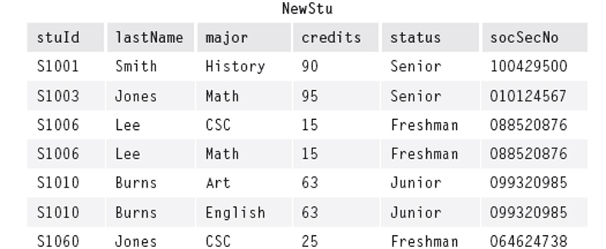
Yet Another Method for 1NF
“Flatten” the original table by making the multi-valued attribute part of the key
Student(stuId, lastName, major, credits, status, socSecNo
Figure 6.3D NewStu Table Rewritten in 1NF, with {stuId, major} as Primary Key
Can cause difficulties in higher normalization

Slide 20
Full Functional Dependency
In relation R, set of attributes B is fully functionally dependent on set of attributes A of R if B is functionally dependent on A but not functionally dependent on any proper subset of A
This means every attribute in A is needed to functionally determine B

Slide 21
Partial Functional Dependency Example
NewClass( courseNo, stuId, stuLastName, facId, schedule, room, grade)
FDs:
{courseNo,stuId} → {lastName}
{courseNo,stuId} →{facId}
{courseNo,stuId} →{schedule}
{courseNo,stuId} →{room}
{courseNo,stuId} →{grade}
courseNo → facId **partial FD
courseNo → schedule **partial FD
courseNo →room ** partial FD
stuId → lastName ** partial FD
…plus trivial FDs that are partial…

Slide 22
Second Normal Form-2NF
A relation is in second normal form (2NF) if it is in first normal form and all the non-key attributes are fully functionally dependent on the key.
No non-key attribute is FD on just part of the key
If key has only one attribute, and R is 1NF, R is automatically 2NF

Slide 23
Converting to 2NF
Identify each partial FD
Remove the attributes that depend on each of the determinants so identified
Place these determinants in separate relations along with their dependent attributes
In original relation keep the composite key and any attributes that are fully functionally dependent on all of it
Even if the composite key has no dependent attributes, keep that relation to connect logically the others

Slide 24
2NF Example
NewClass(courseNo, stuId, stuLastName, facId, schedule, room, grade )
FDs grouped by determinant:
{courseNo} → {courseNo,facId, schedule, room}
{stuId} → {stuId, lastName}
{courseNo,stuId} → {courseNo, stuId, facId, schedule, room, lastName, grade}
Create tables grouped by determinants:
Course(courseNo,facId, schedule, room)
Stu(stuId, lastName)
Keep relation with original composite key, with attributes FD on it, if any
NewStu2( courseNo, stuId, grade)

Slide 25
Transitive Dependency
If A, B, and C are attributes of relation R, such that A → B, and B → C, then C is transitively dependent on A
Example:
NewStudent (stuId, lastName, major, credits, status)
FD:
credits→status (and several others)
By transitivity:
stuId→credits ∧ credits→status implies stuId→status
Transitive dependencies cause update, insertion, deletion anomalies.

Slide 26
Third Normal Form-3NF
A relation is in third normal form (3NF) if whenever a non-trivial functional dependency X→A exists, then either X is a superkey or A is a member of some candidate key
To be 3NF, relation must be 2NF and have no transitive dependencies
No non-key attribute determines another non-key attribute. Here key includes “candidate key”

Slide 27
Making a relation 3NF
For example,
NewStudent (stuId, lastName, major, credits, status)
with FD credits→status
Remove the dependent attribute, status, from the relation
Create a new table with the dependent attribute and its determinant, credits
Keep the determinant in the original table
NewStu2 (stuId, lastName, major, credits)
Stats (credits, status)

Slide 28
Boyce-Codd Normal Form-BCNF
A relation is in Boyce/Codd Normal Form (BCNF) if whenever a non-trivial functional dependency X→A exists, then X is a superkey
Stricter than 3NF, which allows A to be part of a candidate key
If there is just one single candidate key, the forms are equivalent

Slide 29
BCNF Example
NewFac (facName, dept, office, rank, dateHired)
FDs:
office → dept
facName,dept → office, rank, dateHired
facName,office → dept, rank, dateHired
Choose {facName,dept} as primary key
Then NewFac is 3NF but not BCNF because office is not a superkey
To make it BCNF, remove the dependent attributes to a new relation, with the determinant as the key
Use projection to form two relations
Fac1 (office, dept)
Fac2 (facName, office, rank, dateHired)
Note we have lost a functional dependency in Fac2 – no longer able to see that {facName, dept} is a determinant, since they are in different relations

Slide 30
Converting to BCNF
Identify all determinants and verify that they are superkeys in the relation
If not, break up the relation by projection
  For each non-superkey determinant, create a separate relation with all the attributes it determines, also keeping it in original relation
  Preserve the ability to recreate the original relation by joins.
Repeat on each relation until you have a set of relations all in BCNF

Slide 31
Decomposition
Definition: A decomposition of a relation R is a set of relations {R₁,R₂,...,R_{n}} such that each R_{i} is a subset of R and the union of all of the R_{i} is R (i.e. each original attribute of R appears in at least one R_{i})
Starting with a universal relation that contains all the attributes of a schema, we can decompose into relations by projection

Slide 32
Desirable Properties of Decompositions
Attribute preservation - every attribute is in some relation
Dependency preservation – all FDs are preserved
Lossless decomposition – can get back the original relation by joins

Slide 33
Dependency Preservation
If R is decomposed into {R₁,R₂,…,R_{n},} so that for each functional dependency X→Y all the attributes in X ∪ Y appear in the same relation, R_{i}, then all FDs are preserved
Allows DBMS to check each FD constraint by checking just one table for each

Slide 34
Lossless Decomposition
A decomposition of R into {R₁, R₂,....,R_{n}} is lossless if the natural join of R₁, R₂,...,R_{n} produces exactly the relation R
No spurious tuples are created when the projections are joined.
always possible to find a BCNF decomposition that is lossless

Slide 35
Example of Lossy Decomposition
Original EmpRoleProj table: tells what role(s) each employee plays in which project(s)
EmpName role projName
Smith designer Nile
Smith programmer Amazon
Smith designer Amazon
Jones designer Amazon
Project into two tables Table a(empName, role), Table b(role, projname)
Table a Table b
EmpName role role projName
Smith designer designer Nile
Smith programmer programmer Amazon
Jones designer designer Amazon
Joining Table a and Table b produces
EmpName role projName
Smith designer Nile
Smith designer Amazon
Smith programmer Amazon
Jones designer Nile ← spurious tuple
Jones designer Amazon

Slide 36
Lossless Decomposition
Lossless property guaranteed if for each pair of relations that will be joined, the set of common attributes is a superkey of one of the relations
Binary decomposition of R into {R₁,R₂} lossless if and only if one of these holds
        R1 ∩ R2 → R1 - R2
        or
        R1 ∩ R2 → R2 - R1
If projection is done by successive binary projections, can apply binary decomposition test repeatedly

Slide 37
Decomposition Algorithm for BCNF
Can always find a lossless decomposition that is BCNF
Find a FD that is a violation of BCNF and remove it by decomposition process
  Repeat this process until all violations are removed
  See algorithm, Section 6.6.4
No need to go through 1NF, 2NF, 3NF process
Not always possible to preserve all FDs

Slide 38
Normalization Methods
Analysis
  Decomposition method shown previously
Synthesis
  Begin with attributes, combine them into groups having the same determinant
  Use functional dependencies to develop a set of normalized relations
Mapping from ER diagram provides almost-normalized schema

Slide 39
De-normalization
When to stop the normalization process
  When applications require too many joins
  When you cannot get a non-loss decomposition that preserves dependencies
Denormalization means deliberately choosing a lower normal form

Slide 40
Problems with Normalized Databases
Best used when the source data is relatively simple
Stored data does not resemble the original documents from which it is taken, but instead is shredded into separate tables
Usually store only the most current information, not historical data
Useful for OLTP, online transaction processing
Optimized for write operations; read operations may be slow, if joins of the tables are required

Slide 41
Non-normalized Databases
OLAP systems
  Used for planning and decision-making
  Require historical data, not just current data
  Updates are rare; optimized for reading
  Data stored in denormalized form
Object-based systems
  Needed for advanced applications
  Objects are not normalized
Big data systems-XML, Google’s Big Table, HBase, Cassandra, and Hadoop
  Capture data in the format of its source
  Store data in a denormalized, usually duplicated, form
  Allow multiple versions of items to be stored
  Provide efficient and scalable read access to data
  Facilitate data transmission

Slide 42
Additional Material from Online Resource Follows

Slide 43
Multi-valued Dependency
In R(A,B,C) if each A values has associated with it a set of B values and a set of C values such that the B and C values are independent of each other, then A multi-determines B and A multi-determines C
Multi-valued dependencies occur in pairs
Example:
  JointAppoint(facId, dept, committee)
  Assuming faculty member can belong to more than one department and to more than one committee
  Table must list all combinations of values of department and committee for each facId to avoid implying relationships that do not exist

Slide 44
4NF
A table is 4NF if it is BCNF and has no multi-valued dependencies
Example: remove MVDs in JointAppoint
Appoint1(facId,dept)
Appoint2(facId,committee)

Slide 45
5NF and DKNF
A relation is 5NF if there are no remaining non-trivial lossless projections
A relation is in Domain-Key Normal Form (DKNF) is every constraint is a logical consequence of domain constraints or key constraints

Slide 46
Inference Rules for FDs
Armstrong’s Axioms
  Reflexivity If B is a subset of A, then A → B..
  Augmentation If A → B, then AC → BC.
  Transitivity If A → B and B → C, then A → C
Additional rules that follow:
  Additivity If A → B and A → C, then A → BC
  Projectivity If A → BC, then A → B and A → C
  Pseudotransitivity If A → B and CB → D, then AC → D

Slide 47
Closure of Set of FDs
If F is a set of functional dependencies for a relation R, then the set of all functional dependencies that can be derived from F, F⁺, is called the closure of F
Could compute closure by applying Armstrong’s Axioms repeatedly

Slide 48
Closure of an Attribute
If A is an attribute or set of attributes of relation R, all the attributes in R that are functionally dependent on A in R form the closure of A, A⁺
Computed by Closure Algorithm for A, Section 6.10.3
  result ← A;
  while (result changes) do
  for each functional dependency B → C in F
  if B is contained in result then result ← result ∪ C;
  end;
  A⁺ ← result;

Slide 49
Uses of Attribute Closure
Can determine if A is a superkey-if every attribute in R functionally dependent on A
Can determine whether a given FD X→Y is in the closure of the set of FDs. (Find X⁺, see if it includes Y)

Slide 50
Redundant FDs and Covers
Given a set of FDs, can determine if any of them is redundant, i.e. can be derived from the remaining FDs, by a simple algorithm – see Section 6.10.4
If a relation R has two sets of FDs, F and G
  then F is a cover for G if every FD in G is also in F⁺
  F and G are equivalent if F is a cover for G and G is a cover for F (i.e. F⁺ = G⁺)

Slide 51
Minimal Set of FDs
Set of FDs, F is minimal if
  The right side of every FD in F has a single attribute (called standard or canonical form)
  No attribute in the left side of any FD is extraneous
  F has no redundant FDs

Slide 52
Minimal Cover for Set of FDs
A minimal cover for a set of FDs is a cover such that no proper subset of itself is also a cover
A set of FDs may have several minimal covers
See Algorithm for Finding a Minimal Cover, Section 6.10.7

Slide 53
Synthesis Algorithm for 3NF
Can always find 3NF decomposition that is lossless and that preserves all FDs
3NF Algorithm uses synthesis
  Begin with universal relation and set of FDs,G
  Find a minimal cover for G
  Combine FDs that have the same determinant
  Include a relation with a key of R
  See algorithm, Section 6.10.9

