Slide 1
RH403 RH Satellite 6 Administration
VT

Slide 2


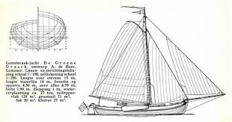
Who is Rik Megens
+30 years of experience in IT Operations
started out with MS DOS 2.0, long time Novell Netware CNE (v2 – v5)
17 year IT training experience (ITIL, Project Management, ISO15504, Microsoft, Linux)
RHCE, RHCI,RHCX, RHCA lvl4
wife and 2 kids
mountainbike (winter) and racing bike (summer)
Sailing
Learning (current project is Python for ethical hacking and Ansible)

Slide 3
Schedule
DAY ONE
DAY TWO
DAY THREE
DAY FOUR
DAY FIVE
CHAPTER 1
INSTALLING RH SATELLITE 6
CHAPTER 5
BUILDIND RPM PACKAGES
CHAPTER 7
SYSTEM CONFIG WITH PUPPET
CHAPTER 3
REGISTER CLIENTS
CHAPTER 9
DEPLOYING HOSTS
CHAPTER 2
MANAGING USERS, HOSTS, ORGS & LOCATIONS
CHAPTER 4
SOFTWARE LIFECYCLE
CHAPTER 6
DEPLOY CUSTOM SOFTWARE
CHAPTER 8
STANDARDIZING SYS CONFIG
CHAPTER 10
ENTERPRISE DEPLOYMENTS

