Slide 1
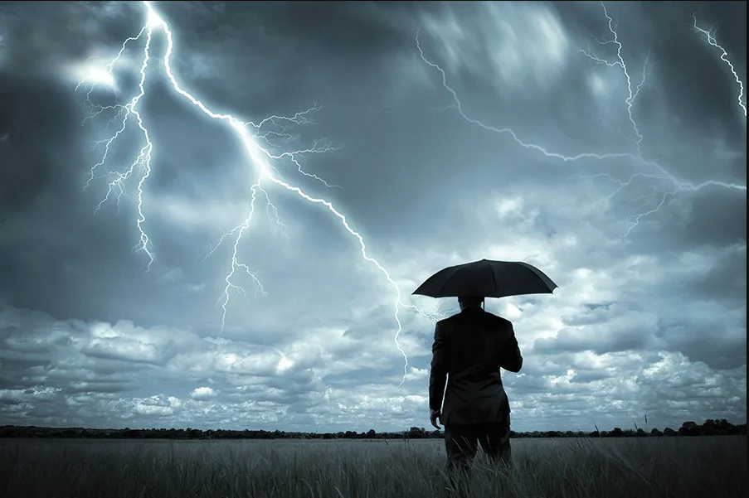
Into the storm

Slide 2
The Truth about storms
Nobody is exempted
It will always come
It reveals something in us.

Slide 3

3 Types of Storm that we can Experience

Slide 4

1. Storm through Testing
James 1:2-3 NIV Consider it pure joy, my brothers and sisters, whenever you face trials of many kinds, because you know that the testing of your faith produces perseverance.

Slide 5
2. Storm because of Disobedience
Jonah 1:4-5 NIV Then the Lord sent a great wind on the sea, and such a violent storm arose that the ship threatened to break up. All the sailors were afraid and each cried out to his own god. And they threw the cargo into the sea to lighten the ship. But Jonah had gone below deck, where he lay down and fell into a deep sleep.

Slide 6
3. Storm because of Obedience
Mark 4:35 NIV
That day when evening came, he said to his disciples, “Let us go over to the other side.”

Slide 7
3. Storm because of Obedience
Matthew 14:22 NIV
Immediately Jesus made the disciples get into the boat and go on ahead of him to the other side, while he dismissed the crowd.

Slide 8
The storm reveals:
reveals the nature of faith
reveals the strength of commitment
reveals the level of maturity
reveals the health of the attitude
reveals the measure of teachability

