Slide 1
Detection and Tracking
Moving Vehicles and Pedestrians
Ryan Mellmer

Slide 2
Table of contents
Intro
Detection
Tracking
Demo
How I Assign ID’s
If I had more time…

Slide 3


How I started
Reading academic articles.
Struggling with OpenCV Building and Version problems using “extra” modules.
Experimenting with different detection methodologies in Python.
Experiment with OpenCV tracking utilities.

Slide 4
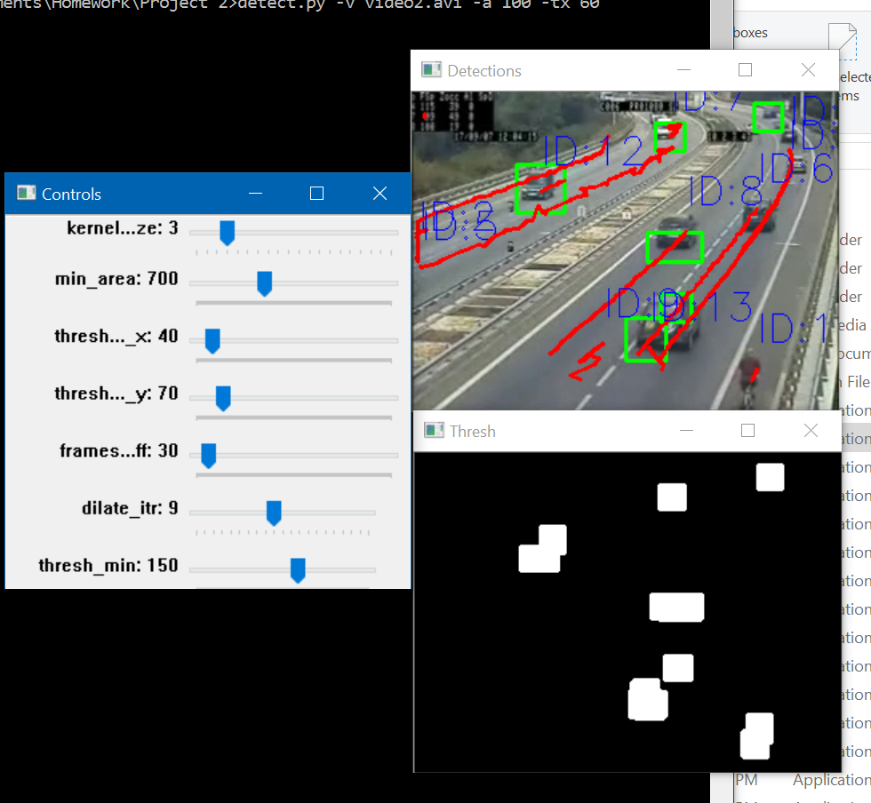
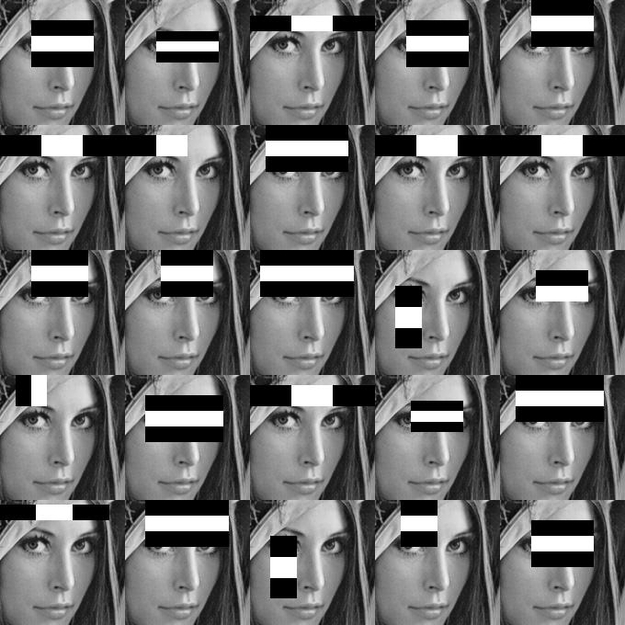
Object DETECTION METHODS
Blob Detection
Haar Cascade Detection

Slide 5
Tracking
OpenCV Implements a few Tracking Algorithms:
MIL (Multiple Instance Learning) – Slow, but accurate
BOOSTING – A decade old. Mediocre compared to others.
MEDIANFLOW – Very fast, but somewhat inaccurate in my experience.
TLD (Tracking, Learning, and Detection) – I experienced many detections that shouldn’t have occurred.
KCF (Kernelized Correlation Filters) – Good balance of accuracy and speed.
I chose KCF for my project after testing all of the available algorithms.

Slide 6
DEMO
https://www.youtube.com/watch?v=_VhF1jRkRTI&feature=youtu.be

Slide 7
Assigning ID’s
Assigning ID’s to objects proved to be a non-trivial task. High-level algorithm I produced as follows:
First, detect all objects in current frame.
For each object:
If a detected object from the previous frame is found within an arbitrary threshold distance, then assume this object is the same object, and assign its ID to us.
If not, then this is a new object, and assign it a unique ID.
Keep a list of all objects currently being tracked. If an object has been inactive for > 100 frames, delete it from the list.

Slide 8
If I Had More Time…
Try implementing a combination of color and direction tracking to help remedy the scenario of two objects passing in front of each other, as this gets difficult to track correctly without more information.

Slide 9
Questions?

