Slide 1

AI Project Updates
Group 15
4/7/2022

Slide 2
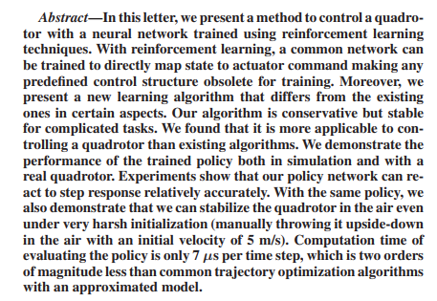
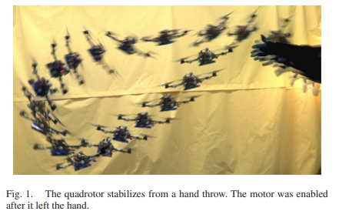
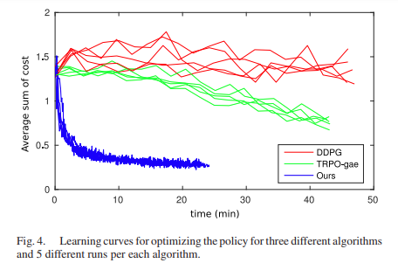
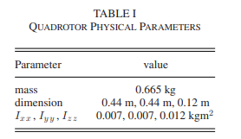
Control of a Quadrotor With Reinforcement Learning
Hwangbo, J., Sa, I., Siegwart, R., & Hutter, M. (2017). Control of a quadrotor with reinforcement learning. IEEE Robotics and Automation Letters, 2(4), 2096-2103.

Slide 3
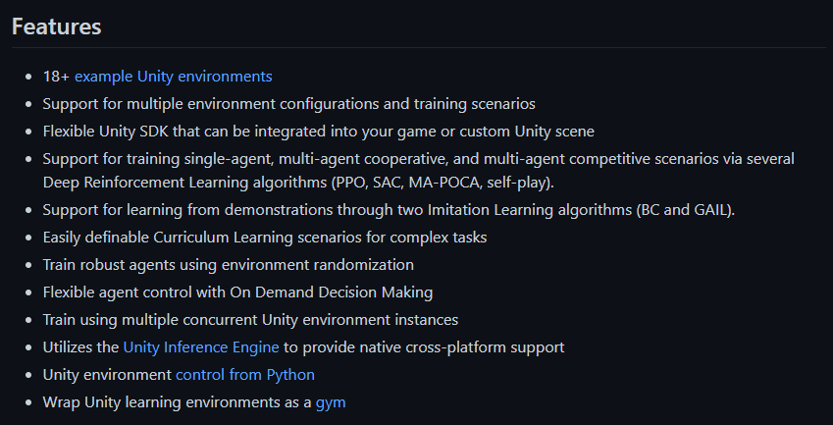
ml-agents Unity asset package for RL
https://github.com/Unity-Technologies/ml-agents

Slide 4
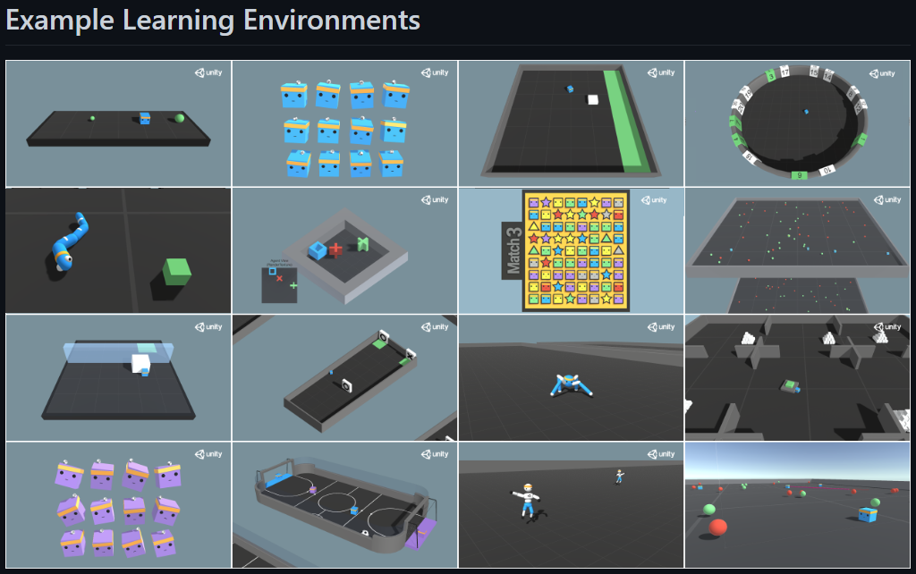
Example Environments
https://github.com/Unity-Technologies/ml-agents/blob/main/docs/Learning-Environment-Examples.md

Slide 5
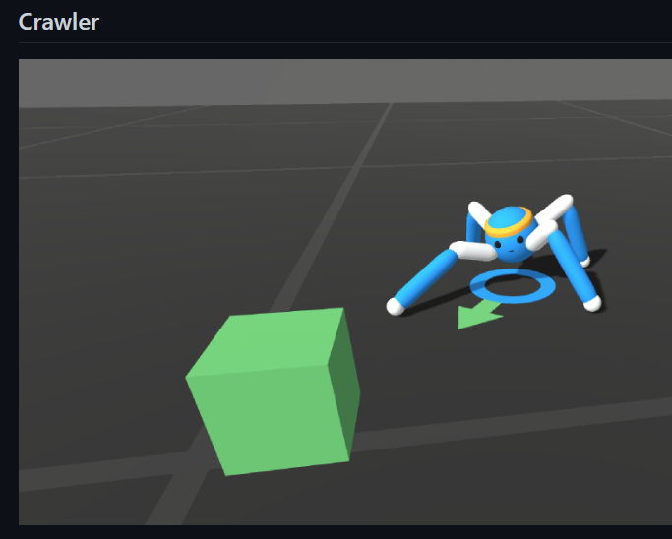
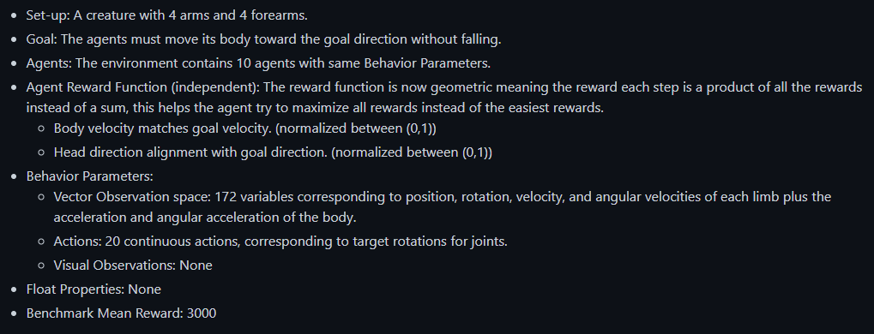
Environment Examples

Slide 6
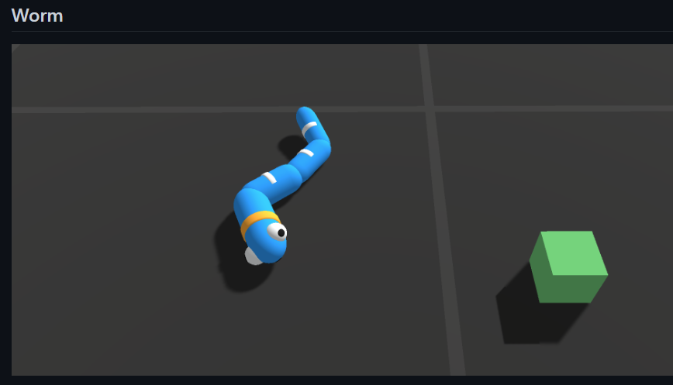
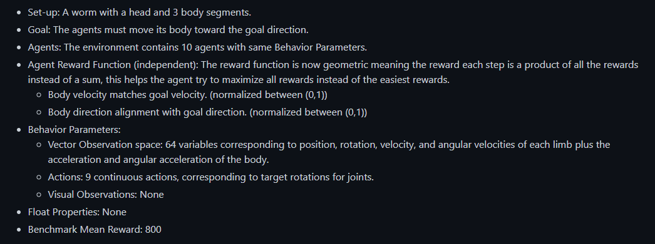
Environment Examples

Slide 7
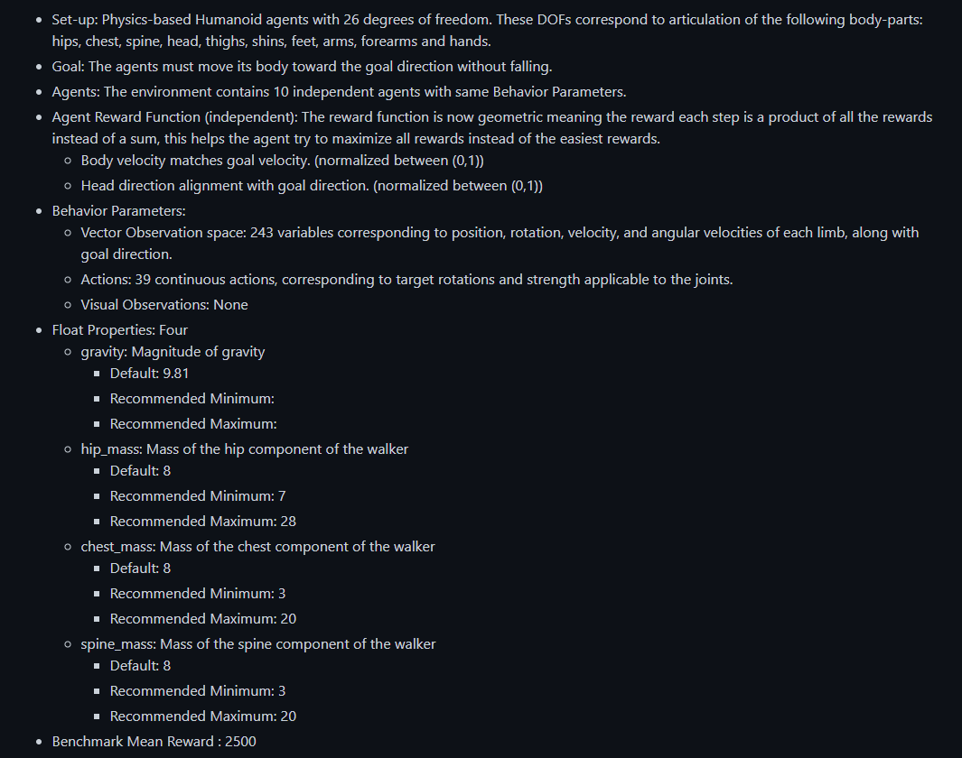
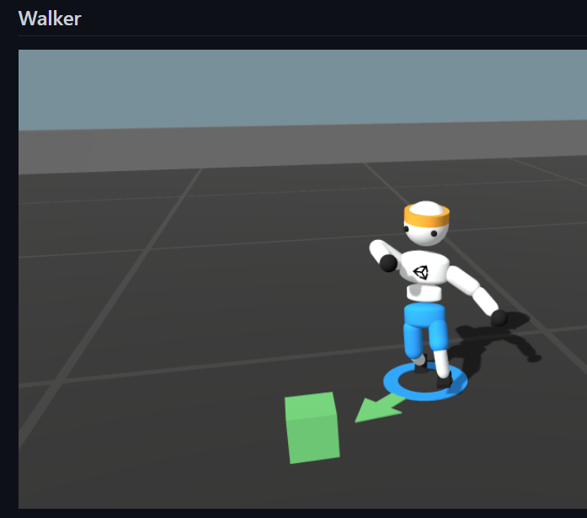
Environment Examples

Slide 8
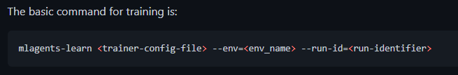
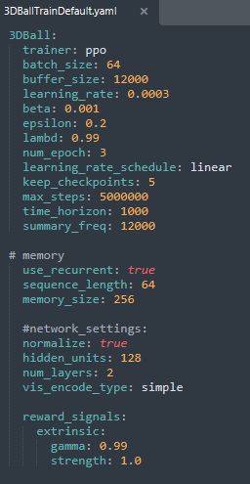
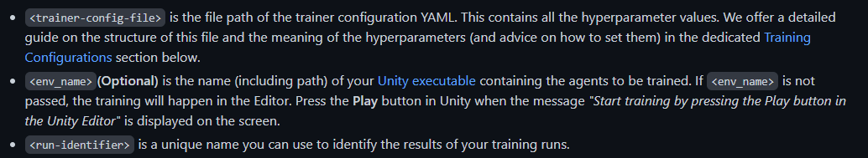
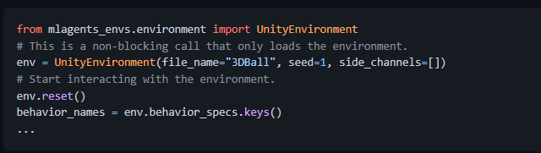
Unity Control using Python
https://github.com/Unity-Technologies/ml-agents/blob/main/docs/Python-API.md

Slide 9
Tasks
(Everyone) Set up Unity on individual PC's & run the ml-agents examples
Prepare a custom training project package in Unity
Create a trainable agent model for the project (drone) to be imported
Create a custom learning environment in Unity for training our agent:
https://github.com/Unity-Technologies/ml-agents/blob/main/docs/Learning-Environment-Create-New.md
Train the agent using default algorithm configurations (PPO, SAC)
Implement a classical path planning algorithm for comparison with RL methods (use one from the AI course)

Slide 10
Environment Examples

