Slide 1
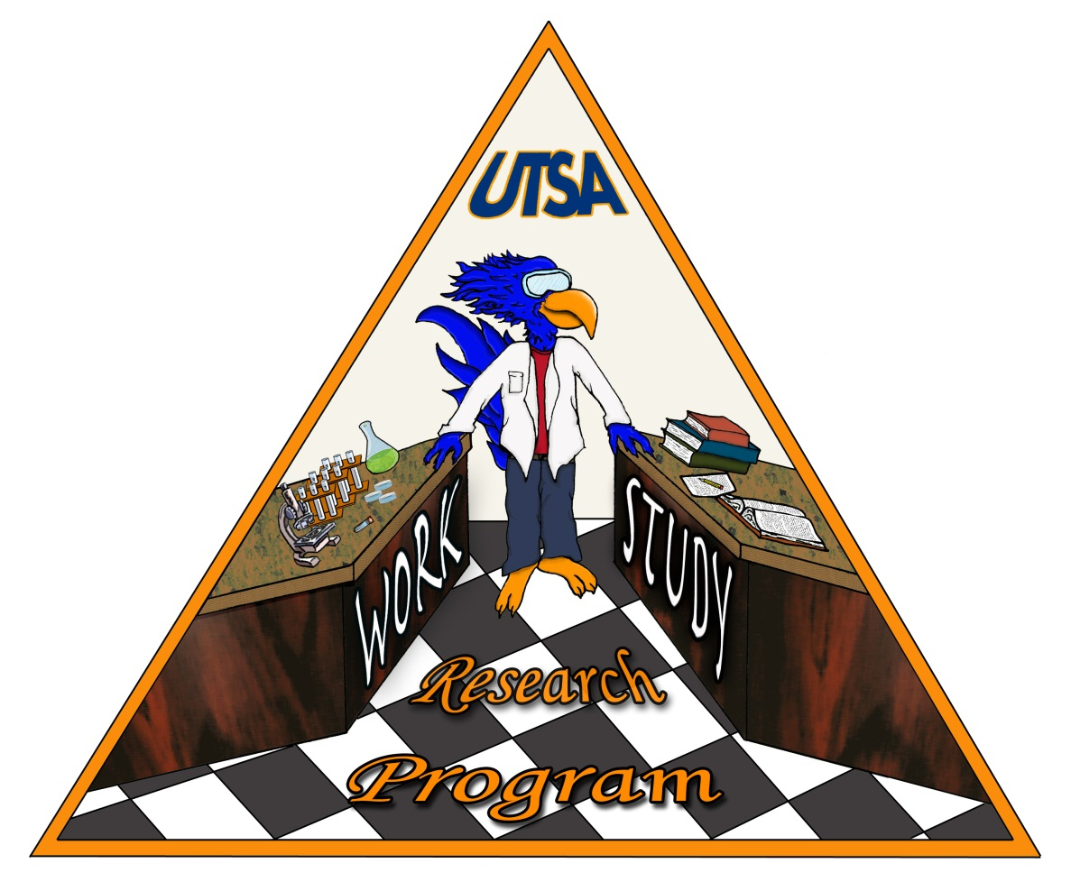

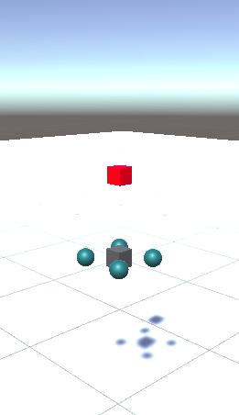
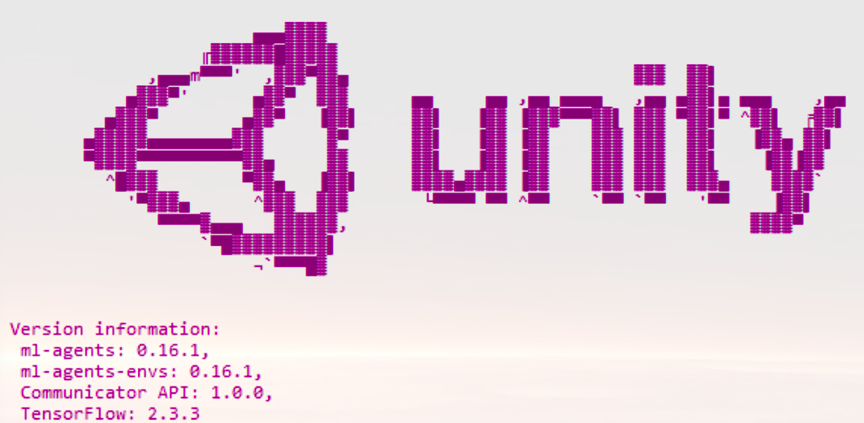
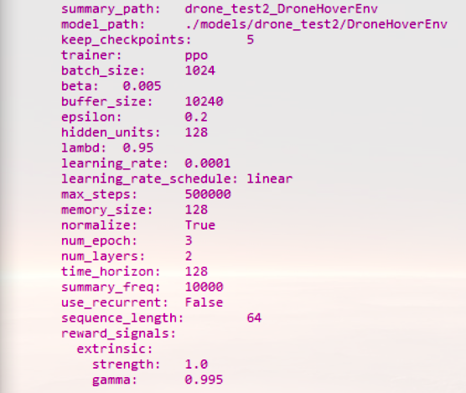
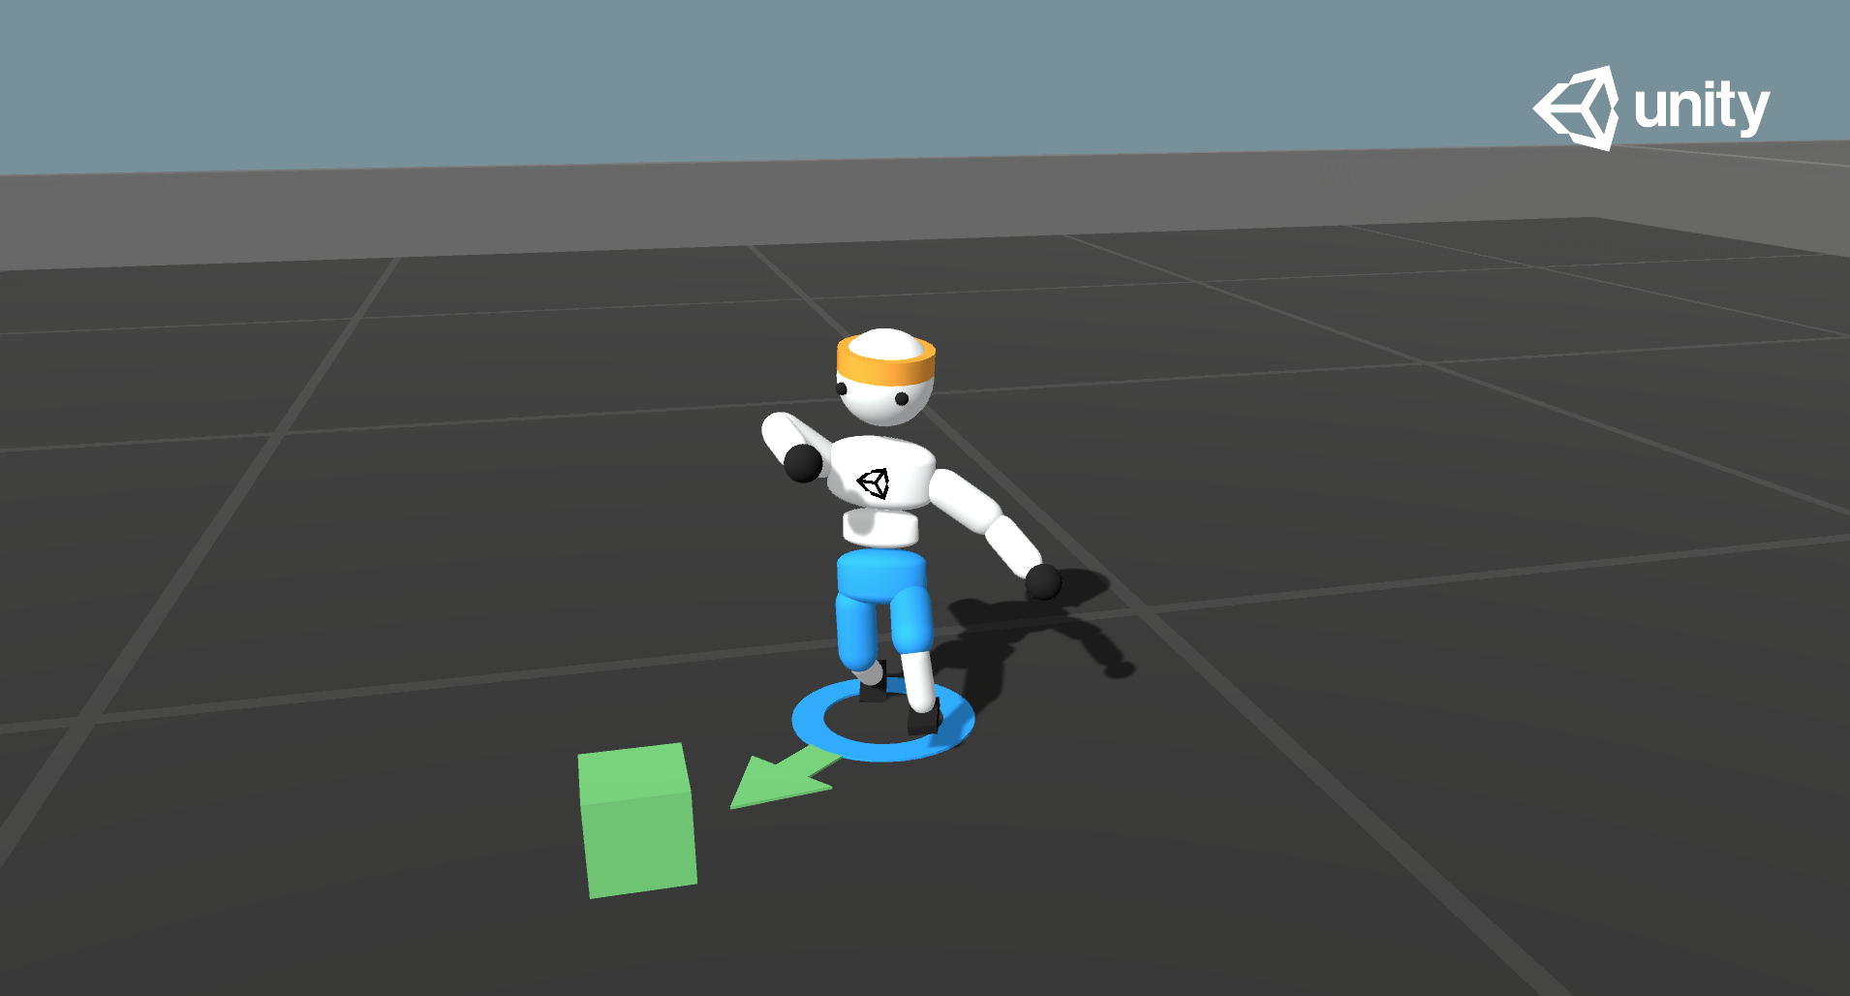
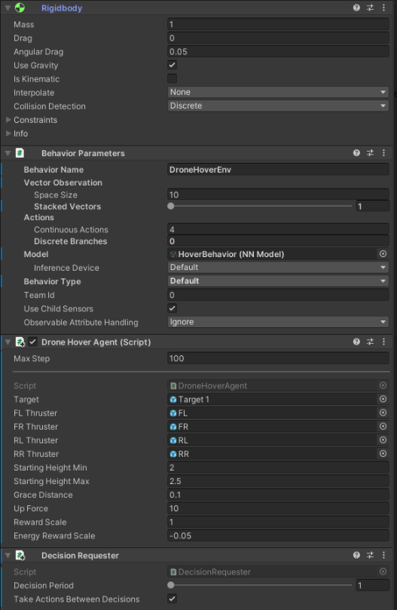
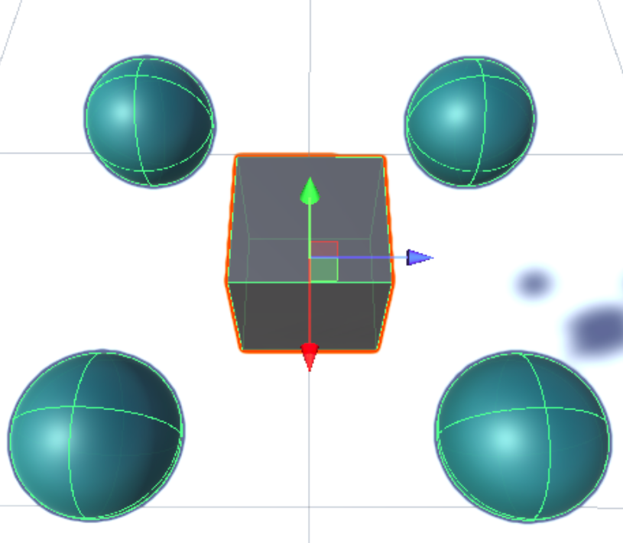
Drone Reinforcement Learning With Unity
Tyrell Lewis, Matt Farnsworth, Ramiro Mendez, Jose Torres, Steven Su
The University of Texas at San Antonio, San Antonio TX, 78249
Abstract
Environment Setup
Demo Results
This project aims to control a quadrotor drone for stabilization and navigation by using reinforcement learning. This will be developed entirely in simulation, however in the final presentation an outline of how this can be applied to a physical system will be included.
The first task is setting up our virtual training environment, including tools and objects necessary to assist the training. Initially, we create a ground plane in our scene with the starting coordinates [0,0,0]. Next, we add the target cube named “Target’ to our scene. These two fundamentals will serve as the vista for the training: Target being the desired result for control and stabilization of the quadrotor drone and the scene being the playground for the drone to train. Shown below is a “Walker” example of the ML-agent training environment package, which we will be using to set-up our own custom training scenario for the quadrotor drone.
Unity Training Environment for Drone Stabilization
Introduction
Artificial Intelligence has been on an accelerated rise in the industry, with automation being a big focus such as self-driving vehicles using computer vision and detection to reach its goal.
Reinforcement Learning is a key component in training the agent by rewarding or punishing it through defined metrics for it to hit. Allowing the agent to increase its success/ accuracy rate through trial and error.
The Unity game development platform was selected because of its available content for implementing custom reinforcement learning algorithms using the ML-Agents package.
Robotics is an application-heavy field that is quickly incorporating reinforcement learning to automate robotic tasks across many industries.
We decided to focus on simulating a quadrotor drone as our learning agent with the goal of training it to self stabilize and navigate its way to a random target.
The simple training environment shown on the left includes a model (GameObject) of the quadcopter and a target destination visualized as a floating red cube. At the start of training, the hyperparameters are loaded from within the ML-agents Unity asset package under the PPO algorithm directory.
Results
Future Developments
After configuring the GameObjects and necessary components to train a network throughout the learning process, each of the algorithms available in the ml-agents package (PPO, SAC, DQN) was tested in the simulation. For this particular environment and task of stabilizing around a fixed target location, PPO was found to perform sufficiently with fewer memory resources required. The drone agent shown below is configured for training through the components shown on the right: a Rigidbody, Behavior Parameters, and a Decision Requester.
Currently, for this project, we used the Proximal Policy Optimization and concluded it was the best approach and had the best results. For the foreseen future we want to try different methods that can result in a better product. We also want to try and further develop the existing drone model and we can do this by teaching it new things. Currently, we showed it how to approach a target and stabilize its flight on the way there with gravity being one of the forces acting on it. For our future developments, we want to teach it how to properly fly with another force acting on it being wind. We also want to add different scenarios into play such as collision avoidance, multi-agent synchronization, multiple goal cases, etc…
Approach
Conclusions
Using Unity and ML-agents, train a drone in a simulation to reach a certain destination.
Utilization of Reinforcement Learning to train the drone.
The PPO algorithm in the ML-Agents package was found to be the best algorithm to use.
Future Developments include wind stabilization, collision avoidance, synchronized flying, etc.
Our approach to solving the task of controlling the quadrotor drone's stabilization and navigation is mainly through using reinforcement learning in a custom simulation training environment using Unity. We are concerned with testing several default reinforcement learning methods, including proximal policy optimization (PPO), soft actor-critic (SAC), Deep Q-learning (DQL), as well as implementation of a neural network to help approximate our reward. All of these will be tested and compared for efficiency in our simulation training environment
References
https://github.com/Unity-Technologies/ml-agents
https://github.com/Unity-Technologies/ml-agents/blob/main/docs/Learning-Environment-Examples.md
https://github.com/Unity-Technologies/ml-agents/blob/main/docs/Learning-Environment-Create-New.md
https://unitylist.com/p/1252/AI-Drone-Unity-Simulation
https://github.com/dracolytch/ML-Simplest-Scenario
Notes:
‹#›

