Slide 1
Spatial Graph-Based Social Trade Transaction Simulation
Manuel Bröchin, Renato Menta, Oliver Blaser

Slide 2
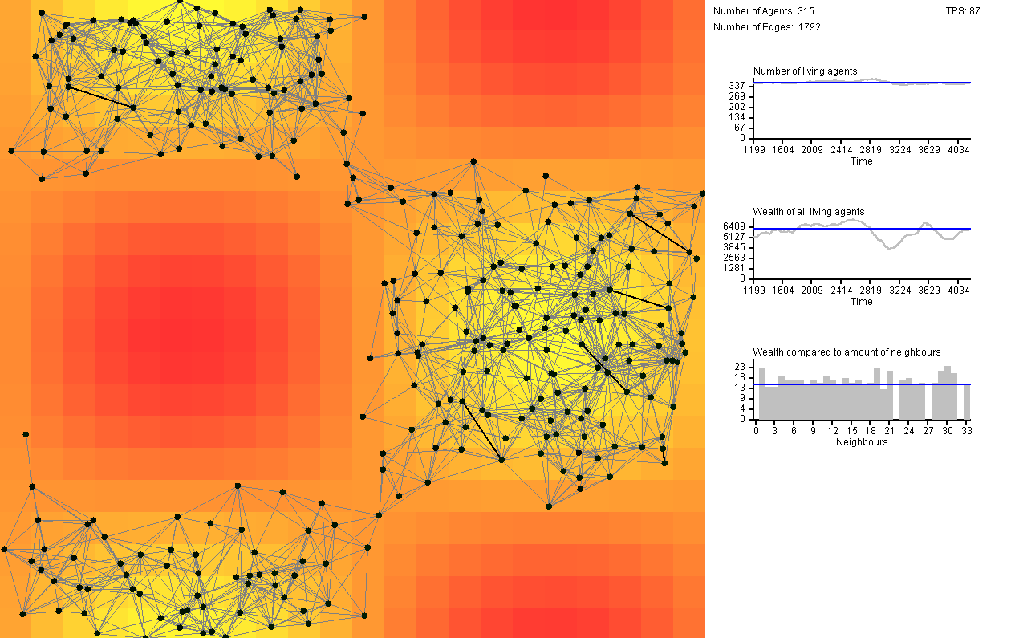

Slide 3
Some Terminology
Willingness-to-trade factor (WTF): The probability of an agent to accept a trade
Gold-Dig-Factor (GDF): A value between 0 and 1 which quantifies the preference of an agent towards money or sympathy respectively.
Resource: A general resource (could be food, money...). If it sinks below 0 the agent dies

Slide 4
Agent behaviour
Each agent has:
Data:
List of neighbours: [(id, sympathy, resource)]
Own resource count
Input:
List of proposed trades from neighbours
Harvest (how much resource he gets by tick)
Independent variables
Willingness-to-trade factor (WTF)
Gold-Dig-Factor (GDF)
Outputs
Propose trades to neighbours
Accept trades from neighbours
Update position
Agent
ID: 0
GDF: 0.5
WTF: 0.5
ID: 4

Slide 5
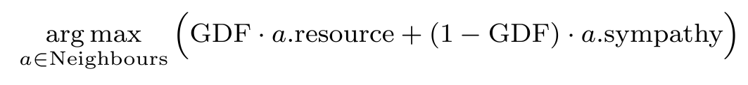
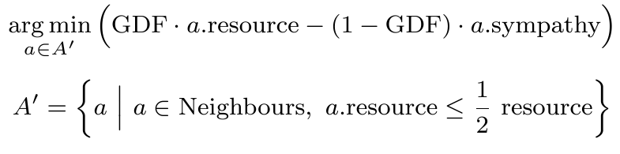
Decision making
In order to decide to whom the agent wants to propose, he computes:
In order to decide which trade to accept, he computes:

Slide 6
Propose trade
ID: 1
ID | Resource | Sympathy from Agent 0
0 | 42 | -
1 | 100 | 40
2 | 120 | 105
3 | 90 | -30
4 | 34 | -1
ID: 0
GDF: 0.5
WTF: 0.5
ID: 2
ID: 3
ID: 4

Slide 7
Computation Example
Agent 0 decides which neighbour he wants to ask to trade
When Agent 0 has received all trade requests from his neighbours, he decides which one to accept
ID | Resource | Sympathy from Agent 0 | GDF * resource + (1 - GDF) * sympathy
0 | 42 | - | -
1 | 100 | 40 | 70
2 | 120 | 105 | 112.5
3 | 90 | -30 | 30
4 | 34 | -1 | 16.5
ID | Resource | Sympathy from Agent 0 | GDF * resource - (1 - GDF) * sympathy
1 | 100 | 40 | 30
3 | 90 | -30 | 60

Slide 8
Emerging behaviour of our agents
Clustering around profitable places
Few agents are able to initiate mass migration (building bridges)
Achieving of an equilibrium in certain scenarios

Slide 9
Possible simulations with our model
Expanding of humans on islands

Slide 10
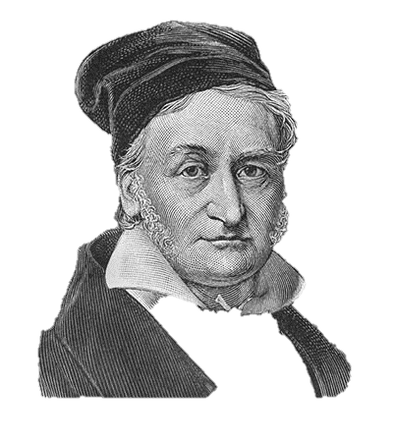
Thank you for your attention!

