Slide 1
Movement control and non-invasive electromyography: development of models
and web clinical teaching tools
LISiN, Politecnico di Torino, 2018
Module N. 3
Physics of elementary electric phenomena of relevance for understanding surface EMG
Roberto Merletti
LISIN, Politecnico di Torino
roberto.merletti@polito.it
www.robertomerletti.it

Slide 2
Why it is necessary to know the concepts described in this material ?
The concepts of electric field, voltage and current:
the action potential is a variation of the membrane voltage in excitable cells. This variation generates an electric field and, therefore, electric currents in the surrounding conductive tissue (volume conductor) . These currents produce a voltage distribution on the skin surface.
This voltage distributioon is a bioelectric signal (ECG, EEG, EMG).
We are immersed in an electric field produced by electric devices and wirings. This field in an important source of interference for all bioelectric signals. Understanding and reducing this interference is a key point for the correct interpretation of a bioelectric signal.
The concepts of resistance and impedance:
muscle and subcutaneous tissues offer a resistance to the flow of electric current. The electrode-skin contact is a noise generator and has an electric impedance. A bioelectric signal amplifier has an input impedance. These impedances affect the quality of the recording of a bioelectric signal. They determine the quality of the equipment and of any measurement and must be well known by the operator.

Slide 3
Learning achievements, objectives and concepts
The main electric physical quantities
(voltage, electric field, current, resistance, impedance)
Electrical conduction in conductors and electrolytic solutions
(metals, biologial tissues, electrode-skin interfaces)
Dualism between electrical and hydraulic quantities
(a general relational framework in different worlds)
The concepts of capacitance and impedance
(parasitic capacitive coupling with the power line)
The voltage divider (a basic mechanism in power line interference)
The power line voltage and its harmonics
(as sources of interference in sEMG)
The concept of noise (generated by the electrode-skin interface)
Common mode and differential voltages (power line interference and EMG)
The concept of amplitude of a signal (EMG amplitude)

Slide 4
Physical quantities and units of measurements
Physical quantity
and symbol
Unit of measurement
notes
Electric charge
(Q)
C, Coulomb
1 Coulomb: 6,24×10¹⁸ electrons. Analog to the quantity of a fluid in a container.
1 Ah = 3600 Coulomb
Electric current
(I)
A, Ampere
1 Ampere: charge flow of 1 C/s
Similar to the flow of a fluid in a conduit.
Voltage or potential difference (V)
V, Volt
Difference of "concentration " or " pressure "
of electric charges.
Similar to pressure for a fluid.
Resistance
(R)
Resistance opposed by a conductor to the flow of current. Similar to friction or resistance opposed to the flow of a fluid.
Ω, Ohm
Impedance
(Z)
Ω, Ohm
Obstacle opposed by a resistor, capacitor or inductor to the flow of electric current.
Similar to obstacle opposed to fluid flow by friction, elastic or inertial components.

Slide 5
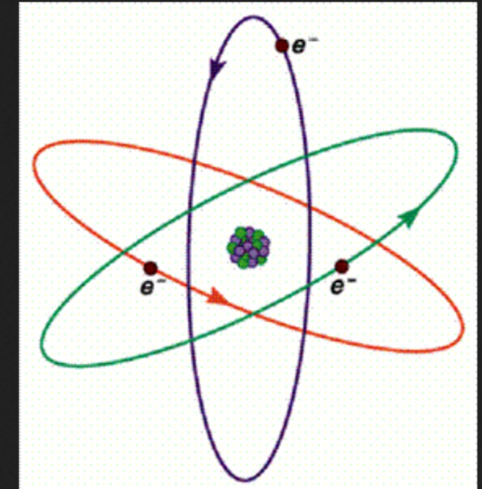
Atomic structure:
Electrons (negative) orbit around
the nucleus (positive, made of
protons and neutrons) at different "energy" levels. Protons and
electrons have the same charge of opposite sign (+ and -).
The number of protons is equal to the number of electrons (atom is neutral).
In metals (conductors) the external electrons are few and loose and can easily move around from one atom to another and flow in the conductive material. Atoms missing electrons have a positive charge.
In other atoms the electrons are not mobile and are linked to their nucleus. The external energy level may " host"
additional electrons making the atom negative. Atoms with more or fewer electrons than protons are “ions“.
Positive nucleus
Negative electron
Mobile electron
Non mobile electrons
https://www.youtube.com/watch?v=xg-7nTYLTpQ

Slide 6
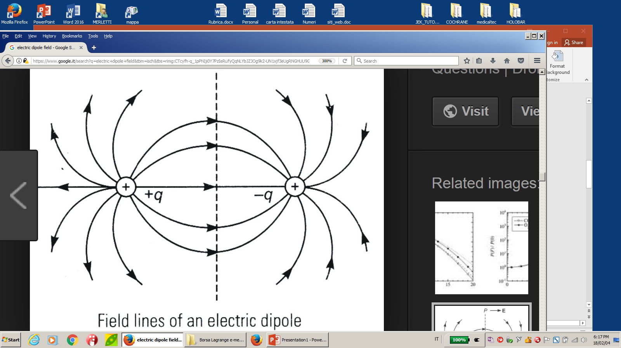
Electric field
Electric field= field of forces that exists in the neighborhood of an electric charge and acts on another charge. Forces are attractive for charges of opposite polarity and repulsive for charges of the same polarity. Consider a small positive test charge that is not significantly altering the spatial field distribution.
Negative
test charge
Such a small charge moves from the + to the - along trajectories called the “force lines” or “field lins” of the field.
Positive
test charge
Directions of forces acting on a single positive or negative test charge (field lines) near a positive charge.
Field lines of a dipole

Slide 7
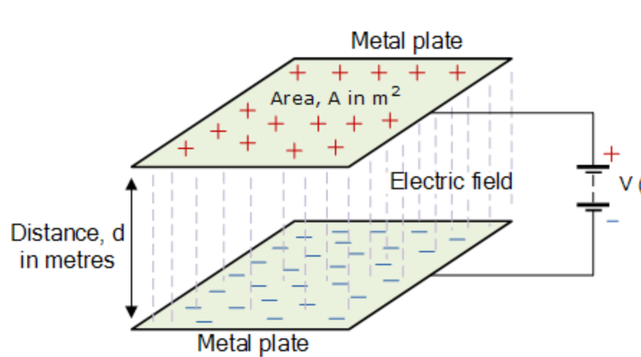
Electrostatic induction
Inducing a charge flow (current)
Into an object C by alternating the polarity of two other objects A and B.
= + = low density of electrons
Click here to activate the animation.
= ⁻ = high density of electrons
1
2
Capacitor
P₁
P₃
P₂
C
A
B
Courtesy of A. Botter.
Consider two plates, A and B, where A is positive (red) and becomes less and less positive and B is negative (blue) and becomes less and less negative until A and B are both at zero charge (white) and the voltage between them is zero. In the object C, between A and B, electrons are initially attracted towards A and repelled by B and progressively released in the neutral condition (white). The process then continues with A becoming more and more negative and B more and more positive and charges move between the extremes 1 and 2 of C. As this cycling continues charges move back and forth between the extremes 1 and 2 of C. The two plates A and B form a “capacitor”. Question: is there any voltage between P₁ and P₂ and between P₁ and P₃?

Slide 8
Person in an electric field of alternating polarity
(power line voltage)
t = t₁ : A is positive
t = t₂ : A is negative
A
A
Field lines
V - V_{p}
Sinusoidal voltage V
V₁
ΔV
V₂
V_{p}
floor
B
The person placed between A and B is subject to a voltage V_{p} (a fraction of V) with respect to B. This is called a “common mode“ voltage because it is the same for any point of the conducting body. The movement of charges induced in the body generates a differential voltage ΔV = V₁ –V₂ between two points of the body (which is not equipotential). V_{p} is of the order of Volt, ΔV is of the order of mV. This concept is fundamental for understanding power line interference in bioelectric signals (EMG, ECG, EEG).

Slide 9
Positive and negative charges and charge carriers in conducting and insulating materials
METALS:
In a metal, atoms are fixed in a lattice structure and do not move around. Their external electrons are loose and move around. They are charge carriers.
Metals are electrical conductors.
+
+
+
+
+
+
+
+
INSULATING MATERIALS: molecules and atoms are fixed and hold their electrons (glass, rubber, plastics, etc.). There are no mobile electrons.
In fluids (e.g. air, oil, etc) molecules move around but remain electrically neutral as the atoms that make them up. There are no charge carriers.

Slide 10
Positive and negative charges and charge carriers
in electrolytic solutions (biological fluids and tissues).
Positive ion (e.g. Na⁺ , H⁺): atom or group of atoms lacking one or more electrons that have been released to an another atom or group of atoms.
Negative ion (e.g.. Cl⁻, OH⁻): atom or group of atoms with one or more extra electrons that have been acquired from another atom or group of atoms.
In an electrolytic solution there is a continuous breakdown of molecules into ions and recombination of ions into molecules
NaCl Na⁺ + CL⁻ H₂O H⁺ + OH⁻
+
In an electrolytic solution (e.g. NaCl) Na⁺ and Cl⁻ ions are not fixed in a lattice structure and move around in the solvent (water). Positive and negative ions are charge carriers.
+
-
-
+
+
-
-
-
+
+
+
+
-
Negative ion (e.g. Cl⁻ or OH⁻)
-
-
-
+
Positive ion (e.g. Na⁺ or H⁺)
molecule

Slide 11
Metal-electrolyte junction
Metal with lattice structure (e.g. Ag)
Electrolytic solution
Atoms are fixed in the metal and mobile in the solution (ions). Charge carriers in the metal are electrons.
Charge carriers in the solution are ions.
The continuous exchange of charges at the metal electrolyte interface causes small random fluctuations of voltage between metal and solution (interface noise). The amplitude of this noise decreases if the interface surface increases (spatial averaging effect).
AgCl
+
OH⁻
-
+
OH⁻
H⁺
NaCl
+
-
+
+
+
-
-
-
+
H⁺
+
-
+
-
-
+
H₂O
+
Metal atoms and ions (e.g. Ag)
Molecule of AgCl or NaCl
-
Negative ion (e.g. Cl⁻)
+
Electrons
+
Positive ion (e.g. Na⁺)
Water molecule

Slide 12
Metal-electrolyte interface (as in ECG, EEG, EMG electrodes)
-
Negative ion (e.g. Cl⁻ or OH⁻)
+
Positive ion (e.g. Na⁺ or H⁺)
Metal electrode
(e.g. Ag)
Interface
Electrolyte
(e.g. Na⁺ + Cl⁻)
10 µV
Instantaneous voltage
time
+
-
+
+
-
-
+
+
+
-10 µV
+
-
-
+
+
+
+
+
Random interface voltage between metal and electrolyte (electrode-skin interface voltage).
+
+
-
-
+
-
Charge exchange
Many phenomena take place at the metal-electrolyte junction.
Some metal ions enter the solution leaving electrons behind.
Positive ions in solution take electron(s) from the metal and become neutral atoms. Negative ions in solution release electron(s) into the metal and become neutral atoms. These events cause random microfluctuation of the interface voltage whose root mean square value is 1-5 µV.

Slide 13
Flow of electric charge in an electric circuit and flow of water in a hydraulic circuit (1 of 2).
+
Positive charge
Negative charge
A concentration/flow of negative charges to the right is equivalent to a concentration/flow of positive charges to the left.
An electric generator is equivalent to a charge pump, similar to a waer pump.
+
+
+
+
+
+
+
+
Water pump
Pump of electric charges
Water flow in the pipe
Flow of positive charges
Flow of negative charges
Elementary charge: 1 electron Elementary water: 1 molecule
Unit of charge: 1 Coulomb Unit of water: 1 liter or 1 m³ or 1 kg
1 Coulomb is the charge of 6.24 10¹⁸ electrons = 6.240.000.000.000.000.000 electrons
1 liter -> I kg_{mass} is the volume/mass of 334 10²³ molecules of H₂O

Slide 14
Flow of electric charge through an electric circuit and flow of water through a hydraulic circuit (2 of 2).
Water pump (moves the water throughout the pipe)‏
+
+
+
+
+
+
+
+
The difference of pressure causes the flow of water
Water flow
Flow of electric charges
+
-
Pump of electric charges (moves the charges throughout the circuit by creating a voltage)‏. Voltage is equivalent to hydraulic pressure.
Flow rate: amount of water passing throughout the pipe every second (molecule/s or liters/s or m³/s or kg_{mass} / s).
The difference
of “pressure” causes the flow of electrical charges
Electric current = amount of charge passing throughout an electric conductor every second (electrons/s or Coulomb/s).
1 Coulomb / s = 1 Ampere = 6,24×10¹⁸ electrons / s‏

Slide 15
Constant pressure pump
Electric voltage generator
The pump keeps constant the difference in the water level (h), regardless of the resistance offered by the pipe T through which the water flows.
The electric pump keeps constant the “electric pressure” on the charges, regardless of the resistance offered by the electric conductor R.
Conductor offering low electric resistance
Pipe offering low flow resistance
+
pump
h
-
Flow of
positive electric charges
Electric resistance
Electric voltage V
T
Pump
of electric charges
R
Water flow
Electric current I
The flow of charges (electric current I) in the circuit (C/s or A) depends on the “pressure” (i.e. the electric voltage produced by the generator) and on the resistance offered by the electric conductor R. This resistance depends on the diameter, length and material of the conductor.
The flow of water through the pipe depends on the difference in the water level h (which is proportional to the pressure produced by the pump) and on the resistance opposed by the pipe (which is related to the pipe characteristics: diameter, length, etc.).

Slide 16
Constant pressure pump
Electric voltage generator
The pump keeps constant the difference in the water level (h), regardless of the resistance offered by the pipe.
The electric pump keeps constant the “electric pressure” on the flowing charges, regardless of the resistance offered by the electric conductor R.
Pump at const. P
+
-
Flow of electric charges
h
Electric resistance
Hydraulic pressure P
R
Electric tension V
Water flow F
Flow resistance
R
Electric current I
flow F
The flow F is directly proportional to the pressure P and inversely proportional to the resistance R to flow.
The electric current is directly proportional to the electric voltage V and inversely proportional to the electric resistance R.
V is the independent variable produced by the generator and causes the dependent variable I.
P is the independent variable produced by the pump and causes the dependent variable F.
V
I = ------
R
P
F = ------
R

Slide 17
Constant flow pump
Generator of electric current
The pump produces a constant flow F regardless of the pipe resistance R. The hydraulic pressure P, proportional to the water unlevel h, depends on the resistance R of the pipe along which the water flows.
The pump of electric charges controls the electric current in the circuit, regardless of the resistance R. The electric voltage V depends on the resistance R of the conductor through which the charges flow.
Water pump
+
Hydraulic pressure P
Flow of electric charges I
-
Electric resistance
Water flow F
h
Pump
of electric charges
R
Electric tension V
R
T
flow F
Electric current I
The hydraulic pressure P is proportional to the flow F and to the resistance R offered by the circuit. If R grows, h increases and F does not change.
The electric voltage V is proportional to the electric current and to the resistance R offered by the circuit. If R increases, V augments and I does not change.
P = FR
F is the independent variable
produced by the pump and
causes the dependent variable P.
I is the independent variable
produced by the generator and
causes the dependent
variable V.
V = RI

Slide 18
Summarizing:
There is a duality between the fundamental electrical variables (voltage, current and resistance) and the fundamental hydraulic variables (pressure, flow of fluid, resistance).
The same law relates the three electric variables to each other and the three hydaulic variables to each other.
Pressure is causing flow in a hydraulic circuit as voltage is causing current in an electric circuit (direct proportionality).
Fluid flow is directly proportional to pressure produced by the pump and inversely proportional to resistance offered by the circuit, as electric current is directly proportional to voltage of the generator and inversely proportional to resistance offered by the circuit.
This relation is described by Ohm’s Law.

Slide 19
Ohm’s Law
R = Resistance = any obstacle met by charges flowing through an electric conductor.
ρ = Resistivity = any obstacle met by the charges moving through an electric conductor with unit volume (e.g. 1 m³)‏
G = Conductance = easyness with which electric charges flow through a conductor. G = 1/R
g = Conductivity = easyness with which a certain material conducts the electric current. g = 1/ ρ
V = Electric voltage = “pressure” with which the charges are pushed along the electric conductor.
I = Electric current = amount of charges passing through a conductor every second.
R, V and I are related as described by Ohm’s Law. Given two of them the third can be computed.
I = V / R, I is directly proportional to V and inversely proportional to R
V = R I, V is proportional to the current passing through R and to R
R = V / I, definition of R: R of any conductor is the ratio between the
voltage V applied to it and the current I created by this V in R.
V is measured in Volt (V), I in Ampere (A or C/s) and R in Ohm (Ω)‏

Slide 20
The electric capacitor
Two conductors (i.e. two metallic surfaces) separated by an insulator (i.e. air) constitute an electric capacitor. The accumulation of positive charges over one surface results in the accumulation of negative charge on the other surface. The generator pumps electric charges from one surface to the other. The electric current does not flow through the insulating medium.
The hydraulic analogy for a capacitor would be a couple
of balloons filled and unfilled by a pump that
alternates its pumping direction periodically.
armatures
+ + + + + + + +
Current generator
Insulating material
pump
- - - - - - - - - - -
Observe that the flow of charges occurs through
the conductor and not through the insulating medium.
The electric charges move back and forth in the circuit,
inflating and deflating the balloons without crossing the insulation layer.

Slide 21
Electric quantities and their mechanical and hydraulic analogies
Electrical quantity Hydraulic quantity Mechanical quantity
Electric charge Amount of fluid Displacement
Voltage Pressure (height of fluid col.) Force or Moment
Current Flow Velocity
Power Power Power
Voltage Gen. (batteries) Pump (at const. pressure) Const. Force Gen.
Current Generator Pump (at const. flow) Const. Velocity Gen. Electric Resistance Fluid resistance Mech. resistance (friction)‏
Inductance Fluid mass (inertia) Inertial mass
Capacitance Elasticity of a balloon Elasticity of a spring
Generators
Voltage generators: generate a constant electric voltage (independent from the circuit features, not necessarily constant in time!), regardless of the current absorbed by the circuit .The electric current changes if the load changes.
Current generators: generate constant current (not constant in time!), despite the load and the voltage generated upon it.
The voltage changes if the load changes.

Slide 22
Elasticity of a balloon and
capacitance of a capacitor
In a yielding balloon a low pressure produces high fluid flow. The balloon houses a large amount of fluid at a relatively low pressure. In a more stiff balloon a greater pressure is required to produce the same flow.
A capacitor with high capacitance houses a large amount of charge at a relatively low voltage. A small capacitor requires greater voltage to house the same charge
The capacitance of a capacitor housing 1 C of charge at a voltage of 1 V is 1 Farad (1F).
This unit is extremely large. In general, the capacitance varies from some pF to a few mF (i.e. for every Volt applied these capacitors house from some pC to a few mC of charge.

Slide 23
The concept of impedance
Three types of "obstacles" oppose the movement of a body to which a force is applied: 1) friction, 2) elasticity (springs), 3) mass of the object (inertia).
Three types of "obstacles“ oppose the flow of a fluid to which a pressure is applied: 1) friction, 2) elasticity (balloon), 3) mass of the fuid to move (inertia).
Three types of "obstacles“ oppose the flow of electric charges (current) in a circuit: 1) electric resistance, 2) capacitive components (capacitor) , 3) inductive components (“inductances” or coils).
These three "obstacles“ are globally called “impedances”, symbol Z, of resistive, capacitive or inductive types (or any of their combinations).
The electrode-skin junction is a resistive and capacitive impedance. The coupling of our body with the power line is a capacitance and is an important source of interference in sEMG.

Slide 24
Generalized Ohm’s Law
R
V
V = R·I = Z·I R = Z
Current and voltage have the same waveshape.
I
V
V = Z·I
Current and voltage do NOT have the same waveshape.
Z is a function of the frequency of V (f=0 for DC).
C
I
V
C
R
V = Z·I
Current and voltage do NOT have the same waveshape.
Z is a function of the frequency of V (f=0 for DC).
I
C
V = Z·I
Current and voltage do NOT have the same waveshape.
Z is a function of the frequency of V (f=0 for DC).
I
R
V

Slide 25
Passive circuit elements: Electric-hydraulic-mechanical analogy
v = inst. voltage; i = inst. current; q = charge; f = force; M; mass;
K = elastic const.; u = velocity; x = displacement; F= flow, P = pressure
Electric component Hydraulic or mechanical component
v
Pressure drop P
friction
i
Resistance
R
Dlow F
R
P= RF F= P/R
Damper
v = voltage drop
v
x
Spring or elastic balloon
i
Capacitor
C
K
f
v
Mass
i
f
M
u
Inductance
L

Slide 26
Voltage Generators
Batteries
Batteries are voltage generators and are described by three main parameters:
Open circuit voltage or electromotive force (i.e. when the battery is not connected and the current produced = 0) constant over time (continuous voltage, abbreviated as d.c., c.c., D.C. or C.C.)‏
Internal resistance R_{i}
Amount of charge (or of energy) stored
Voltage from the power stations
A power station is a generator of alternated voltage at a rate (frequency) of 50 or 60 cycles/s (50 Hz in Europe, 60 Hz in the USA). The voltage between the two pins of a power socket changes polarity 100 or 120 times per second. The current crossing plugged devices changes direction 120 times per second.
The waveform (i.e. the voltage variation over time), is a sinusoid with period T equal to 1/50 s (20 ms) or 1/60 s (~17 ms), with 155 V peak amplitude and 110 V_{RMS} (Root Mean Square) amplitude for the 110 V system and 310 V peak amplitude and 220 V_{RMS} (Root Mean Square) amplitude for the 220 V system. Harmonics are usually present.

Slide 27
Notion of internal resistance in a non ideal voltage generator. The Voltage Divider.
R₁
I
I = E /(R₁ + R₂)
V = I R₂ = E R₂ /(R₁ + R₂)‏
Internal resistance
R₁ is the internal resistance of the generator G
R₂ is the internal resistance of the device measuring V.
E
G
V
R₂
Ideal generator of voltage E‏
Actual generator
For V to represent E “accurately”, R₂ must be 100-1000 higher than R₁.
Example: E is the actual signal generated in a muscle and appearing on the surface of the skin. R1: electrode-skin resistance. R2 internal resistance of the measurement device. I: current absorbed by the measurement device. V: signal generated in the muscle and appearing on the skin surface when the measurement device is positioned over it.
The electrode-skin resistance varies greatly, from 10 kΩ to 1 MΩ.
Instruments designed to detect bioelectric signals (ECG. EEG, EMG) must have input resistance of at least 1000 - 10000 MΩ. Capacitance is also present and very important (2-20 pF). The impedance depends on frequency and can
be MUCH less than R₂ because of the input capacitance.

Slide 28
Notion of internal impedance in a non ideal voltage generator
The Voltage Divider
I
Z₁
Internal impedance
I = E /(Z₁ + Z₂) therefore
V = I Z₂ = E Z₂ /(Z₁ + Z₂)
E
Z₂
V
Ideal generator
(output voltage =E)
Real generator
Without Z₂ (open circuit) it is V = E. The presence of Z₂ modifies V.
EMG example: Z₁ is the tissue + the electrode-skin impedance and is very variable (between10 kΩ and 1 MΩ). It is reduced by skin abrasion.
The amplifier for bioelectric signals (ECG. EEG, EMG) must have an internal impedance Z₂ of at least 200 - 500 MΩ at 50-60 Hz (see Module 6).

Slide 29
Generators of alternating voltage
The voltage supplied by the power stations
The voltage provided by power stations has a sinusoidal waveform, with 50 or 60 Hz frequency (i.e. period equal to 1/50s = 20 ms or 1/60 s ~ 17 ms). For technical reasons of diverse natures, the waveform is not a perfect sinusoid.
The Root Mean Square amplitude of a sinusoidal voltage is the value of a constant voltage (constant in time) that produces, on a resistor, the same thermal effect of the sinusoidal voltage.
Power socket
Earth connection (i.e. connection
to a null, reference potential).
20 ms
300V
V_{p}=310 V
RMS value
220 V
Instantaneous voltage
time
-300V
The RMS value of a perfect sinusoidal voltage equals 0.707 V_{p} (70.7% of V_{p}), where V_{p} is the value corresponding to the peak amplitude.
This applies ONLY to sinusoidal waveforms.

Slide 30
Sources of noise, interference and artifacts in bioelectric signals
~17 ms
60 Hz,
1st harmonic
Power line interference
results from the parasitic capacitances between the body of the subject and the conductors of the power line at 120V or 220 V, 60 Hz or 50 Hz (and its harmonics).
120 Hz,
2nd harmonic
180 Hz,
3rd harmonic
Etc.
Power line interference is usually not a sinusoidal waveform but its period is 17ms for 60 Hz or 20ms for 50Hz.
Example of power line interference at 60 Hz with many harmonics
~17 ms

Slide 31
Power line interference
The conductors of the power line supplying a room constitute one of the two armatures of a capacitor. Any other conducting object is the other armature. A person in the room is the other armature.
The capacitance of this capacitor (C₁) is about 0.5 – 5 pF.
A person in a room is one armature of another capacitor. Any metallic structure (earth connected) surrounding the subject constitutes the other armature. The person to ground capacitance value of C₂ is 5 – 50 pF.
Power line conductor
120 V_{rms} or
220 V_{rms}
The voltage V_{interf.} between the subject and the earth might reach a few Volts (at 50- 60 Hz), due to this “parasitic” capacitances.
C₁
This voltage is 10.000 times higher than that of the bioelectric signals we wish to acquire and, thus, might create serious problems.
Shoes or dielectric floor
V_{interf.}
C₂
earth/ground
(metallic structure of the building)‏

Slide 32
Sources of noise, interference and artifacts in bioelectric signals
spike
10 µV
Instantaneous voltage
time
-10 µV
spike
Noise:
comprises random voltage fluctuations that are not predictable and might be described only on statistical basis (mean value, standard deviation, estimated spectrum).
It is generated by any electronic device and by the electrode-skin interface.
When EMG electrodes are located on the skin, the amplitude (RMS) of the noise voltage might reach a few µV_{RMS}.

Slide 33

Differential (H_{diff} ) and
Common Mode (H_{CM} ) height
Differential and common mode voltages
Electrical equivalent
cute
H_{diff}
V_{diff}
V_{CM} +V_{diff} /2
To be completed
V_{CM} –V_{diff} /2
V_{CM}
H_{CM}
H_{CM} >> H_{diff}
Both are variable in time
V_{CM} >> V_{diff}
Both are variable
Variable sea level
Ground/earth (reference)
H_{CM} + H _{diff} /2
H_{CM}
H_{diff} /2
H_{diff} /2
H_{diff}
H_{CM} - H _{diff} /2

Slide 34
What is the "amplitude“ of a signal ?
s(t)
Original signal s(t)
The mean value is zero.
t
|s(t)|
Absolute value or " rectified“ signal
Average rectified value (ARV), or mean absolute value (MAV), on a signal epoch of duration T.
mean
epoch duration of T seconds
t
[s(t)]²
Signal squared
mean
Mean of the squared value.
Its square root is the root mean square value (RMS).
epoch duration of T seconds
t

