Slide 1
Movement control and non-invasive electromyography: Development of models and web clinical teaching tools.
Project COMES
LISiN, Politecnico di Torino, 2018
Teaching module N 8
European recommendations and their updating
Roberto Merletti
LISIN, Politecnico di Torino
roberto.merletti@polito.it
www.robertomerletti.it

Slide 2
Why is it necessary to know the material presented in this module?
It is important to know the research and training efforts implemented by many Funding Agencies (EU, ESA, ASI, Bank Foundations) and carried out by many engineering and clinical institutions. The results of these efforts are fundamental for both standard and continuing education in Rehabilitation Sciences.
These efforts are spread over a period of over 35 years but the transfer of the results to clinical training has been limited in many countries: further efforts in translational research are necessary.
Because of the fast technological developments some European recommendations are becoming obsolete or do not address recent techniques. Updating is necessary and new projects must be proposed.
This module focuses on EU Projects.

Slide 3
Learning objectives and acquired knowledge:
Clinical operators in the Rehabilitaion Sciences must be aware of the standards that have been proposed at the international level for detection, processing and interpretation of sEMG.
The EU Project “Surface Elecromyography for Non Invasive Assessment of Muscles: European Recommendations for Surface Electromyography” (SENIAM,1997-1999) provided eight volumes and one web site (www.seniam.org) of great value. Almost 20 years later it is important to be aware of the technological developments that require updating of this material.
Among the many other educational projects, SENIAM is a milestone for any teaching and continuing education activity concerning sEMG. This module focuses primarily on the Recommendations provided by the SENIAM project and on the need for their upgrading.
In research or clinical reports, thesis, internal documents, publications, etc. the gudelines for reporting sEMG data must be followed.

Slide 4
Main EU Projects about sEMG (1 of 2)
In the last 35 years the EU sponsored or co-sponsored more than 20 projects directly or indirectly involving movement analysis, surface EMG and continuous education in these fields. The main ones are listed below:
Knowledge-Based Assistant for Electromyography, 1984-1989, Denmark
European standardised telematic tool to evaluate electromyographic knowledge-based systems and methods, (ESTEEM) 1998-2000, Portugal.
Surface EMG for non-invasive assessment of muscles (SENIAM), 1997-1999,
Roessingh Research and Development, Enschede, The Netherlands.
Prevention of muscle disorders in operation of computer input devices
(PROCID) 1999-2001, University of Goteborg, Sweden.
Neuromuscular assessment of elderly workers (NEW), 2001-2003, Politecnico di Torino, Italy.
On asymmetry in sphincters (OASIS), 2002-2004, University of Tuebingen,
Germany. Followed by Technologies for anal sphincter analysis and incontinence (TASI), 2006-2008, Politecnico di Torino, Italy.
.

Slide 5
Main EU Projects about sEMG (2 of 2)
7. Decomposition of multichannel surface electromyograms (DEMUSE),
2006-2008, Politecnico di Torino, Italy and University of Maribor, Slovenia.
8. Extraction of information on muscle control during movements, 2009-2012,
University of Maribor, Slovenia.
9. A Wireless, Modular, Flexible, High-Density EMG Recording System,
2017-2019, University of Stuttgart, Germany.
10. Wireless Body Area Networks for high density myoelectric neuro-
rehabilitation technologies, 2017-2019, OT Bioelettronica, Torino, Italy
11. Electromyography-driven musculoskeletal modelling for biomimetic myo-
electric control of prostheses with variable stiffness actuators.
2018-2020, Fondazione Istituto Italiano di Tecnologia, Genova, Italy
For more information and other projects see:
https://cordis.europa.eu/
Other projects on sEMG and training have been sponsored by the European Space Agency, the Italian Space Agency and local Bank Foundations.

Slide 6
EU Projects on training of users:
Movement Analysis INstructional Course (MAINCO), October 2001, Politecnico di Milano, Fond. Don Gnocchi, Milano, Italy.
A 3-day course designed for medical doctors, physical therapists, laboratory technicians, medical and bioengineering researchers.. 30 Faculty Members.
Participants :
Introductory course: 14 MDs, 19 PTs, 7 Engineers, 8 others
Master course: 18 MDs, 9 PTs, 12 Engineers, 9 others
2. Methodology for training European physiotherapy managers using interactive systems (MEMPHIS), 1999-2001, Associazione Italiana Terapisti della Riabilitazione (A.I.T.R., now A.I.F.I), Rome, Italy.

Slide 7
The SENIAM Project Books and CD-ROM
SENIAM 1: European Activities on Surface Electromyography
SENIAM 2: European Applications of Surface Electromyography
SENIAM 3: Surface Electromyography Application Areas and Parameters
SENIAM 4: Future Applications of Surface Electromyography
SENIAM 5: The State of the Art on Sensors and Sensor Placement Procedures for Surface ElectroMyoGraphy: A proposal for sensor placement procedures
SENIAM 6: State of the Art on Modelling Methods for Surface Electromyography
SENIAM 7: The State of the Art on Signal Processing Methods for Surface Electromyography
SENIAM 8: European Recommendations for Surface Electromyography
(this volume has been translated in Italian)
CD-ROM: The SENIAM CD-rom (SENIAM 9)
Website: http://www.seniam.org/ e-mail: info@seniam.org
Contact: Dr. ir. H.J. Hermens, Roessingh Research and Development,
PO Box 310, 7500 AH Enschede , The Netherlands, e-mail: info@seniam.org

Slide 8
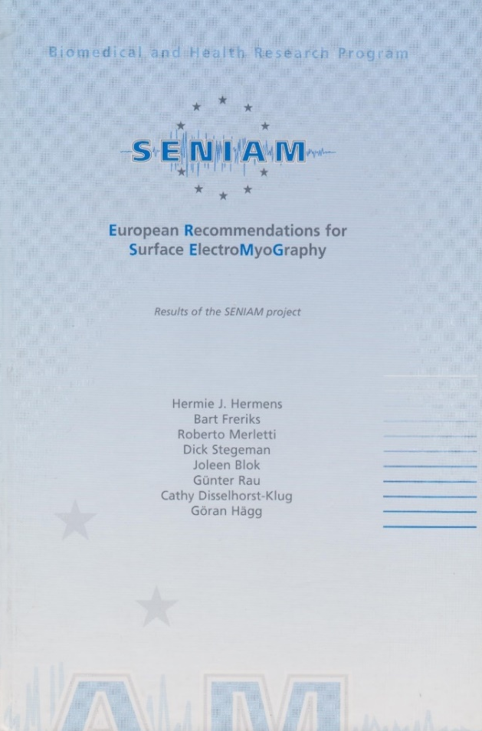
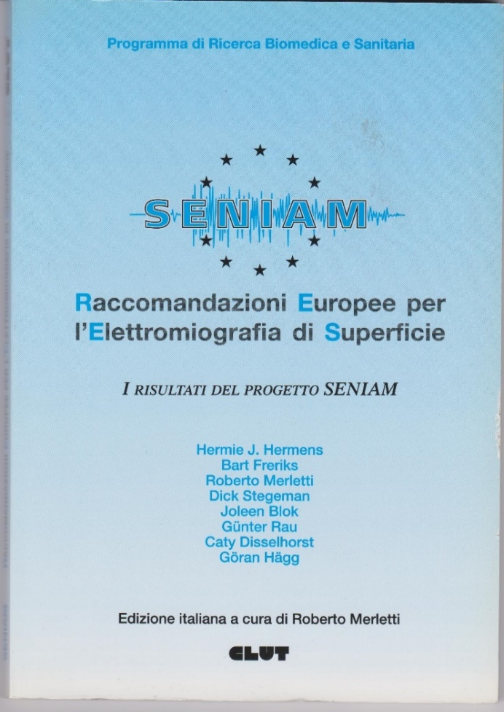
The SENIAM Project (www.seniam.org)
Objective 1: “….to exchange knowledge and experience on sEMG between different countries and disciplines and to enhance the transfer of knowledge between basic and applied research.”
Objective 2: “….to develop recommendations on key items that presently prevent e useful exchange of knowledge and experience with respect to experimental and clinical data.”
Coordination Committee:
H. Hermens, B. Freriks Enschede, The Netherlands
R. Merletti, Torino, Italy
G. Rau, C. Disselhorst-Klug, Aachen, Germany
G. Hägg, Stockholm, Sweden
D. Stegeman, J. Blok Njimegen, The Netherlands

Slide 9
The SENIAM Project: achievements and failures.
Achievements: The SENIAM Project has been successful in organizing exchanges, workshops and miniprojects where presentations were given and discussions were held. Participants were mostly researchers, biomedical engineering students, occasionally clinicians. The goal of providing opportunities for exchange and discussions and for standardiza-tion was certainly achieved in the research environment.
The SENIAM Recommendations are still followed, almost 20 years later, as being followed by most research groups and are mentioned in most papers dealing with sEMG.
Failures: International recommendations and standards should be a basic building block of any profession and should be taught in the schools that train professionals. This happened only in some countries, not in others. Transfer of knowledge in schools of a country has not been necessarily related to the level of research and the quality of teaching material. The situation is still very variable from country to country. The gap between research level and teaching is still very wide in some countries. Involvement of physiotherapist and movement scientists in research is still different between countries as well as between the two categories.
The results of some other EU projects on training are not available.

Slide 10
The SENIAM Project main topics. Updates.
(slide 1 of 4)
The SENIAM main topics were:
Sensor placement procedures
sEMG signal processing and information extraction
sEMG models

Slide 11
The SENIAM Project main topics. Updates.
(slide 2 of 4)
Sensor placement procedures.
A literature scan (1999) of 144 peer reviewed papers published on seven international journals indicated a range of electrode diameter from 1mm to 20mm and interelectrode distances from 10mm to 50mm with a huge variety of electrode locations. After 20 years the situation is not much improved. EU standards and recommendations are not yet taught in PT schools of some EU countries.
Some of the electrode size and placement criteria indicated in the SENIAM book have been modified by subsequent investigations. Electrode diameter and interelectrode distance are now indicatd as < 3mm and < 5mm respectively. Sizes up to 5mm diameter and 10mm interelectrode distances can be accepted (at the cost of some low pass spatial filtering and some spatial aliasing) for non critical applications. See Module 6 on detection systems.
Two- dimensional sensors (grids, electrode arrays) have been developed after the termination of the SENIAM pproject. International standardization of these techniques is badly needed.
Hermens H, Freriks B., Disselhorst-Klug C., Rau G., Development of recommendations for sEMG sensors and sensor placement procedures, J. of Electrom. and Kinesiol. 2000, 10, 361-374

Slide 12
The SENIAM Project main topics. Updates.
(slide 3 of 4)
2. sEMG signal processing and information extraction.
The sEMG is “processed” to obtain clinically relevant features such as amplitude (RMS, ARV, their spatial distribution), muscle activation intervals, spectral parameters (mean or median frequency), conduction velocity, other fatigue indicators).
The algorithms for their estimation underwent minor improvements but are still valid. Novel fields, not addressed by SENIAM, are spatial filtering and decom-position of sEMG into the constituent trains of MUAPs generating information about the MU firing rates and recruitment/derecruitment times.
The features of the sEMG signal are heavily affected by a number of anatomi-cal and geometrical parameters such as a) the thickness of muscle and subcutaneous tissue between the sources (Motor Unit Action Potentials) and the detection system, b) the electrical conductivity of such tissues,
c) the detection system (monopolar, single or double differential), d) electrode size, location and interelectrode distance, e) angle between the fiber direction and the detection system, f) crosstalk from other muscles. Despite these sources of variability (of which the user must be aware) the sEMG features provide useful information if correctly detected and interpreted.
Farina D., Cescon C., Merletti R., Influence of anatomical physical and detection-system parameters on sEMG, Biological Cybernetics, 2002, 86, 445-456

Slide 13
The SENIAM Project main topics. Updates.
(slide 4 of 4)
3. sEMG Models.
Models are tools for understanding, describing and teaching physical objects or phenomena through computer simulations. The four sEMG models developed within SENIAM, have been improved and used in research. The use of models in teaching is still very limited in most countries.
Surface EMG models belong to two types: a) sEMG is generated by filtering white Gaussian noise to obtain a sEMG spectrum, b) sEMG is generated by summing the surface contributions of simulated MUAPs; in turn MUAPS are simulated by summing the contributions of the propagating Action Potentials (AP) of the individual fibers of the MUs. Models are designed to answer specific questions of the type “What if…..?” . For example;
What if the muscle is pennate or is shortening under the electrodes? What if the electrode system is not parallel to the fibers? What if muscle fiber conduction velocity decreases? What physiological/pathological muscle properties may produce the set of observed sEMG features of a muscle? etc. Models are an approximation of reality and may be misleading. The results of a simulation may be associated to more than one physiological situation producing the same results.
Schneider J, Silny J, Rau G. Influence of tissue inhomogeneities on noninvasive muscle fiber conduction velocity measurements investigated by physical and numerical modeling. IEEE Trans Biomed Eng. 1991,38:851-60.

Slide 14
Dissemination and teaching efforts subsequent
to Project SENIAM in Italy.
The impact of Project SENIAM on education has been different in different countries. Dozens of seminars illustrating SENIAM results have been held around the world.
In Italy, Project SENIAM has been the foundation for the preparation of four educational and training initiatives of international relevance:
Italian translation of the SENIAM book (v. 8) “European Recommendations for surface electromyography”. The book was distributed to all academic PT schools.
“Interactive course on biomechanics and non invasive electromyography:
Website and CD-ROM” , LISiN, Politecnico di Torino and School of Exercise and Sport Sciences of the University of Torino, Italy (2009-2012). Financially supported by Compagnia di San Paolo, Torino, Italy. This material is no longer accessible because Adobe Flash Player is no longer supported by browsers.
Textbook by Barbero R., Rainoldi A, Merletti R., “Atlas of muscle innervation zones: Understanding surface EMG and its applications”, Springer, Italy, 2012. LISiN, Politecnico di Torino, School of Exercise and Sport Sciences of the University of Torino, Italy, University of Applied Sciences and Arts of Southern Switzerland. (SUPSI), 2009-2012. Financially supported by Compagnia di San Paolo, Torino, Italy and SUPSI, Switzerland.
Project CoMES. This project (see the “Introduction” file).
This body of material is adopted in a few Italian Schools of Movement
Sciences and phisiotherapy..

Slide 15
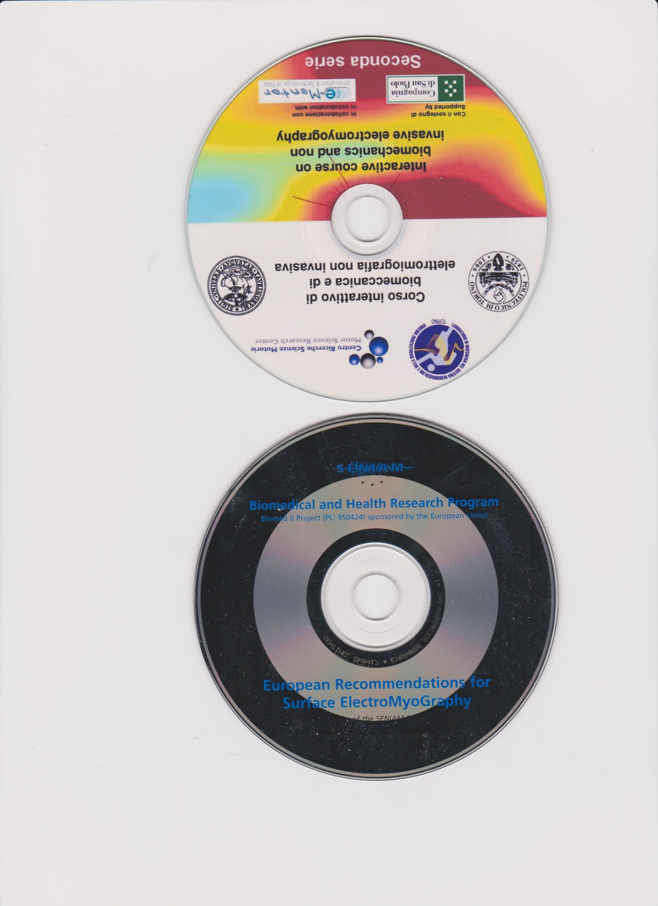
This material is no longer on-line because Adobe Flash Player is no longer supported by most browsers. The CD version may work, if Adobe Flash Player is installed, with old versions of browsers.
Copies available from roberto.merletti@polito.it.
The SENIAM CD ROM
Website: http://www.seniam.org/
e-mail: info@seniam.org
Contact: Dr. ir. H.J. Hermens, Roessingh Research and Development, PO Box 310, 7500 AH Enschede , The Netherlands,
e-mail: info@seniam.org

Slide 16
Guidelines for reporting sEMG data: SENIAM Project, vol. 8. (1 of 2).
Scientific standards are well known about data and results reporting (e.g. drawing axis and labeling plots, etc) and structuring a report or publication.
In addition, any document concerning sEMG signals should include the following information to allow other investigators to reproduce the described tests:
Experimental voluntary sEMG
Electrodes: anatomical location, configuration (Mon. SD, DD, others) material, shape, size, interelectrode distance (for non monopolar detection), location of the reference electrode, gel used, if any, and skin preparation adopted. Presumed orientation with respect to the fiber direction.
Amplifier and A/D: manufacturer, gain, input resistance and capacitance (or impedance at 50/60 Hz), Common Mode Rejection Ratio at 50/60 Hz, filter type and order, high pass and low pass cut-off frequencies, input referred noise, input range, use of a notch filter (acceptable for non critical applications), sampling frequency, number of bits of the A/D.

Slide 17
Guidelines for reporting sEMG data:
SENIAM Project, vol. 8. (2 of 2).
Amplitude parameters: indicate which parameters are used (RMS, ARV, others) and on which epoch duration they are estimated.
Envelope detection (smoothing): Indicate order and cut off frequency of the filter used.
Spectral analysis: indicate on which signal epoch duration the power spectrum is estimated and the algorithm used (single PSD, window used, Welch method with or without overlap, interpolation or zero padding, others)
Normalization of force/torque or sEMG: describe force/torque and sEMG normalization procedures, if any.
Estimation of muscle fiber conduction velocity: describe the electrode array used (position, electrode size and interelectrode distance, orientation, etc), the channels used, the algorithm used.
Guidelines concerning electrically elicited sEMG are not addressed in this work.

Slide 18
Twenty years after the SENIAM Project
Twenty years after the SENIAM Project the main updates concern the electrode size and the interelectrode distance.
The maximal spatial frequency of monopolar instantaneous sEMG maps is 80-100 cycles/m. The spatial sampling frequency should be >200 samples/m. That means IED < 5mm with tolerance up to 8-10mm if some aliasing can be accepted.
The IED = 20mm recommended by SENIAM was based on clinical practice and implies strong spectral changes that are unacceptable if further processing is performed. In any case, spatial and temporal sEMG features can be compared only if sEMG signals have been collected with the same detection parameters (electrode location on the muscle, electrode size and interelectrode distance).
Electrode diameter should be between 1mm and 3mm with tolerance up to
4-5mm. Electrode diameter >10mm implies strong low-pass spatial filtering. This applies to electrode grids, linear arrays or single electrode pairs.
Too many European teaching institutions are unaware of this European effort and do not inform students of motor sciences and physiotherapy about these Recommendations.

Slide 19
EMG consensus project (June 2018)
An EMG international consensus project has been proposed by Prof. Paul Hodges during the ISEK 2018 conference in Dublin.
Summary of proposal:
Develop a series of decision matrices to guide selection of methods in EMG experiments.
Develop checklist to be completed when designing EMG studies and submitting results for publication.
Related Projects
Publication of a series of sEMG tutorials on the Journal of Electromyography and Kinesiology (JEK).

