Slide 1

Modelling shot success rate and win probabilities in soccer
Michael Womble, Daniel Diaz, Rose Mesina, and Ganesh Ghimire
March 8, 2022

Slide 2







Data Set Overview:
2016:
1,974 Matches
3,251,294 events & 18 variables
2017 / 2018:
2018:

Slide 3
Match Event Data Frame Variables:
Event Name
Subevent Name
Event Time
Event Coordinates
Player
Shots
Pass
Free Kick
Simple Pass
Cross
Goal Kick
x, y
start
end
Team
Match Date
Tags
Match ID
Goals
Assist
Key Passes

Slide 4
SMART Question 1:
Given the variables that describe the (X, Y) coordinates of the beginning and end of key events (shots, assists, key passes), which configuration of the variables result in the best fitting model that gives the probability of a shot on goal being successful?

Slide 5
Match Event Data Frame Variables:
Event Name
Subevent Name
Event Time
Event Coordinates
Player
Shots
Pass
Free Kick
Simple Pass
Cross
Goal Kick
x, y
start
end
Team
Match Date
Tags
Match ID
Goals
Assist
Key Passes

Slide 6
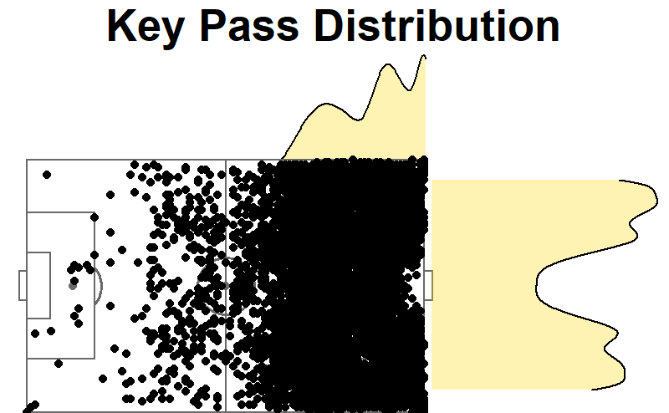
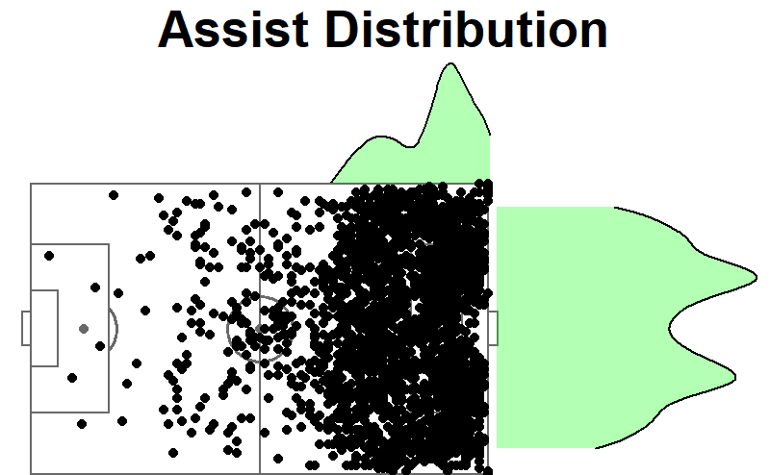
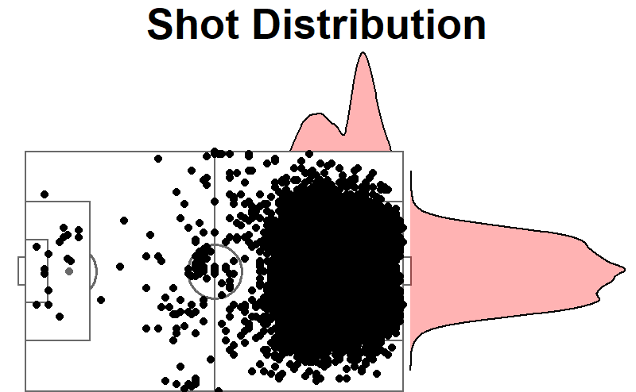
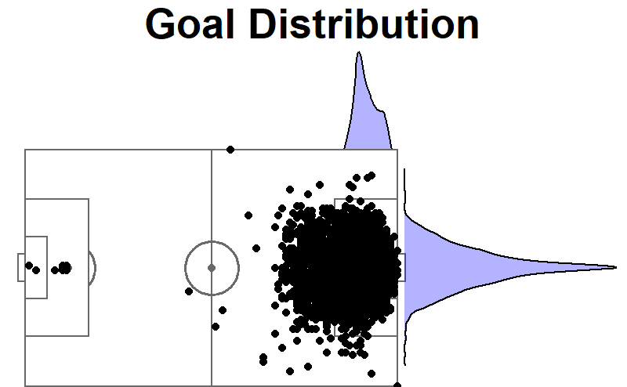
Visualizing Match Events

Slide 7
Model
Obtain distance of play (field dimensions: 120 by 75 yards)
Balance and center data
Use (X, Y) coordinates of events as independent variables: start, end, and distance
Build Logit models, select best with BIC and VIF
Obtain vector of probabilities
Build new model with vector from 4 as dependant variable

Slide 8
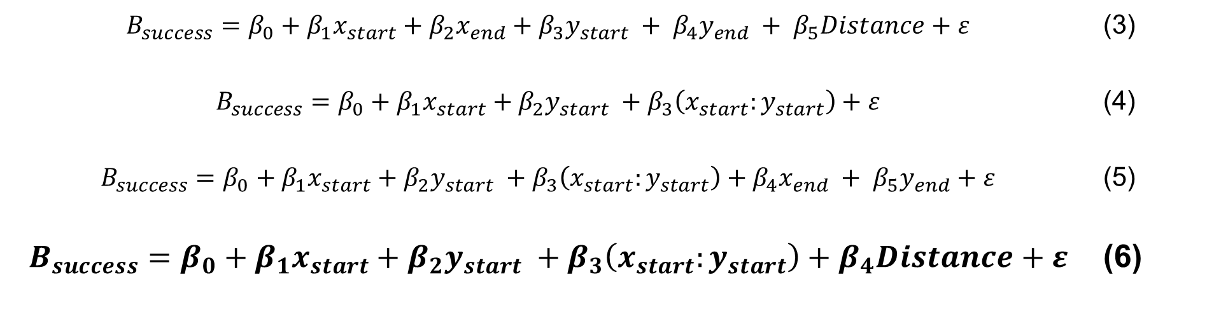
Model
$$B_{success}=β_{0}+β_{1}x_{start}+β_{2}x_{end}+β_{3}y_{start} + β_{4}y_{end} + β_{5}Distance+ε$$ | (3)
$$B_{success}=β_{0}+β_{1}x_{start}+β_{2}y_{start} +β_{3}\left(x_{start}:y_{start}\right)+ε$$ | (4)
$$B_{success}=β_{0}+β_{1}x_{start}+β_{2}y_{start} +β_{3}\left(x_{start}:y_{start}\right)+β_{4}x_{end} + β_{5}y_{end}+ε$$ | (5)
$$B_{success}=β_{0}+β_{1}x_{start}+β_{2}y_{start} +β_{3}\left(x_{start}:y_{start}\right)+β_{4}Distance+ε$$ | (6)

Slide 9
Model
$$B_{success}=β_{0}+β_{1}x_{start}+β_{2}y_{start} +β_{3}\left(x_{start}:y_{start}\right)+β_{4}Distance+ε$$ | (6b)

Slide 10
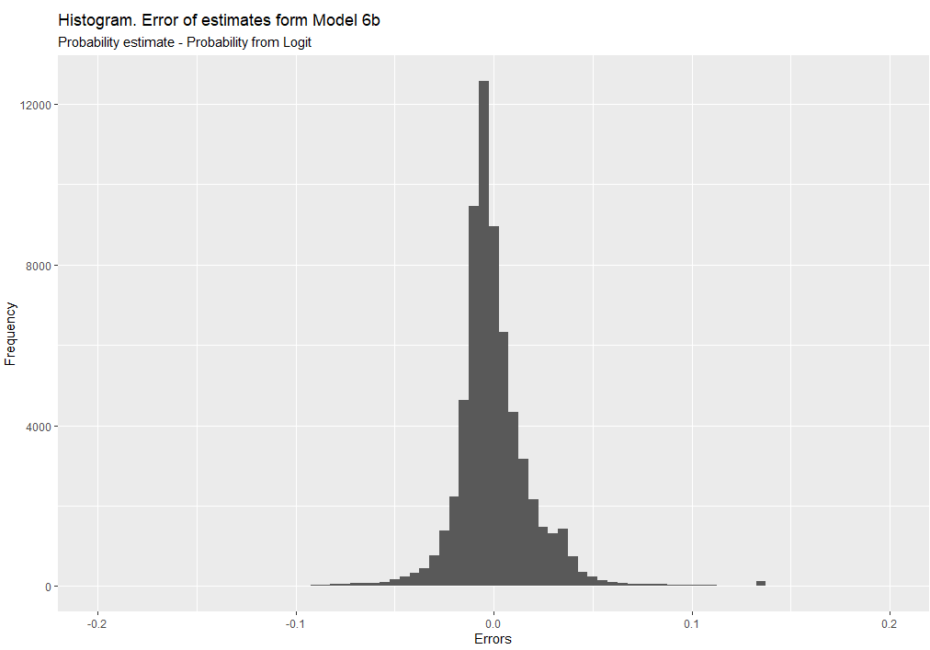

Slide 11
SMART Question 2:
Based on match stats (i.e., percentage of possession of the ball, number of shots, number of shots on target, being home team vs being visitor team, etc.), can we predict who the winner of a particular match was?

Slide 12
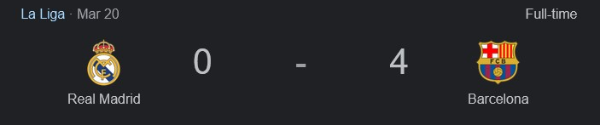
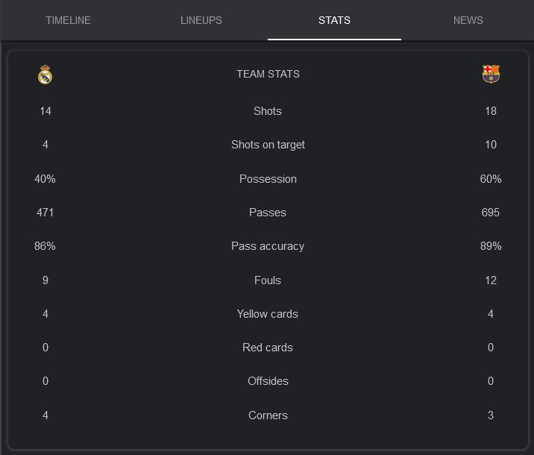
Match Stats

Slide 13
Calculating Match Stats:
Event Name
Subevent Name
Event Time
Event Coordinates
Player
Shots
Pass
Foul
Simple Pass
Cross
Goal Kick
x, y
start
end
Team
Match Date
Tags
Match ID
Yellow card
Red card
Accurate

Slide 14
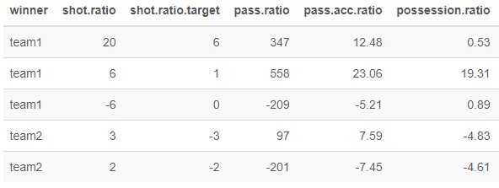
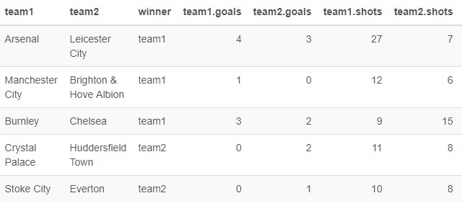
Calculating Match Stats:

Slide 15
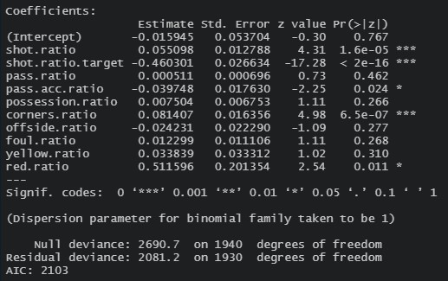
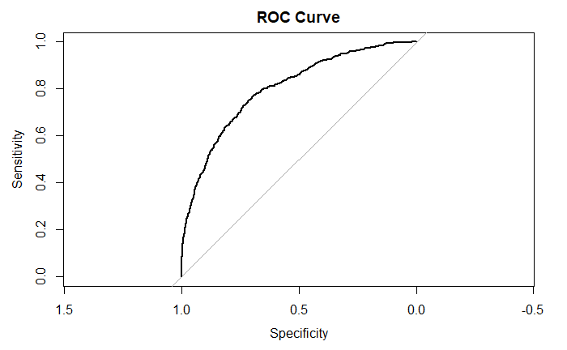
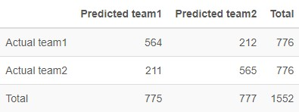
Logistical Regression Model
AUC = 0.801
Accuracy = 73%

Slide 16
Smart Question 3
Based on match stats (i.e., percentage of possession of the ball, number of shots, number of shots on target, being home team vs being visitor team, etc.), can we predict the number of goals scored by each team?

Slide 17
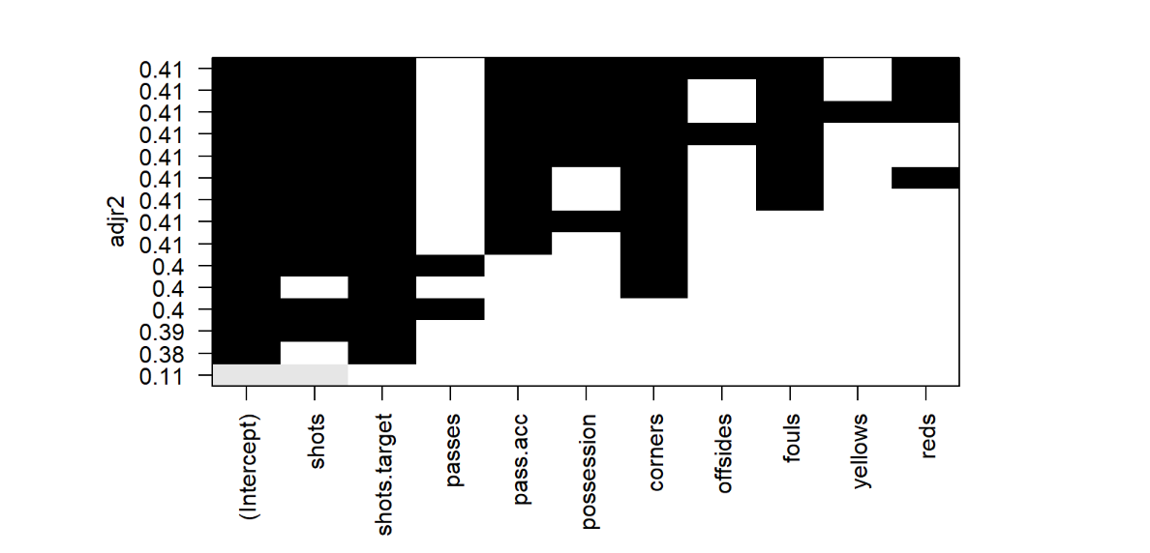
Model – Adjusted R Squared

Slide 18
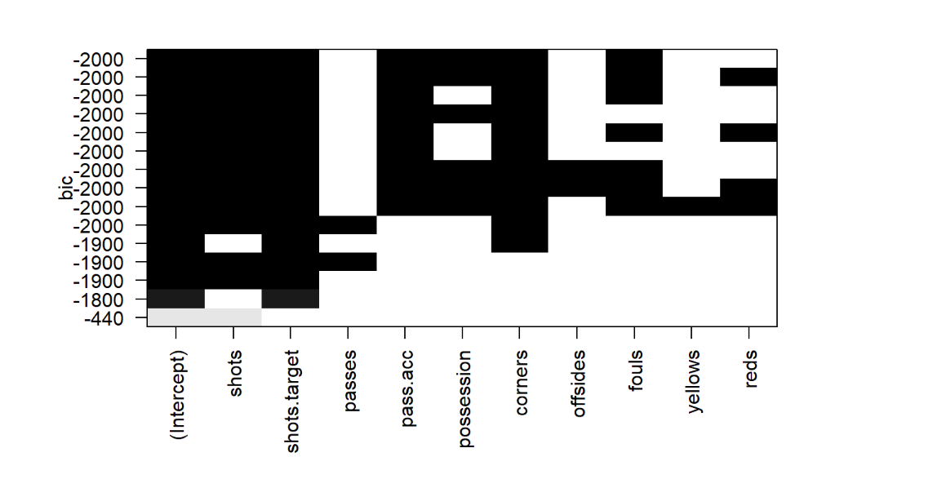
Model – BIC

Slide 19
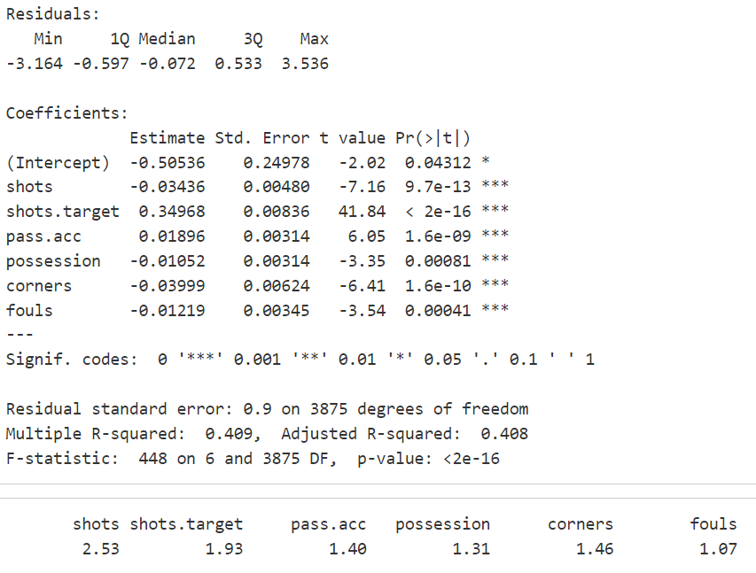
Best Linear Regression Model
Goals = Shots + Shots.Target + Pass.Acc + Possession + Corners + Fouls
Statistically significant estimates
Adjusted R-Squared can be improved
No concern for multicollinearity

Slide 20
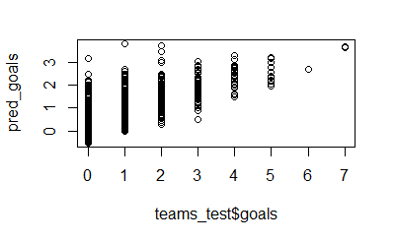
Best Linear Regression Model
RMSE R2
5.275 0.418

Slide 21
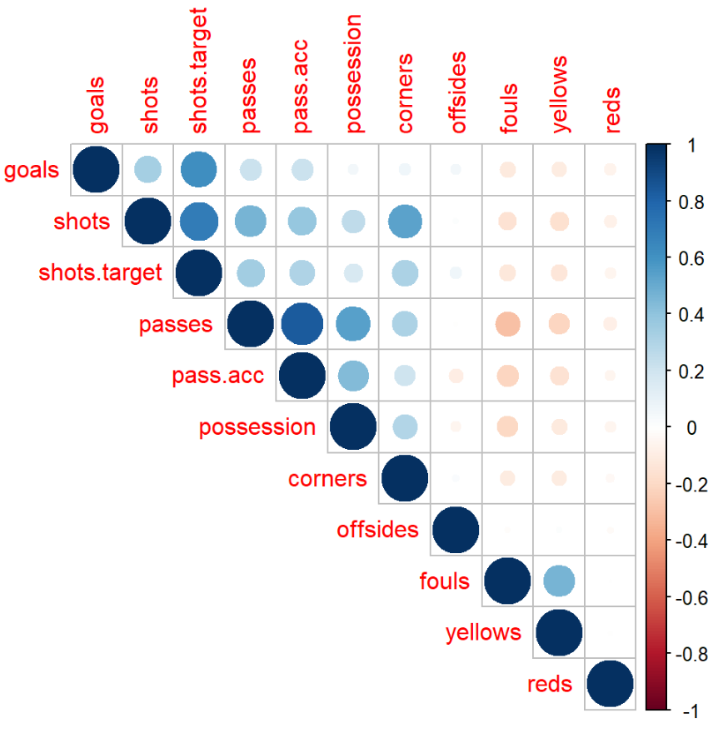
Other Variables in the Data

Slide 22
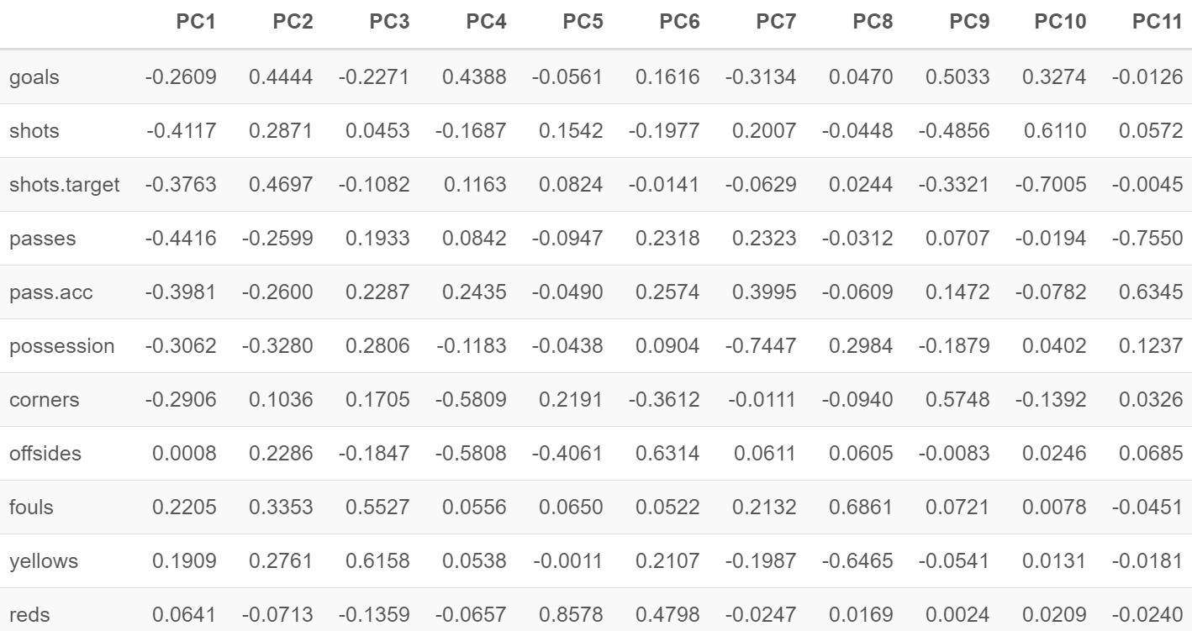
PCA

Slide 23
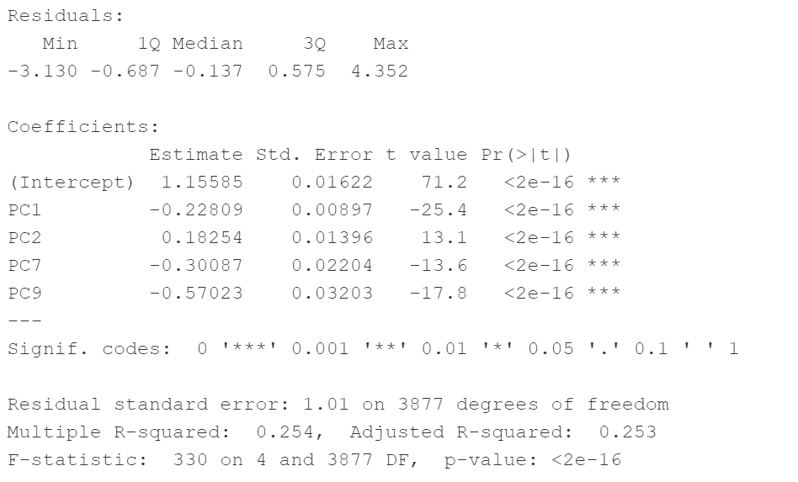
PCR

Slide 24
Conclusions

Slide 25




Questions?

