Slide 1

Modelling shot success rate and win probabilities in soccer
Michael Womble, Daniel Diaz, Rose Mesina, and Ganesh Ghimire
March 8, 2022

Slide 2
SMART Question 1:
Given the variables that describe the (X, Y) coordinates of the beginning and end of key events (shots, assists, key passes), which configuration of the variables result in the best fitting model that gives the probability of a shot on goal being successful?

Slide 3







Data Set Overview:
2016:
1,974 Matches
3,251,294 events & 18 variables
2017 / 2018:
2018:

Slide 4
Match Event Data Frame Variables:
Event Name
Subevent Name
Event Time
Event Coordinates
Player
Shots
Pass
Free Kick
Simple Pass
Cross
Goal Kick
x, y
start
end
Team
Match Date
Tags
Match ID
Goals
Assist
Key Passes

Slide 5
Match Event Data Frame Variables:
Event Name
Subevent Name
Event Time
Event Coordinates
Player
Shots
Pass
Free Kick
Simple Pass
Cross
Goal Kick
x, y
start
end
Team
Match Date
Tags
Match ID
Goals
Assist
Key Passes

Slide 6
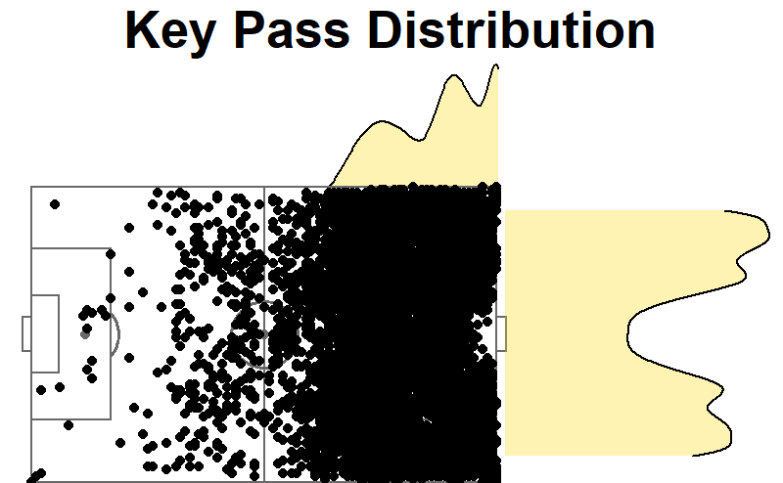
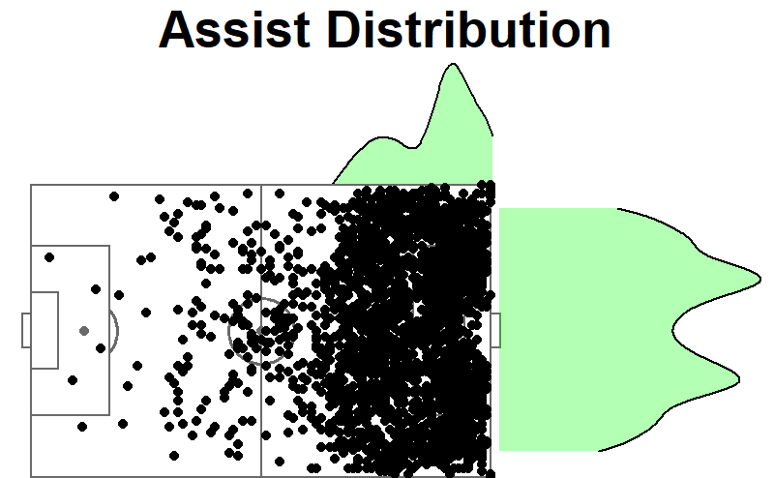
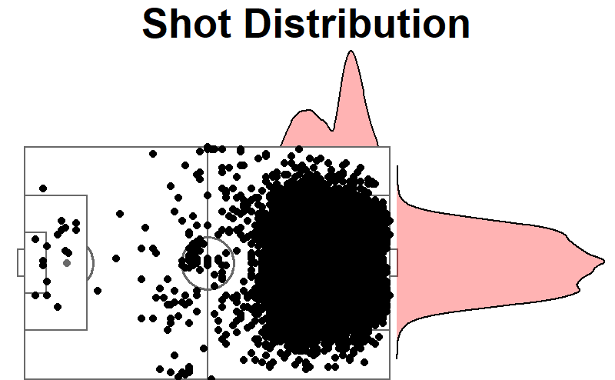
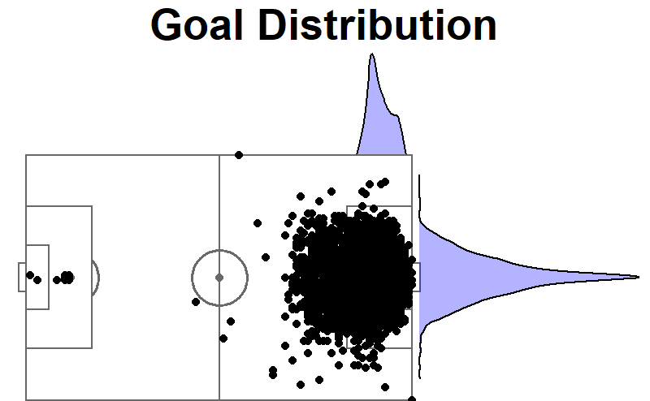
Visualizing Match Events

Slide 7
Model

Slide 8
SMART Question 2:
Based on match stats (i.e., percentage of possession of the ball, number of shots, number of shots on target, being home team vs being visitor team, etc.), can we predict who the winner of a particular match was?

Slide 9
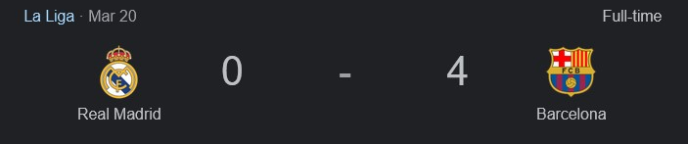
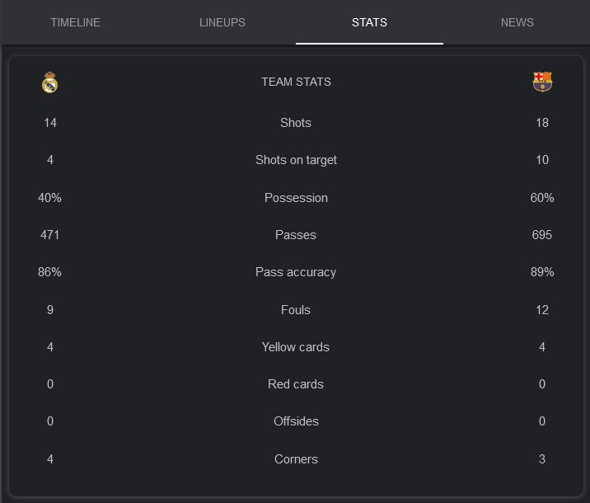
Match Stats

Slide 10
Calculating Match Stats:
Event Name
Subevent Name
Event Time
Event Coordinates
Player
Shots
Pass
Foul
Simple Pass
Cross
Goal Kick
x, y
start
end
Team
Match Date
Tags
Match ID
Yellow card
Red card
Accurate

Slide 11
Model

Slide 12
Conclusions

Slide 13




Questions

