Slide 1

Modelling shot success rate and win probabilities in soccer
Michael Womble, Daniel Diaz, Rose Mesina, and Ganesh Ghimire
March 8, 2022

Slide 2







Ganesh
Data Set Overview:
2016:
1,974 Matches
3,251,294 events & 18 variables
2017 / 2018:
2018:

Slide 3
Ganesh
Match Event Data Frame Variables:
Event Name
Subevent Name
Event Time
Event Coordinates
Player
Shots
Pass
Free Kick
Simple Pass
Cross
Goal Kick
x, y
start
end
Team
Match Date
Tags
Match ID
Goals
Assist
Key Passes

Slide 4
Ganesh
Match Event Data Frame Variables:
Event Name
Subevent Name
Event Time
Event Coordinates
Player
Shots
Pass
Free Kick
Simple Pass
Cross
Goal Kick
x, y
start
end
Team
Match Date
Tags
Match ID
Goals
Assist
Key Passes

Slide 5
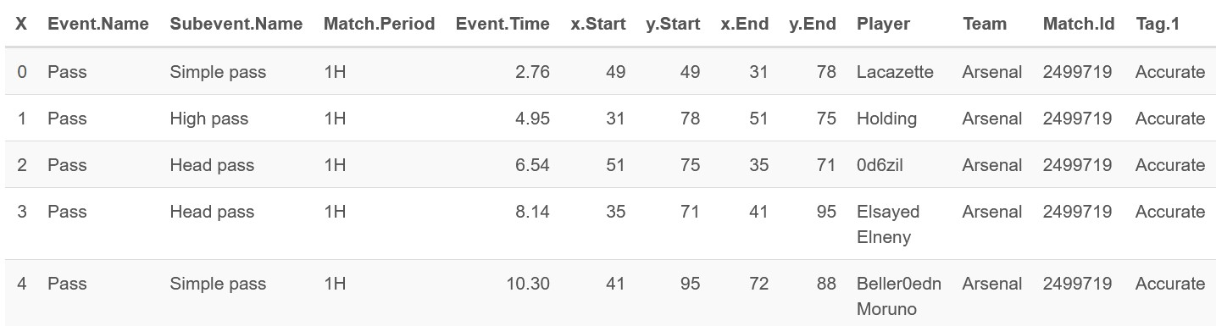
Ganesh
Match Event Data Frame Variables:

Slide 6
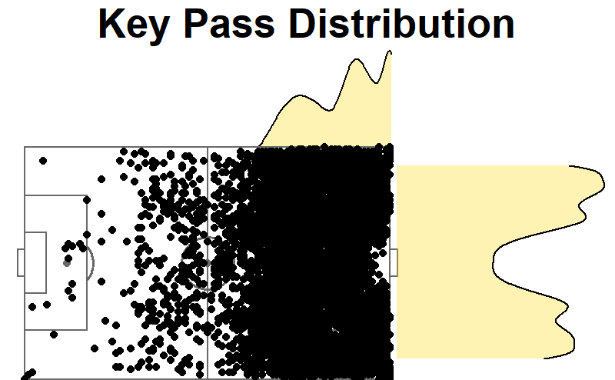
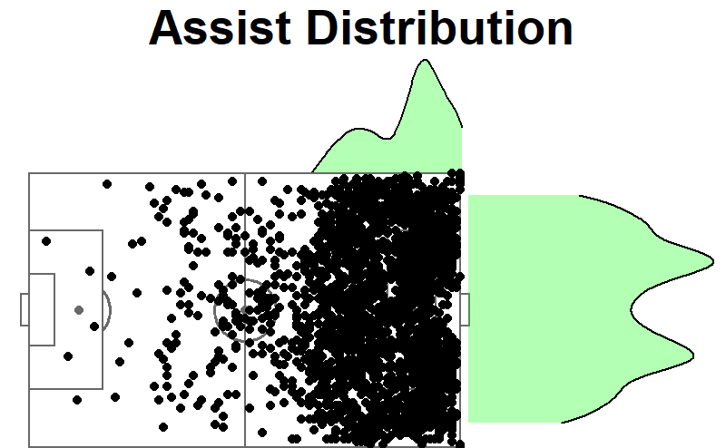
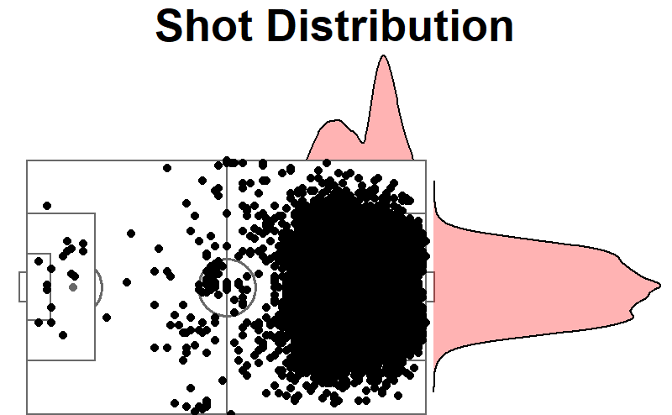
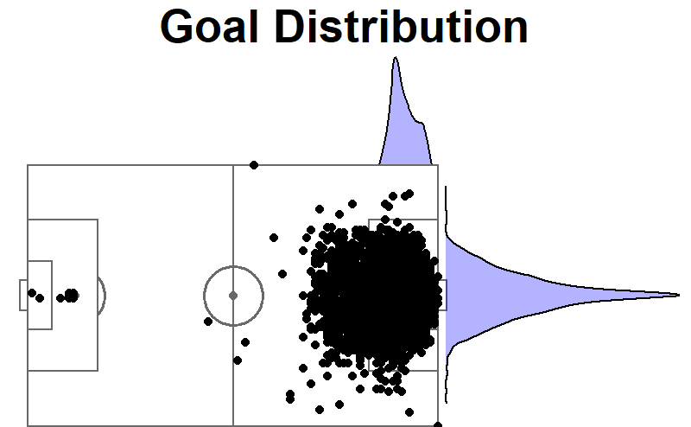
Ganesh
Visualizing Match Events

Slide 7
Daniel
SMART Question 1:
Given the variables that describe the (X, Y) coordinates of the beginning and end of key events (shots, assists, key passes), which configuration of the variables result in the best fitting model that gives the probability of a shot on goal being successful?

Slide 8
Daniel
Model
Obtain distance of play (field dimensions: 120 by 75 yards)
Balance and center data
Use (X, Y) coordinates of events as independent variables: start, end, and distance
Build Logit models, select best with BIC and VIF
Obtain vector of probabilities
Build new model with vector from 4 as dependant variable

Slide 9
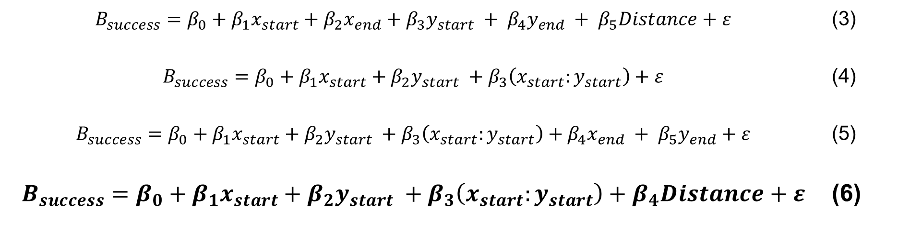
Daniel
Model
$$B_{success}=β_{0}+β_{1}x_{start}+β_{2}x_{end}+β_{3}y_{start} + β_{4}y_{end} + β_{5}Distance+ε$$ | (3)
$$B_{success}=β_{0}+β_{1}x_{start}+β_{2}y_{start} +β_{3}\left(x_{start}:y_{start}\right)+ε$$ | (4)
$$B_{success}=β_{0}+β_{1}x_{start}+β_{2}y_{start} +β_{3}\left(x_{start}:y_{start}\right)+β_{4}x_{end} + β_{5}y_{end}+ε$$ | (5)
$$B_{success}=β_{0}+β_{1}x_{start}+β_{2}y_{start} +β_{3}\left(x_{start}:y_{start}\right)+β_{4}Distance+ε$$ | (6)

Slide 10
Daniel
Model
$$B_{success}=β_{0}+β_{1}x_{start}+β_{2}y_{start} +β_{3}\left(x_{start}:y_{start}\right)+β_{4}Distance+ε$$ | (6b)

Slide 11
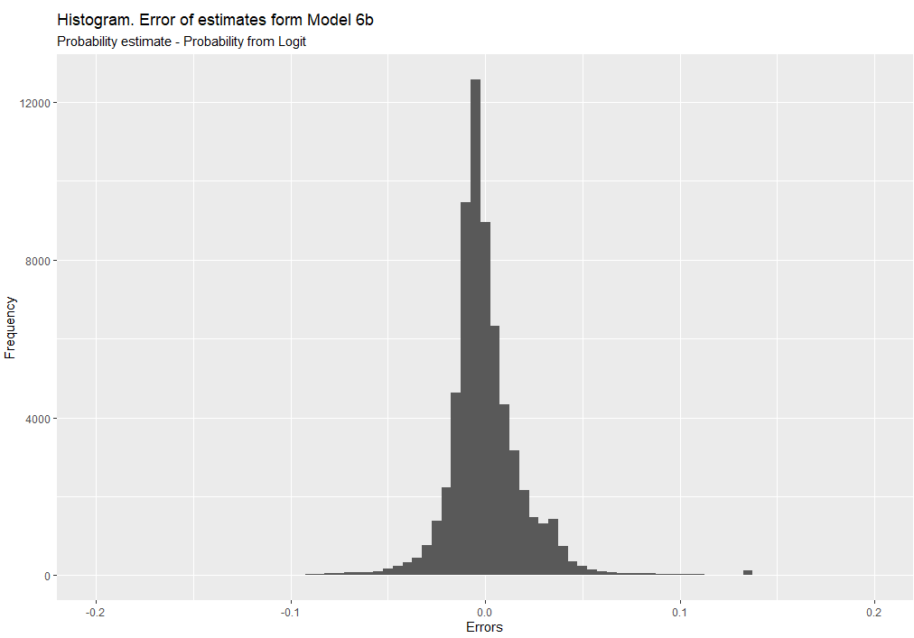
Daniel

Slide 12
Michael
SMART Question 2:
Based on match stats (i.e., percentage of possession of the ball, number of shots, number of shots on target, being home team vs being visitor team, etc.), can we predict who the winner of a particular match was?

Slide 13
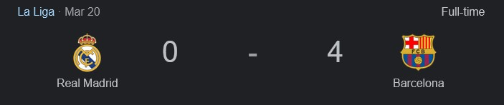
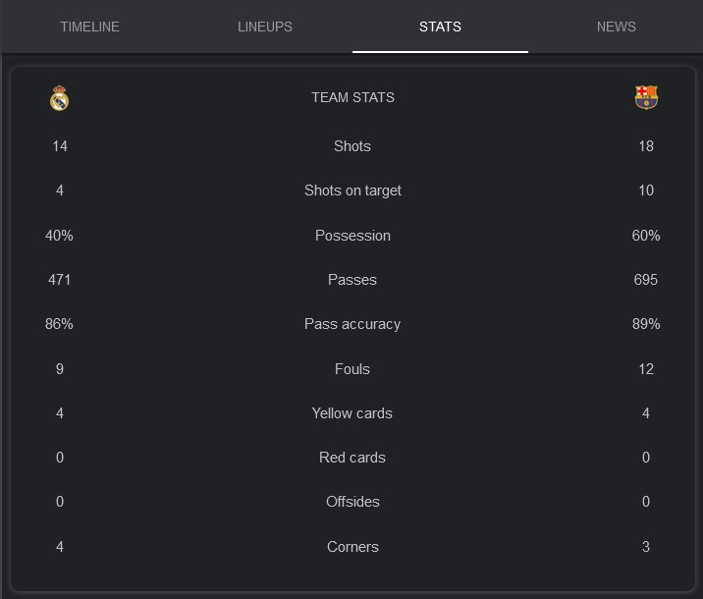
Michael
Match Stats

Slide 14
Michael
Calculating Match Stats:
Event Name
Subevent Name
Event Time
Event Coordinates
Player
Shots
Pass
Foul
Simple Pass
Cross
Goal Kick
x, y
start
end
Team
Match Date
Tags
Match ID
Yellow card
Red card
Accurate

Slide 15
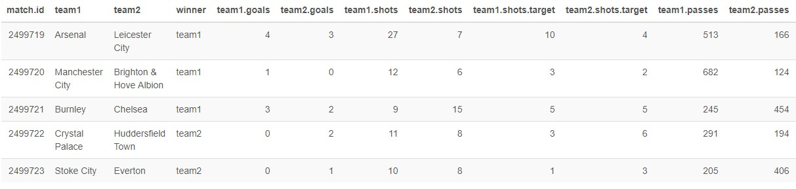
Michael
Calculating Match Stats:

Slide 16
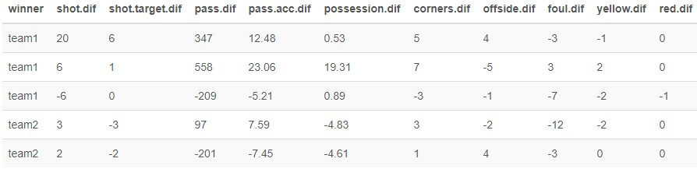
Michael
Calculating Match Stats:
Team 1
+
Team 2
-

Slide 17
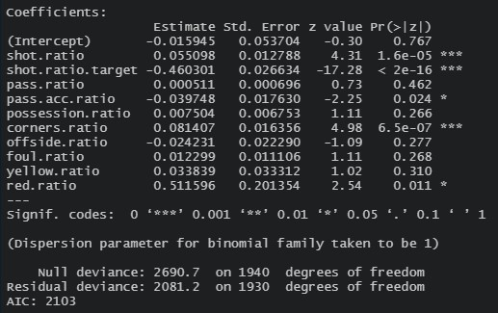
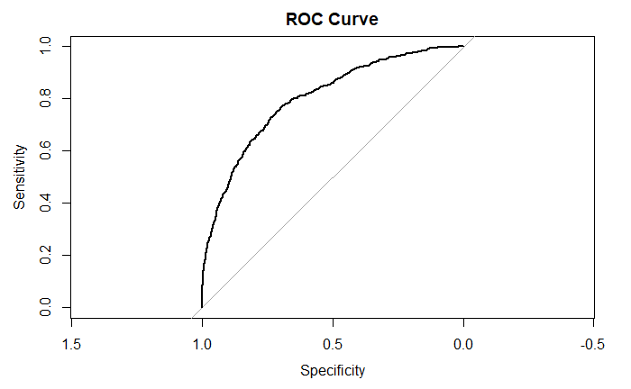
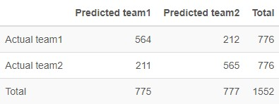
Michael
Logistical Regression Model
AUC = 0.801
Accuracy = 73%
Precision = 73%

Slide 18
Rose
Smart Question 3
Based on match stats (i.e., percentage of possession of the ball, number of shots, number of shots on target, etc.), can we predict the number of goals scored by each team?

Slide 19
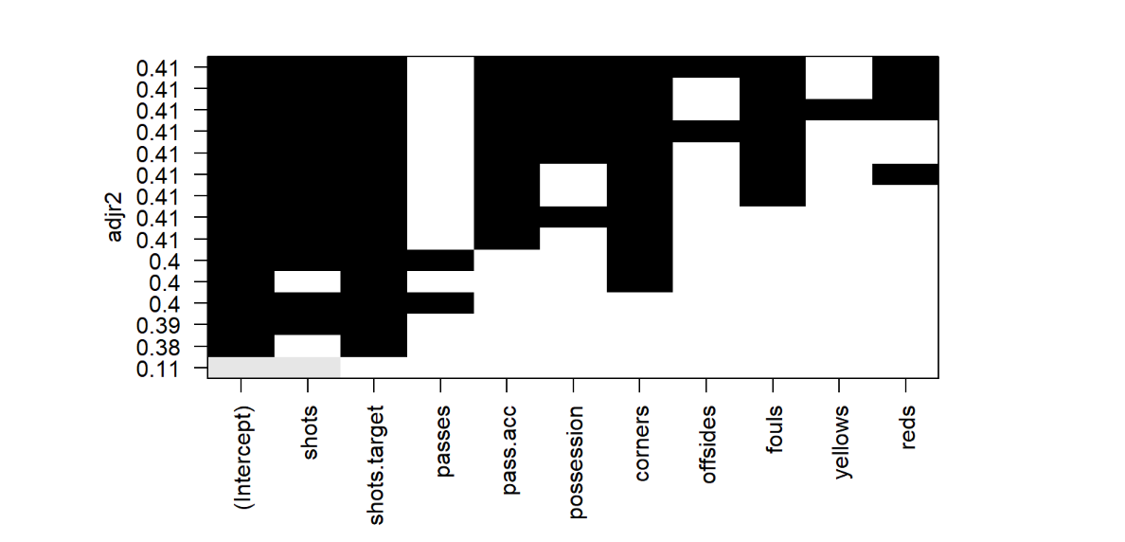
Rose
Model – Adjusted R Squared

Slide 20
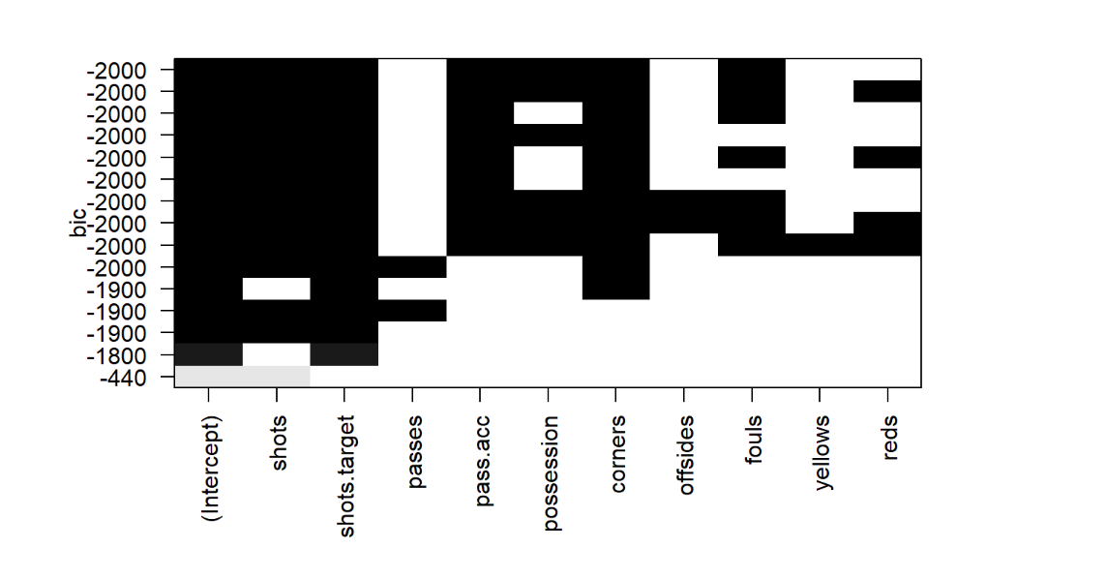
Rose
Model – BIC

Slide 21
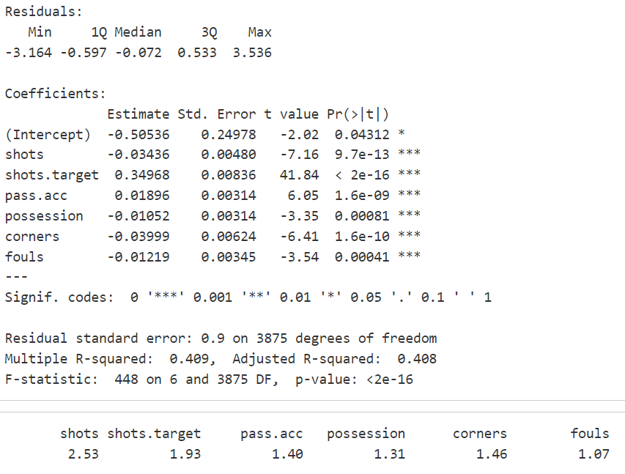
Rose
Best Linear Regression Model
Goals = Shots + Shots.Target + Pass.Acc + Possession + Corners + Fouls
Statistically significant estimates
Adjusted R-Squared can be improved
No concern for multicollinearity

Slide 22
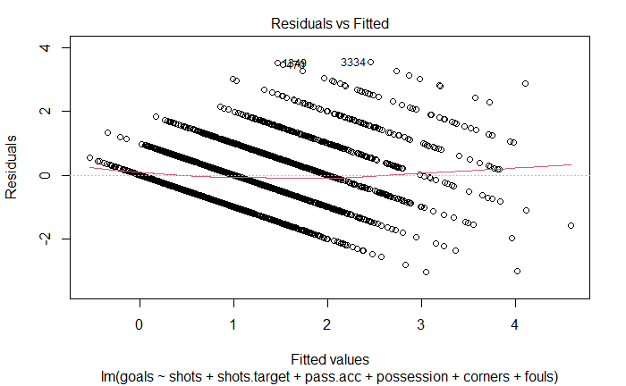
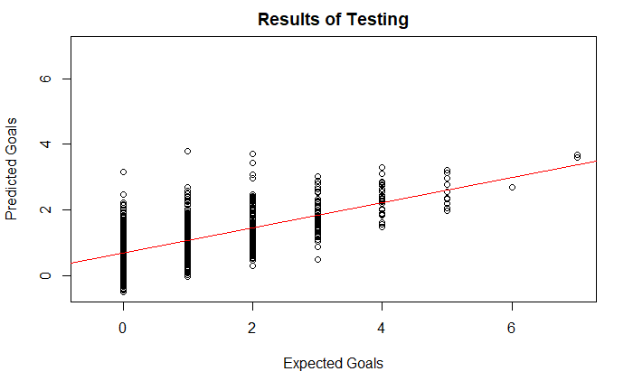
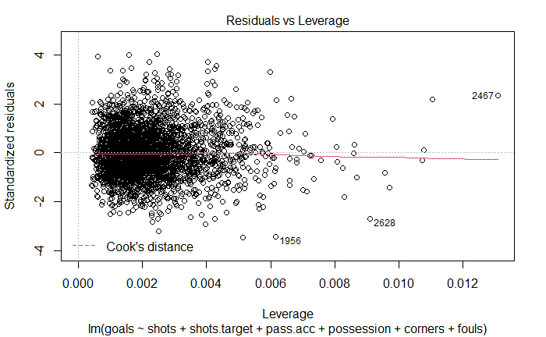
Rose
Best Linear Regression Model
RMSE | R²
5.275 | 0.418

Slide 23
Ganesh
Conclusions
As expected shorter passes and closer to the goal has higher probability of the goal being successful.
We are able to predict a match winner based on the match summary statistics with 73% accuracy.
Good, but also indicates that there may be other variables better able to predict match outcomes.
The model Goals = Shots + Shots.Target + Pass.Acc + Possession + Corners + Fouls is the best linear regression model under BIC and Adjusted R-Squared measures. However, because the response variable is a non-negative count variable, count data models such as Poisson (a Generalized Linear Model) may be more appropriate.

Slide 24
Ganesh
Future Work
Apply a multinomial logistic regression model to predict expected goals, treat expected goals as categorical variable rather than continuous value.
Apply a generalized linear model (likely, Poisson) to predict number of goals since it is a non-negative count variable.
Uncover patterns in match summary data using PCA & PCR that could help predict expected goals better.

Slide 25




Questions?

