Slide 1

CLI Git Workshop
Raphaela Mettig
WICS @ LSU, Fall 2022

Slide 2
A few considerations…
This is a beginner-level workshop
No prior experience required
There’s something for every level
Follow along to the practical demo
Ask questions
Have fun! ☺

Slide 3
Outline
Presentation
What is Git
Why Git
How to Git
Basic CLI usage
Useful terminology
Git Terminology
Git Workflow
Workshop
Setup
Basic Git usage
Github Page setup

Slide 4

What is Git
Version Control System (VCS)
Multiple different versions of the same project
Used *everywhere* in the industry

Slide 5
Why Git?
Keep track of changes
Doesn't apply only to code!
Freedom to try different approaches and make mistakes
Contribute to open source projects (good for resume)

Slide 6
How to Git

Slide 7


Git vs Github
Git
VCS tool to manage your code
Works locally
Github
Cloud-based host for Git repositories

Slide 8





There are others!

Slide 9
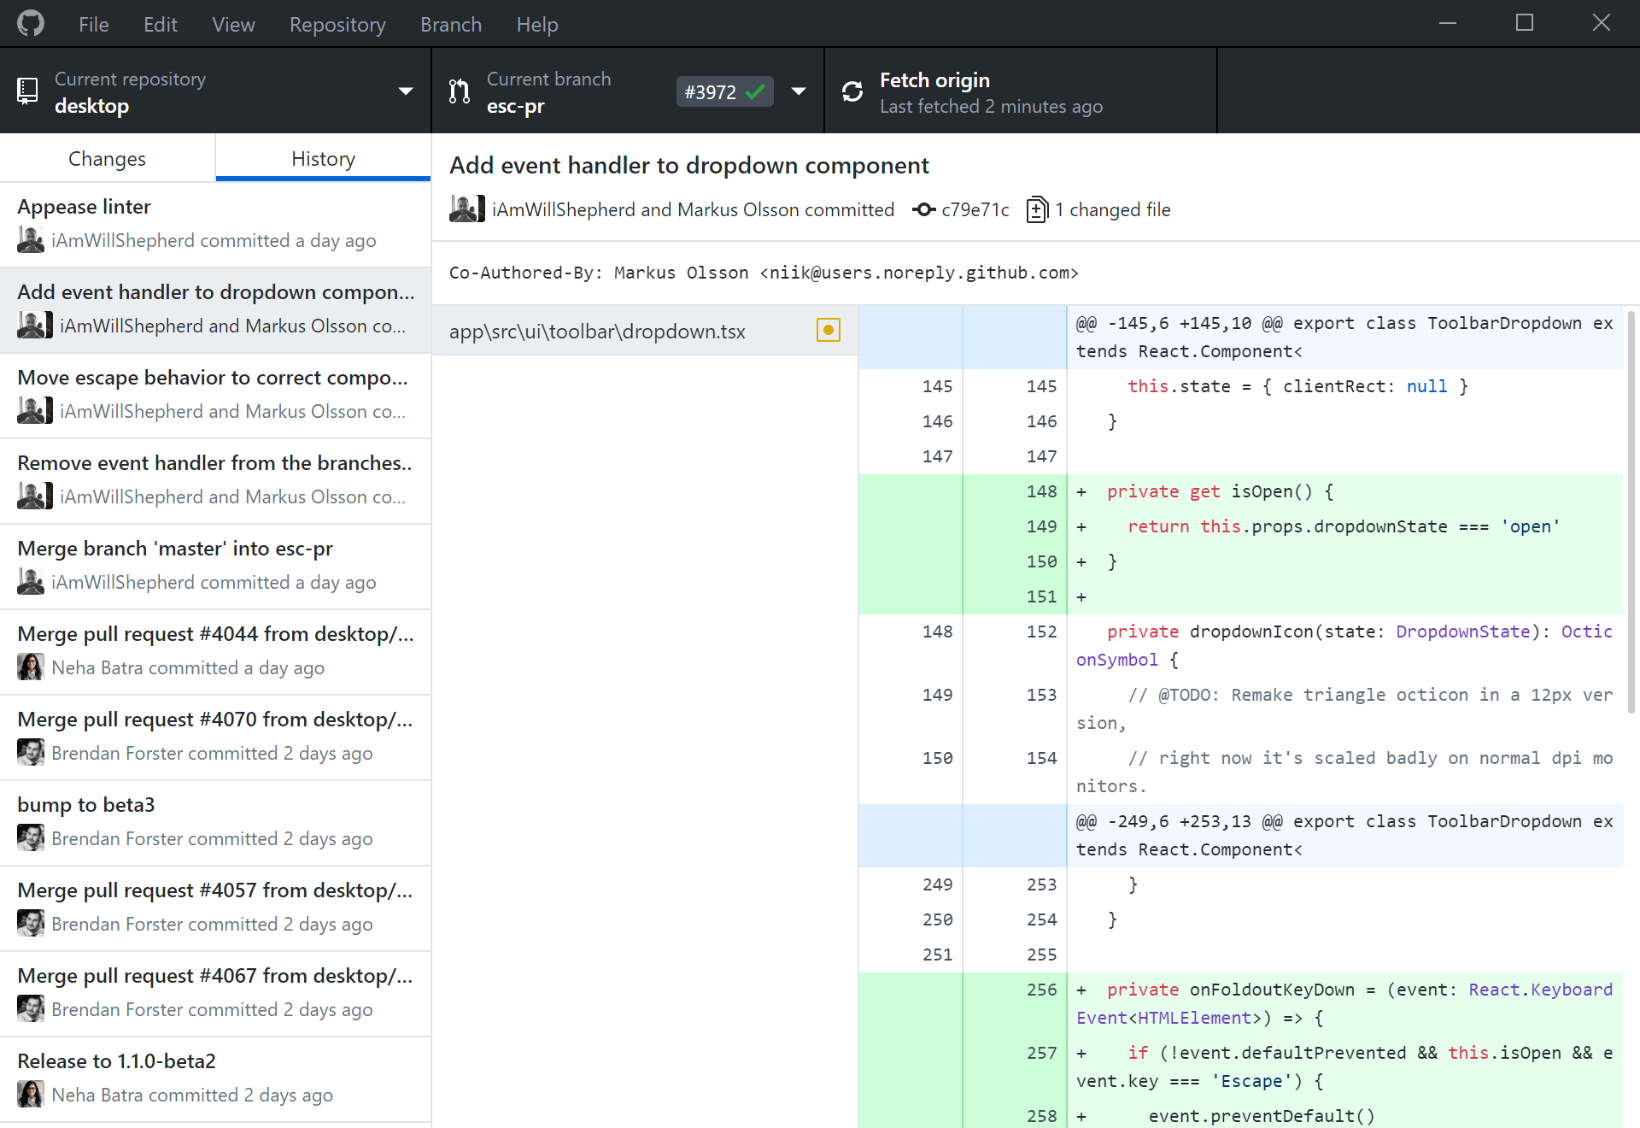
Desktop vs CLI
Github has a desktop client
It’s really easy to use!
Git concepts are the same across all platforms
CLI is less user-friendly
…sometimes it’s your only option

Slide 10
CLI Navigation Cheat Sheet
Windows
Mac/Linux
Help – shows help
[tab] -- autocomplete
Dir – lists current directory
Cd – change directory
Mkdir – make directory
Rmdir – remove directory
Cls – clear screen
[ctrl] + [c] – interrupt process
Help – shows help
[tab] -- autocomplete
ls – lists current directory
Cd – change directory
Mkdir – make directory
Rm (-r) – remove directory
clear – clear screen
[ctrl] + [c] – interrupt process

Slide 11


Useful Terminology
Remote
Local
Needs network connection
Works offline

Slide 12
Git Terminology
Repository
Contains project files and stores file version history
Branch
A version timeline within a repository
Commit
“Save” the changes done to the project to the working version
Clone
A local copy of a remote repository
Fork
Personal copy of another user’s repository
Changes made to your fork don’t affect the other user’s directly

Slide 13
Git Terminology (cont.)
Fetch
Get changes from a remote repository without merging them
Merge
Get changes from one branch and applies it into another
Either in the same repository or on another fork (aka Pull Request)
Pull
Fetch and merge changes in one command
Push
Send committed changes to a remote repository
Pull Request (PR)
proposed changes to a repository submitted by a user and accepted or rejected by a repository's collaborators

Slide 14
General Workflow
Clone/Fork/Create repository
Create working branch
Work and make changes
Commit changes (frequently)
Push local changes
Merge changes into main branch

Slide 15
Workshop

Slide 16
References
Git documentation - https://git-scm.com/
Github documentation - https://docs.github.com/en
Git cheat sheet - https://training.github.com/downloads/github-git-cheat-sheet.pdf
Github Pages documentation- https://docs.github.com/en/pages
Github Student - https://education.github.com/students

