Slide 1

Command Line 101 Attendee Handout
Women in Computer Science at LSU
Spring 2023

Slide 2
Navigation Commands
Command | Purpose | Command | Purpose
pwd | path of working dir | cd .. | change back one level
ls | list contents of dir | cd ../.. | change back two levels
ls –l | list contents long format | cd ../../.. | change back three levels
ls –a | list all contents in dir | … | so on and so forth
ls –t | list and sort by time | cd / | change to root dir
ls <target dir> | list contents of target dir | cd | change to home dir
cd <target dir> | change directory to target dir | cd ~ | change to home dir

Slide 3
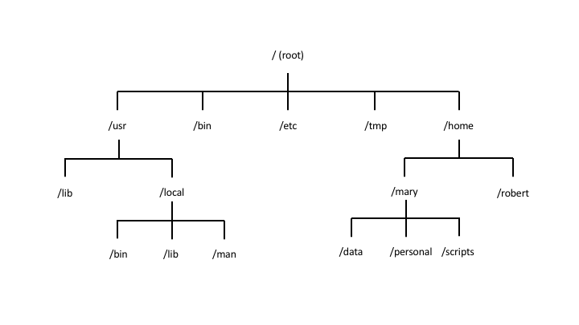
Linux File System Overview

Slide 4
Exercises -- Navigation
Use pwd to see your current location
Use ls to see the contents of your current location
Use flags –l, -a, -t, and a combination of them all (e.g.: -la, lt, -at, etc)
Use ls to list the contents of /bin
After listing it, use the pwd to check your location – did your location change from the previous check?
Bonus – did you notice anything interesting about the contents of the directory?
Use cd / to change into the root directory, then use pwd and ls
Did your location change? Where are you now?
Spend some time navigating around and playing with the commands
Challenge: using only cd <target dir>, navigate back to your home directory!

Slide 5
File/dir creation and editing
Command | Purpose | Command | Purpose
man <command> | manual!! Check this when in doubt!! | mv <old name> <new name> | renames a new file or dir
touch <file name> | creates an empty file | rm <file name> | deletes a file or empty dir
dir <name> | creates empty dir | rm –r <dir name> | recursively deletes all files in non-empty dir
mv <file> <target> | moves a file to the specified target dir | rm –rf <dir name> | same as above, but forces and overrides any warnings
cp <file> <target file> | copies a file into the specified target file | head -10 <file name> | shows first 10 lines in file
cat | see file contents | tail -10 <file name> | shows last 10 lines in file
mkdir | creates new dir | nl <file name> | shows the contents with numbered lines

Slide 6
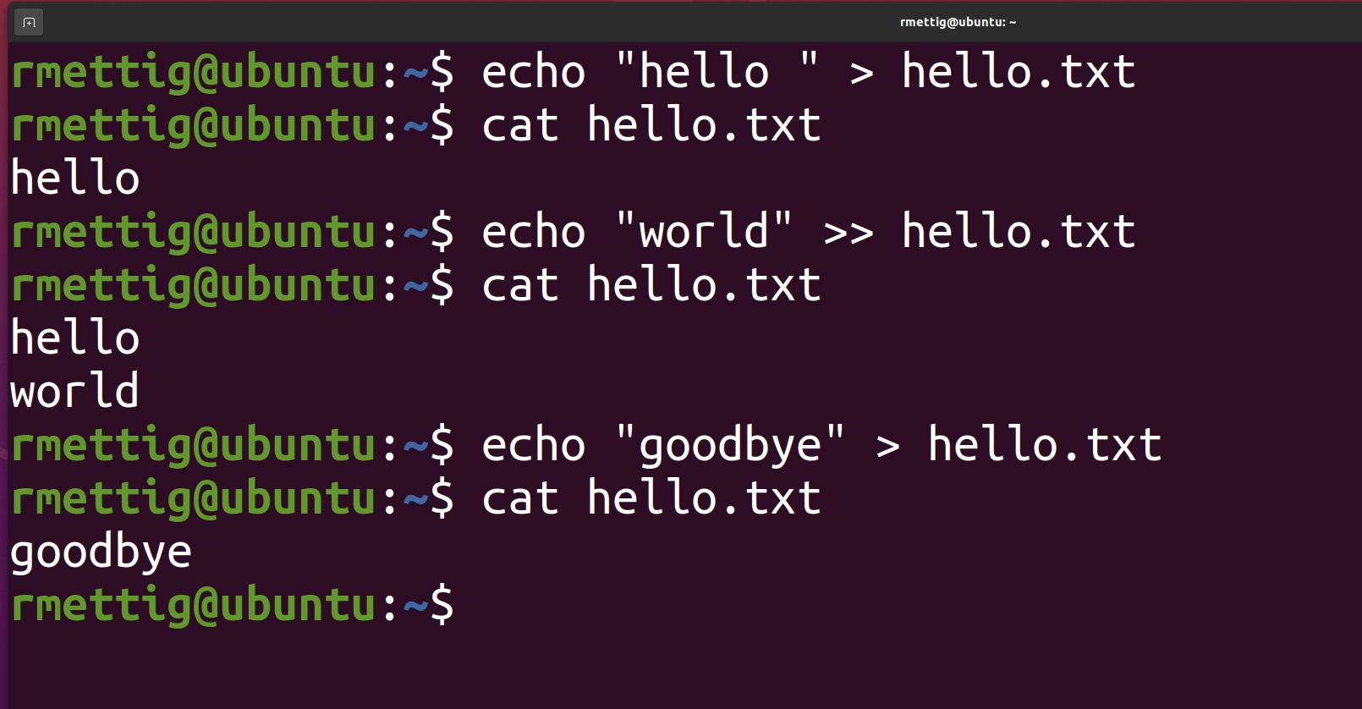
Adding content to file
Append or overwrite with echo
Text editor

Slide 7
Vim basics
Command | Purpose | Command | Purpose
vim <file> | open file in Vim | :q | quit
[I] | insert mode (edit file) | :w | write to file (save)
[ESC] | return to normal mode | :wq | write then quit
[UP, DOWN, RIGHT, LEFT] | navigate the editor | :x | write changes and close file
:q! | discard changes and quit | :w <new name> | save current file as new file
Vim cheat sheet:
https://www.cs.cmu.edu/~15131/f17/topics/vim/vim-cheatsheet.pdf

Slide 8
Exercises – File/dir creation
Change into the home dir
Create a new directory named “darkness” and change into it
Inside the new dir, create a new file “hellodarkness”
Open the new file in Vim, write “my old friend”, save and exit
From the terminal, show the contents of the file without using the editor
Change the name of the file to “herecomesthesun”
Without the editor, overwrite the contents to “sun, sun, sun”
Still without the editor, append “here it comes” to the end of the file
Show the contents of the file on the terminal
Exit the directory to the upper level
Make a copy of it and name it “sunshine”
Delete the “darkness” directory with the contents inside

Slide 9
Package management
Command | Purpose | Command | Purpose
sudo <command> | run command with admin privileges | sudo apt-get upgrade | updates the installed packages in your system
apt-get install <package> | install the package
apt-get remove <package> | uninstall the package
apt-get purge <software> | uninstall and remove configuration files
apt-get update | updates list of packages available for download

Slide 10
Exercises – Package management
Update your list of available packages
Update your installed packages
It will throw an error… why?
Successfully run apt-get upgrade
Using the install module, install the docker package

Slide 11
Other useful commands
Command | Purpose | Command | Purpose
history | shows CLI history | ssh | connect to remote server over ssh
!<history number> | runs the command in history | chmod | change file permissions
find <start> -type <f|d> -name <name> | scans the FS for a target file or directory | cowsay <text> | prints cow made of ASCII art with input text
grep <string> | will only show results containing string | clear | clear the contents in the terminal window
less <file> | display file contents in a fixed amount of lines | [UP, DOWN] | scroll through recent command history
sed | text replacement | which | checks whether a given command is installed in $PATH
wc | counts output lines

Slide 12
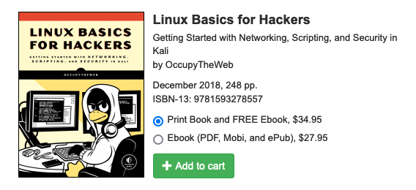
Further reading
https://nostarch.com/linuxbasicsforhackers

Slide 13
Challenge time!
https://overthewire.org/wargames/bandit/

