Slide 1

Command Line 101
Women in Computer Science at LSU
Spring 2023

Slide 2
A few considerations…
This is a workshop for all levels…
…but we start from the ground up
No prior experience required
There’s something for every level
Follow along to the practical demo
Ask questions
Have fun! ☺

Slide 3
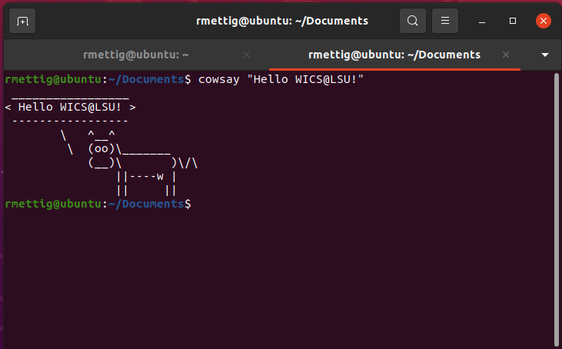
What is the command line interface (CLI)?
Text-based interface that allows you to issue commands to the computer
Every OS has one
Navigate file system
Run programs
Create/delete/edit files
Change system configuration
And MUCH more!

Slide 4
Why use it?
It’s quicker
More powerful
Scare people at coffee shops
Sometimes it’s your only option

Slide 5
Workshop
Linux-based
Kali Linux VMs
Basic commands
Navigation
File creation/editing
Directory
Package management
…more
Exercises
If you are already an advanced user:
https://overthewire.org/wargames/bandit/

Slide 6
Navigation Commands
Command | Purpose | Command | Purpose
pwd | path of working dir | cd .. | change back one level
ls | list contents of dir | cd ../.. | change back two levels
ls –l | list contents long format | cd ../../.. | change back three levels
ls –a | list all contents in dir | … | so on and so forth
ls –t | list and sort by time | cd / | change to root dir
ls <target dir> | list contents of target dir | cd | change to home dir
cd <target dir> | change directory to target dir | cd ~ | change to home dir

Slide 7
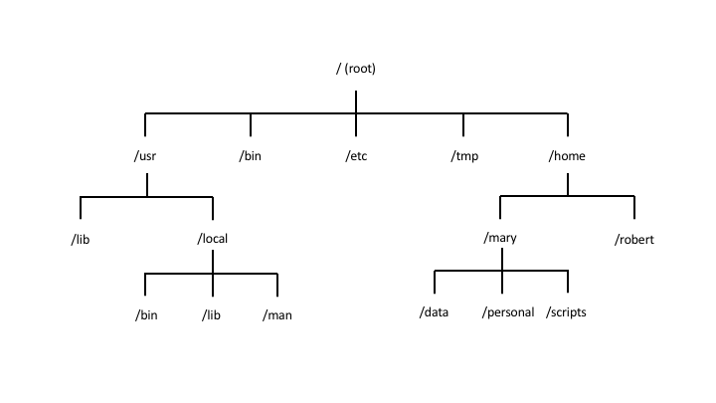
Linux File System Overview

Slide 8
Demo

Slide 9
Exercises -- Navigation
Use pwd to see your current location
Use ls to see the contents of your current location
Use flags –l, -a, -t, and a combination of them all (e.g.: -la, lt, -at, etc)
Use ls to list the contents of /bin
After listing it, use the pwd to check your location – did your location change from the previous check?
Bonus – did you notice anything interesting about the contents of the directory?
Use cd / to change into the root directory, then use pwd and ls
Did your location change? Where are you now?
Spend some time navigating around and playing with the commands
Challenge: using only cd <target dir>, navigate back to your home directory!

Slide 10
File/dir creation and editing
Command | Purpose | Command | Purpose
man <command> | manual!! Check this when in doubt!! | mv <old name> <new name> | renames a new file or dir
touch <file name> | creates an empty file | rm <file name> | deletes a file or empty dir
mkdir <name> | creates empty dir | rm –r <dir name> | recursively deletes all files in non-empty dir
mv <file> <target> | moves a file to the specified target dir | rm –rf <dir name> | same as above, but forces and overrides any warnings
cp <file> <target file> | copies a file into the specified target file | head -10 <file name> | shows first 10 lines in file
cat | see file contents | tail -10 <file name> | shows last 10 lines in file
mkdir | creates new dir | nl <file name> | shows the contents with numbered lines

Slide 11
Demo

Slide 12
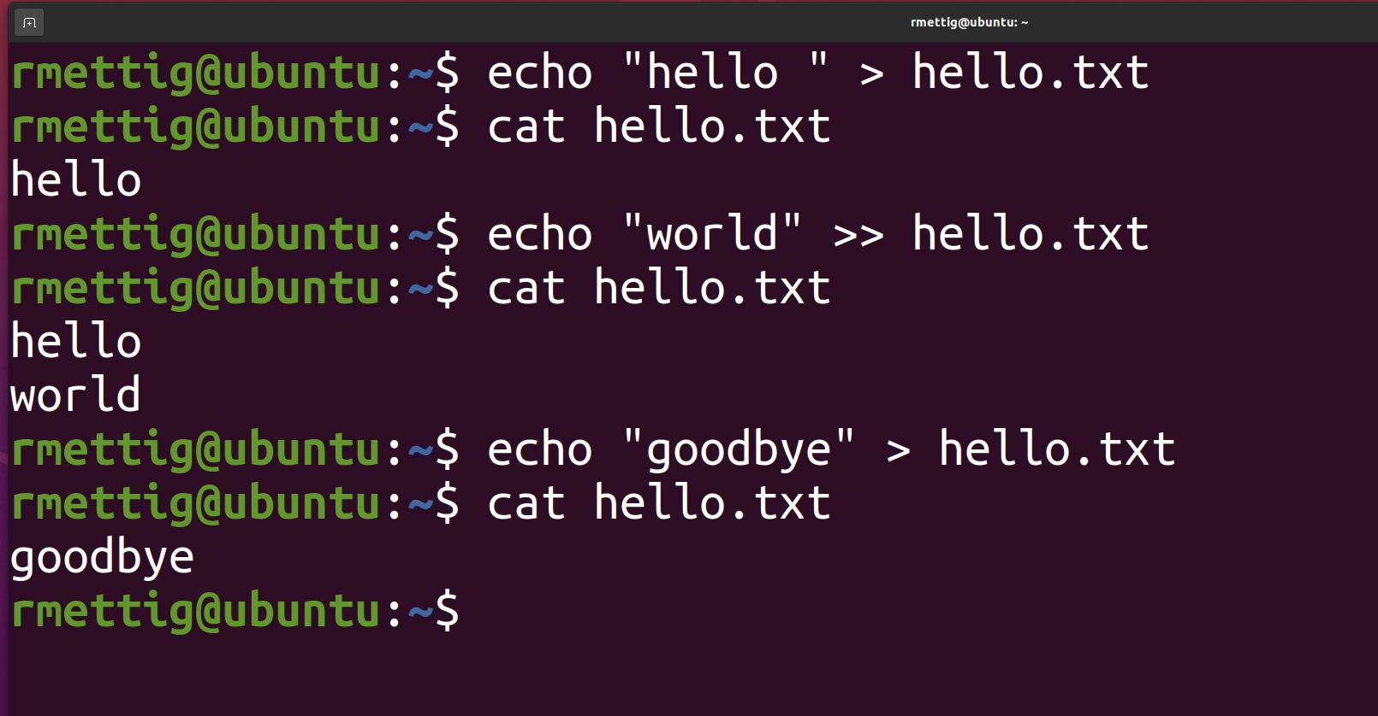
Adding content to file
Append or overwrite with echo
Text editor

Slide 13

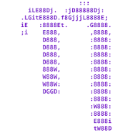

Text editor -- The Editor Wars™
Vim
Emacs
GNU Nano

Slide 14

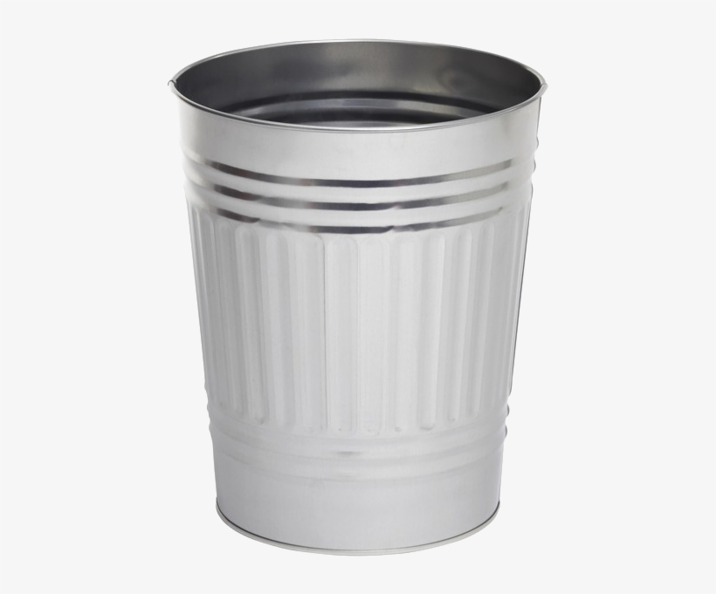
The Editor Wars™ -- MY workshop ☺

Slide 15
Vim basics
Command | Purpose | Command | Purpose
vim <file> | open file in Vim | :q | quit
[I] | insert mode (edit file) | :w | write to file (save)
[ESC] | return to normal mode | :wq | write then quit
[UP, DOWN, RIGHT, LEFT] | navigate the editor | :x | write changes and close file
:q! | discard changes and quit | :w <new name> | save current file as new file
Vim cheat sheet:
https://www.cs.cmu.edu/~15131/f17/topics/vim/vim-cheatsheet.pdf

Slide 16
Demo

Slide 17
Exercises – File/dir creation
Change into the home dir
Create a new directory named “darkness” and change into it
Inside the new dir, create a new file “hellodarkness”
Open the new file in Vim, write “my old friend”, save and exit
From the terminal, show the contents of the file without using the editor
Change the name of the file to “herecomesthesun”
Without the editor, overwrite the contents to “sun, sun, sun”
Still without the editor, append “here it comes” to the end of the file
Show the contents of the file on the terminal
Exit the directory to the upper level
Make a copy of it and name it “sunshine”
Delete the “darkness” directory with the contents inside

Slide 18
Package management
Command | Purpose | Command | Purpose
sudo <command> | run command with admin privileges | sudo apt-get upgrade | updates the installed packages in your system
apt-get install <package> | install the package
apt-get remove <package> | uninstall the package
apt-get purge <software> | uninstall and remove configuration files
apt-get update | updates list of packages available for download

Slide 19
Demo

Slide 20
Exercises – Package management
Update your list of available packages
Update your installed packages
It will throw an error… why?
Successfully run apt-get upgrade
Using the install module, install the docker package

Slide 21
Other useful commands
Command | Purpose | Command | Purpose
history | shows CLI history | ssh | connect to remote server over ssh
!<history number> | runs the command in history | chmod | change file permissions
find <start> -type <f|d> -name <name> | scans the FS for a target file or directory | cowsay <text> | prints cow made of ASCII art with input text
grep <string> | will only show results containing string | clear | clear the contents in the terminal window
less <file> | display file contents in a fixed amount of lines | [UP, DOWN] | scroll through recent command history
sed | text replacement | which | checks whether a given command is installed in $PATH
wc | counts output lines

Slide 22
Next steps:
Get comfortable with the commands we've discussed
Learn how to compile and run programs in the CLI
Java, C, Rust, Python, etc.
Learn Bash scripting basics
Learn how to customize your CLI environment
Hint: check out .bashrc
Learn how to interact with your OS
Network config, manage processes, schedule jobs...

Slide 23
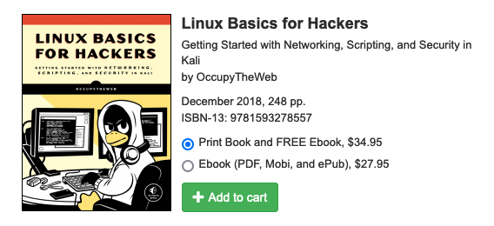
Further reading
https://nostarch.com/linuxbasicsforhackers

Slide 24

For next time:
Set up Github account
Make sure you verify your email!
Workshop: part 2 -- Intro to Git
Setup GH access tokens
Git overview and basics
Prep for part 3! ☺

Slide 25
Challenge time!
https://overthewire.org/wargames/bandit/

