Slide 1

Introduction to Git
Women in Computer Science at LSU
Spring 2023

Slide 2
A few considerations…
This is a workshop for all levels…
…but we start from the ground up
No prior experience required
There’s something for every level
Follow along to the practical demo
Ask questions
Have fun! ☺

Slide 3
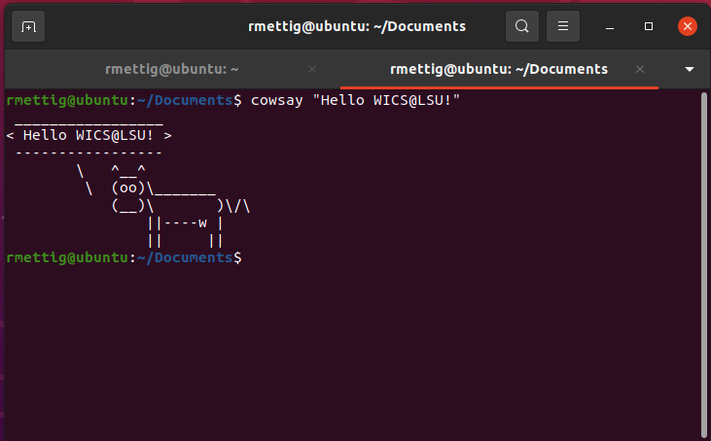
In the previous chapter…
Command Line Interface (CLI) : Text-based interface that allows you to issue commands to the computer
Navigate Linux file system
Create/delete/edit files
Manage packages

Slide 4

What is Git
Version Control System (VCS)
Multiple different versions of the same project
Used *everywhere* in the industry

Slide 5
Why Git?
Backup our work
Keep track of changes
Doesn't apply only to code!
Freedom to try different approaches and make mistakes
Contribute to open source projects (good for resume)

Slide 6
Workshop
Linux-based
Kali Linux VMs
Pre-reqs
CLI basics (navigation, file mgmt., etc.)
Github account
Basic commands
Staging
Committing
Roll backs
Pushing to remote repository
…more
Exercises

Slide 7
How to Git

Slide 8


Git vs Github
Git
VCS tool to manage your code
Works locally
Github
Cloud-based host for Git repositories

Slide 9





There are others!

Slide 10
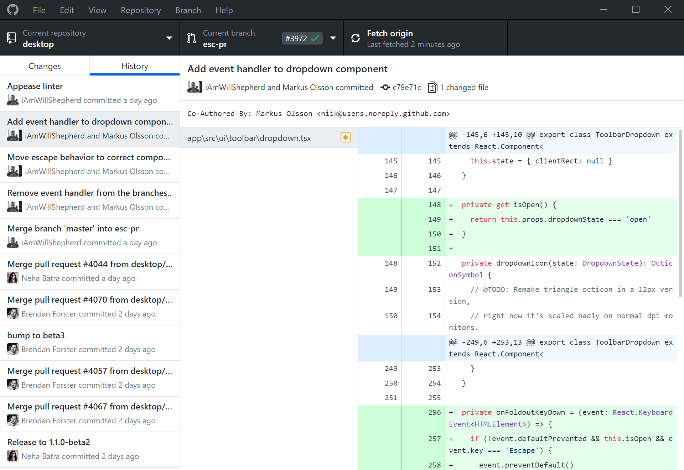
Desktop vs CLI
Github has a desktop client
It’s really easy to use!
Git concepts are the same across all platforms
Github also has their own CLI tool
gh – we will not be using it
CLI is less user-friendly
…sometimes it’s your only option

Slide 11


Useful Terminology
Remote
Local
Needs network connection
Only keeps backup of what you push
Works offline
On your machine only

Slide 12
Git Terminology
Repository
Contains project files and stores file version history
Branch
A version timeline within a repository
Commit
“Save” the changes done to the project to the working version
Clone
A local copy of a remote repository
Fork
Personal copy of another user’s repository
Changes made to your fork don’t affect the other user’s directly

Slide 13
Git Terminology (cont.)
Fetch
Get changes from a remote repository without merging them
Merge
Get changes from one branch and applies it into another
Either in the same repository or on another fork (aka Pull Request)
Pull
Fetch and merge changes in one command
Push
Send committed changes to a remote repository
Pull Request (PR)
proposed changes to a repository submitted by a user and accepted or rejected by a repository's collaborators

Slide 14
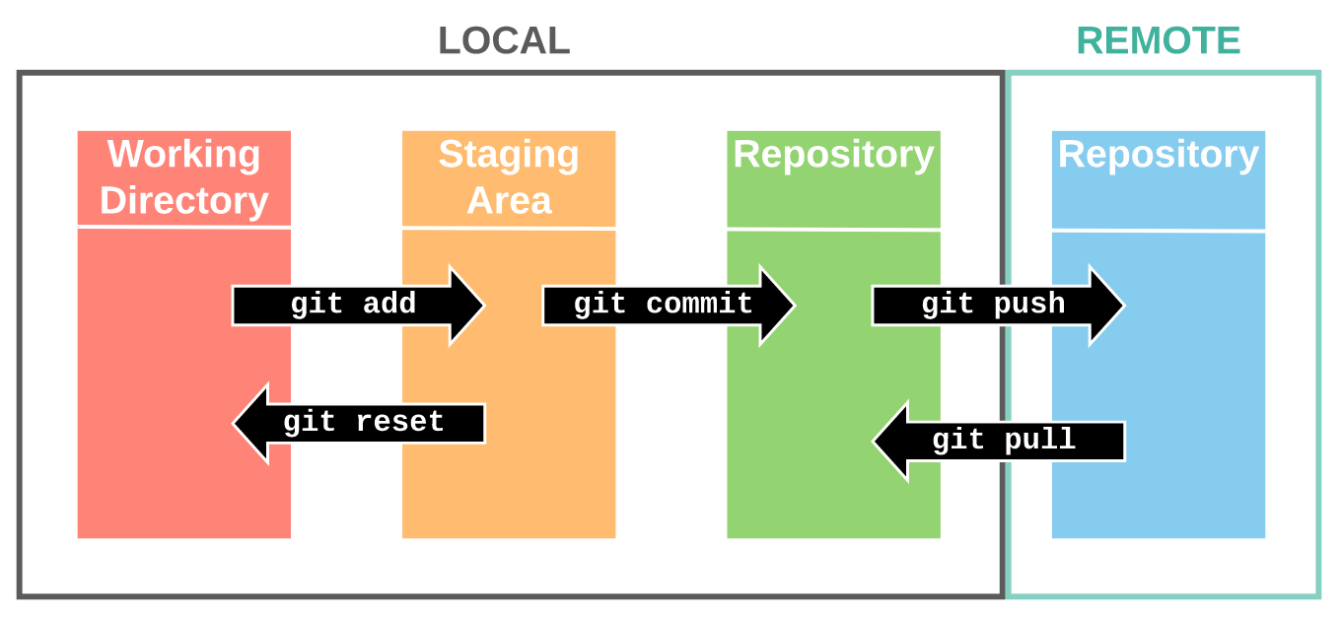
General Workflow
Clone/Fork/Create repository
Create working branch
Work and make changes
Commit changes (frequently)
Push local changes
Merge changes into main branch
Img src: https://support.nesi.org.nz/hc/en-gb/articles/360001508515-Git-Reference-Sheet

Slide 15
Git Commands
Command | Purpose | Command | Purpose
git config | check local repo config | git branch
git config user.name “username” | set local repo username (--global flag can set for all) | git config user.email “email” | set local repo email (--global flag can set for all)
git init | initialize git repo | git push –u origin <dest-branch> | push local changes to destination branch
git clone <url> | download remote repo | git pull | fetch and merge remote changes to working repo
git add <file> | add files to staging | git merge <branch> | merge changes into your current branch
git status | check staging status | git diff <branch-1> <branch-2> | show changes
git commit –m “<message>” | commit current changes to local working dir | git reset --hard origin/main | rollback working dir to that of last commit erasing changes
git remote | show remote version of repository | git reset --soft origin/main | rollback working dir to that of last commit keeping changes
git checkout <branch> | change branch | git log | list of commits on a branch

Slide 16
More commands
Command | Purpose | Command | Purpose
rm –rf .git | undo $git init | git checkout –b <new-branch> | create a new branch and switch to it
git branch –a | list all branches including remote | git help | git CLI manual!
git --version | check current version (or if it’s installed!) | git branch -M main | rename branch as main
git config --list --show-origin | see current config settings | git remote add origin <url> | link working repo to remote repo!!
git rm –cached <file> | remove file from staging | git restore <file> | reverts changes in staged file

Slide 17
Before we start – setup personal access token
Security measure
Avoid using your password
Limit access scope
Can be expired and needs to be reissued periodically
Most VCS hosts will make you use it
Necessary for APIs – DO NOT STORE THESE PUBLICLY!!!!! EVER!!!
Their docs have walkthroughs
But it can be confusing!
More info: https://docs.github.com/en/authentication/keeping-your-account-and-data-secure/creating-a-personal-access-token

Slide 18
More considerations
Access token will be up to 7 days
Please do all your work on your Desktop folder!
We will delete all the local repositories after
Please make sure you push all the changes by the end of the workshop
If you are not sure if they went through, please let me know before we leave and I will help you

Slide 19
Access Token Setup
Please follow along!

Slide 20
Exercises pt. 1 – Simple Initialization
Navigate to home Desktop folder, create new dir and initialize it as a git repo
Create remote repository “myfirstrepo”
Add remote repo as origin
Check current staging status
Create file named README.md
Add some text to it if you’d like, such as “WICS workshops and Vim Rulez!” ☺
Add that file to your staging area and check status
Commit that file with a message saying “first commit”
Check staging area again – it should be clear
Check your commit log – do you see your commit on there?
Push changes to remote repository
Check the repo on Github to see if your changes went through!
Notes:
Do this together

Slide 21
Exercises pt.2 – Personal webpage with Github Pages
Via the Github UI, create a new public repository titled <your_username>.github.io
Via the CLI, navigate to Desktop and from there clone the remote repository we just created
Navigate into it
From the CLI, create a new file titled index.html and write “Hello WICS! This is my first web page” and save it
Stage and commit the changes
Commit message should be “first commit”
Push the changes to the remote repository
Navigate to https://<your_username>.github.io
Homework: go through the docs and fiddle around with your personal webpage!
Link in “References” slide

Slide 22
Break
There are more exercises after!

Slide 23
Exercises pt. 3 – Staging area
The goal with this exercise is for you to get some practice with the staging area – run git status in between every command to see what happened!
In the directory/repo from exercise 1, create a new file “file1” and make changes to it.
Add it to the staging area.
Repeat steps 1 and 2 – create “file2”.
Remove one of the files from the staging area – don’t delete it!
Repeat steps 1 and 2 – you should have 3 files now.
Make a change to “file1”.
Revert that change.
Commit with message “committing file 1 and 3”
What are the contents of file1 now?
Make edits to file 1 and 2.
Commit them with message “edited file 1 and added file 2”

Slide 24
Exercises pt. 4 – Branching/merging
Continue in the same directory from exercises 1 and 3! On top of checking git status, make sure to check git log between commits and merges!
Create a new branch called “mybranch” and change into it
Check the contents of “file1”
While in mybranch, edit the contents of file1 to “mybranch”
Commit change “changed contents of file1” and check git log
Checkout branch “main” and check the contents of file1
Is it different from when you were in “mybranch”?
Merge mybranch into main
Create a new fiile “myfile” in branch “main” and list contents of your current directory (ls) , then stage and commit it
Checkout mybranch and create a new file “otherfile” and list the contents of your directory, then stage and commit it
Change back into branch main and merge “mybranch”, then list the contents of your directory
Push changes to your remote repository!

Slide 25
Next steps:
Get comfortable with the commands we've discussed
Do the exercises!
Search for project on Github you’re interested in
Clone/fork it!
Practice creating, breaking, and fixing your own repos!
Get familiar with Github as a platform
Sign up for Github Student!
https://education.github.com/students

Slide 26
Further reading
“Linux Basics for Hackers”
NoStarchPress link: https://nostarch.com/linuxbasicsforhackers
Github documentation
https://nostarch.com/linuxbasicsforhackers

Slide 27
References
Git documentation - https://git-scm.com/
Github documentation - https://docs.github.com/en
Git cheat sheet - https://training.github.com/downloads/github-git-cheat-sheet.pdf
Github Pages - https://pages.github.com/
Github Pages documentation- https://docs.github.com/en/pages
Github Student - https://education.github.com/students

Slide 28

For next time:
Be comfortable committing and push/pulling changes
Workshop: part 3 – Working on shared projects
Working on a shared repo
Set up our own personal webpage

Slide 29
PS: How to find a personal project
What kind of project are you looking to do?
Web dev, tools development, build an app, game hacking…?
What field are you leaning towards?
Applied sciences, software performance, full-stack, DevOps, cyber, …?
It doesn’t matter what you pick – all will require SWE fundamentals
Why do you want to work on the project?
Yes, we know you want to build your resume
Learn new tool (e.g.: Docker, Metasploit,..), learn new prog lang(e.g.: python, javascript, c++, …), learn a new skill (e.g.: design, SW orchestration, pipeline development, using APIs, …)
Think about your day-to-day
What can be automated?
What is *ONE* skill you really want to learn?
Take some time exploring your options << really important!

Slide 30
Appendix
CLI baiscs reference

Slide 31
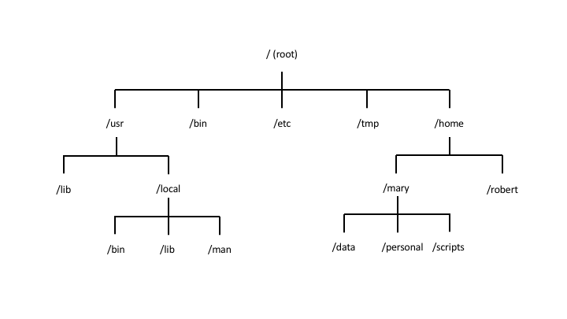
Linux File System Overview

Slide 32
Navigation Commands
Command | Purpose | Command | Purpose
pwd | path of working dir | cd .. | change back one level
ls | list contents of dir | cd ../.. | change back two levels
ls –l | list contents long format | cd ../../.. | change back three levels
ls –a | list all contents in dir | … | so on and so forth
ls –t | list and sort by time | cd / | change to root dir
ls <target dir> | list contents of target dir | cd | change to home dir
cd <target dir> | change directory to target dir | cd ~ | change to home dir

Slide 33
File/dir creation and editing
Command | Purpose | Command | Purpose
man <command> | manual!! Check this when in doubt!! | mv <old name> <new name> | renames a new file or dir
touch <file name> | creates an empty file | rm <file name> | deletes a file or empty dir
mkdir <name> | creates empty dir | rm –r <dir name> | recursively deletes all files in non-empty dir
mv <file> <target> | moves a file to the specified target dir | rm –rf <dir name> | same as above, but forces and overrides any warnings
cp <file> <target file> | copies a file into the specified target file | head -10 <file name> | shows first 10 lines in file
cat | see file contents | tail -10 <file name> | shows last 10 lines in file
mkdir | creates new dir | nl <file name> | shows the contents with numbered lines

Slide 34
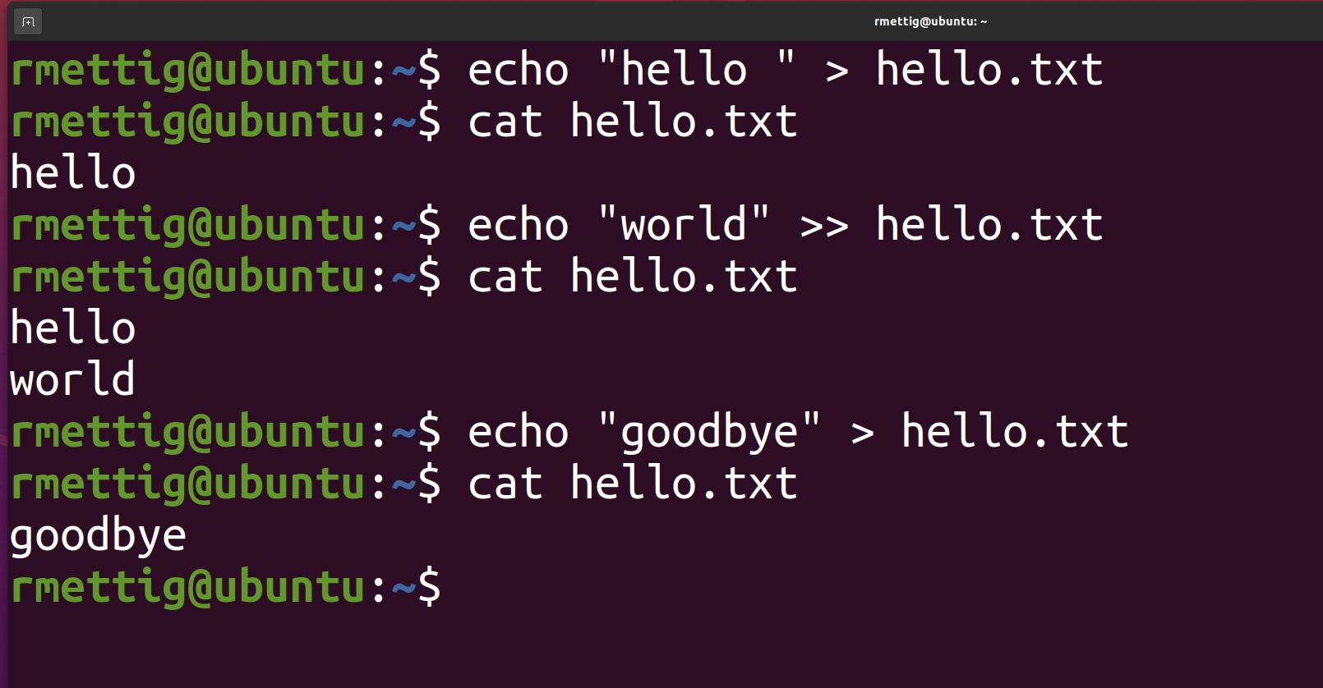
Adding content to file
Append or overwrite with echo
Text editor

Slide 35
Vim basics
Command | Purpose | Command | Purpose
vim <file> | open file in Vim | :q | quit
[I] | insert mode (edit file) | :w | write to file (save)
[ESC] | return to normal mode | :wq | write then quit
[UP, DOWN, RIGHT, LEFT] | navigate the editor | :x | write changes and close file
:q! | discard changes and quit | :w <new name> | save current file as new file
Vim cheat sheet:
https://www.cs.cmu.edu/~15131/f17/topics/vim/vim-cheatsheet.pdf

Slide 36
Package management
Command | Purpose | Command | Purpose
sudo <command> | run command with admin privileges | sudo apt-get upgrade | updates the installed packages in your system
apt-get install <package> | install the package
apt-get remove <package> | uninstall the package
apt-get purge <software> | uninstall and remove configuration files
apt-get update | updates list of packages available for download

Slide 37
Other useful commands
Command | Purpose | Command | Purpose
history | shows CLI history | ssh | connect to remote server over ssh
!<history number> | runs the command in history | chmod | change file permissions
find <start> -type <f|d> -name <name> | scans the FS for a target file or directory | cowsay <text> | prints cow made of ASCII art with input text
grep <string> | will only show results containing string | clear | clear the contents in the terminal window
less <file> | display file contents in a fixed amount of lines | [UP, DOWN] | scroll through recent command history
sed | text replacement | which | checks whether a given command is installed in $PATH
wc | counts output lines

