Slide 1

Introduction to Collaborative Projects
Women in Computer Science at LSU
Spring 2023

Slide 2
A few considerations…
This is a workshop for all levels…
…but we start from the ground up
Required knowledge: CLI basics, Git basics
Follow along to the practical demo
Ask questions
Have fun! ☺

Slide 3
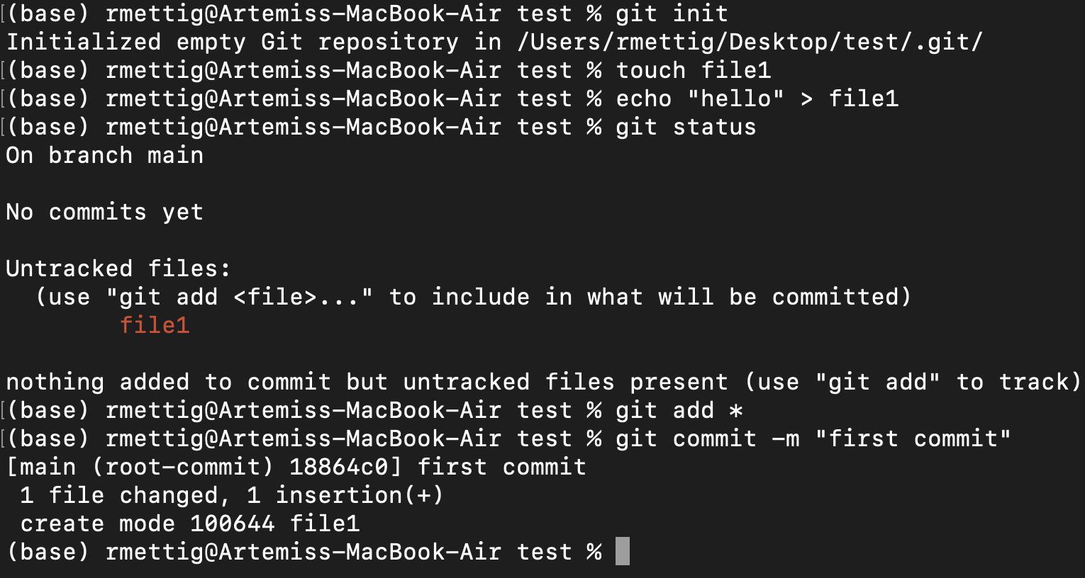
In the previous chapters…
Part 1: CLI
Navigate the file system
Create/delete/edit files
Part 2: Git
Initialize/clone a repository
Stage, commit, and push changes
Creating, changing, merging branches

Slide 4
Workshop
Linux-based
Kali Linux VMs
Pre-reqs
CLI basics (navigation, file mgmt., etc.)
Git basics
Project collaboration
Shared repo vs forked repo
Pull requests
Merge conflicts
Issues
Exercises

Slide 5
Different ways to collaborate
Shared repository model
Fork and pull model

Slide 6
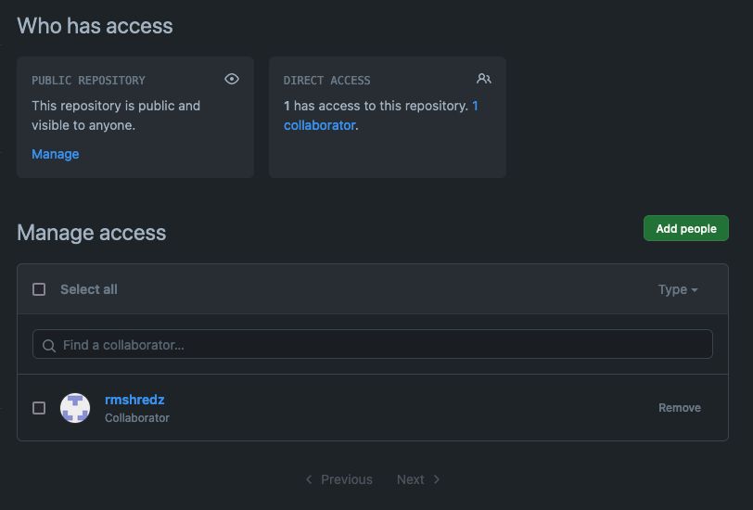
Shared repository
One repository you own
You can control all the settings
You have the ability to send invites to collaborate
The invitee will get an email and has to accept it before accessing
Add and remove people, transfer ownership

Slide 7
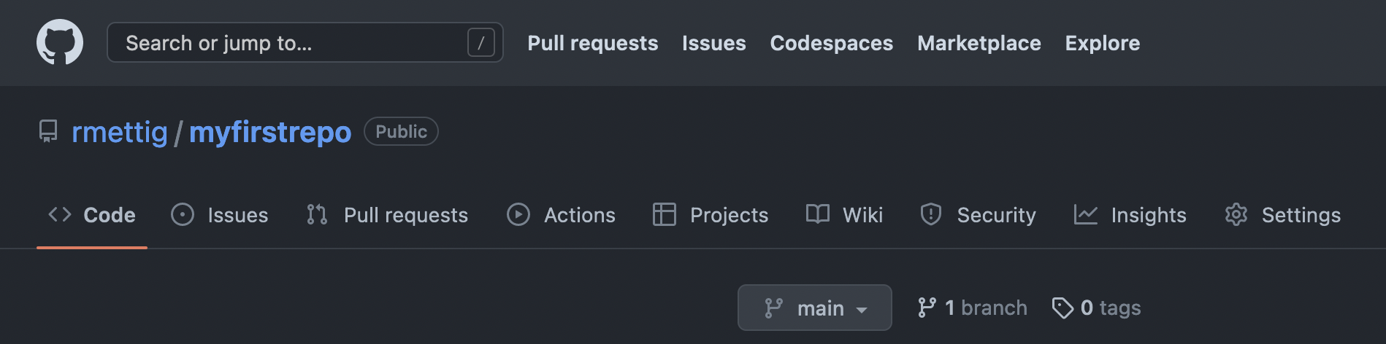
Adding collaborators to a shared repository

Slide 8
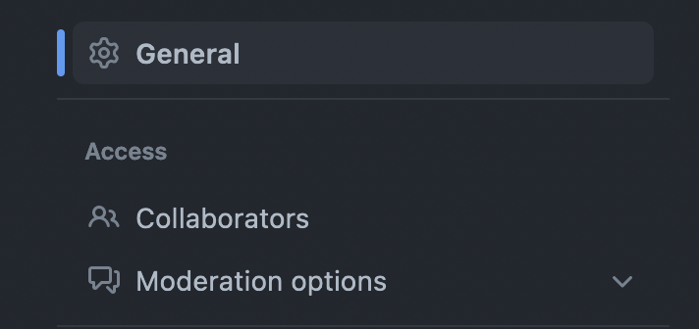
Adding collaborators to a shared repository

Slide 9
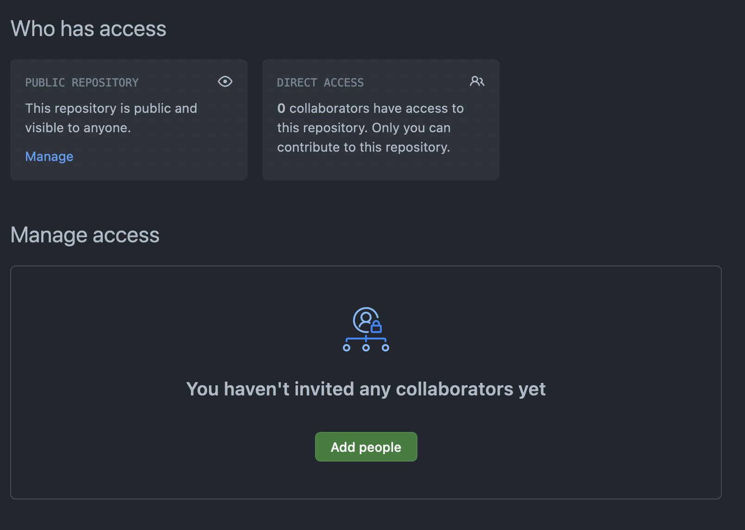
Adding collaborators to a shared repository

Slide 10
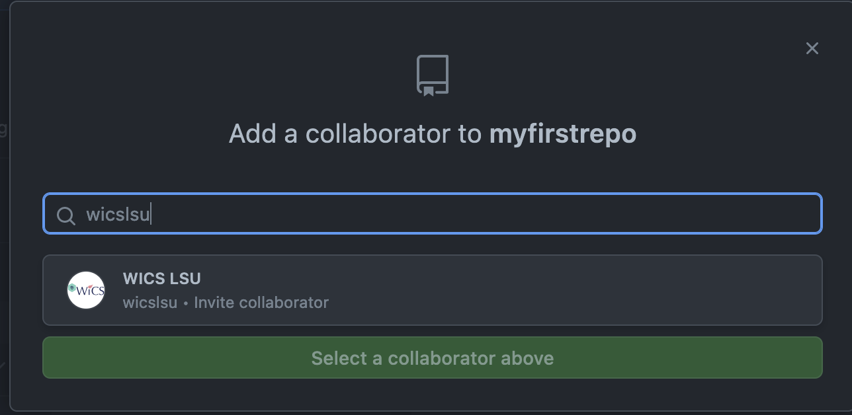
Adding collaborators to a shared repository

Slide 11
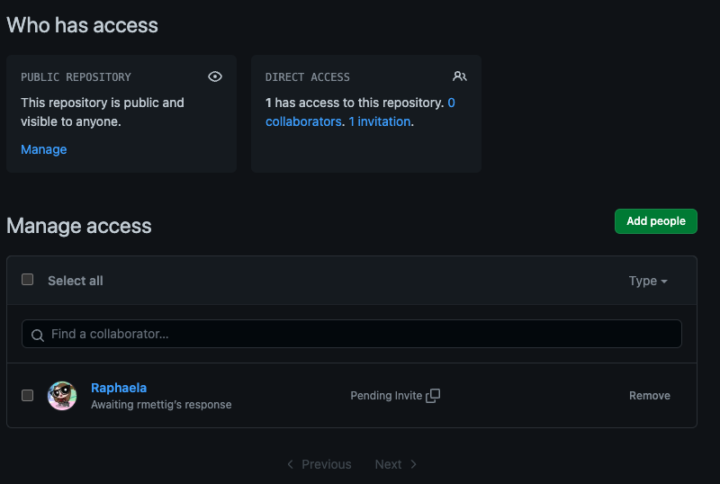

Slide 12
Exercise 1 – simple PR (pair up!)
Create a new repository with your partner, and invite them as a collaborator
One of you will create a README with contents and commit it to main
Each of you will create a personal working branch and individually create new files and commit to your personal branches (play around with it!)
You will see that it will prompt you to create a pull request
Look over the pull requests with your partner, merge them through
Delete branches after merge

Slide 13
Merge conflicts
Starting from the same commit
Two people making changes that conflict with each other when merging
Edit the same line in the same file
Delete a file in a commit where the other person still has it

Slide 14
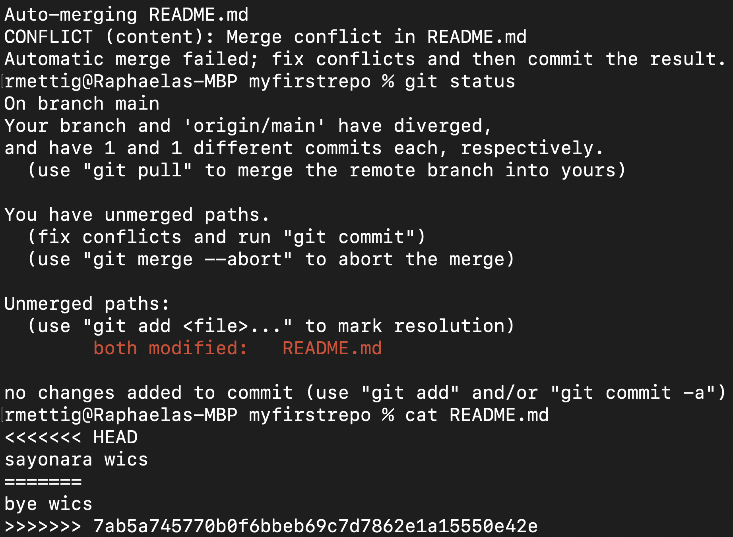

Slide 15

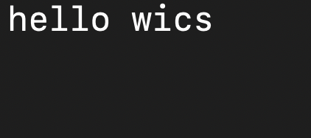
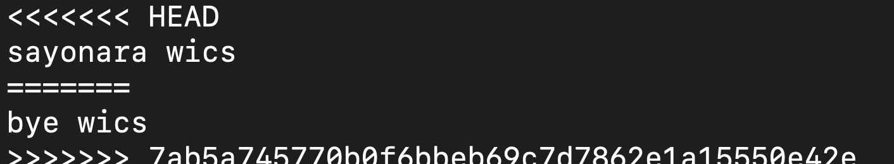
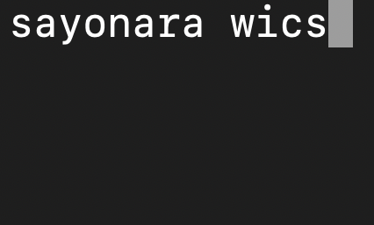
Resolving merge conflicts
Fork A
Merge A
start
Fork B
Merge B

Slide 16
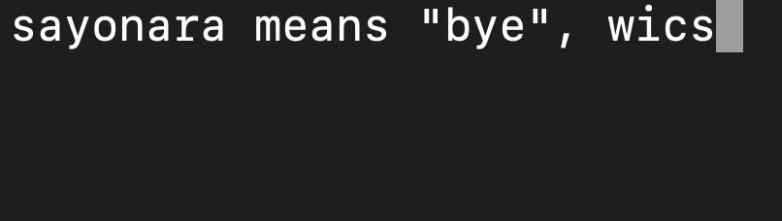
Resolving merge conflicts
We need to figure out what text between the arrows we want to keep!
Stage, commit, push

Slide 17
Exercise 2 – merge conflict (pair up!)
Still in the same repository as ex 1, each person will create another working branch each
In each branch, each of you will make a change to the same line in the README both of you should have from the initial branch
Try to merge – it should result in a conflict
Fix the conflict and push the change

Slide 18
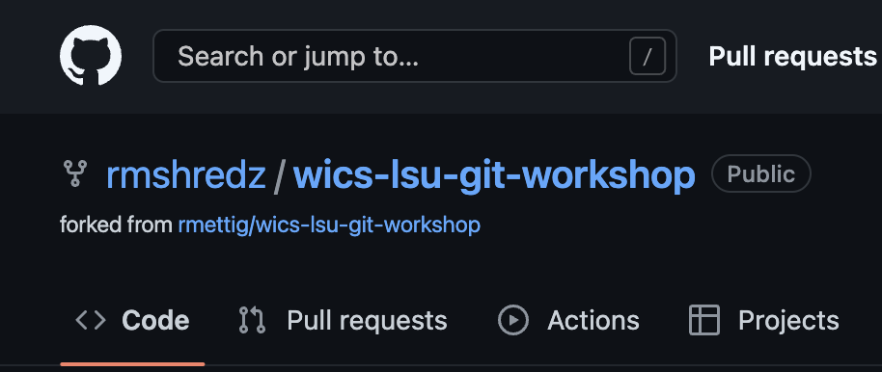

Fork and pull
Find a project you want to work on
The repository is owned by someone else
You make a personal copy of it to do your work
Once done, you ask the original project maintainer to review your changes

Slide 19
Exercise 3 – individual group work ☺
Create a personal fork of: https://github.com/rmettig/wics-lsu-git-workshop
Create 3 files with lyrics to 3 songs that you like (one per commit)
Add your name to the readme and the songs you included
We will review merge conflicts together
One you’re done, create the pull request to the original project
We will review them together and I will approve them!

Slide 20
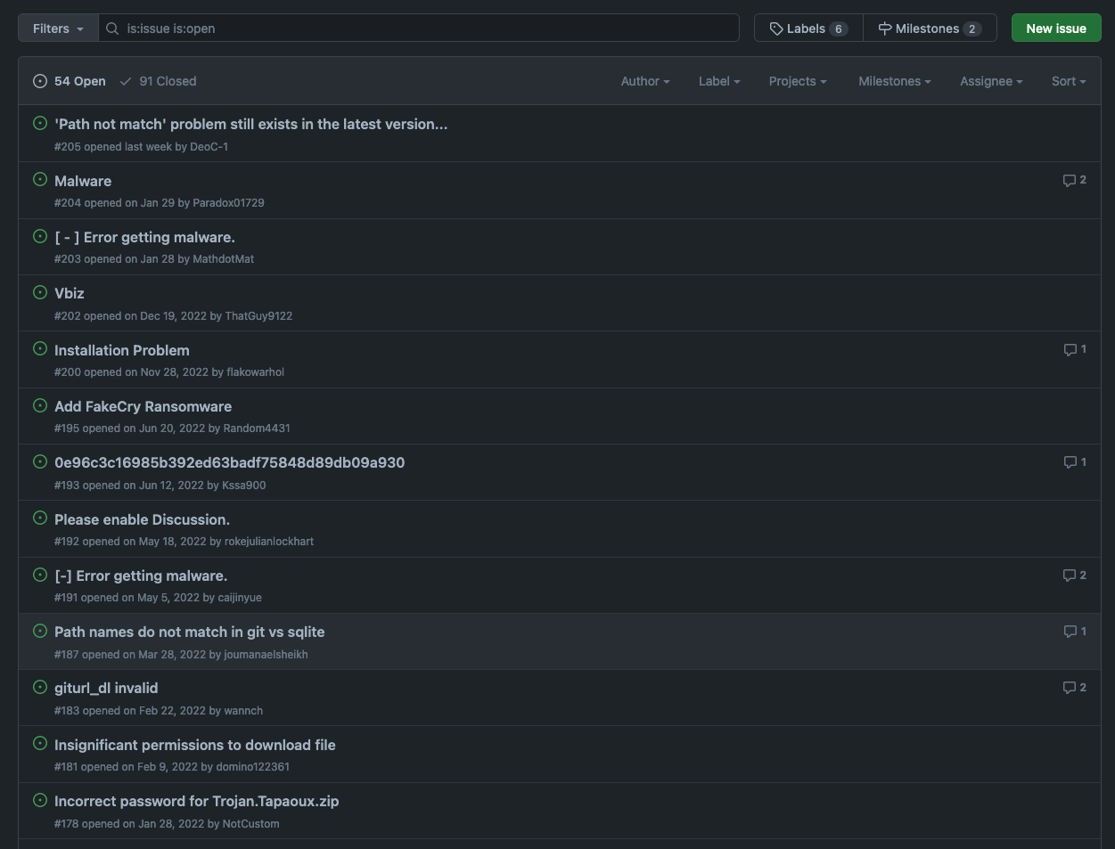
Github Issues
Discussion forum within each project
Always good to scan it before starting to work on an existing project
Some etiquette expected
Follow StackOverflow question guidelines when in doubt (link in references slide)

Slide 21
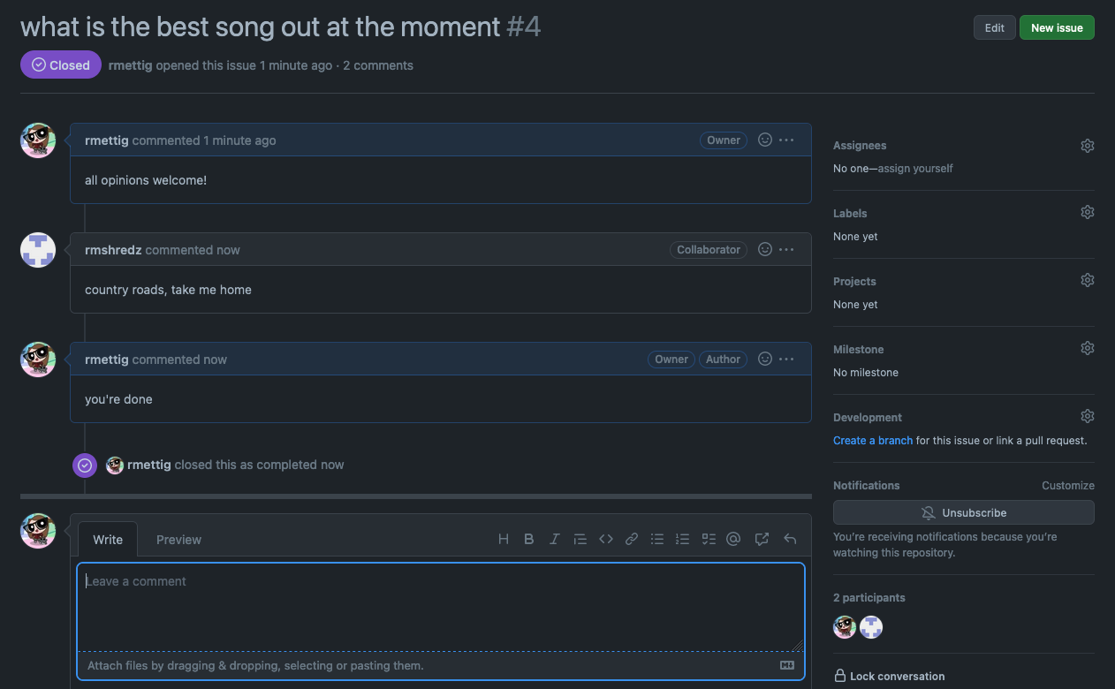

Slide 22

What's next?
We're done!
Use it as much as you can
Practice, practice, practice!
Find cool projects to work on
Part 2 slides have some tips on how to do that
Explore what else Github has to offer!
Student discouts, automation, configuration, test/build pipelines... so much more!

Slide 23
Further reading
“Linux Basics for Hackers”
NoStarchPress link: https://nostarch.com/linuxbasicsforhackers
Github documentation (refs in next slide)
https://nostarch.com/linuxbasicsforhackers

Slide 24
References
Git documentation - https://git-scm.com/
Github documentation - https://docs.github.com/en
Github access tokens - https://docs.github.com/en/authentication/keeping-your-account-and-data-secure/creating-a-personal-access-token
Github PR doc - https://docs.github.com/en/pull-requests
Github forks - https://docs.github.com/en/pull-requests/collaborating-with-pull-requests/working-with-forks/about-forks
StackOverflow question guidelines - https://stackoverflow.com/help/how-to-ask

Slide 25
Appendix A
CLI basics reference

Slide 26
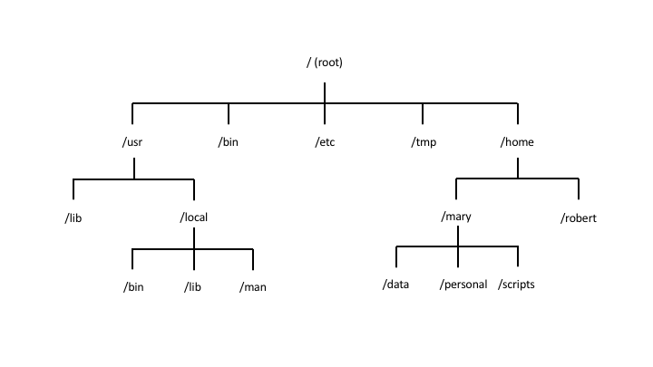
Linux File System Overview

Slide 27
Navigation Commands
Command | Purpose | Command | Purpose
pwd | path of working dir | cd .. | change back one level
ls | list contents of dir | cd ../.. | change back two levels
ls –l | list contents long format | cd ../../.. | change back three levels
ls –a | list all contents in dir | … | so on and so forth
ls –t | list and sort by time | cd / | change to root dir
ls <target dir> | list contents of target dir | cd | change to home dir
cd <target dir> | change directory to target dir | cd ~ | change to home dir

Slide 28
File/dir creation and editing
Command | Purpose | Command | Purpose
man <command> | manual!! Check this when in doubt!! | mv <old name> <new name> | renames a new file or dir
touch <file name> | creates an empty file | rm <file name> | deletes a file or empty dir
mkdir <name> | creates empty dir | rm –r <dir name> | recursively deletes all files in non-empty dir
mv <file> <target> | moves a file to the specified target dir | rm –rf <dir name> | same as above, but forces and overrides any warnings
cp <file> <target file> | copies a file into the specified target file | head -10 <file name> | shows first 10 lines in file
cat | see file contents | tail -10 <file name> | shows last 10 lines in file
mkdir | creates new dir | nl <file name> | shows the contents with numbered lines

Slide 29
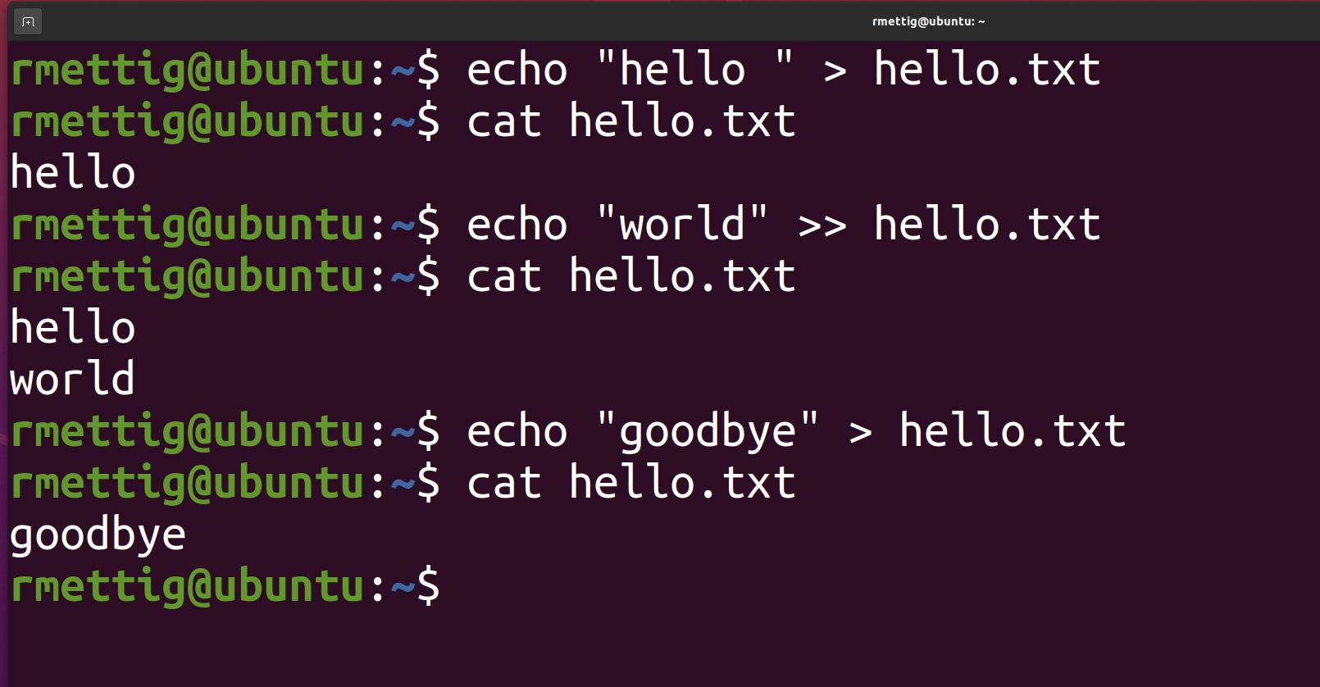
Adding content to file
Append or overwrite with echo
Text editor

Slide 30
Vim basics
Command | Purpose | Command | Purpose
vim <file> | open file in Vim | :q | quit
[I] | insert mode (edit file) | :w | write to file (save)
[ESC] | return to normal mode | :wq | write then quit
[UP, DOWN, RIGHT, LEFT] | navigate the editor | :x | write changes and close file
:q! | discard changes and quit | :w <new name> | save current file as new file
Vim cheat sheet:
https://www.cs.cmu.edu/~15131/f17/topics/vim/vim-cheatsheet.pdf

Slide 31
Package management
Command | Purpose | Command | Purpose
sudo <command> | run command with admin privileges | sudo apt-get upgrade | updates the installed packages in your system
apt-get install <package> | install the package
apt-get remove <package> | uninstall the package
apt-get purge <software> | uninstall and remove configuration files
apt-get update | updates list of packages available for download

Slide 32
Other useful commands
Command | Purpose | Command | Purpose
history | shows CLI history | ssh | connect to remote server over ssh
!<history number> | runs the command in history | chmod | change file permissions
find <start> -type <f|d> -name <name> | scans the FS for a target file or directory | cowsay <text> | prints cow made of ASCII art with input text
grep <string> | will only show results containing string | clear | clear the contents in the terminal window
less <file> | display file contents in a fixed amount of lines | [UP, DOWN] | scroll through recent command history
sed | text replacement | which | checks whether a given command is installed in $PATH
wc | counts output lines

Slide 33
Appendix B
Git basics reference

Slide 34


Useful Terminology
Remote
Local
Needs network connection
Only keeps backup of what you push
Works offline
On your machine only

Slide 35
Git Terminology
Repository
Contains project files and stores file version history
Branch
A version timeline within a repository
Commit
“Save” the changes done to the project to the working version
Clone
A local copy of a remote repository
Fork
Personal copy of another user’s repository
Changes made to your fork don’t affect the other user’s directly

Slide 36
Git Terminology (cont.)
Fetch
Get changes from a remote repository without merging them
Merge
Get changes from one branch and applies it into another
Either in the same repository or on another fork (aka Pull Request)
Pull
Fetch and merge changes in one command
Push
Send committed changes to a remote repository
Pull Request (PR)
proposed changes to a repository submitted by a user and accepted or rejected by a repository's collaborators

Slide 37
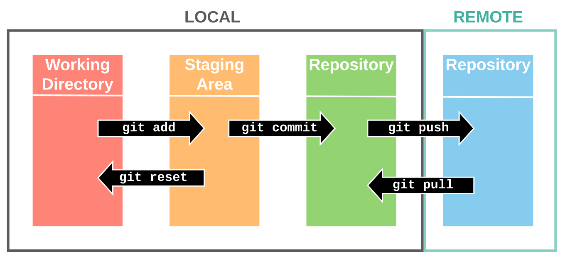
General Workflow
Clone/Fork/Create repository
Create working branch
Work and make changes
Commit changes (frequently)
Push local changes
Merge changes into main branch
Img src: https://support.nesi.org.nz/hc/en-gb/articles/360001508515-Git-Reference-Sheet

Slide 38
Git Commands
Command | Purpose | Command | Purpose
git config | check local repo config | git branch
git config user.name “username” | set local repo username (--global flag can set for all) | git config user.email “email” | set local repo email (--global flag can set for all)
git init | initialize git repo | git push –u origin <dest-branch> | push local changes to destination branch
git clone <url> | download remote repo | git pull | fetch and merge remote changes to working repo
git add <file> | add files to staging | git merge <branch> | merge changes into your current branch
git status | check staging status | git diff <branch-1> <branch-2> | show changes
git commit –m “<message>” | commit current changes to local working dir | git reset --hard origin/main | rollback working dir to that of last commit erasing changes
git remote | show remote version of repository | git reset --soft origin/main | rollback working dir to that of last commit keeping changes
git checkout <branch> | change branch | git log | list of commits on a branch

Slide 39
More commands
Command | Purpose | Command | Purpose
rm –rf .git | undo $git init | git checkout –b <new-branch> | create a new branch and switch to it
git branch –a | list all branches including remote | git help | git CLI manual!
git --version | check current version (or if it’s installed!) | git branch -M main | rename branch as main
git config --list --show-origin | see current config settings | git remote add origin <url> | link working repo to remote repo!!
git rm –cached <file> | remove file from staging | git restore <file> | reverts changes in staged file

