Slide 1


Slide 2

Full Stack Job Portal with Strapi and Next.js using REST API and Postgres

Slide 3
Group Members Introduction
Group Members
VU ID | Name
BC200414326 | Raja Muhammad Haider Ali

Slide 4

INTRODUCTION OF PROJECT
Full Stack Jobs Portal is a web-based project designed for job seekers looking for employment and companies that are hiring. In this project, I leveraged the strengths of Next.js, Strapi, and Postgres. By following industry best practices, I aim to create an application that is both robust and efficient.

Slide 5
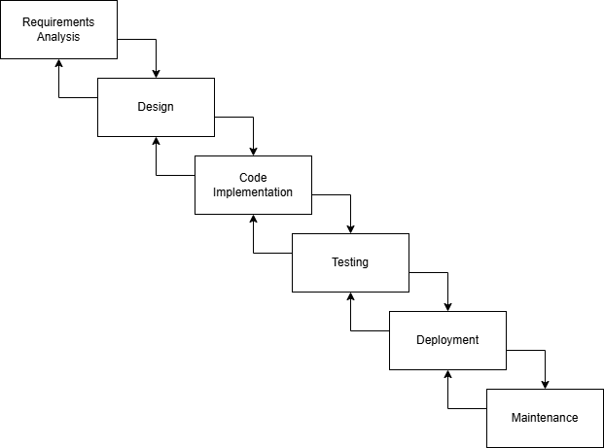
VU Process Model Diagram

Slide 6
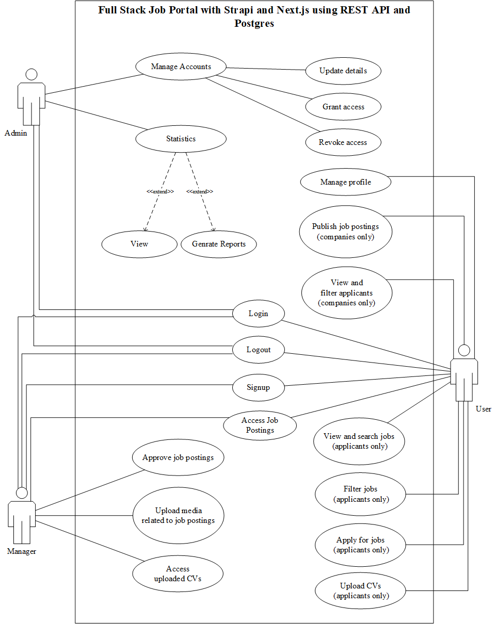
Use Case Diagram

Slide 7
Business Rules Catalog
Account Management:
Users (Admins, Managers, Companies, Applicants) can register, log in, and log out.
Profile management is available for all user types to update their information.
Job Posting:
Companies can create, publish, and manage job postings with all required details.
Job postings must include an expiry date to stop applications after the deadline.
Managers must approve job postings before they are visible to Applicants.

Slide 8
Business Rules Catalog
Search & Filter Jobs:
Applicants can search, filter, and apply for jobs with an option to upload CVs.
Companies can view and evaluate applications based on their criteria.
Content Moderation:
Managers are responsible for moderating job postings and ensuring compliance with the platform's guidelines.
Media uploads by Companies must also be moderated for relevance and quality.

Slide 9
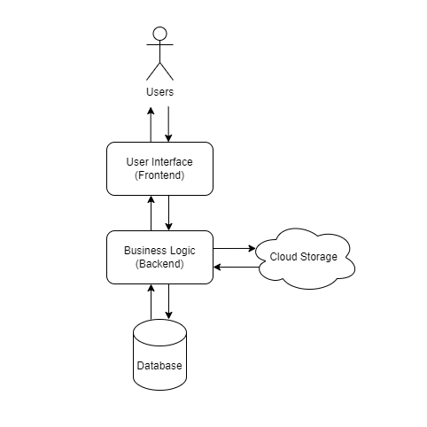
Architectural Design

Slide 10
Team Structure
Name | Role
Raja Muhammad Haider Ali | Designer/Developer
Amjad Iqbal Khan | Project Supervisor

Slide 11
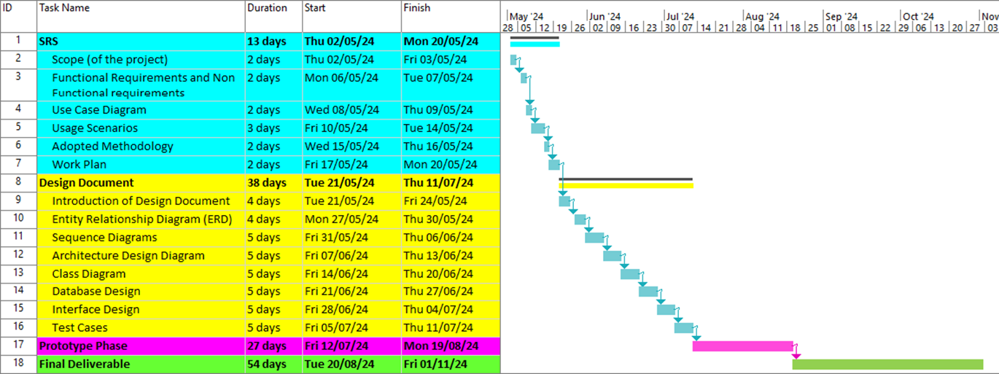
Project Schedule

Slide 12
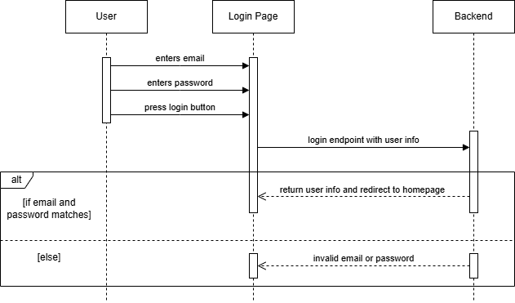
Sequence Diagrams
Login Sequence Diagram

Slide 13
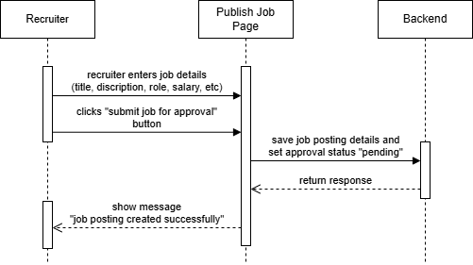
Job Posting Sequence Diagram

Slide 14
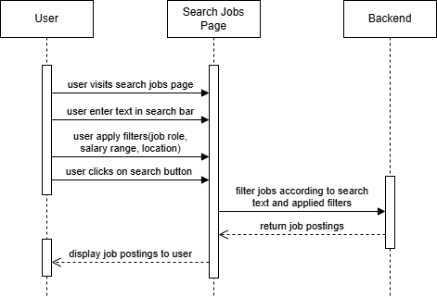
Search and Filter Jobs Sequence Diagram

Slide 15
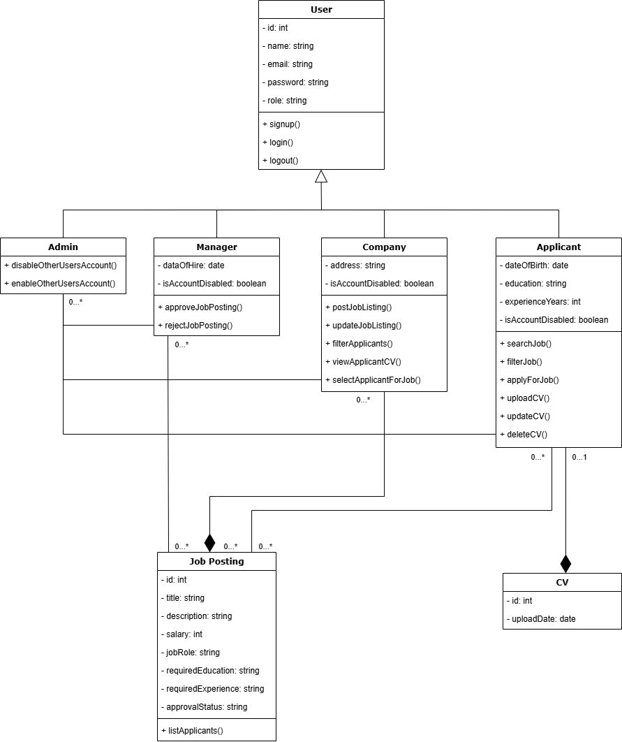
Logical Model/Class Diagram

Slide 16
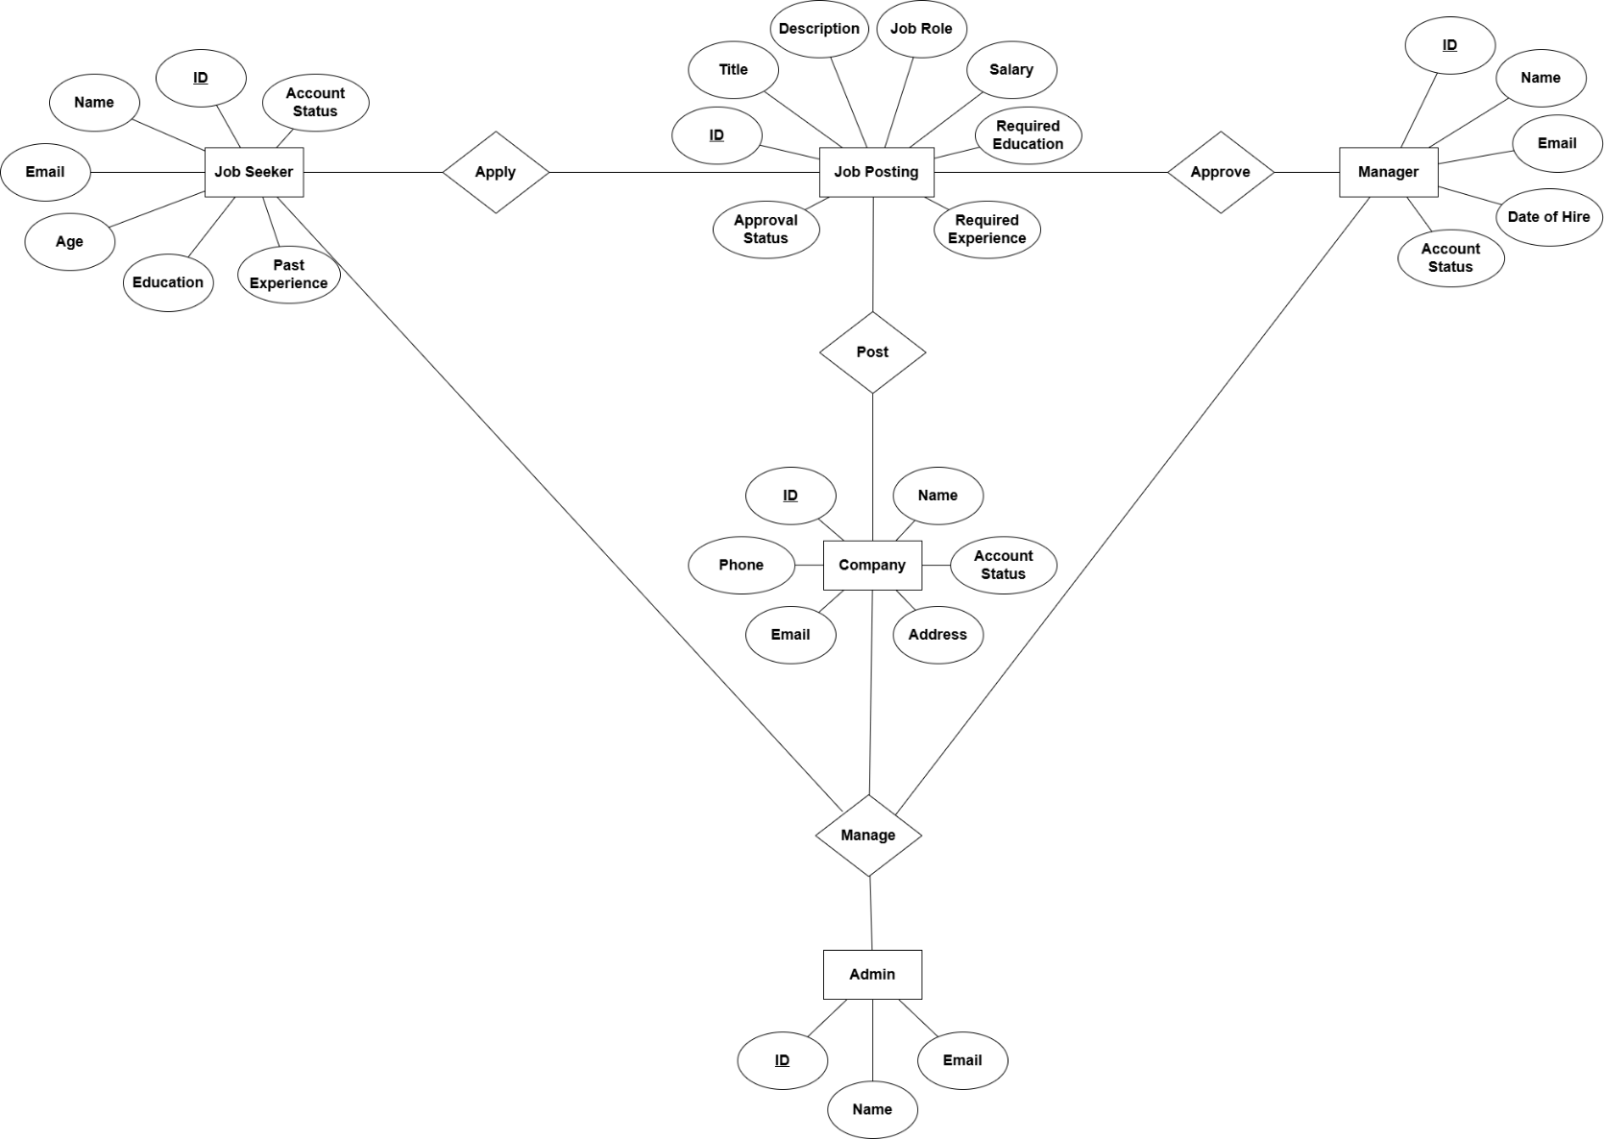
Entity-Relationship Diagram

Slide 17
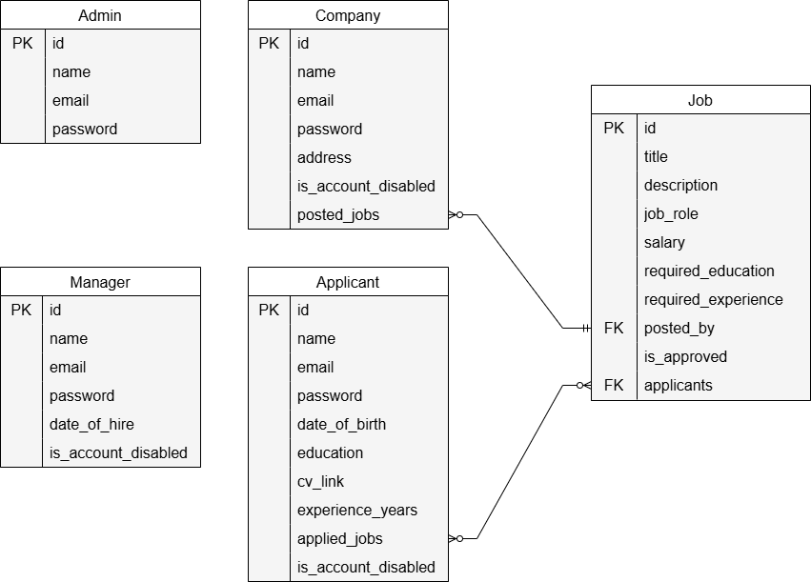
Database Diagram

Slide 18
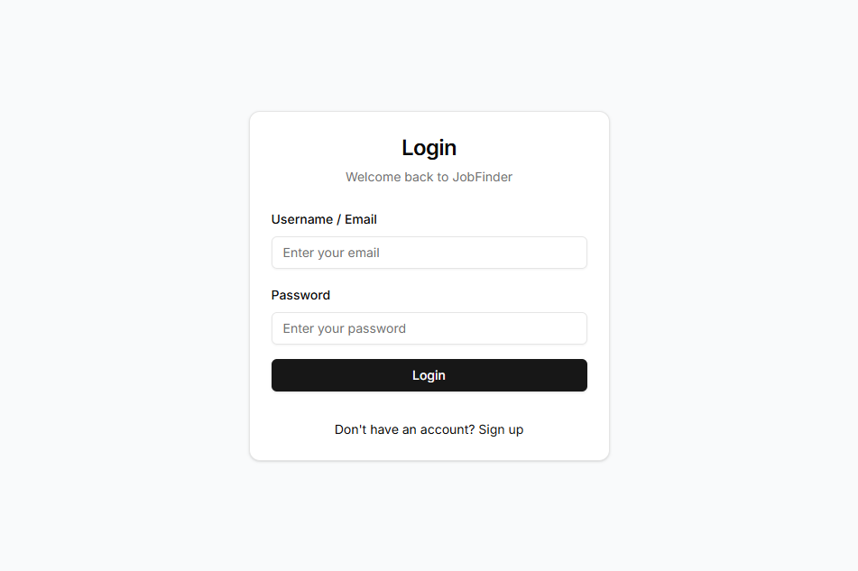
User Interfaces

Slide 19
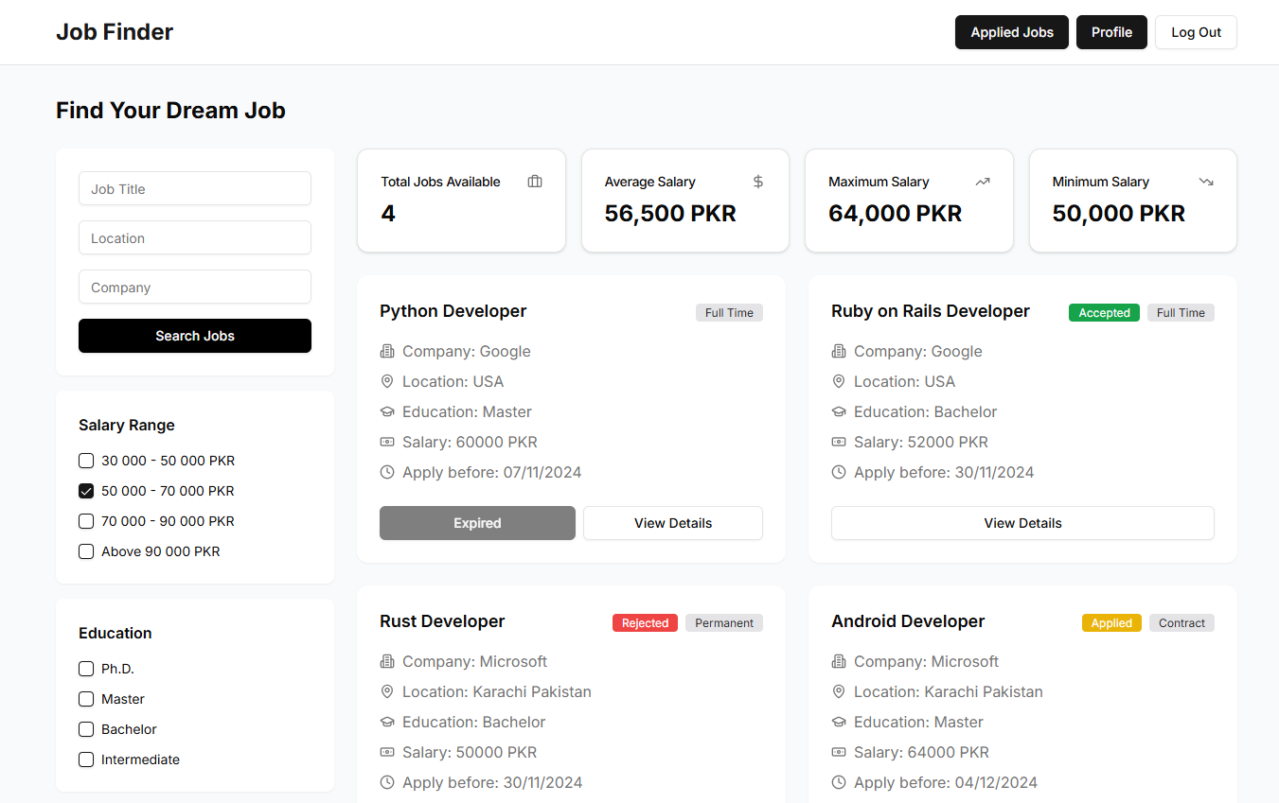
User Interfaces

Slide 20
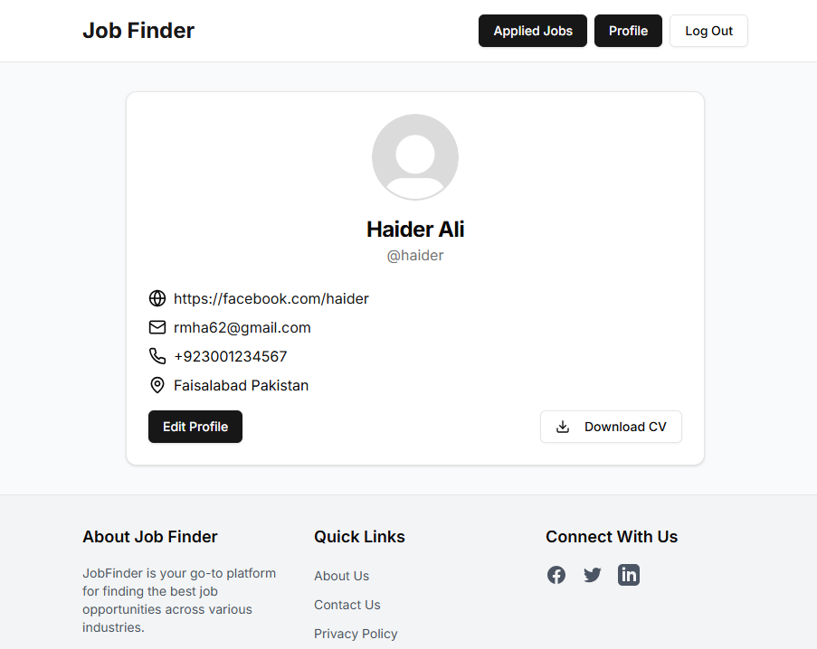
User Interfaces

Slide 21
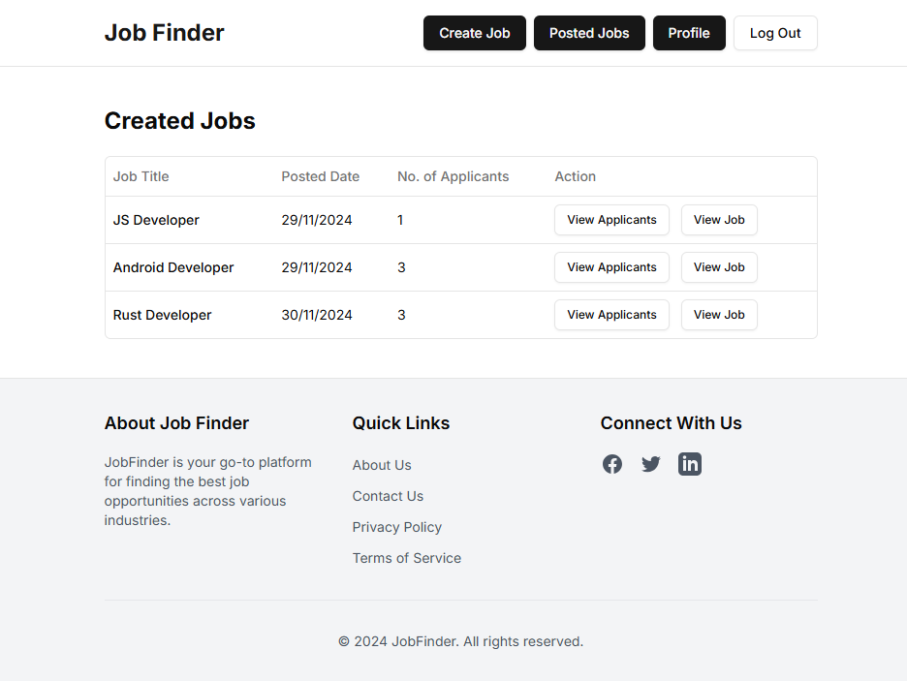
User Interfaces

Slide 22
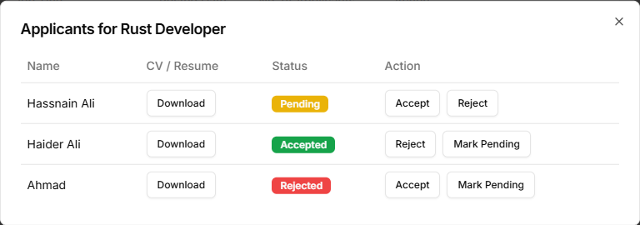
User Interfaces

Slide 23
Tools
Next.js
Strapi
Rest API Framework
Postgres Database
Visual Studio Code

