Slide 1
Python for Data Science II: Plotting with matplotlib and seaborn
Ramkumar Hariharan, PhD
Scientist,
Institute for Systems Biology,
Seattle

Slide 2
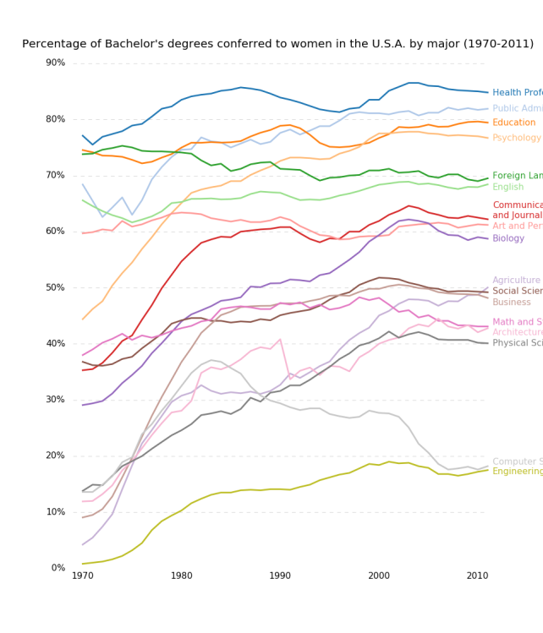
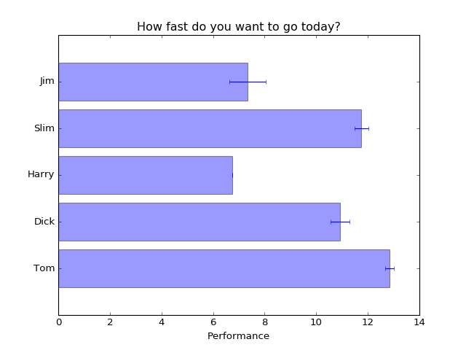
What is matplotlib ?
matplotlib is a python 2D plotting library which produces publication quality figures
generate plots, histograms, power spectra, bar charts, errorcharts, scatterplots, etc, with just a few lines of code
A simple interface and a OO interface

Slide 3
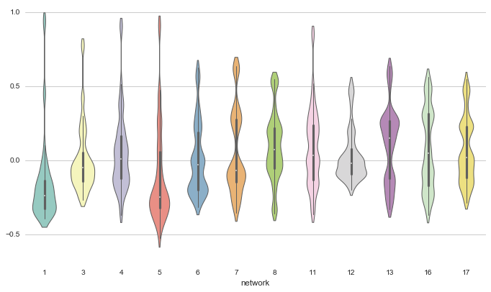
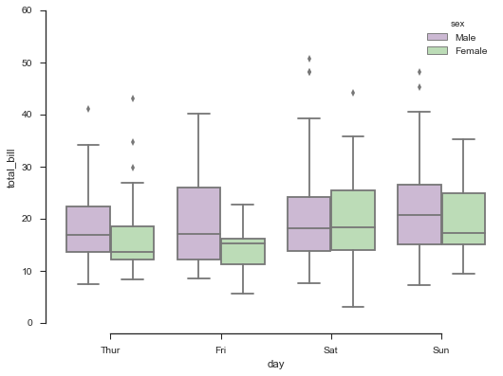
What is seaborn ?
Seaborn is a Python visualization library based on matplotlib
It provides a high-level interface for drawing attractive statistical graphics

