Slide 1
One Language to Bring Them All
And Start Coding…

Slide 2

Why did van Rossum call it Python ?
He liked Pythons and thought they were just awesome
He was a fan of “Monty Python’s Flying Circus”
He was well, a bit batty, that’s all !
I don’t know, and after all, who really cares ?

Slide 3

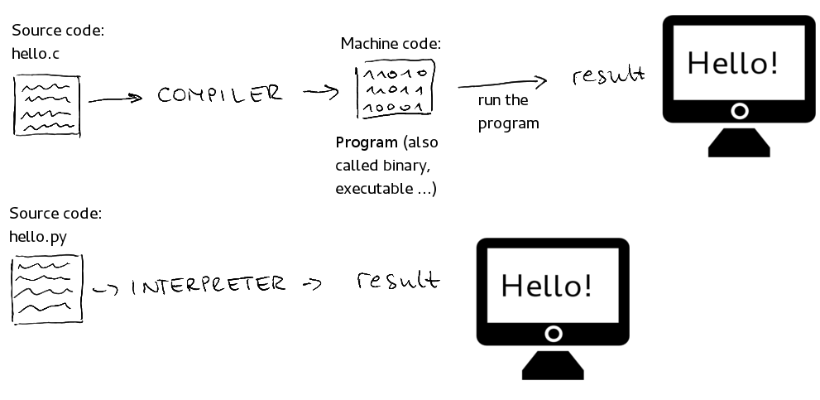
What kind of a language is Python
Pssst: Ram is plain wrong, it’s actually a byte compiled language !But, let’s not hurt his feelings !
Source: ikajic.github.io

Slide 4

Why Python ?
“Hello world” in Java
“Hello world” in Python
public class HelloWorld {
public static void main(String[ ] args) {
System.out.println("Hello, World");
}
}
print (“Hello World”)

Slide 5
Python is an expressive language: each statement says a lot !
Ratio of High-Level-Language Statements to Equivalent C Code
Language Level Relative to C
C 1
C++ 2.5
Fortran 95 2
Java 2.5
Perl 6
Python 6
Smalltalk 6
Microsoft Visual Basic 4.5
Source: Adapted from Estimating Software Costs (Jones 1998), Software Cost Estimation with Cocomo
Higher ratio = higher productivity !

Slide 6
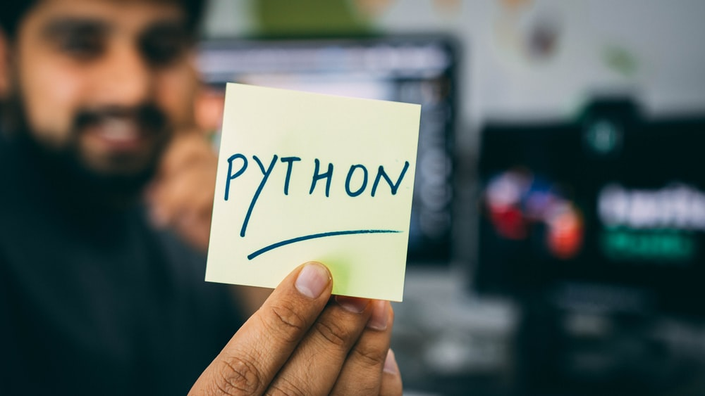
Five fun facts about Python
A dynamic, interpreted language
No type declarations
Error checks at runtime
Python source code, or “scripts” are modules…end in .py
Indentation is used to demarcate blocks of code

Slide 7
Our punch line
You can learn one fun ton of Python in 2 hours

Slide 8
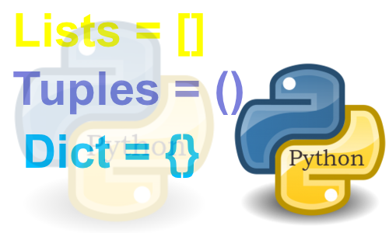
Common data structures in Python
Source: teknosains.com

Slide 9
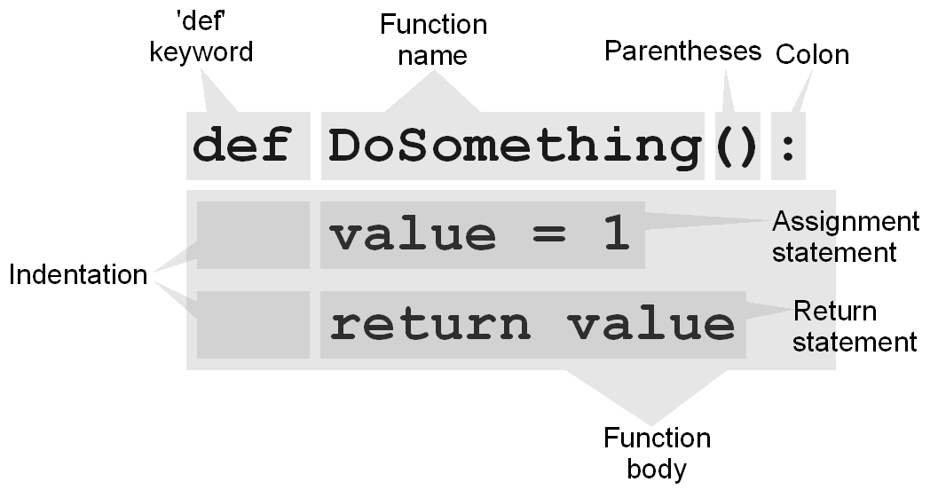
Python functions
Source: weebly.com

Slide 10
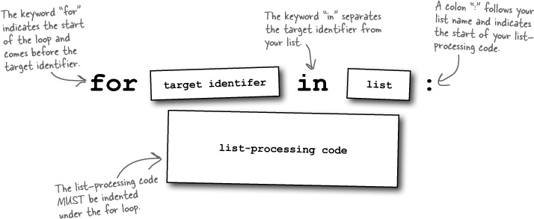
For loops in Python
Source: safaribooksonline.com

Slide 11

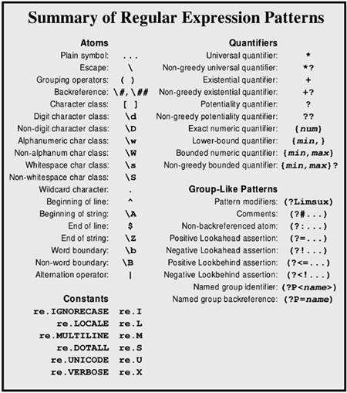
Python re module: regular expressions made easy
Source: etutorials.org

Slide 12

Five great Pythony resources
Help()
Dir()
Google
Python docs
StackOverflow

