Slide 1
Searching for concepts
in semantic space
Vector search is not just for examples anymore
https://github.com/rmhorton/PMC_classifiers
Robert Horton, PhD
Win-Vector Labs
rhorton@win-vector.com
Bay Area Use R Group
https://www.meetup.com/r-users/events/303488652/
October 15, 2024

Slide 2
Technical Takeaways
Semantic embeddings
Capture the meaning of text in fixed-length numeric vectors
Turn NLP problems into geometry problems: search & prediction
Label Mining
Build upon existing captured human judgement in Pubmed Central
Section heading patterns
Key terms (MeSH)
Concept vectors
Represent abstract concepts in semantic space.
Prediction (model scoring) can be framed as similarity search.
Models as data
Similarity search is scalable (FANN).
Transfer Learning
Will models trained on PMC data work for you?
Notes:
There are a lot of parts here: ML on semantic embeddings in the context of the remarkable Pubmed dataset
Logistic regression is cool again.

Slide 3
Semantic Embeddings
sentence embedding: a numeric representation of a sentence in the form of a vector of real numbers which encodes meaningful semantic information.
https://en.wikipedia.org/wiki/Sentence_embedding

Slide 4
All the Python
from sentence_transformers import SentenceTransformer​
xformer = SentenceTransformer("all-mpnet-base-v2")​
embeddings = xformer.encode(sentences)
Notes:
How Transformers Got Their Name (https://blogs.nvidia.com/blog/what-is-a-transformer-model/)
Attention is so key to transformers the Google researchers almost used the term as the name for their 2017 model. Almost.
“Attention Net didn’t sound very exciting,” said Vaswani, who started working with neural nets in 2011.
Jakob Uszkoreit, a senior software engineer on the team, came up with the name Transformer.
“I argued we were transforming representations, but that was just playing semantics,” Vaswani said.

Slide 5
Pubmed Free database of biomedical and life sciences literature
https://pubmed.ncbi.nlm.nih.gov/download/
Pubmed Central (PMC) Free full-text archive of biomedical and life sciences journal literature from the National Institutes of Health's National Library of Medicine (NIH/NLM) ftp.ncbi.nlm.nih.gov/pub/pmc/oa_bulk/oa_comm/xml/
No librarians were harmed in the making of this demo

Slide 6
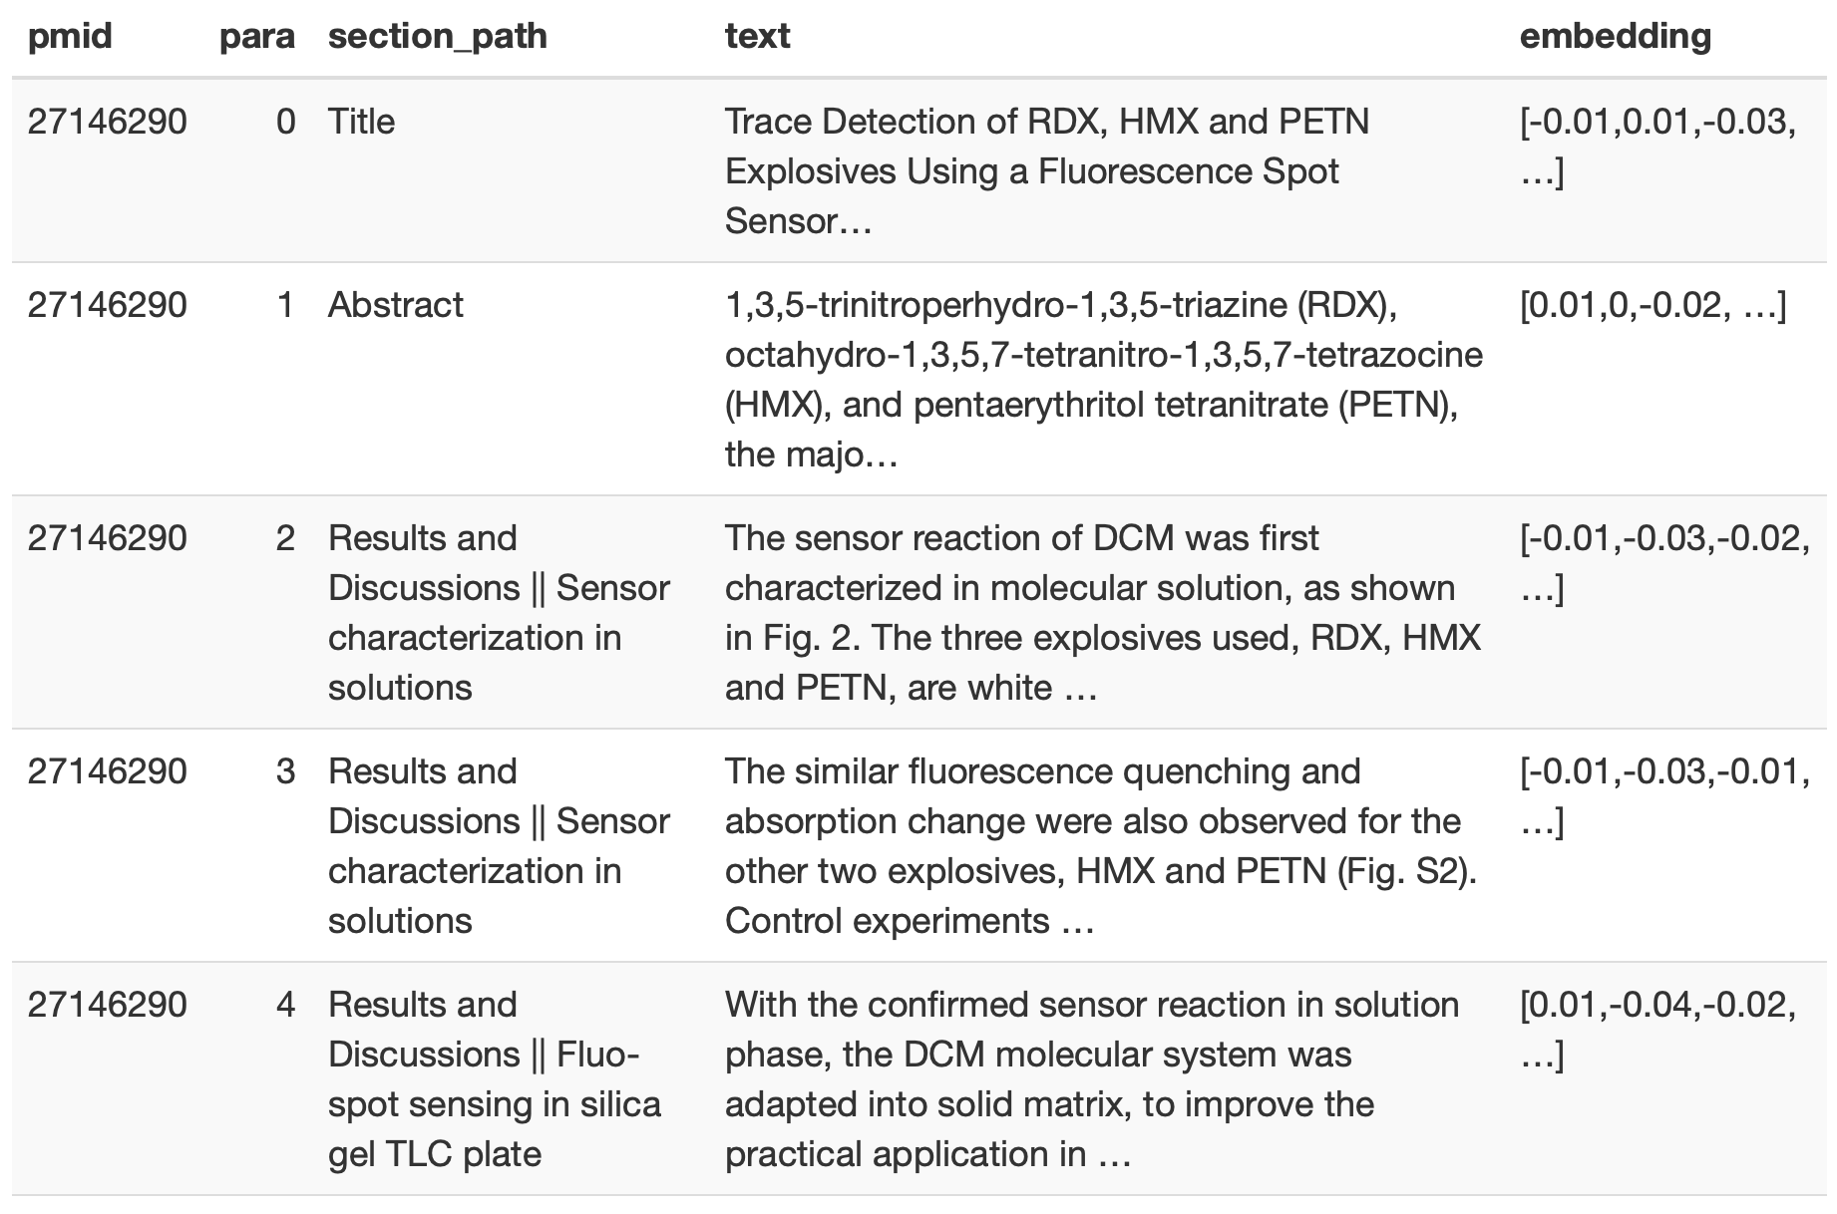
Notes:
Sections can have subsections. These are indicated by concatenating the whole path of headings to get to the subsection.
Not all papers in PMC are medical. This one is about detecting explosives.

Slide 7
Label Mining
Labels capture human judgement about concepts.
A lot of judgement has already been captured
Indexing keywords in databases
Section headings as metadata
Can we extract labels from this existing metadata?
Notes:
Data mining: the process of extracting and discovering patterns in large data sets.

Slide 8
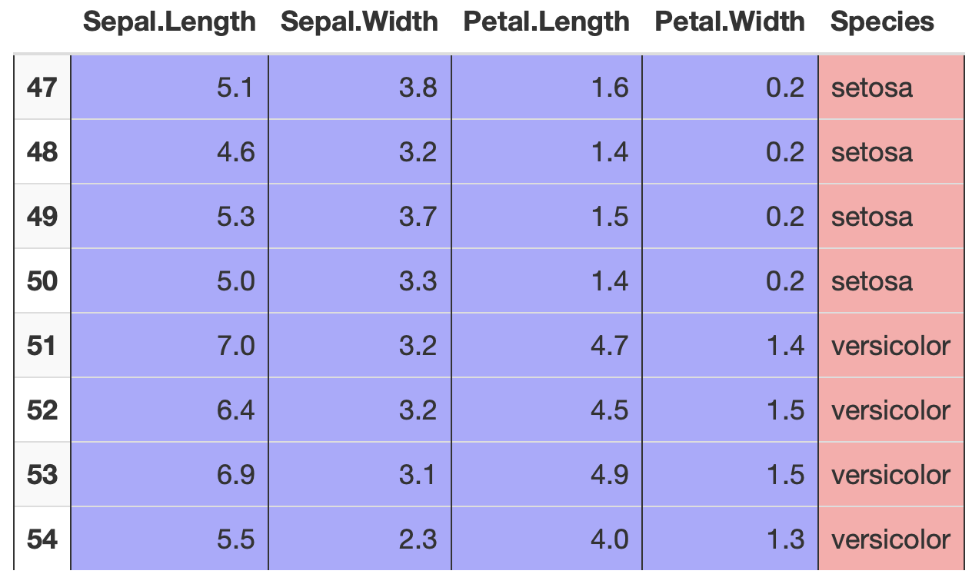
Machine Learning: use FEATURES to predict LABELS
Notes:
We need data in this format.

Slide 9
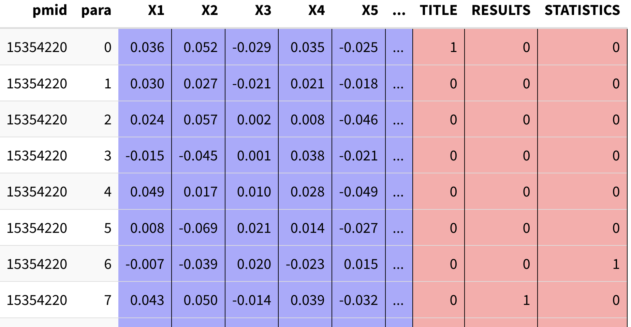
Notes:
The features are the individual dimensions of the semantic embedding and the labels are boolean flags. Here the labels are from matching regular text patterns to the section headings.
We will train a separate model on each label.

Slide 10
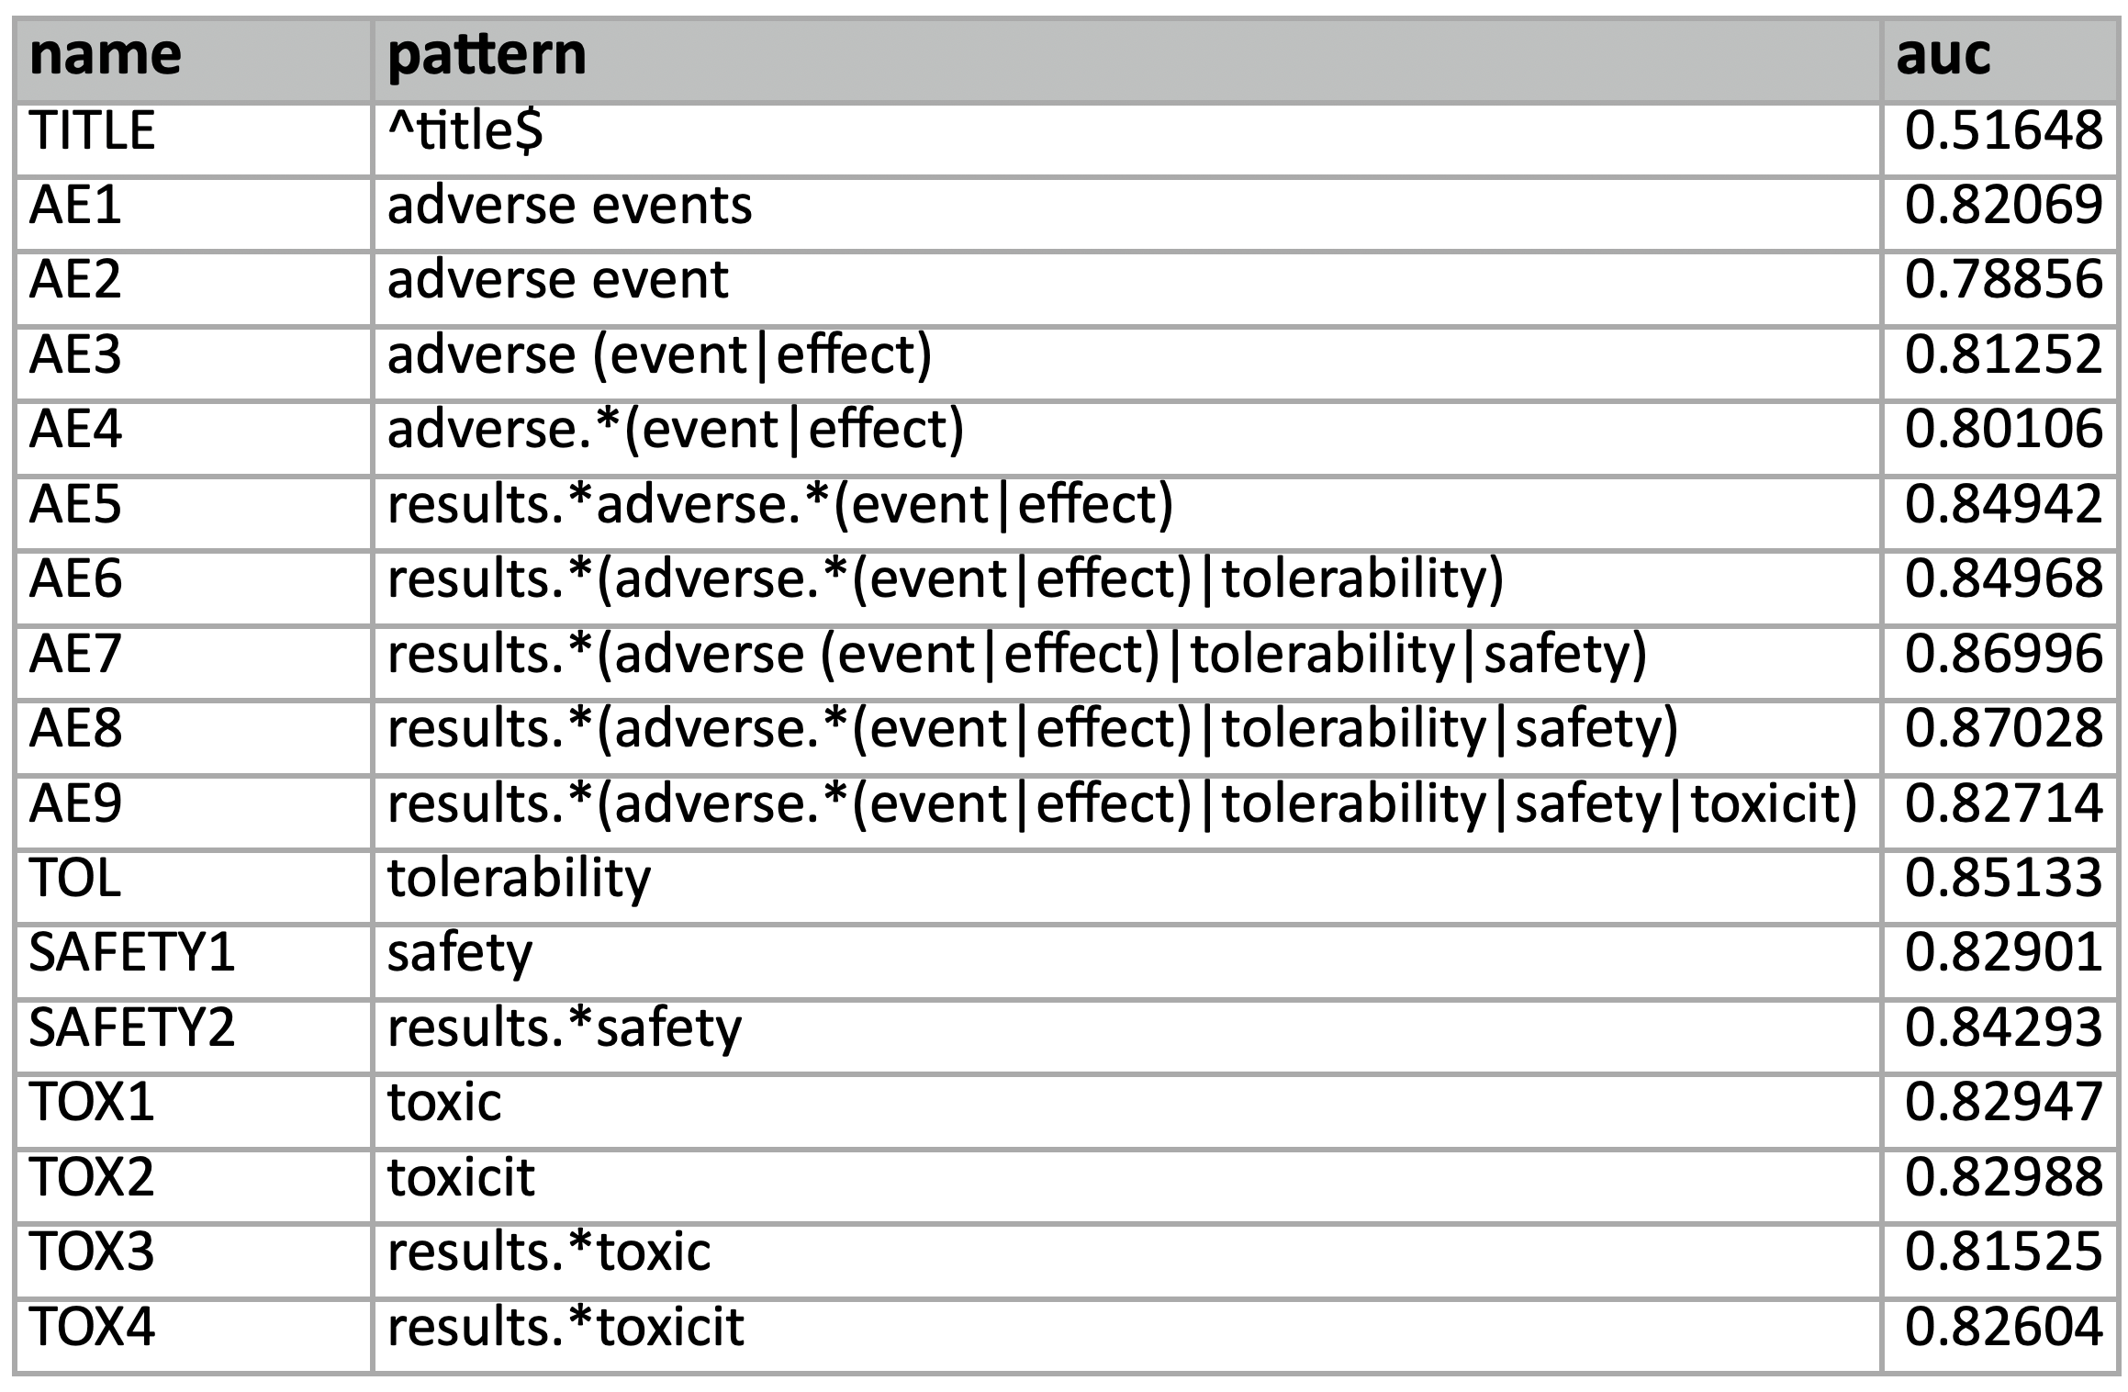
Performance of pattern models on a test set hand-labelled for adverse events
Notes:
It helps to focus on the results section.
Adding tolerability didn't make much difference, but it didn't hurt. We left it in because subsections of results talking about tolerability were generally on target.
Adding safety helped quite a bit. <- This is our best model, and it beats the ones we trained earlier so laboriously on Prodigy
Adding toxicity made it worse. This looks like it is because 'toxicity' covers things like cytotoxicity experiments unrelated to clinical trials.

Slide 11
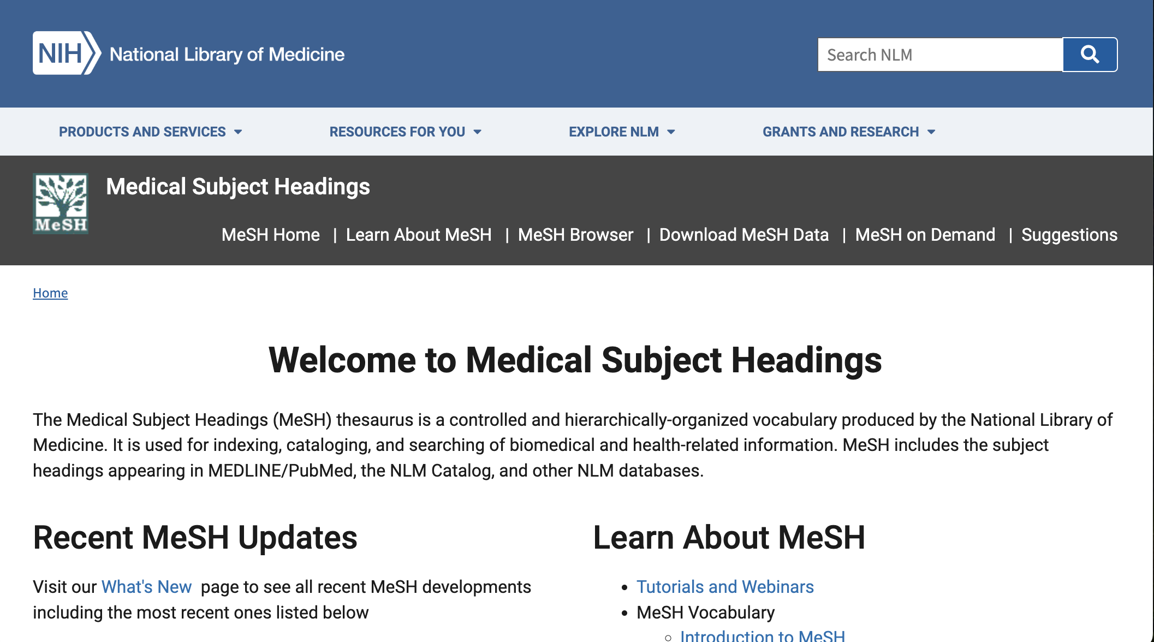
https://www.nlm.nih.gov/mesh/meshhome.html

Slide 12
Concept Vector
A representation of a category of items in a semantic embedding space. This represents a concept to the extent that the items in the category represent the concept.
These vectors can be constructed from the coefficients of a logistic regression classifier.

Slide 13
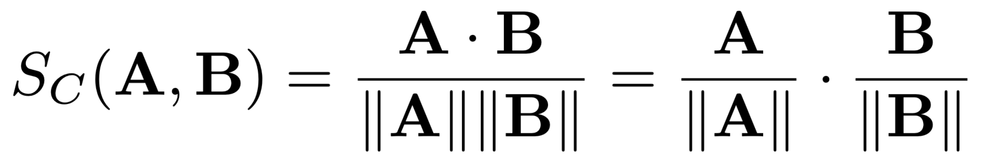
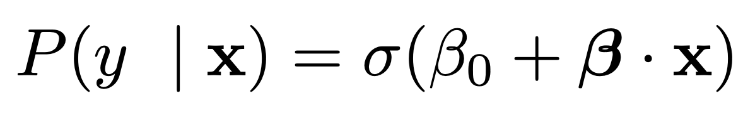
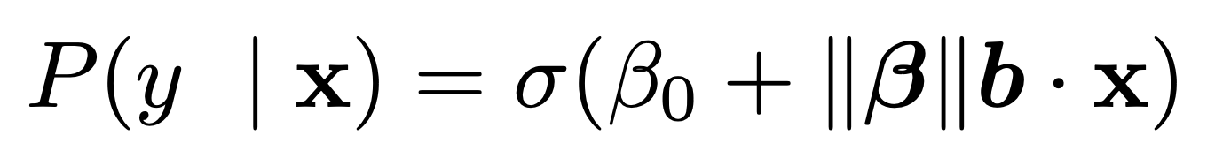
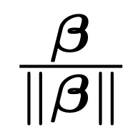
All the math
dot product
cosine similarity
vector lengths
unit vectors
logistic regression
logistic “squashing” function
feature vector
intercept
coefficient vector
feature vector
coefficient vector
b
where b =
is the
coefficient
unit vector
squash it!
dot product
shift it!
scale it!
Notes:
data.frame(x=t, P=squash(t)) %>% ggplot(aes(x=x, y=P)) + geom_line() + ylab(expression(P~"="~1/(1-~e^"-x")))

Slide 14
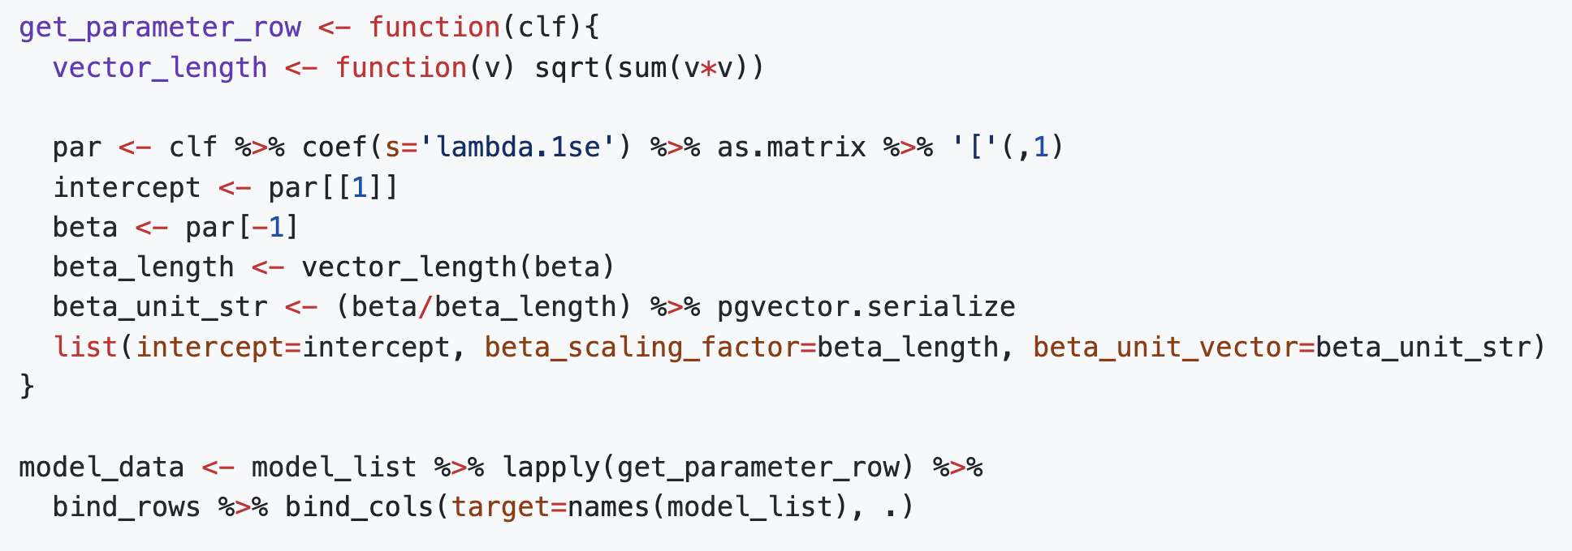
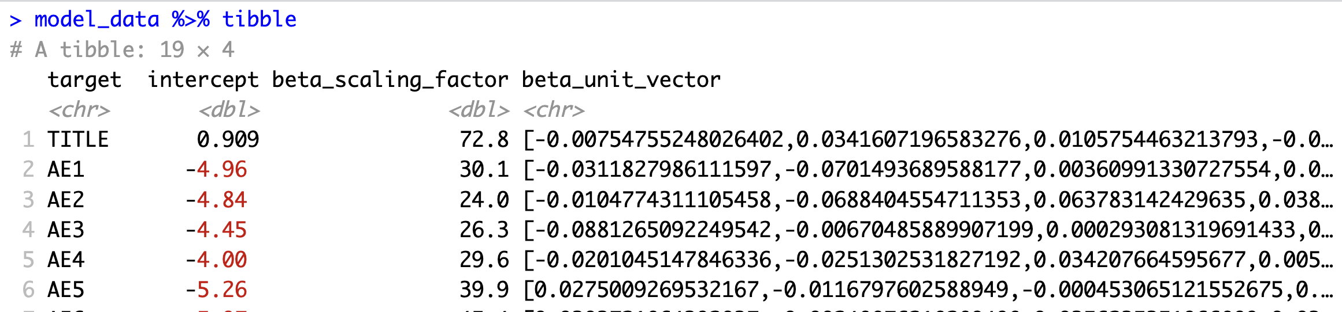
Extract model data

Slide 15
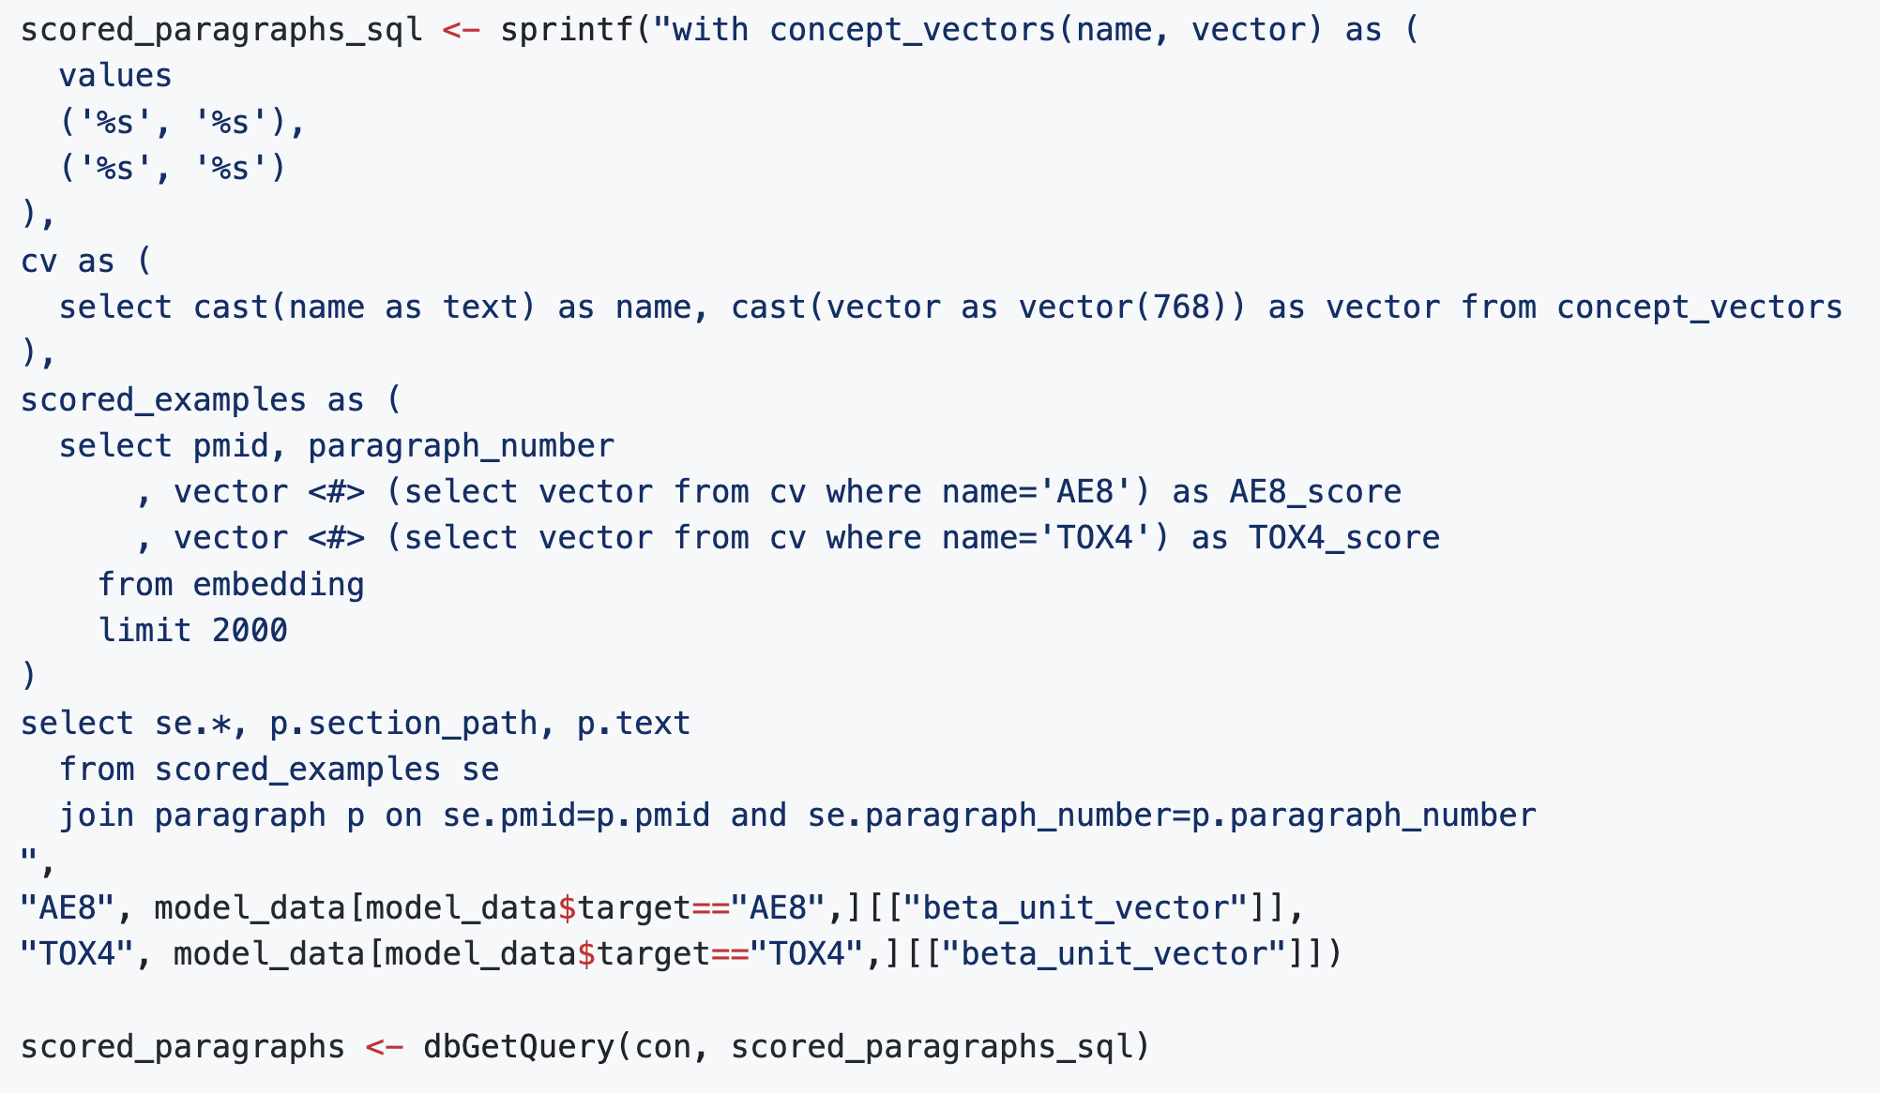
Vector search
I foolishly named my
vector columns 'vector'
There is also a data type named 'vector'
Inner product of two vectors

Slide 16
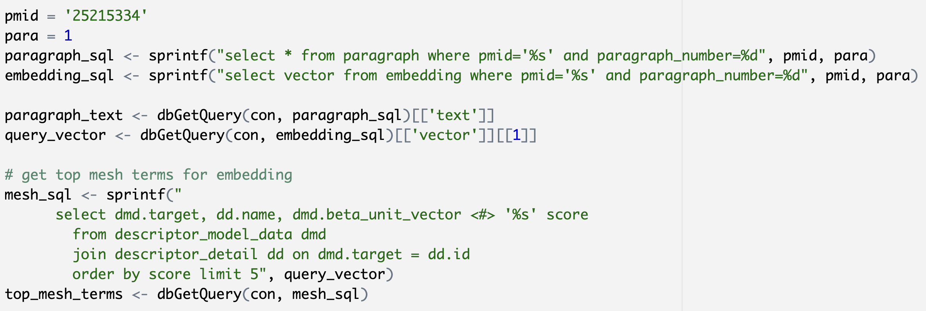
Find the top MeSH terms for a paragraph

Slide 17
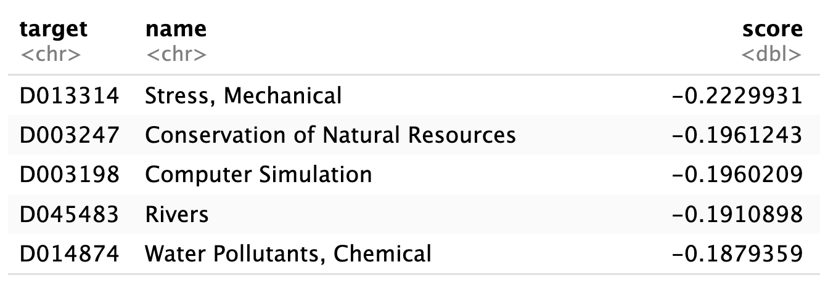
Find the top MeSH terms for a paragraph
"Most coastal structures have been built in surf zones to protect coastal areas. In general, the transformation of waves in the surf zone is quite complicated and numerous hazards to coastal communities may be associated with such phenomena. Therefore, the behavior of waves in the surf zone should be carefully analyzed and predicted. Furthermore, an accurate analysis of deformed waves around coastal structures is directly related to the construction of economically sound and safe coastal structures because wave height plays an important role in determining the weight and shape of a levee body or armoring material. In this study, a numerical model using a large eddy simulation is employed to predict the runup heights of nonlinear waves that passed a submerged structure in the surf zone. Reduced runup heights are also predicted, and their characteristics in terms of wave reflection, transmission, and dissipation coefficients are investigated."

Slide 18
Transfer Learning
“A technique in machine learning (ML) in which knowledge learned from a task is re-used in order to boost performance on a related task.”
https://en.wikipedia.org/wiki/Transfer_learning
For our purposes it mostly means:
“Training a model to recognize a concept in PMC articles, then using it to predict that concept (or a related concept) in a different corpus.”

Slide 19
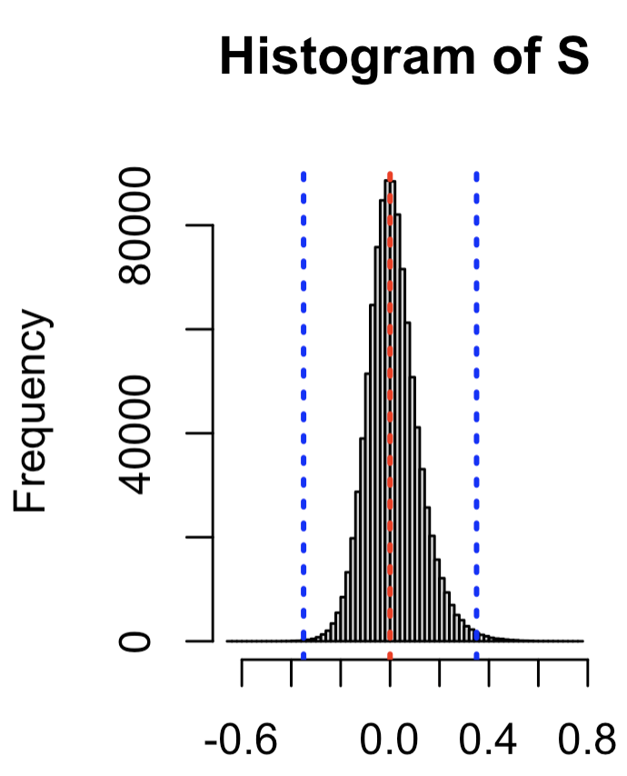
Compare concept vectors to each other
S <- M %*% t(M)
diag(S) <- 0 # diagonal
threshold <- 0.35
hist(S, breaks=100)
abline(
v=c(-threshold, 0, threshold),
col=c('blue', 'red', 'blue'),
lty=3, lwd=3)

Slide 20
Are Humans Animals?
Animals: Unicellular or multicellular, heterotrophic organisms, that have sensation and the power of voluntary movement. Under the older five kingdom paradigm, Animalia was one of the kingdoms. Under the modern three domain model, Animalia represents one of the many groups in the domain EUKARYOTA.
Humans: Members of the species Homo sapiens.

Slide 21
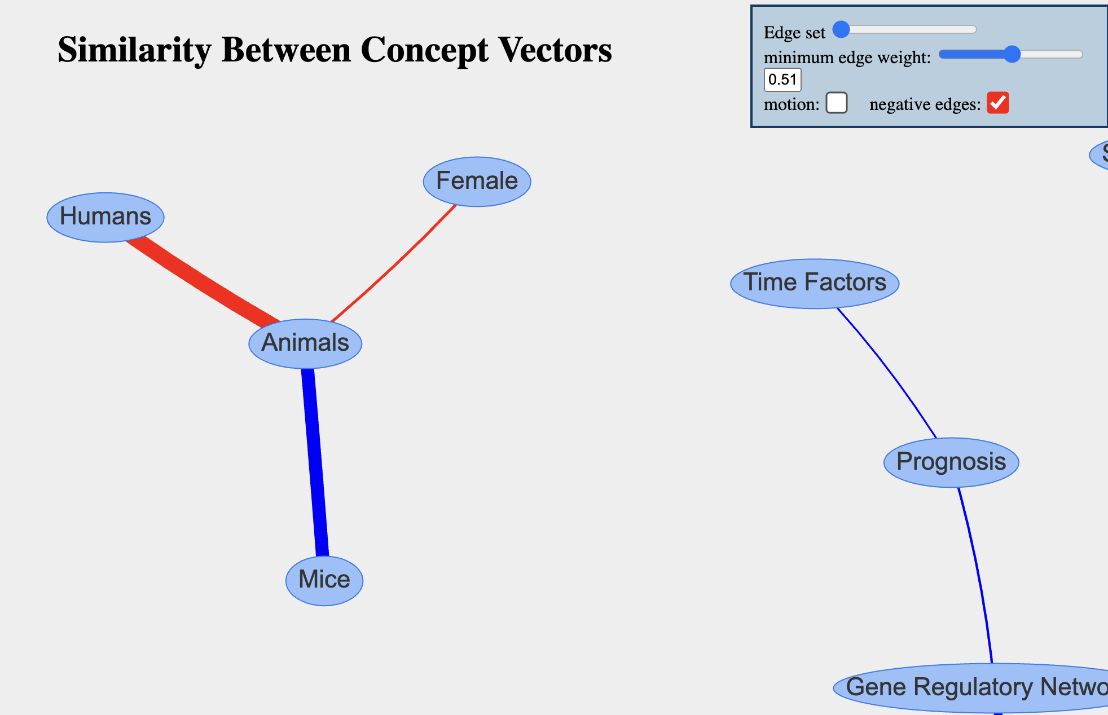
Graph Visualization

Slide 22
Compare concept vectors to definition embeddings
definition_embeddings <- read_parquet(DEFINITION_EMBEDDINGS_FILE)
D <- definition_embeddings$vector %>% do.call('rbind',.)
definition_meshterms <- D %*% t(M)
dimnames(definition_meshterms) <- list(
definition_embeddings$term,
model_data$name
)
dim(definition_meshterms) # [1] 30605 1014

Slide 23
# definition is row, MeSH term is column
definition_meshterms['Animals', 'Mice'] # 0.028
definition_meshterms['Mice', 'Animals'] # 0.314
definition_meshterms['Animals', 'Humans'] # -0.106
definition_meshterms['Humans', 'Animals'] # -0.024

Slide 24
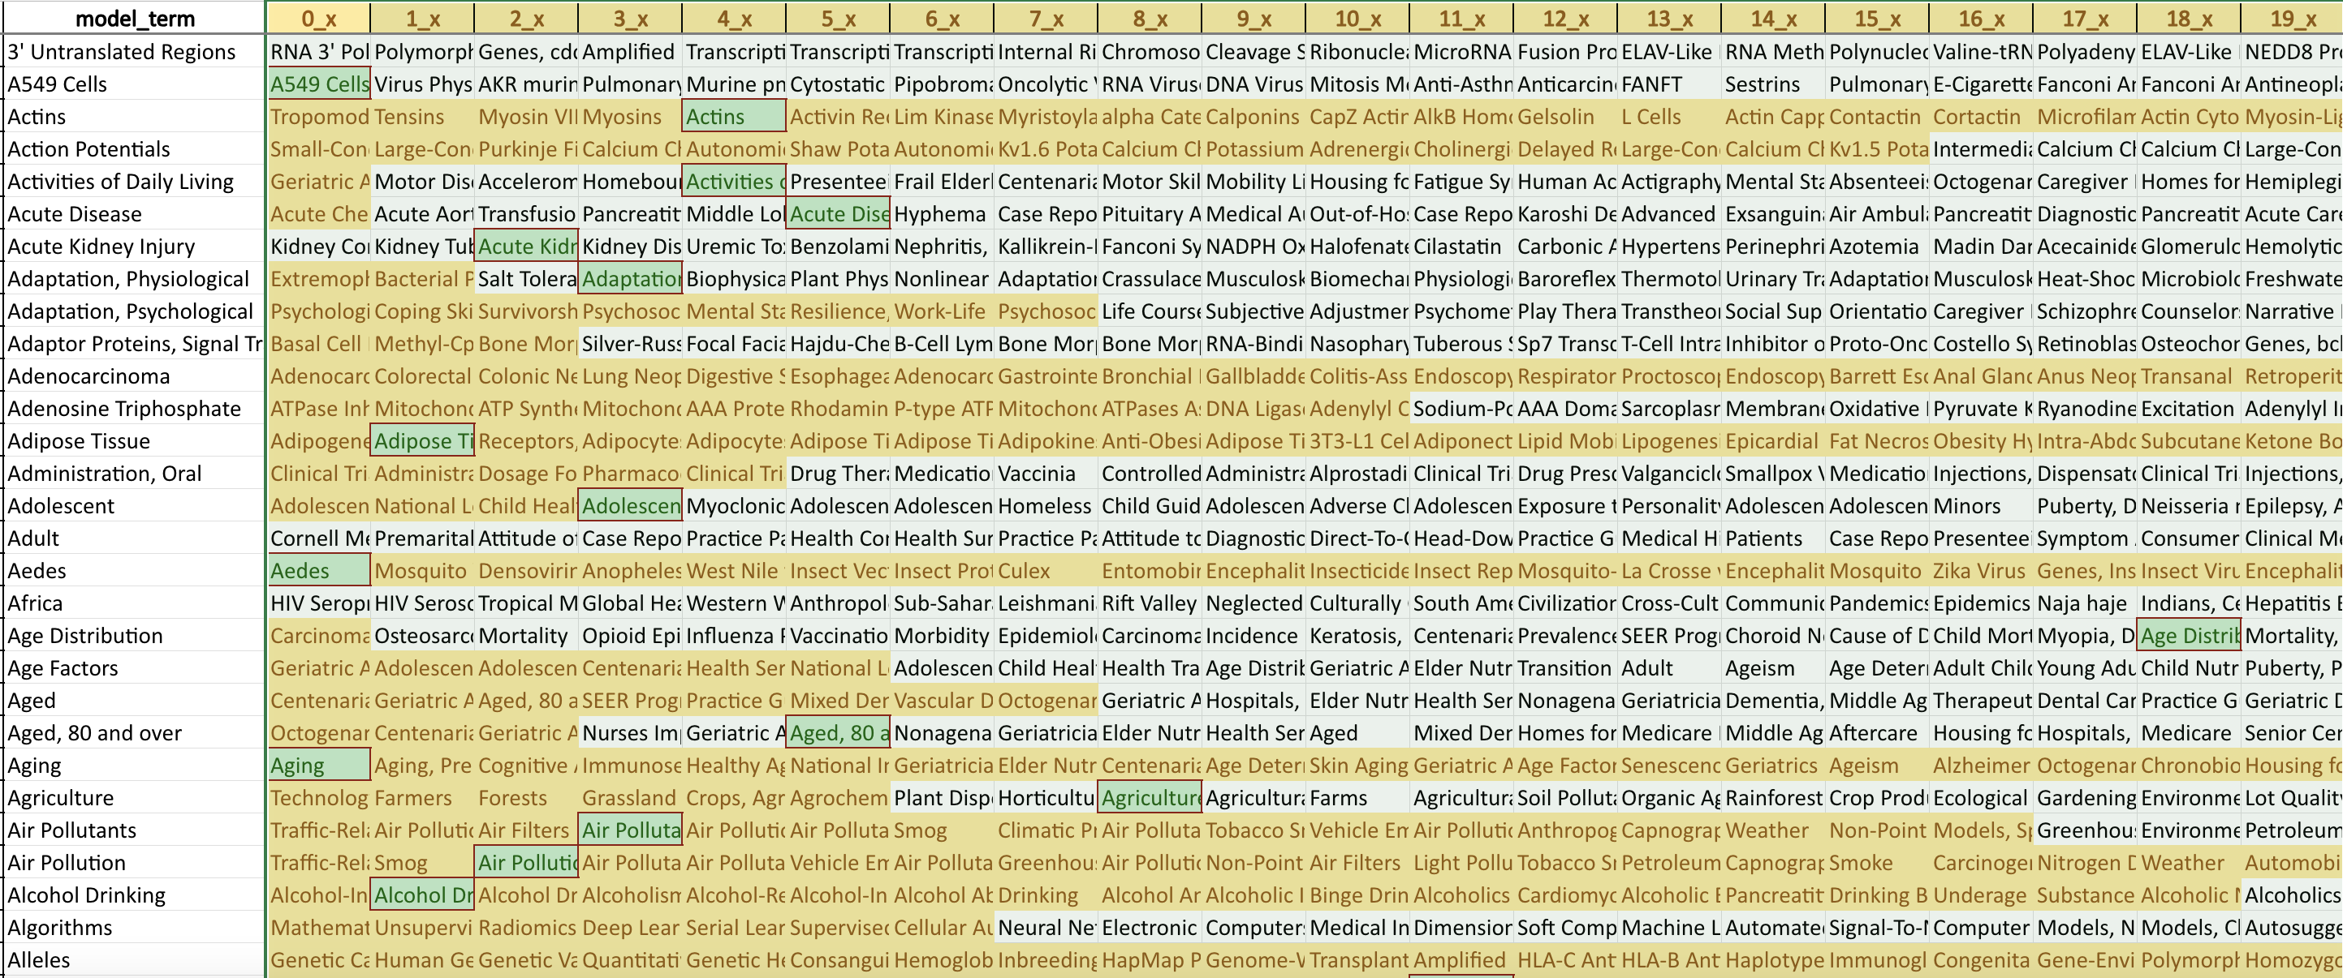
Models vs. Definitions
top_20_definition_terms.xlsx

Slide 25
Future Goals
Assess and document biases in MeSH term models
Train models on big datasets using GPU
How many MeSH terms can we predict reasonably?
Interpretable representation in 'MeSH term space'

