Slide 1
Introduction to ROC Curves
Robert M. Horton, PhD MS
Senior Data Scientist
Microsoft

Slide 2
Receiver Operating Characteristic (ROC) Curve
A way to characterize sensitivity/specificity tradeoffs
for binary classifiers
that make quantitative predictions

Slide 3
Confusion Matrix for Binary Classifier
 |  | Test
 |  | + | -
Disease | + | TP | FN
 | - | FP | TN
Notes:
The green boxes on the top-left to lower-right diagonal are the ones the test got correct. The red boxes are (type1 and type 2) errors.
Why can’t we just use a simple metric like accuracy (the fraction correct)? Consider when the outcomes are imbalanced, such as in a disease that affects 1% of the population, so 99% of patients are negative for disease. Then a bogus test that always comes back negative will have 99% true negatives and 1% false negatives, so it will be 99% accurate.
This is how cold cures work; almost everyone who takes the cure will get better, even if the cure does nothing.

Slide 4
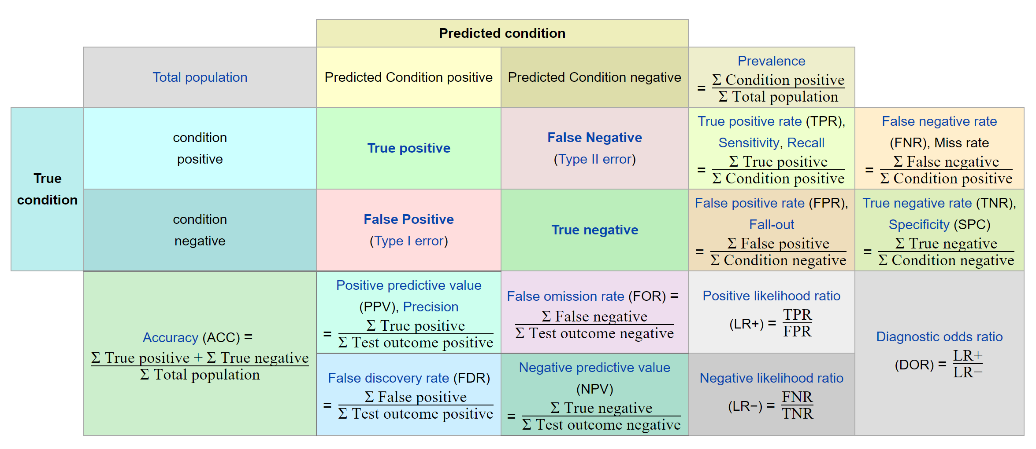
Wikipedia, Sensitivity and Specificity

Slide 5
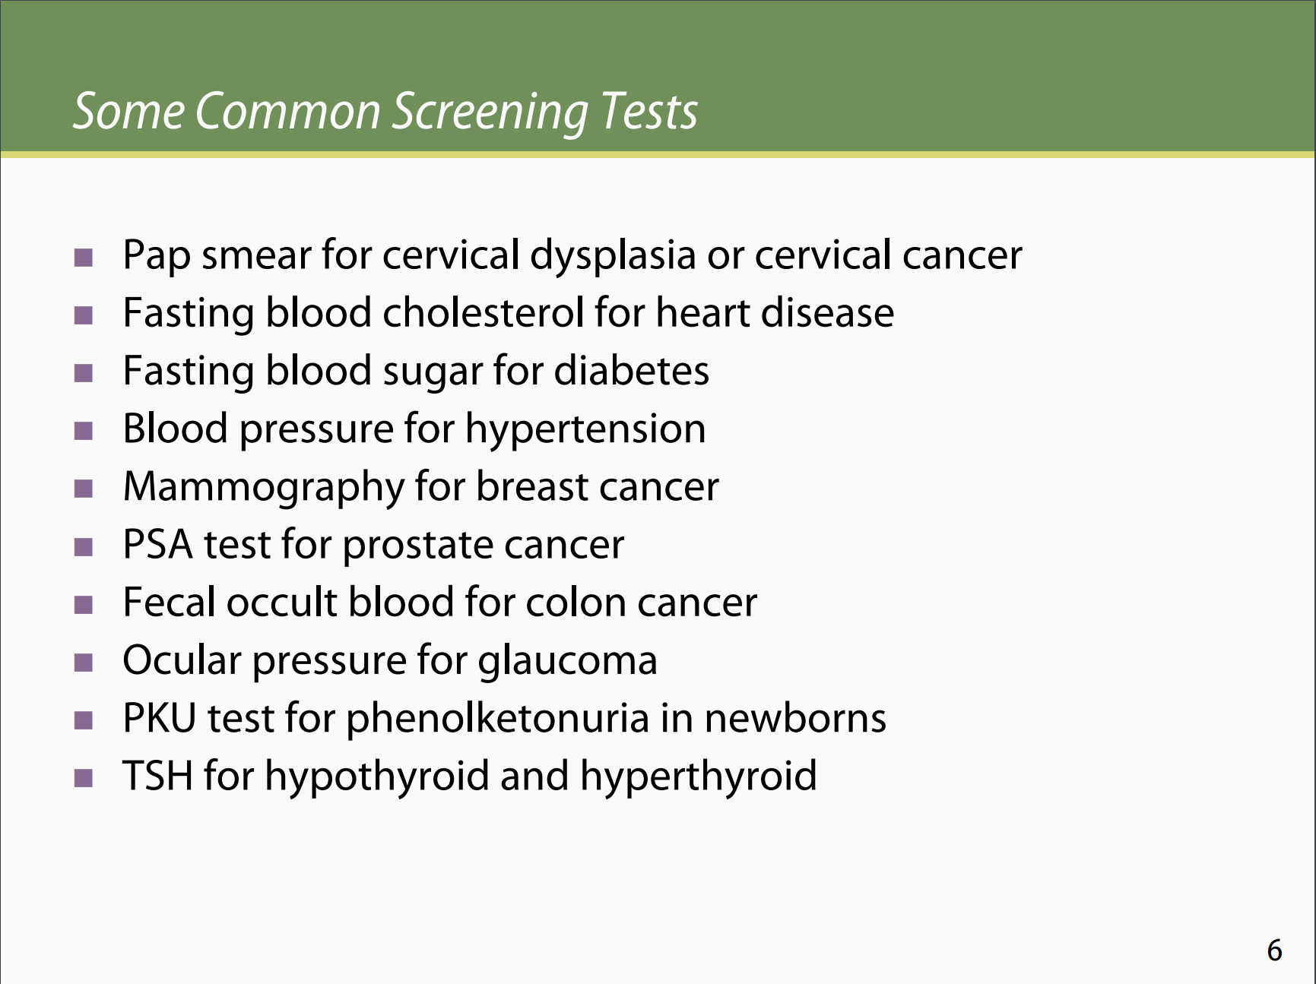
http://ocw.jhsph.edu/courses/fundepi/PDFs/Lecture11.pdf
http://ocw.jhsph.edu/courses/fundepi/PDFs/Lecture11.pdf
Notes:
Many test give continuous outputs.
The next few slides are from Johns Hopkins School of Public Health

Slide 6
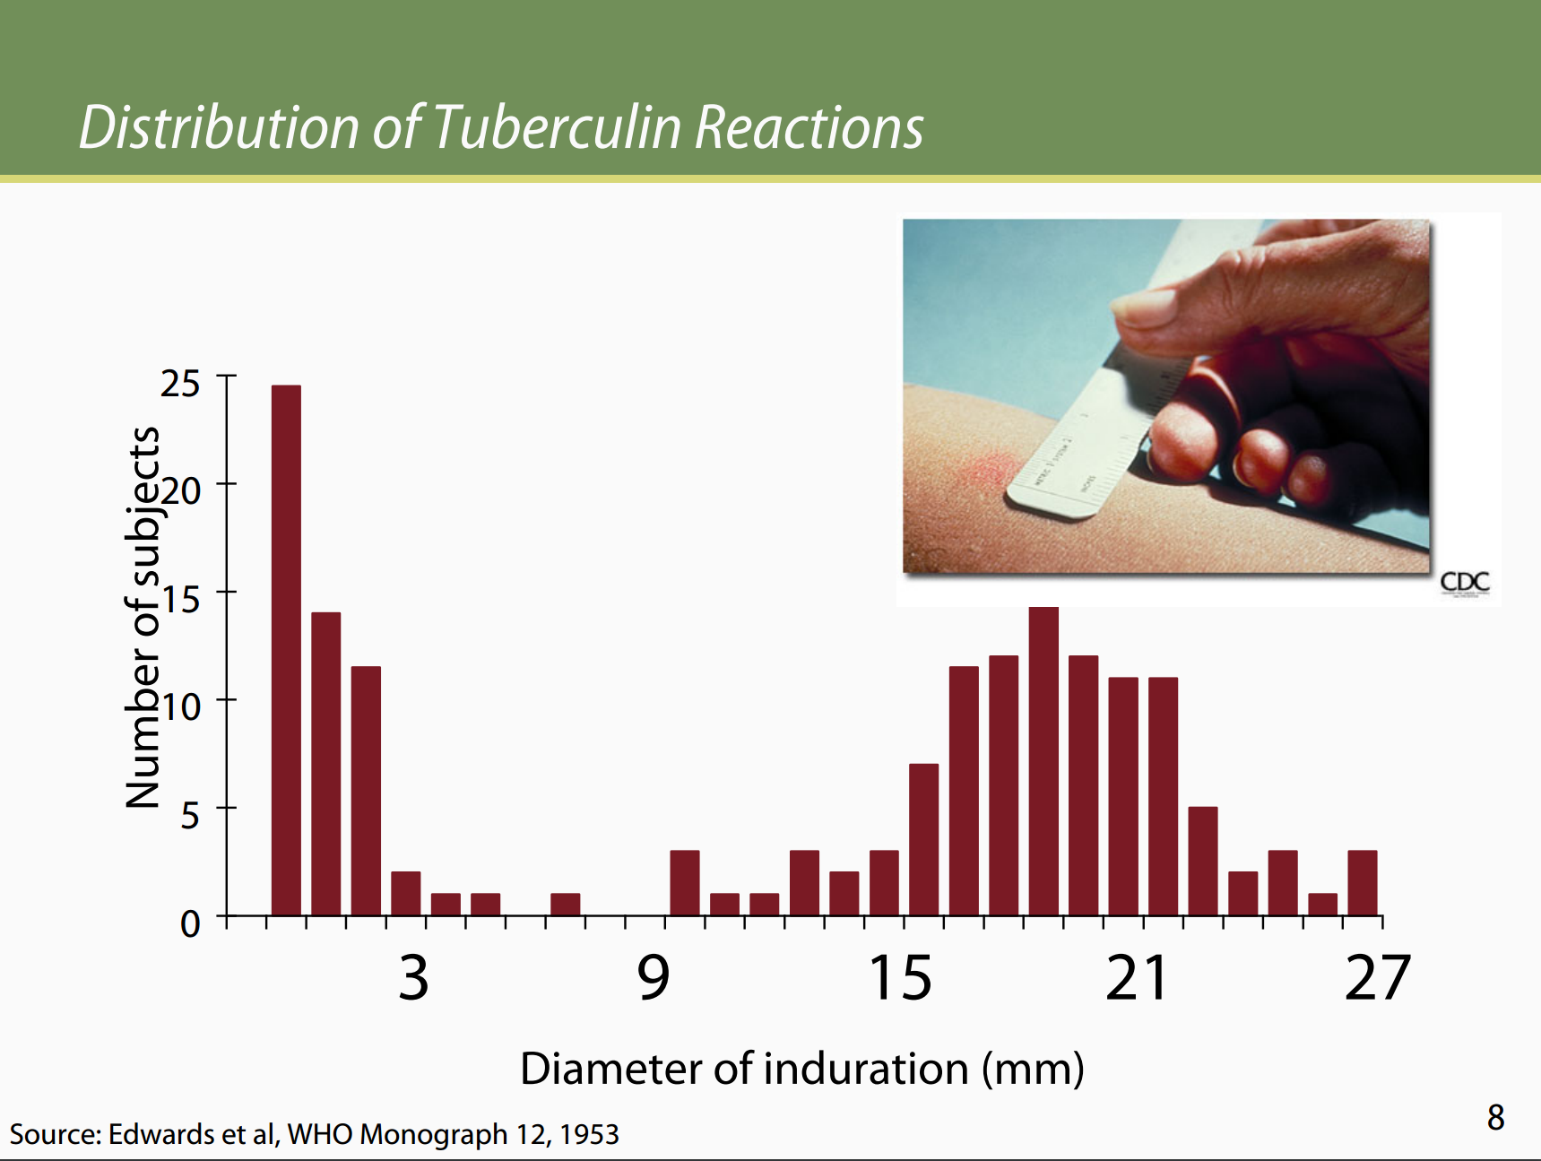
http://ocw.jhsph.edu/courses/fundepi/PDFs/Lecture11.pdf
Notes:
Where do you draw the line to separate “positive” from “negative”?

Slide 7
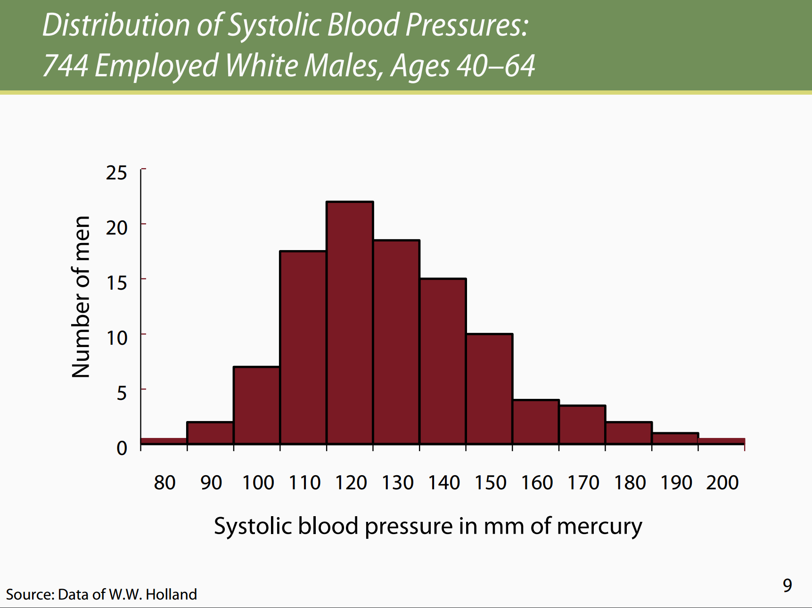
Notes:
Now where do you draw the line for high blood pressure?

Slide 8
ROC Curves discrete viewpoint
Examples use a finite number of individual cases, each with a label and a score.

Slide 9
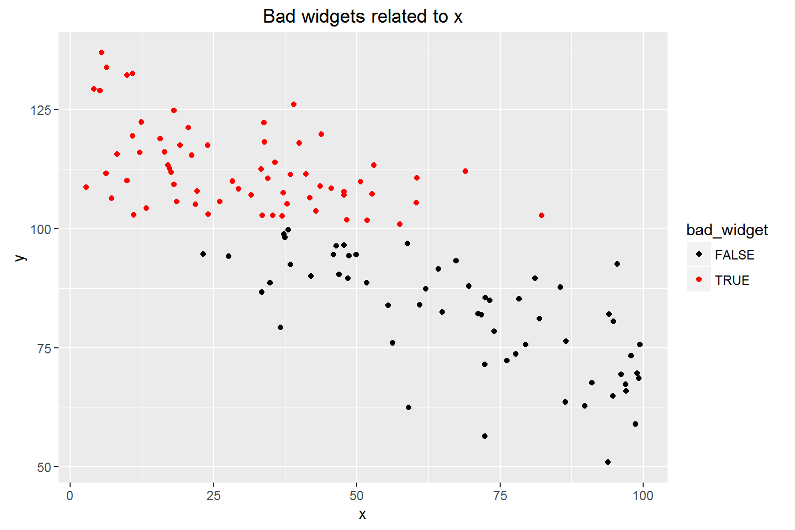

Slide 10
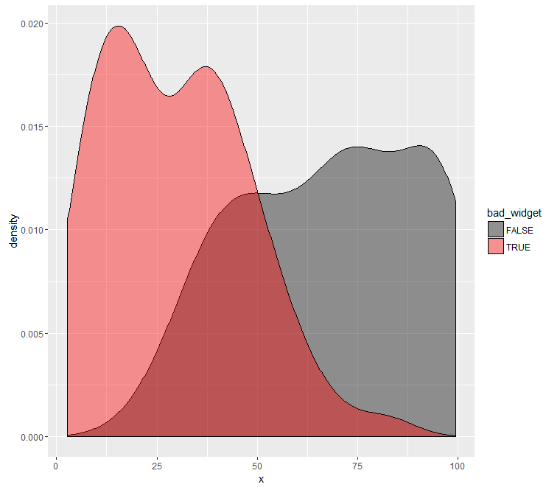
The logistic regression model never sees the y variable; it is based on x and the outcome class.
fit_glm <-
glm(bad_widget ~ x,
training_set,
family=binomial(link="logit"))
Notes:
Since the blog post used a set seed, you can recreate the data exactly, then create this plot like this:
test_set %>%
ggplot(aes(x=x, fill=bad_widget)) +
geom_density(alpha=0.4) +
scale_fill_manual(values = c("black", "red"))

Slide 11
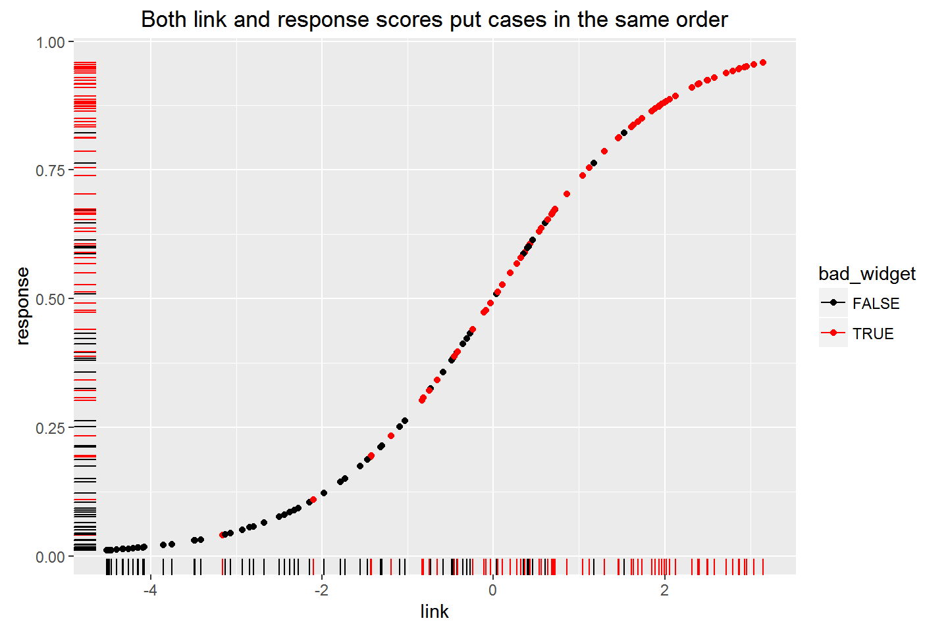

Slide 12
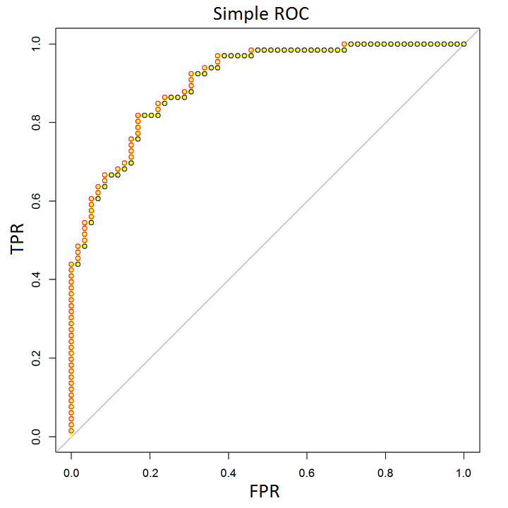
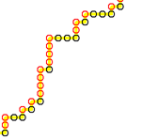
A turtle’s path along sorted cases:
For a positive case, go up
For a negative case, go right

Slide 13
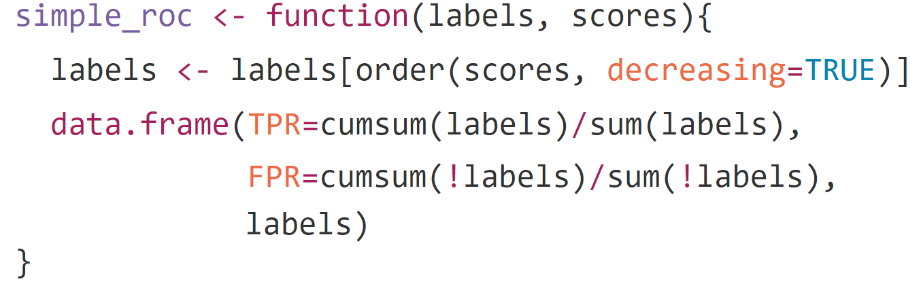
Two-step ROC calculation*:
* For educational use only
Notes:
sort cases by scores
calculate cumulative True Positive and False Positive rates from highest to lowest score

Slide 14
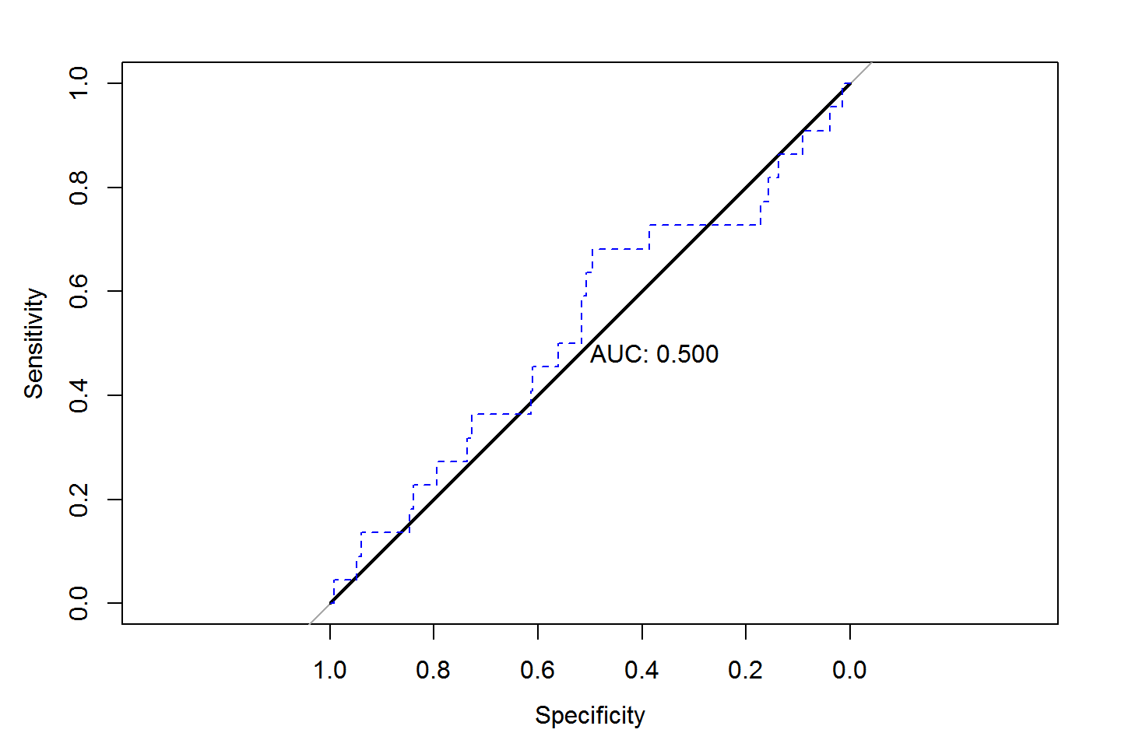
The simple approach does not correctly handle ties.
Multiple points with identical scores should be represented as diagonal segments.
Notes:
Here all points are given the same score. The black line correctly represents this situation with a diagonal. The turtle thinks order matters, and traces out meaningless steps.

Slide 15
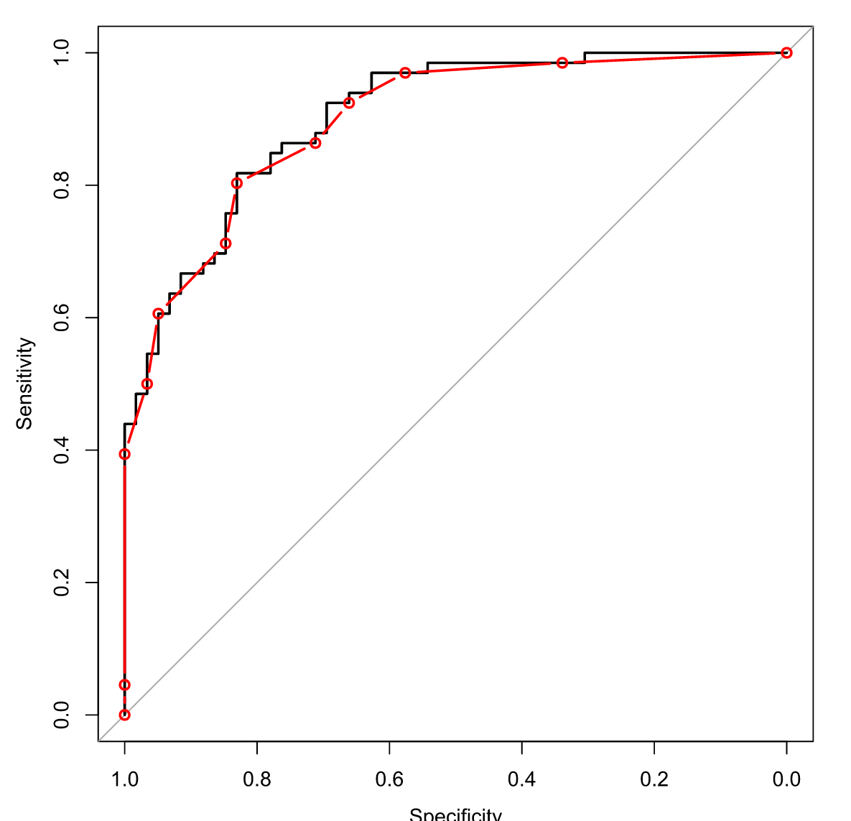
The black line shows high-precision scores, so each point has a unique score.
The red line uses rounded scores, so there are lots of ties.

Slide 16
ROC Curves continuous viewpoint
Positive and negative populations are described by continuous distributions.
(screenshots from https://kennis-research.shinyapps.io/ROC-Curves/ )

Slide 17
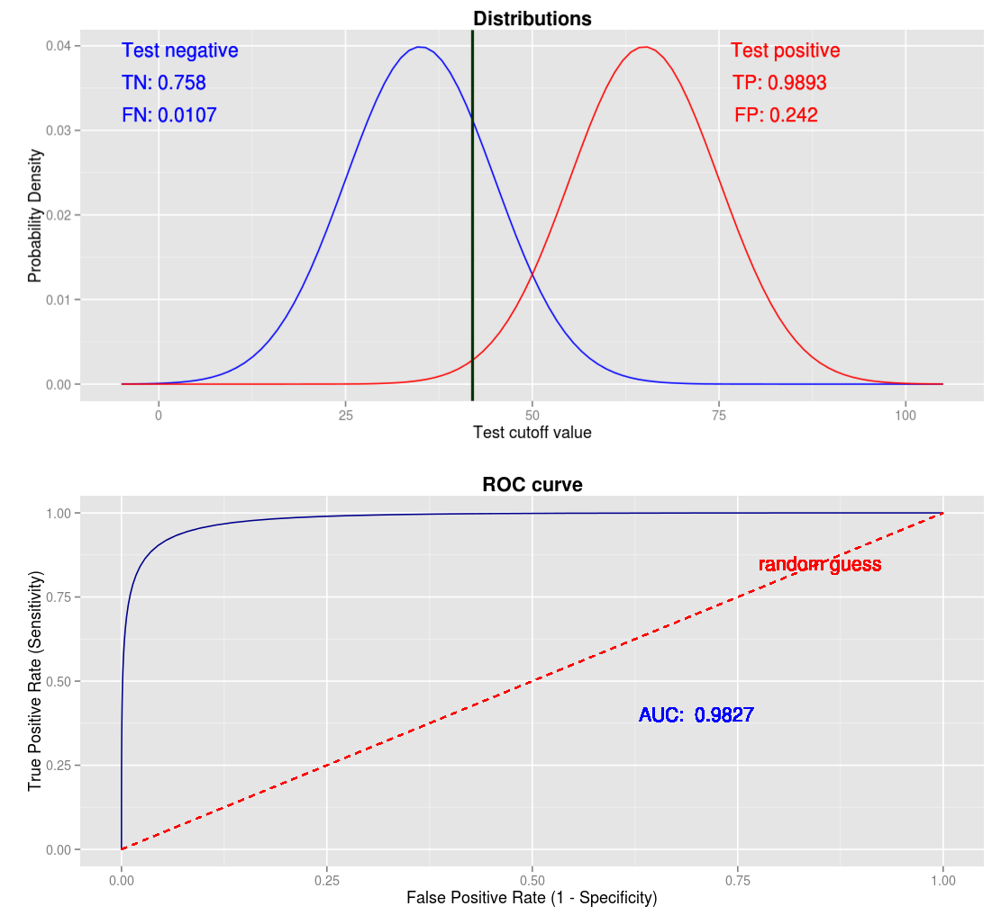

Slide 18
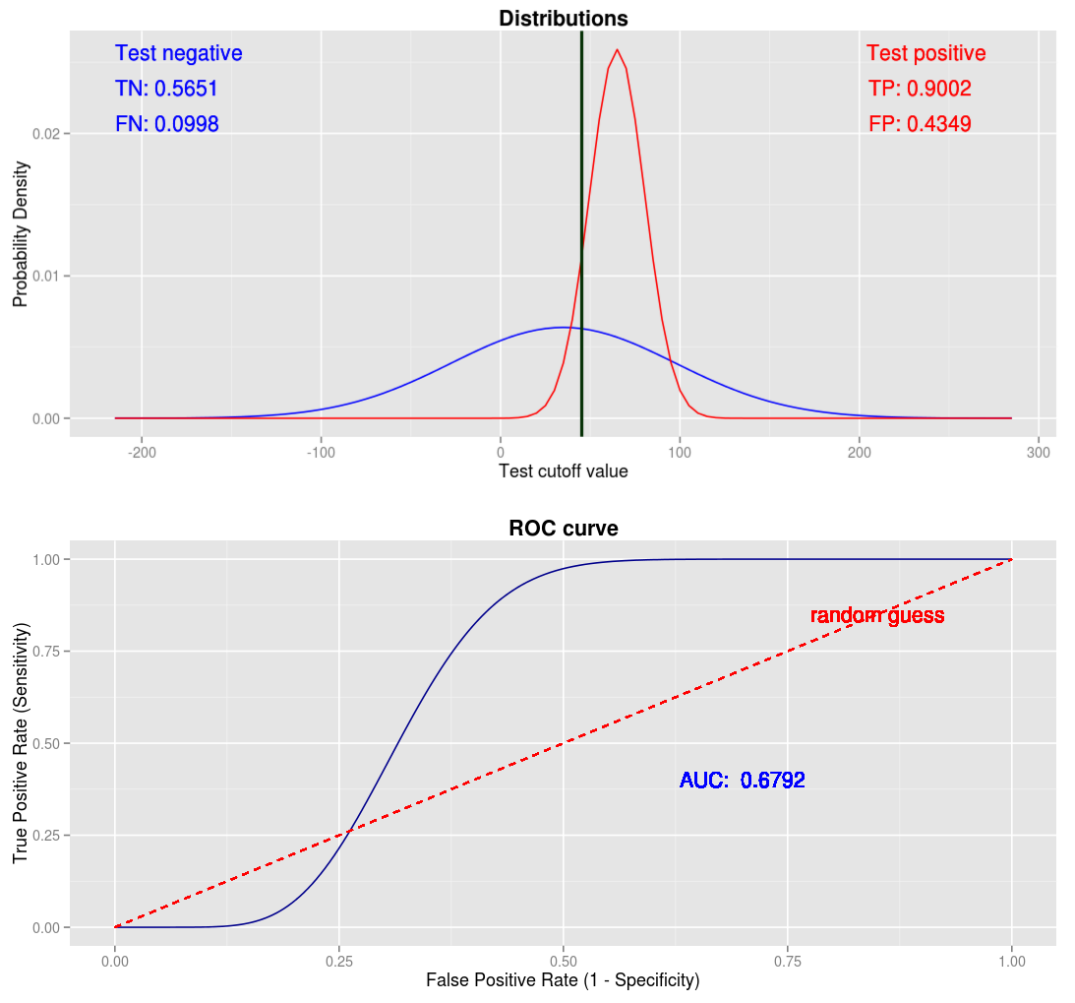

Slide 19
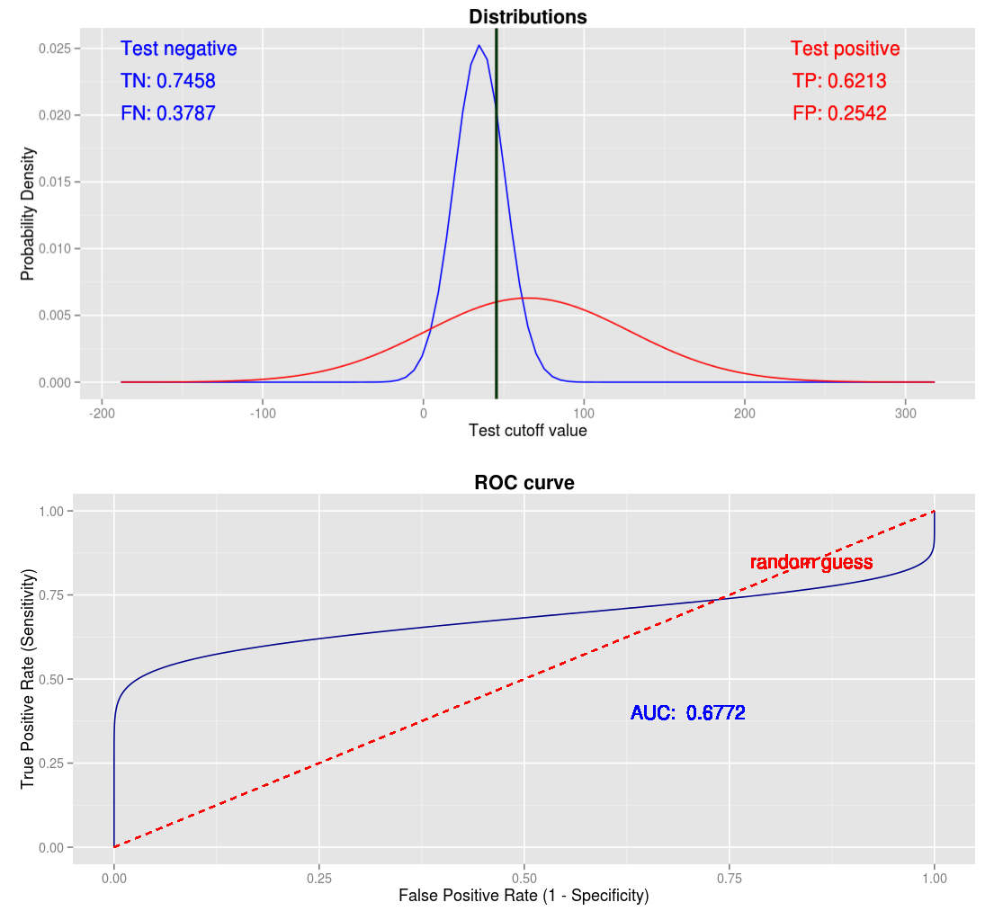

Slide 20
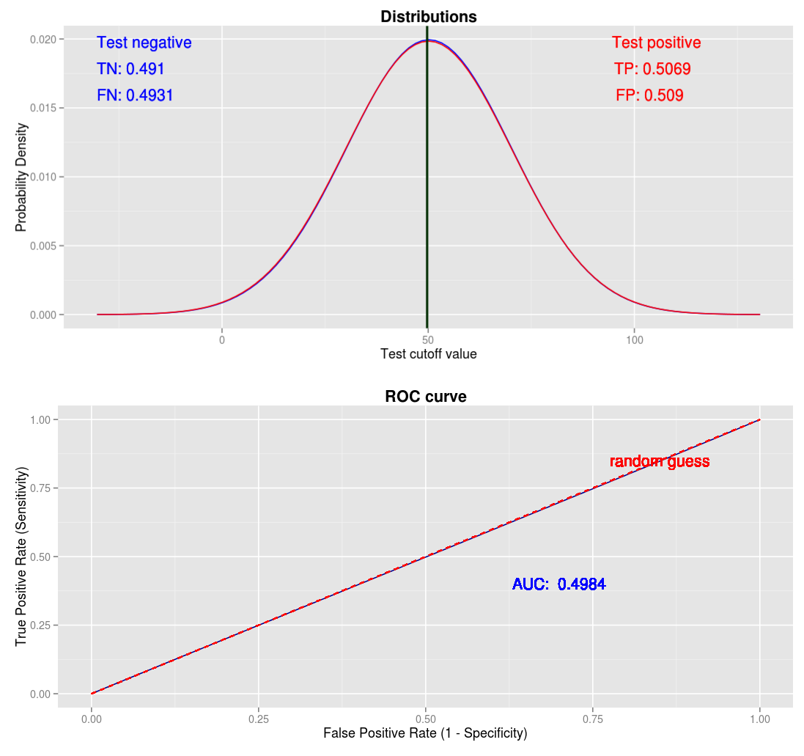

Slide 21
Funny-Looking ROC Curves

Slide 22
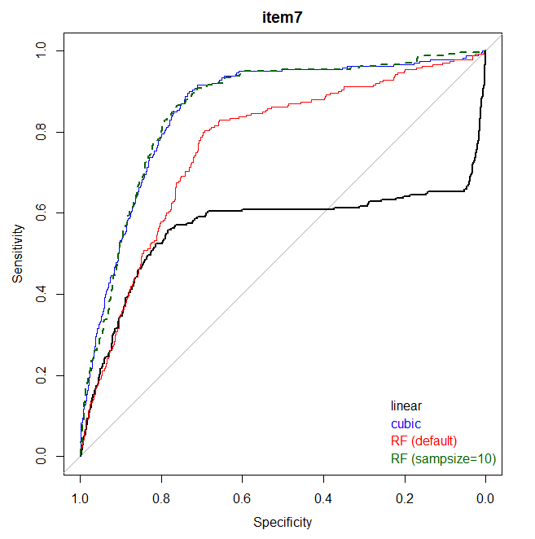

Slide 23
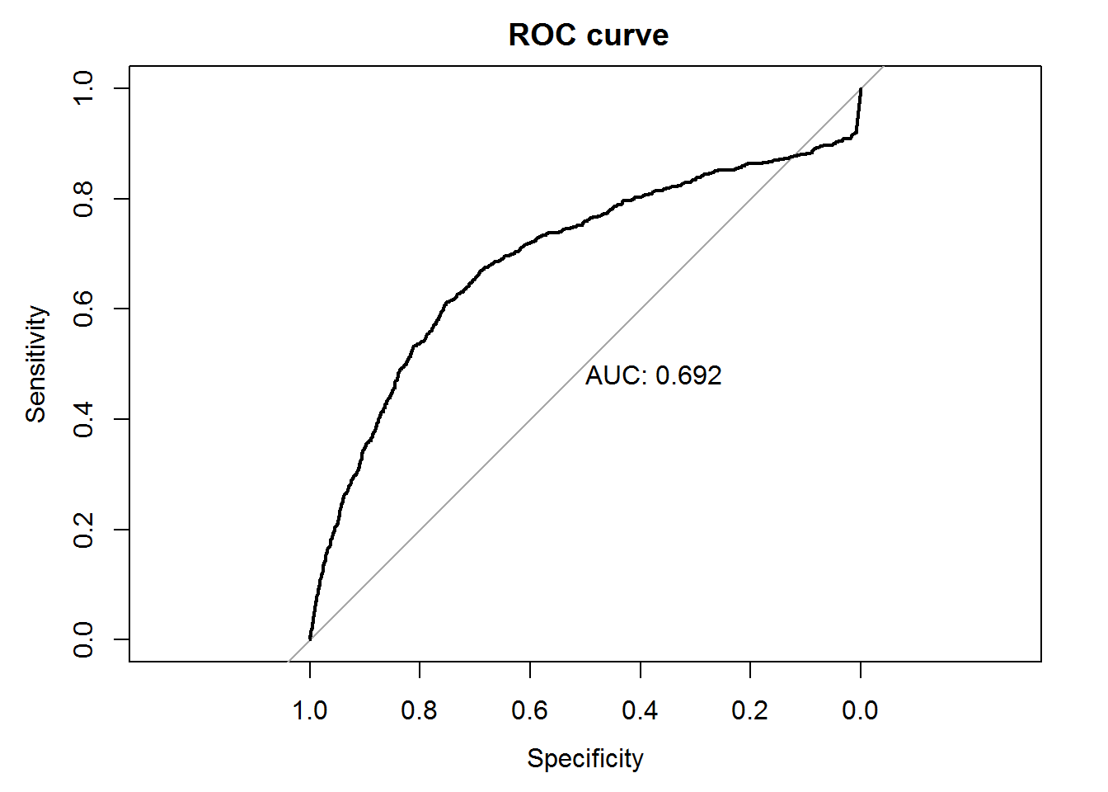
FLC IRL

Slide 24
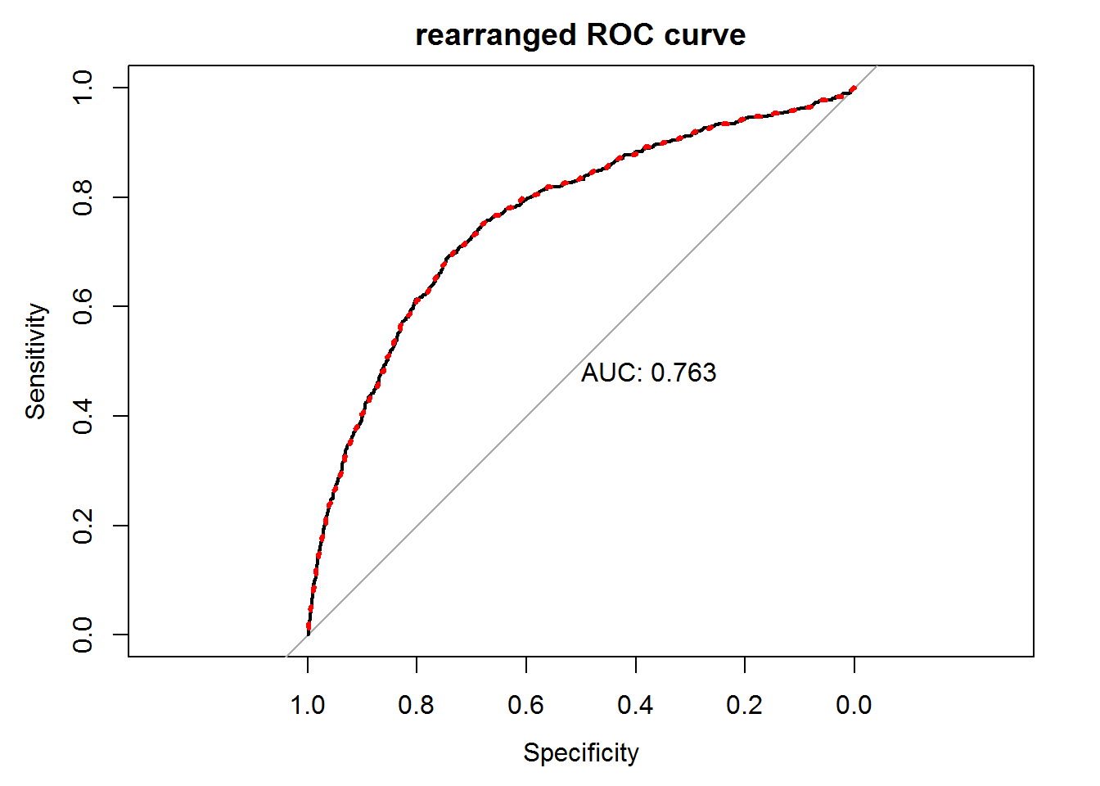

Slide 25
Area Under the Curve (AUC)
Reduces the ROC curve to a single number.
Relates to how well the positive and negative cases are separated by the test.
May not be what you really want to optimize.

Slide 26
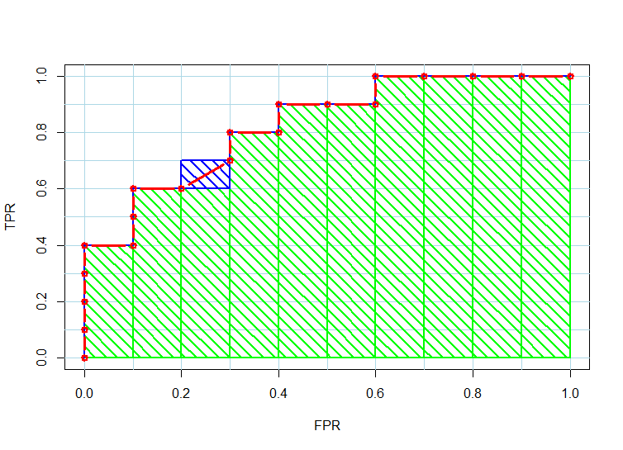
labels <- c(1, 1, 1, 1, 0, 1, 1, 0, 1, 0, 1, 0, 1, 0, 0, 1, 0, 0, 0, 0)
scores <- rev(seq_along(labels))
scores[9:10] <- mean(scores[9:10])
Notes:
The simulated data for this plot has exctly 10 positive and 10 negative samples. This makes the step sizes on both axes fall on a grid.

Slide 27
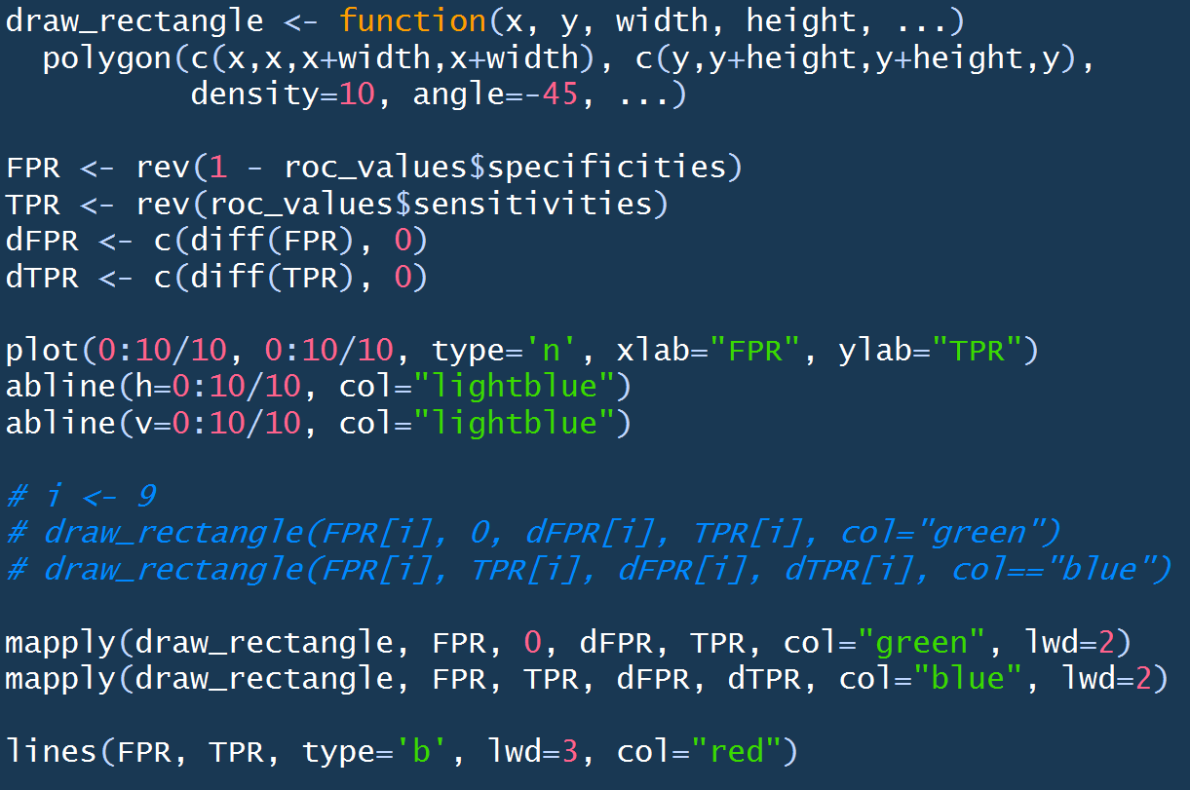

Slide 28
simple_auc <- function(TPR, FPR){
dFPR <- c(diff(FPR), 0)
dTPR <- c(diff(TPR), 0)
sum(TPR * dFPR) + sum(dTPR * dFPR)/2
}

Slide 29
How well does your classifier separate the classes?
Is the ordering of red and black dots random?
Notes:
plot(1:nrow(glm_simple_roc), rep(1, nrow(glm_simple_roc)), col=1+glm_simple_roc$labels, bg=1+glm_simple_roc$labels, pch=21)
plot(1:nrow(glm_simple_roc), rep(1, nrow(glm_simple_roc)), col=2*glm_simple_roc$labels, bg=2*glm_simple_roc$labels, pch=21)
col <- ((glm_simple_roc$labels+1) %% 2)
plot(1:nrow(glm_simple_roc), rep(1, nrow(glm_simple_roc)), col=col, bg=col, pch=21)

Slide 30

Mann-Whitney-Wilcoxon U statistic
auc_mww <- function(labels, scores){
pos <- scores[labels]
neg <- scores[!labels]
U <- wilcox.test(pos, neg)$statistic
U/(length(pos) * length(neg))
}
See Mann–Whitney U test in Wikipedia
Notes:
The U-test is a nonparametric alternative to the t-test. It is more robust to outliers, and does not assume the populations are normally distributed.

Slide 31
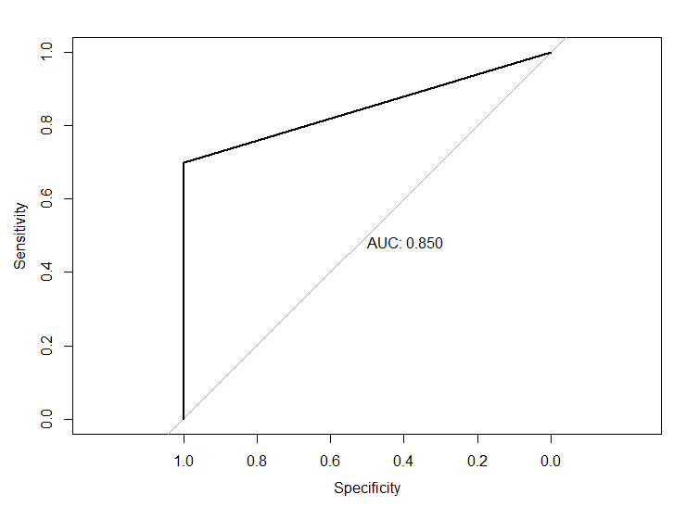
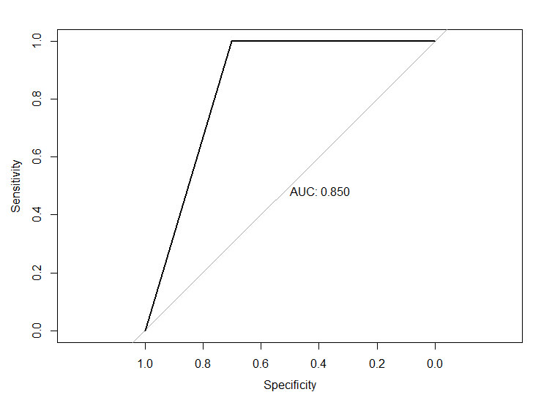
Two models with equal AUCs
Better at identifying positive cases.
Better at identifying negative cases.

Slide 32
Related plots
Gain
Lift
Precision-recall

Slide 33
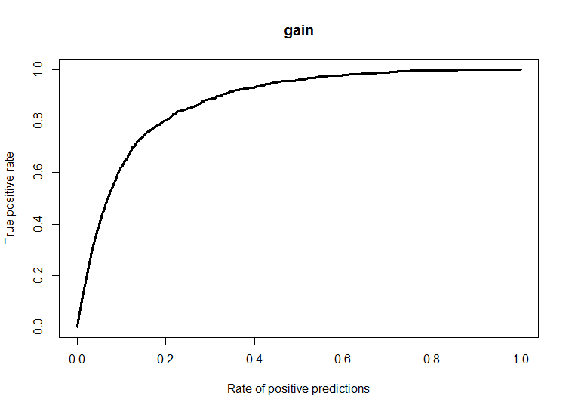
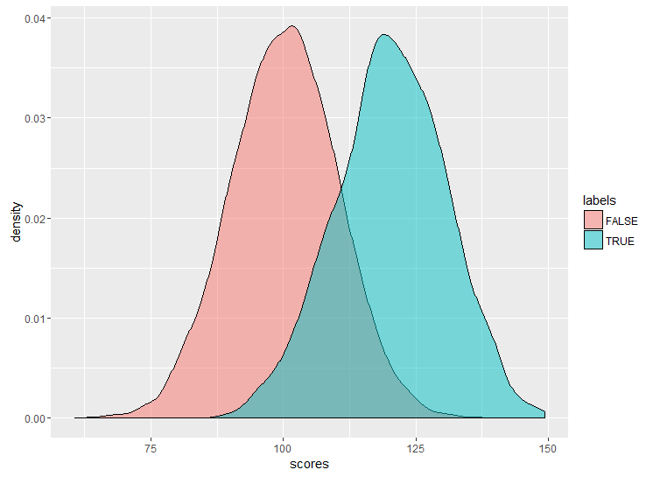
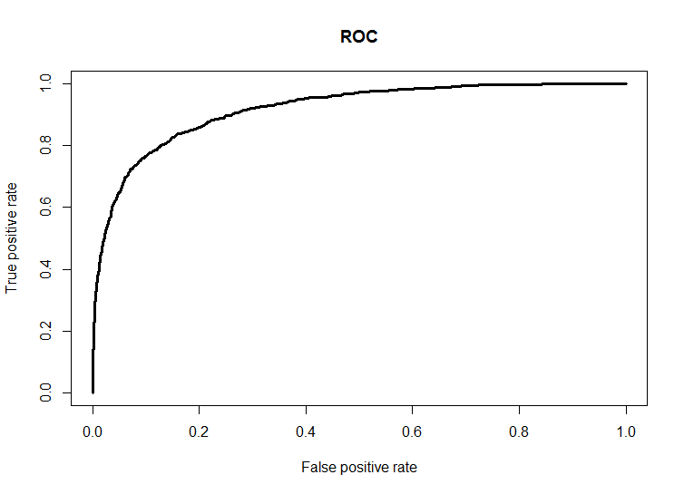
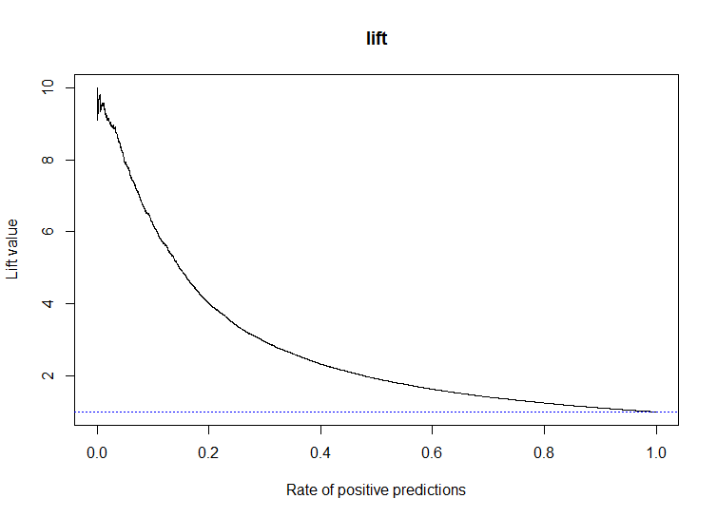
10,000 samples, 10% positive
Notes:
Gain and lift curves show total samples classified as positive on X-axis (ROC curve just shows fraction of negatives classified as positive).
A gain curve makes it easier to ask “what fraction of samples will need to be positive before 50% of the actual positives are detected”.

Slide 34
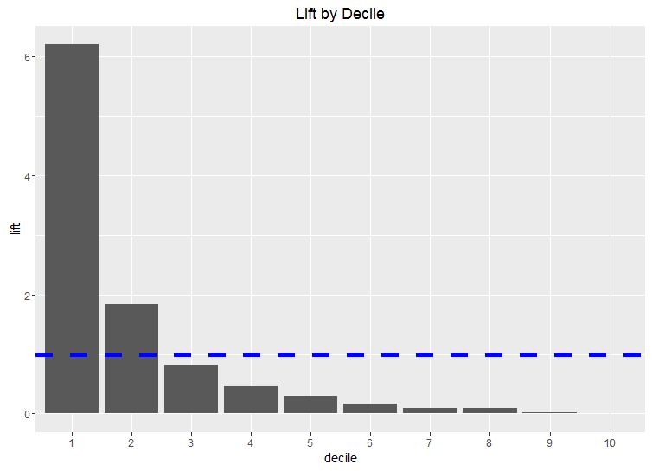

Slide 35
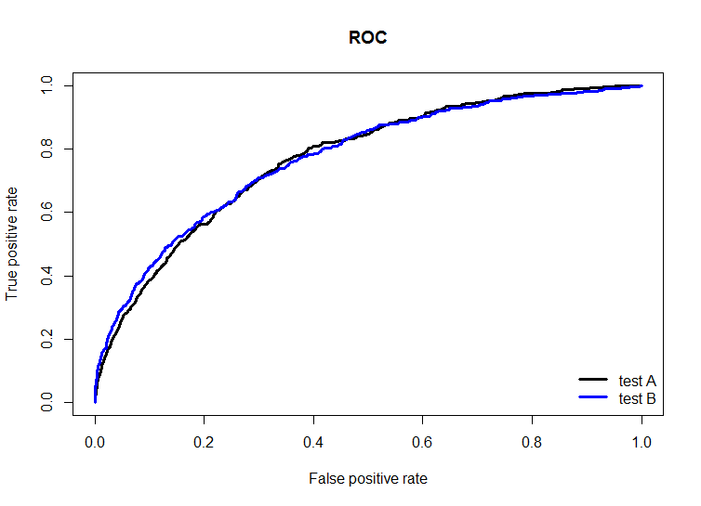
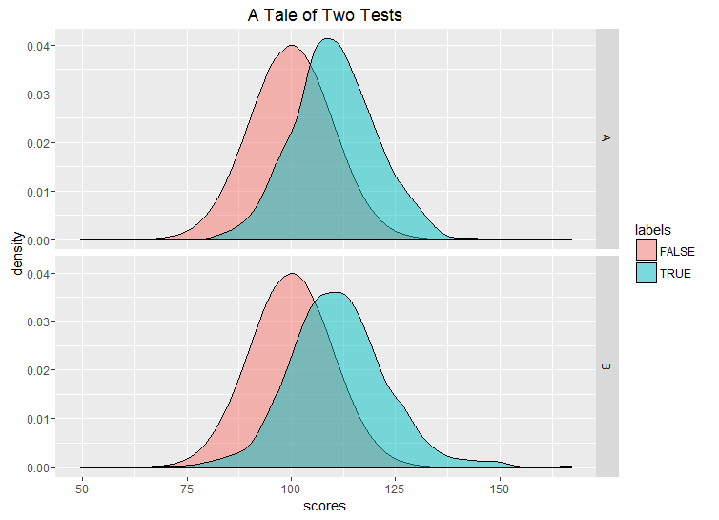
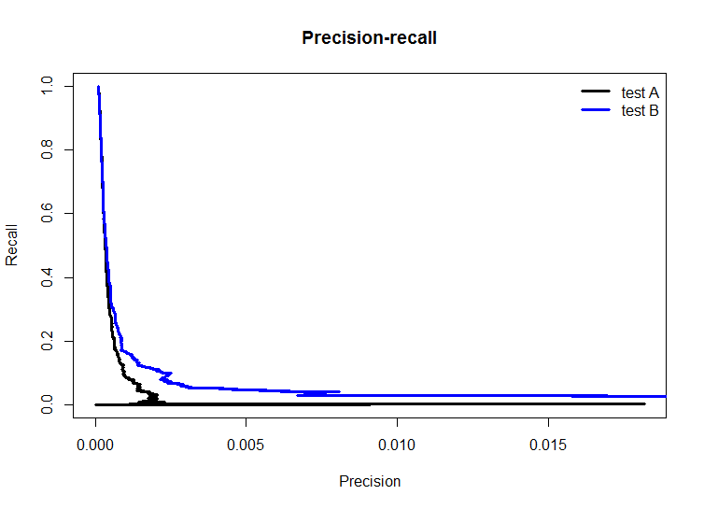
Precision is sensitive to class imbalance. ROC is not.
Prevalence of positive cases = 0.01%, N=5 million

Slide 36
Further Reading
Fawcett, T. An Introduction to ROC Analysis (Pattern Recognition Letters 27; 861–874, 2006)
Horton, R. ROC Curves in Two Lines of R Code (Revolutions Blog)
Berrizbeitia, L. Receiver Operating Characteristic (ROC) Curves (Shiny App)
Kanchanaraksa, S. Evaluation of Diagnostic and Screening Tests: Validity and Reliability (Johns Hopkins)
Kruchten, N. ML Meets Economics (blog post)

Slide 37
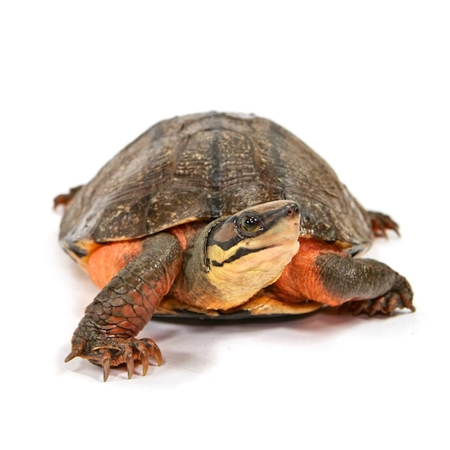
Thank You
turtleconservancy.org

