Slide 1
Funny-Looking ROC Curves

Slide 2
FLC IRL
Notes:
Funny-Looking ROC Curve In Real Life: Here the scores were predicted probabilities from a machine learning model that assumed that no score could be a perfect 1; the ones were truncated to zeros. This means the cases that were actually most likely to be positive were given the lowest possible score.

Slide 3
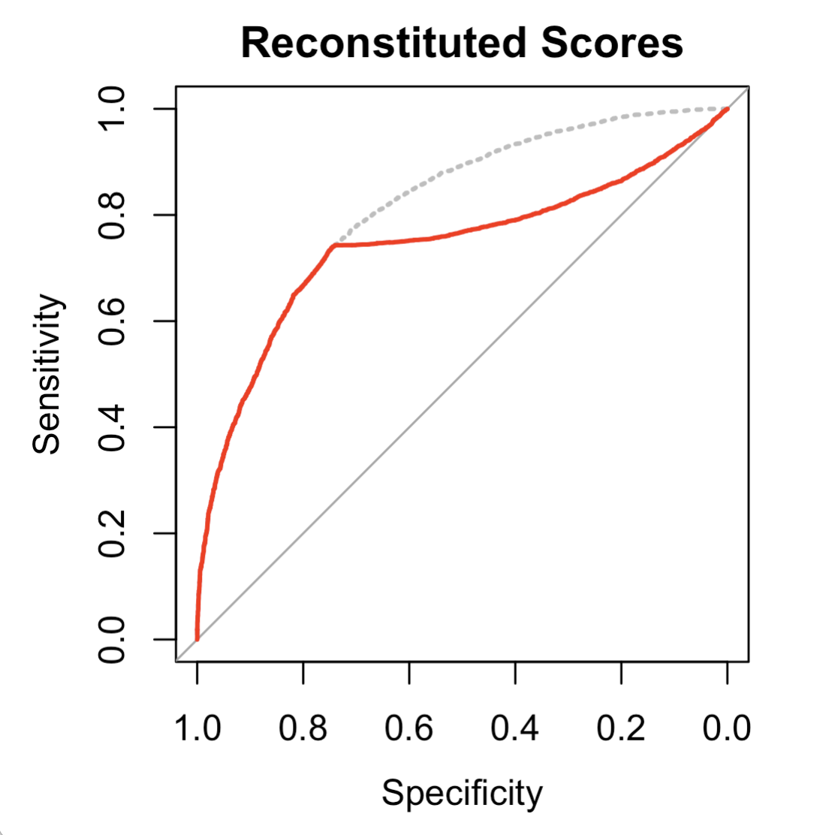
Notes:
This post is re-created from a real-life example. A data scientist tried to combine outputs from a model that returned a predicted class and a confidence into a single score. Predicting the actual class from this combined score gave the ROC curve shown by the red line. Combining the original model outputs differently gave the curve shown by the dotted gray line.
The scores giving the red line were used in a popular scoring service, and it took a long time before anyone noticed this behavior. Part of the reason for this is probably that if you use this kind of score as a predictor in a sophisticated ML model, the model can figure out the relationship between the score and the outcome, and account for the non-monotonicity. Not all ML models do that automatically, however (this would be a problem with simple linear regression, for example).

Slide 4

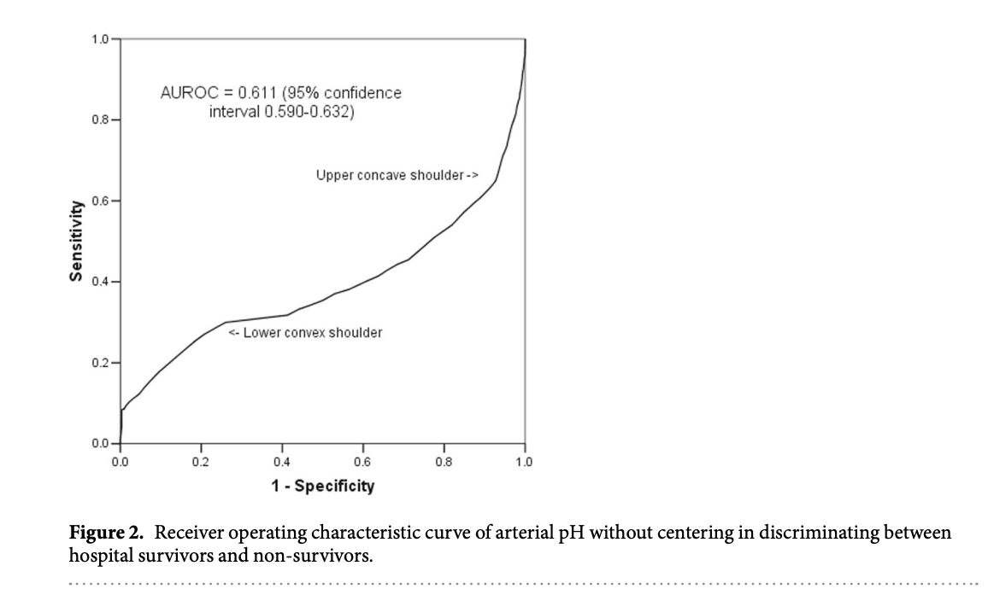

Slide 5
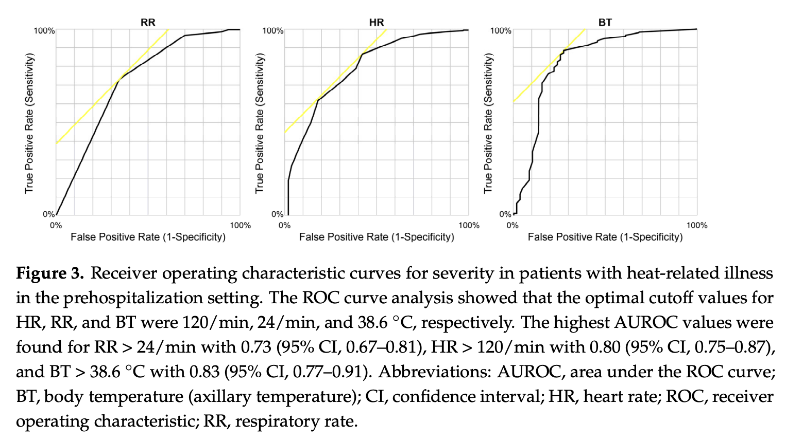


Slide 6
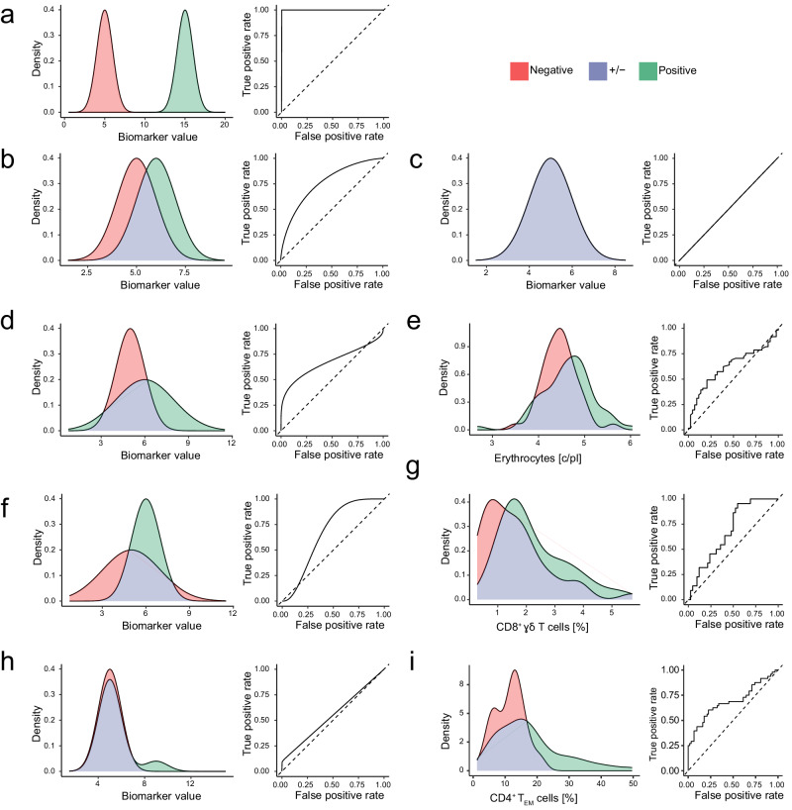
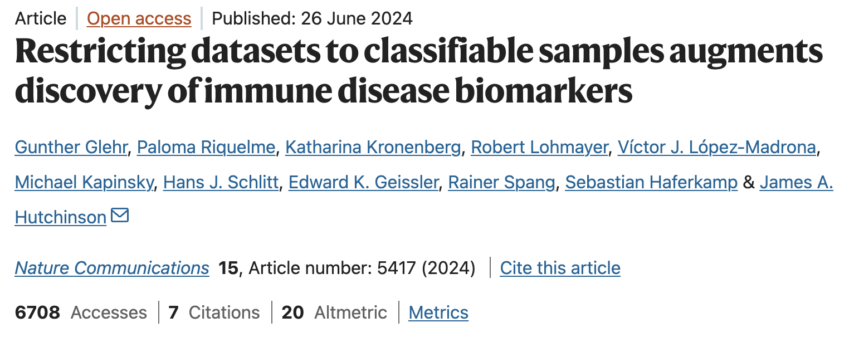
Fig. 1. Two-class distributions resulting in asymmetric ROC curves.

