Slide 1



Approaches to Optimizing Medical Treatment Policy using Temporal Causal Model-Based Simulation NeurIPS Workshop on Synthetic Data for Empowering ML Research 2 Dec 2022
Robert M Horton
rhorton@microsoft.com
Maryam Tavakoli Hosseinabadi
Maryam.Tavakoli@microsoft.com
John Mark Agosta
John-Mark.Agosta@microsoft.com

Slide 2
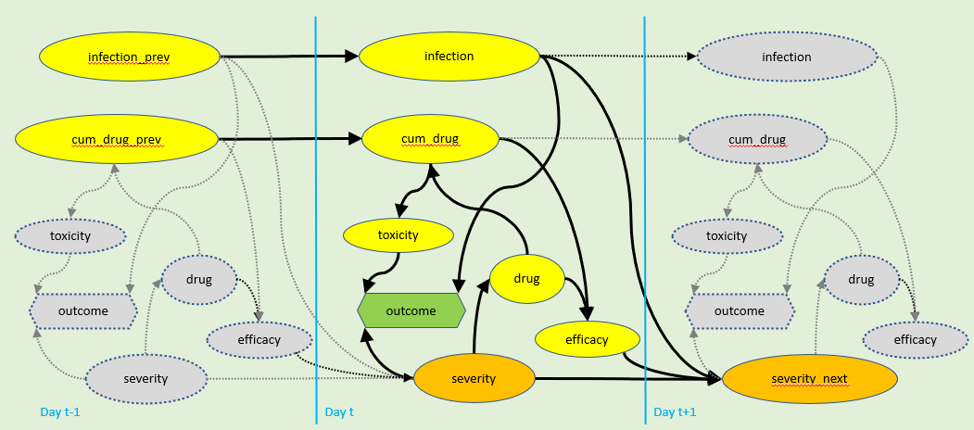
Build simulators with causal models extended by domain knowledge
Bogovirus disease model incorporates confounding by severity

Slide 3
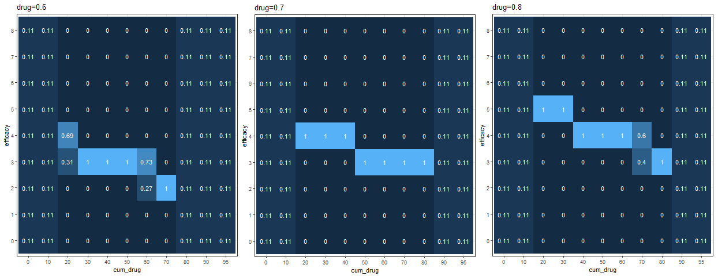
Use domain knowledge to extrapolate predictions
Conditional Probability Table from Bayes Net model
No data for extreme values – extrapolate

Slide 4
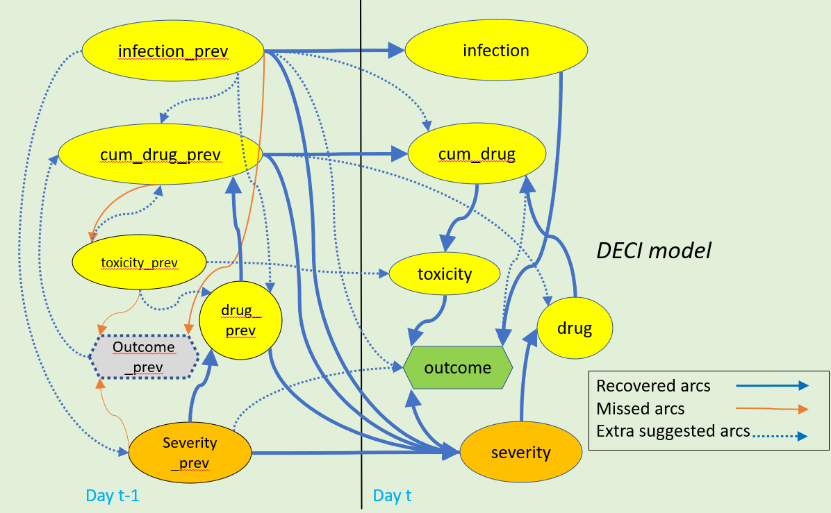
Causal models use data + domain knowledge

Slide 5
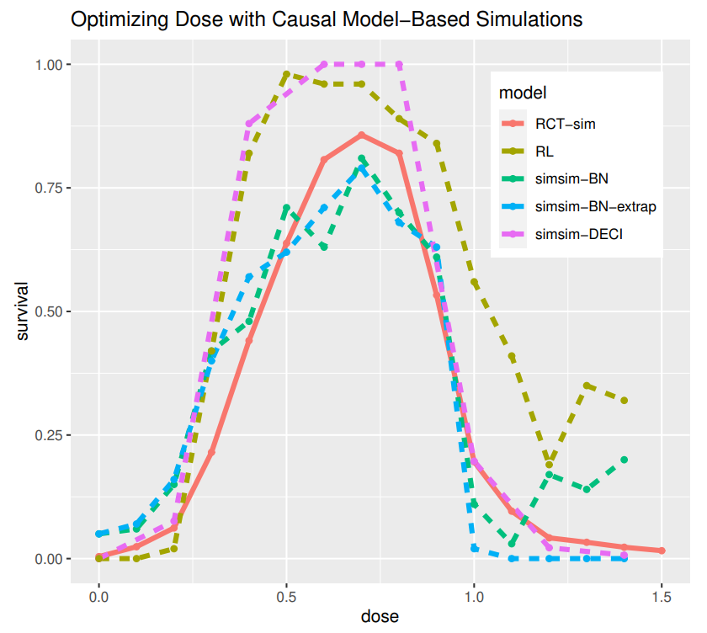
Explore policies in simulations

Slide 6

Approaches to Optimizing Medical Treatment Policy using Temporal Causal Model-Based Simulation
SyntheticData4ML Workshop, NeurIPS 2022
Robert Horton rhorton@microsoft.com,
Maryam Tavakoli Hosseinabadi Maryam.Tavakoli@microsoft.com,
John-Mark Agosta john-mark.Agosta@microsoft.com

Slide 7
Figures

Slide 8
infection_prev
infection
live
cum_drug_prev
cum_drug
toxicity
drug
die
efficacy
severity
severity_next

Slide 9
infection_prev
infection
infection
cum_drug_prev
cum_drug
cum_drug
toxicity
toxicity
toxicity
drug
drug
drug
outcome
outcome
outcome
efficacy
efficacy
efficacy
severity
severity
severity_next
Day t-1
Day t
Day t+1

