Slide 1
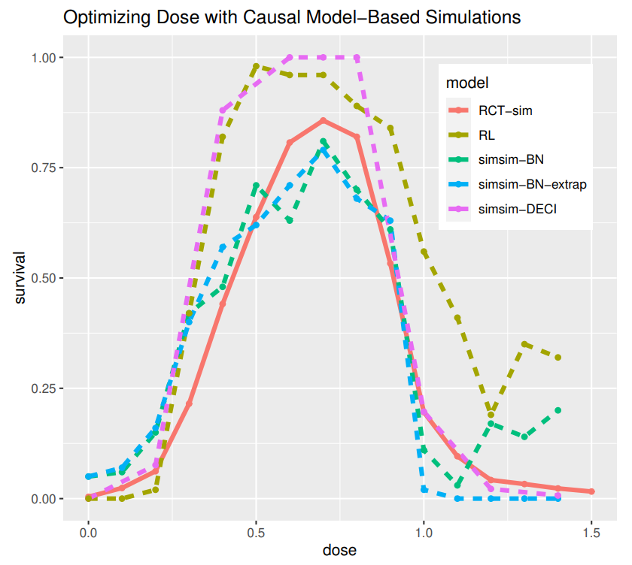
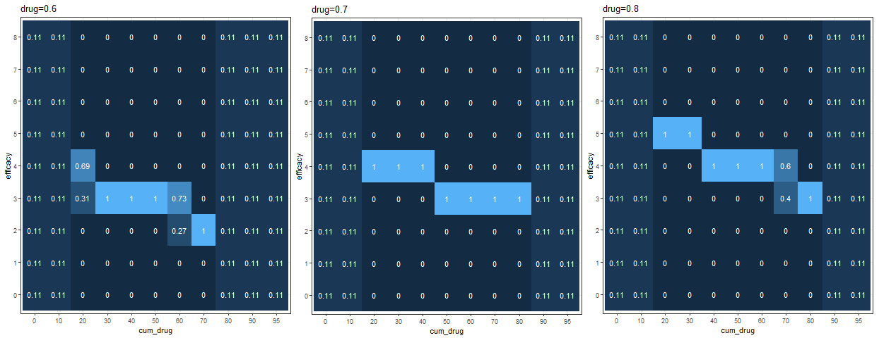
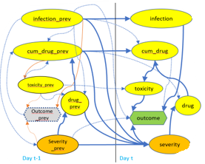
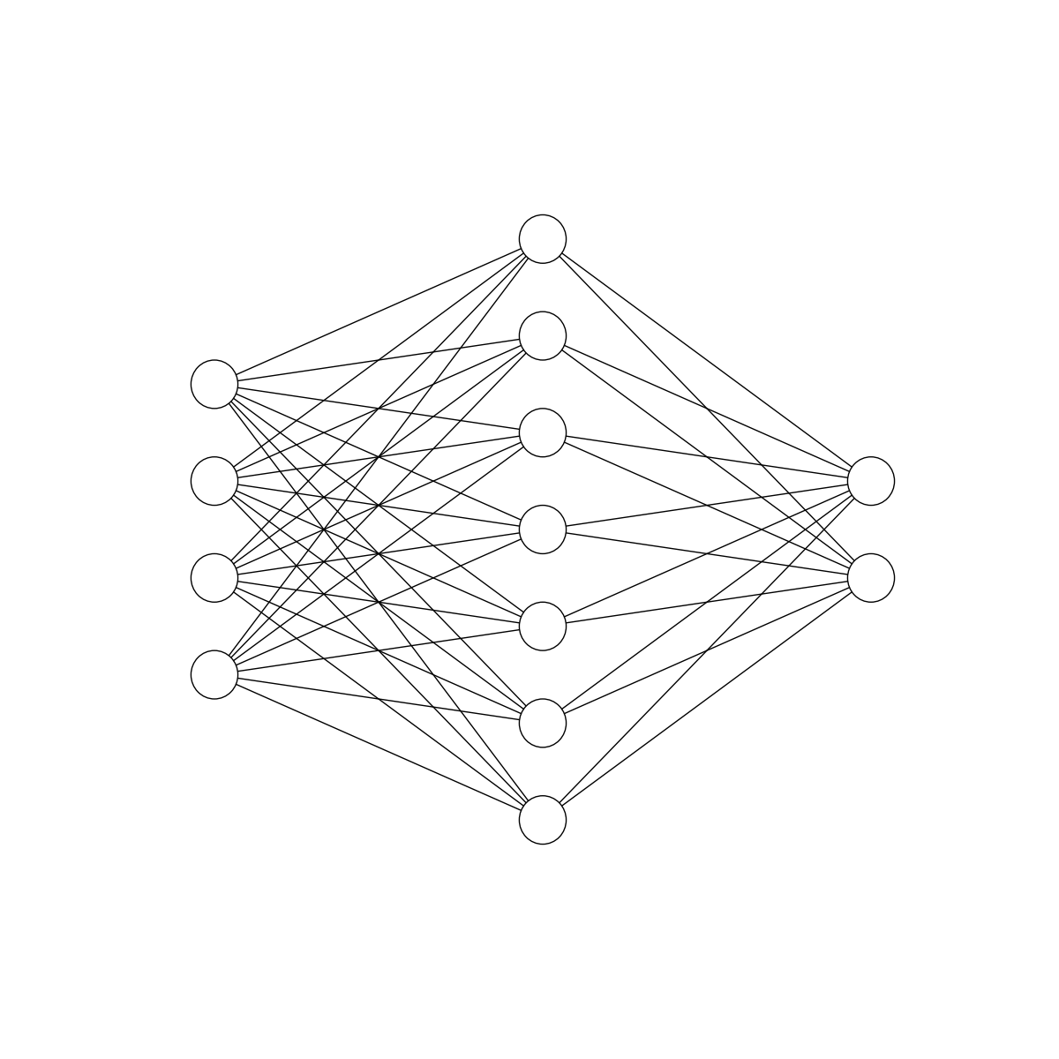



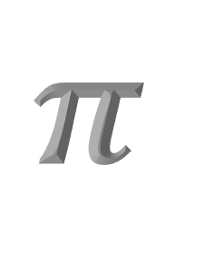
Build simulators with causal models extended by domain knowledge
infection_prev
infection
infection
cum_drug_prev
cum_drug
cum_drug
toxicity
drug
toxicity
drug
toxicity
drug
outcome
efficacy
outcome
efficacy
outcome
efficacy
severity
severity
severity_next
Day t-1
Day t
Day t+1
Bogovirus disease model incorporates confounding by severity
Explore policies in simulations
Use domain knowledge to extrapolate predictions
Conditional Probability Table from Bayes Net model
No data for extreme values – extrapolate
With causal models we can build better simulators
Causal models use
data + domain knowledge
Your data
$$π$$
infection_prev
infection
cum_drug_prev
cum_drug
Simulator
Policy
to find fair, explainable, optimal policies
toxicity_prev
drug_prev
toxicity
DECI model
Outcome_prev
outcome
drug
Severity
_prev
severity
Recovered arcs
Missed arcs
Extra suggested arcs
Robert Horton, Maryam Tavakoli Hosseinabadi, John-Mark Agosta
Approaches to Optimizing Medical Treatment Policy using Temporal Causal Model-Based Simulation
SyntheticData4ML Workshop, NeurIPS 2022
Day t-1
Day t

