Slide 1
Multi-Stage Simpson’s Paradox Machine
Bob Horton
cybertory@gmail.com
https://github.com/rmhorton/multistage_simpson

Slide 2
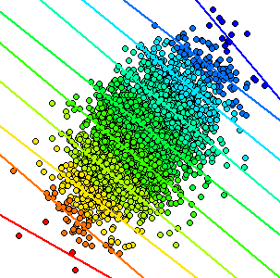
Color by disease severity
Pain
Treatment

Slide 3
Color by school
Verbal score
Math score

Slide 4
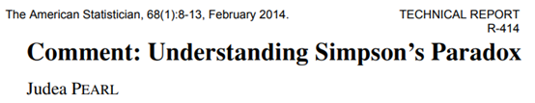
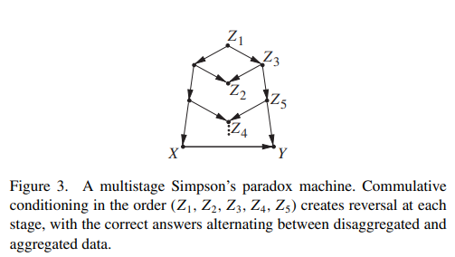

Slide 5
Confounder
Z
X
Y

Slide 6
Collider
Z
X
Y

Slide 7
Mediator
Z
X
Y

Slide 8
Loop
Z
X
Y
We can’t handle loops (think temporal paradoxes in Star Trek). Sometimes we can remove them by unrolling in time, but that is a different topic.

Slide 9
Z1
Multi-Stage Simpson’s Paradox Machine
Z3
Z3b
Z2
Z5b
Z5
Z4
…
X
Y

Slide 10
Demo

Slide 11
Feedback
Did the firehose approach work?
Yes: I'm going home with lots to think about
Maybe: I don't know yet
No: it just confused everything

Slide 12
What next?
EBMs
Analyze Python objects in R
extract parameters
smooth the curves
predict in SQL
Causal-model based simulations
Temporal unrolling
Incorporating domain knowledge
causal graph
Extrapolation

