Slide 1
Introduction to Data Science for Administrators
EMRTS

Slide 2
What could you do with your data if it were well organized?
Legacy system
(a miracle occurs)
Data Lakehouse

Slide 3
Databases
Relational databases
SQL: Structured Query Language
Hierarchical databases
MUMPS, VistA, Intersystems Caché
Document stores
XML, JSON
QLs: Xquery, JMESPath, etc.
Graph databases
Semantic web, knowledge graphs
QLs: SPARQL, Gremlin, Cypher, ...

Slide 4
Levels of Data Analytics
Descriptive: “BI”
Trends and relationships
Predictive: machine learning
Which patients are most at risk for this disease?
Does this claim look fraudulent?
Prescriptive: causal modeling
Will this change increase revenue?
What should I do to reduce harmful outcomes?
How would I answer this question with an experiment?
Notes:
https://online.hbs.edu/blog/post/descriptive-analytics

Slide 5
Hands-on Workshop: Database Paradigms
SQL or NoSQL ?

Slide 6
Hands-on Workshop: Sanity-Checking Data
Is this weird ?

Slide 7
Hands-on Workshop: Machine Learning
Which patients are at highest risk for diabetes-related amputation?

Slide 8
Measuring the effect of an intervention on an outcome
Your job is to analyze data from an experiment to determine how effective wound care education is for preventing amputation in people with diabetes.
We use machine learning to select patients to include in the study.
We use simulated data so you don’t have to worry about privacy, lives or money (for now).

Slide 9
Allergies
START
STOP
PATIENT
ENCOUNTER
CODE
SYSTEM
DESCRIPTION
TYPE
CATEGORY
REACTION1
DESCRIPTION1
SEVERITY1
REACTION2
DESCRIPTION2
SEVERITY2
Imaging_Studies
Id
DATE
PATIENT
ENCOUNTER
SERIES_UID
BODYSITE_CODE
BODYSITE_DESCRIPTION
MODALITY_CODE
MODALITY_DESCRIPTION
INSTANCE_UID
SOP_CODE
SOP_DESCRIPTION
PROCEDURE_CODE
Claims
Id
PATIENTID
PROVIDERID
PRIMARYPATIENTINSURANCEID
SECONDARYPATIENTINSURANCEID
DEPARTMENTID
PATIENTDEPARTMENTID
DIAGNOSIS1
DIAGNOSIS2
DIAGNOSIS3
DIAGNOSIS4
DIAGNOSIS5
DIAGNOSIS6
DIAGNOSIS7
DIAGNOSIS8
REFERRINGPROVIDERID
APPOINTMENTID
CURRENTILLNESSDATE
SERVICEDATE
SUPERVISINGPROVIDERID
STATUS1
STATUS2
STATUSP
OUTSTANDING1
OUTSTANDING2
OUTSTANDINGP
LASTBILLEDDATE1
LASTBILLEDDATE2
LASTBILLEDDATEP
HEALTHCARECLAIMTYPEID1
HEALTHCARECLAIMTYPEID2
Synthea Tables
Primary Key
Foreign Key
ontology code
Patients
Id
BIRTHDATE
DEATHDATE
SSN
DRIVERS
PASSPORT
PREFIX
FIRST
LAST
SUFFIX
MAIDEN
MARITAL
RACE
ETHNICITY
GENDER
BIRTHPLACE
ADDRESS
CITY
STATE
COUNTY
ZIP
LAT
LON
HEALTHCARE_EXPENSES
HEALTHCARE_COVERAGE
Payer_Transitions
PATIENT
MEMBERID
START_YEAR
END_YEAR
PAYER
SECONDARY_PAYER
OWNERSHIP
OWNERNAME
Claims_Transactions
ID
CLAIMID
CHARGEID
PATIENTID
TYPE
AMOUNT
METHOD
FROMDATE
TODATE
PLACEOFSERVICE
PROCEDURECODE
MODIFIER1
MODIFIER2
DIAGNOSISREF1
DIAGNOSISREF2
DIAGNOSISREF3
DIAGNOSISREF4
UNITS
DEPARTMENTID
NOTES
UNITAMOUNT
TRANSFEROUTID
TRANSFERTYPE
PAYMENTS
ADJUSTMENTS
TRANSFERS
OUTSTANDING
APPOINTMENTID
LINENOTE
PATIENTINSURANCEID
FEESCHEDULEID
PROVIDERID
SUPERVISINGPROVIDERID
Payers
Id
NAME
ADDRESS
CITY
STATE_HEADQUARTERED
ZIP
PHONE
AMOUNT_COVERED
AMOUNT_UNCOVERED
REVENUE
COVERED_ENCOUNTERS
UNCOVERED_ENCOUNTERS
COVERED_MEDICATIONS
UNCOVERED_MEDICATIONS
COVERED_PROCEDURES
UNCOVERED_PROCEDURES
COVERED_IMMUNIZATIONS
UNCOVERED_IMMUNIZATIONS
UNIQUE_CUSTOMERS
QOLS_AVG
MEMBER_MONTHS
Organizations
Id
NAME
ADDRESS
CITY
STATE
ZIP
LAT
LON
PHONE
REVENUE
UTILIZATION
Encounters
Id
START
STOP
PATIENT
ORGANIZATION
PROVIDER
PAYER
ENCOUNTERCLASS
CODE
DESCRIPTION
BASE_ENCOUNTER_COST
TOTAL_CLAIM_COST
PAYER_COVERAGE
REASONCODE
REASONDESCRIPTION
Providers
Id
ORGANIZATION
NAME
GENDER
SPECIALITY
ADDRESS
CITY
STATE
ZIP
LAT
LON
UTILIZATION
Medications
START
STOP
PATIENT
PAYER
ENCOUNTER
CODE
DESCRIPTION
BASE_COST
PAYER_COVERAGE
DISPENSES
TOTALCOST
REASONCODE
REASONDESCRIPTION
Conditions
START
STOP
PATIENT
ENCOUNTER
CODE
DESCRIPTION
Procedures
START
STOP
PATIENT
ENCOUNTER
CODE
DESCRIPTION
BASE_COST
REASONCODE
REASONDESCRIPTION
Careplans
Id
START
STOP
PATIENT
ENCOUNTER
CODE
DESCRIPTION
REASONCODE
REASONDESCRIPTION
Observations
DATE
PATIENT
ENCOUNTER
CATEGORY
CODE
DESCRIPTION
VALUE
UNITS
TYPE
Devices
START
STOP
PATIENT
ENCOUNTER
CODE
DESCRIPTION
UDI
Supplies
DATE
PATIENT
ENCOUNTER
CODE
DESCRIPTION
QUANTITY
Immunizations
DATE
PATIENT
ENCOUNTER
CODE
DESCRIPTION
BASE_COST
Notes:
In this slide, we can see all the Entities in Synthea. The Yellow attributes are primary keys in each table and the blue ones are the foreign keys for defining relationships between the tables. With this information, you can draw its ERD (Entity-Relationship Diagram). Note that some tables are fine without any primary key, as no other table is referring to them [they are the many-side of the relationships] -- e.g., Medication table.
Note that CODE columns (in green) usually map to standard clinical vocabularies or ontologies such as SNOMED or ICD10. These tables are "denormalized" in that the code descriptions are copied into the tables, so you don't need to look them up every time. The downside of this denormalization is that the description for a given code is repeated each time the code appears, and it is possible for multiple descriptions to be stored for a code.

Slide 10
Predictive modeling with machine learning: Who is at risk?
features
outcome
age | sex | BMI | race | ... | eyes | homeless | married | HbA1c | amputation
42 | F | 25 | W |  | brown | no | no | 4 | no
81 | M | 32 | B |  | green | yes | no | 5 | no
68 | F | 29 | N |  | blue | no | yes | 12 | yes
55 | F | 41 | A |  | brown | no | yes | 9 | no
patients

Slide 11
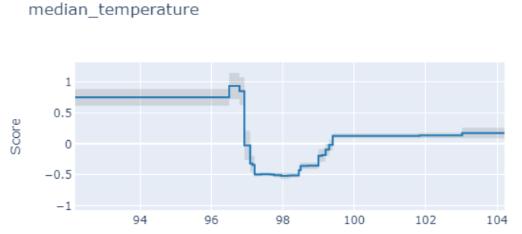
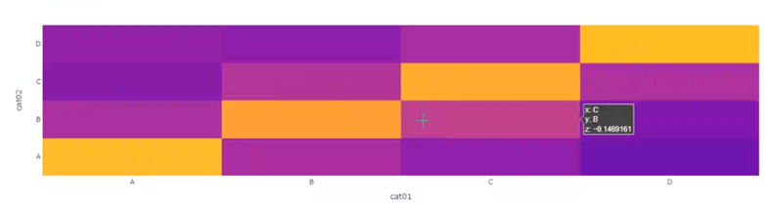
Explainable Boosting Machine (EBM)
a fast implementation of GA²M Generalized Additive Model Plus Interactions
functions of individual features
'heatmaps' of
interacting feature pairs
link function
expected outcome
constant
Open-source implementation: https://interpret.ml
"InterpretML: A Unified Framework for Machine Learning Interpretability" (H. Nori, S. Jenkins, P. Koch, and R. Caruana 2019)
Notes:
Glass-box models are models that are interpretable due to their structure. Examples include linear models, rule lists, generalized additive models, and GA²Ms (EBMs).
EBMs rival the prediction abilities of the best full-complexity models such as random forests and gradient boosting machines, while being highly interpretable.
An EBM model consists of a constant term, arbitrary functions of individual features, and functions of feature pairs.

Slide 12
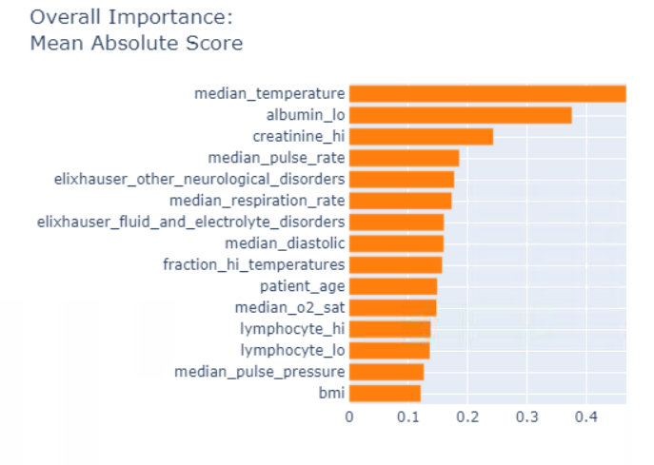
Interpreting an EBM Model
Use case: use COVID-19 patient data to predict the likelihood of ventilation within 72 hours
Notes:
EBM models are easy to interpret:
The EBM algorithm found median temperature to be the most important feature
Furthermore, EBM found that a temperature that is too low or too high predicts a higher likelihood of ventilation, while having a normal temperature lowers the predicted likelihood of ventilation.

Slide 13
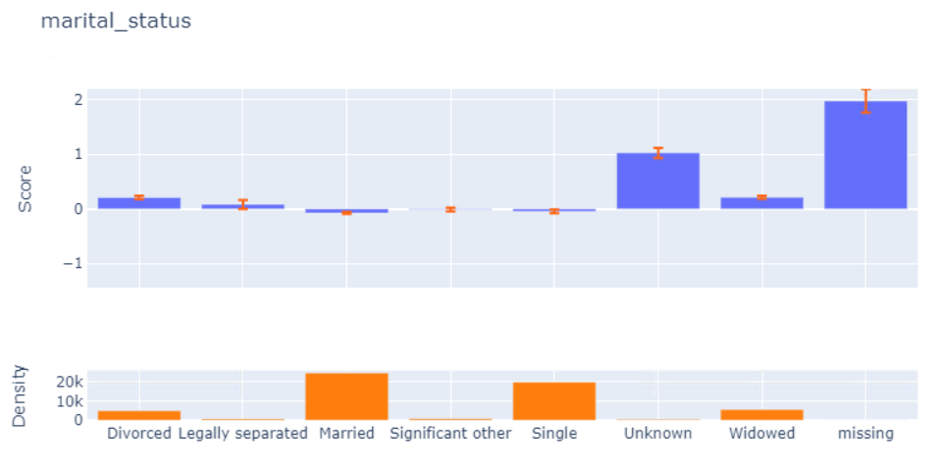
Missingness is meaningful
Notes:
EBMs can help us better understand our data.
The model shows that if marital_status is Unknown or missing, it tends to predict a higher chance of ventilation. This may be because patients in imminent need of ventilation coming into the ER are too sick to provide their marital status.

Slide 14
Hands-on Workshop on Statistical Analysis of a Policy Experiment How can we tell if a healthcare policy is effective?
It’s complicated

Slide 15

Animal experiments are easy
All of these mice get the treatment.
None of these mice get the treatment.
They all eat the same diet and live in exactly the same conditions.
Inbred mice are genetically identical.
Notes:
EBMs can help us better understand our data.
The model shows that if marital_status is Unknown or missing, it tends to predict a higher chance of ventilation. This may be because patients in imminent need of ventilation coming into the ER are too sick to provide their marital status.

Slide 16

Real-life experiments on people are hard
They drink, smoke, have varied diets, live in different conditions, etc.
They are genetically diverse.
They don’t necessarily do what you want them to do.
Notes:
EBMs can help us better understand our data.
The model shows that if marital_status is Unknown or missing, it tends to predict a higher chance of ventilation. This may be because patients in imminent need of ventilation coming into the ER are too sick to provide their marital status.

Slide 17
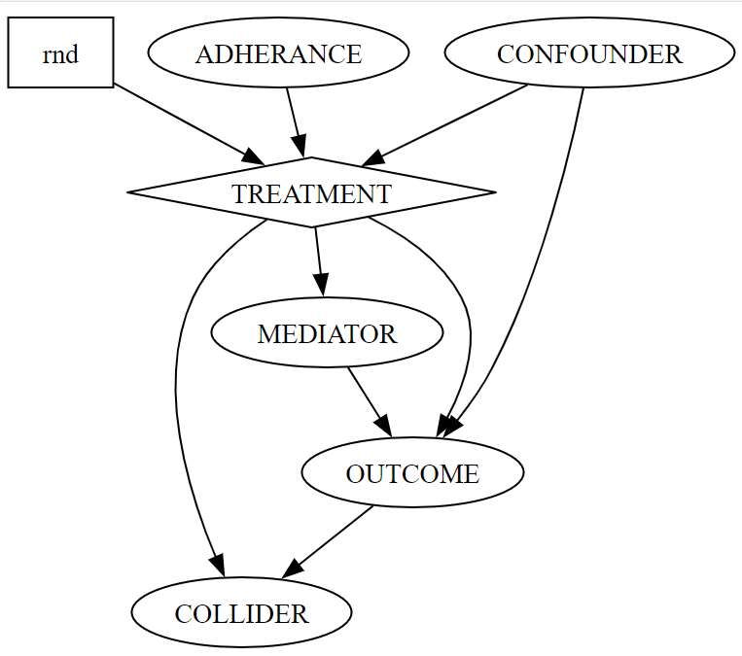
Statistical Confounding
Notes:
EBMs can help us better understand our data.
The model shows that if marital_status is Unknown or missing, it tends to predict a higher chance of ventilation. This may be because patients in imminent need of ventilation coming into the ER are too sick to provide their marital status.

