Slide 1

Data Architect Assesment
Rosa Mestres
June 2025

Slide 2
Content
Data-Driven Platform to Accelerate AI-Powered Sales Intelligence
EDW Architecture
E2E Sales Dashboard Design
Data Architect Assesment - Rosa Mestres | June 2025

Slide 3





Data-Driven Platform to Accelerate AI-Powered Sales Intelligence
01 Strategic Business Target
02 Expected Business Impact
Grow top-line above market
Technical excellence to increase business margin
Best in class service levels
Apply process automation
Enablement of AI models for sales and churn prediction
Increase 20% efficiency in strategic reporting
30% reduction in data operation costs
Global revenues increased by 5%
Time-to-insight reduced
03 Estimated investiment
04 Core Team Structure
1Mn€ for the Cloud Platform
2Mn€ for External Development / Consultancy
3 Data Architects (high knowledge of the Azure data platform)
3 Data Engineers
(medium knowledge of the Azure data platform)
Data Architect Assesment - Rosa Mestres | June 2025

Slide 4
Content
Data-Driven Platform to Accelerate AI-Powered Sales Intelligence
EDW Architecture
E2E Sales Dashboard Design
Data Architect Assesment - Rosa Mestres | June 2025

Slide 5
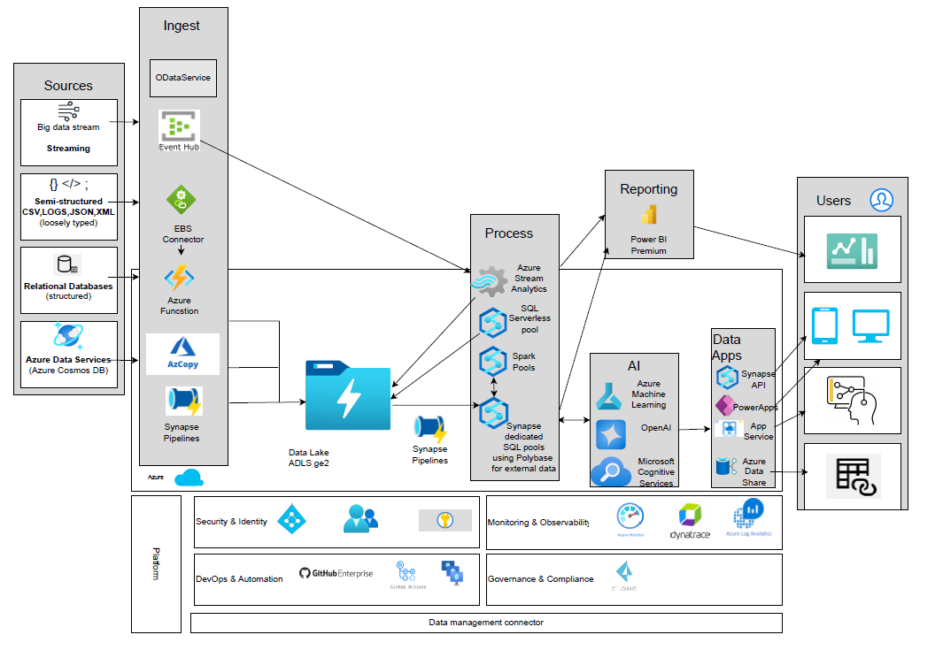
EDW Architecture Logical Architecture based on Azure
Data Architect Assesment - Rosa Mestres | June 2025

Slide 6
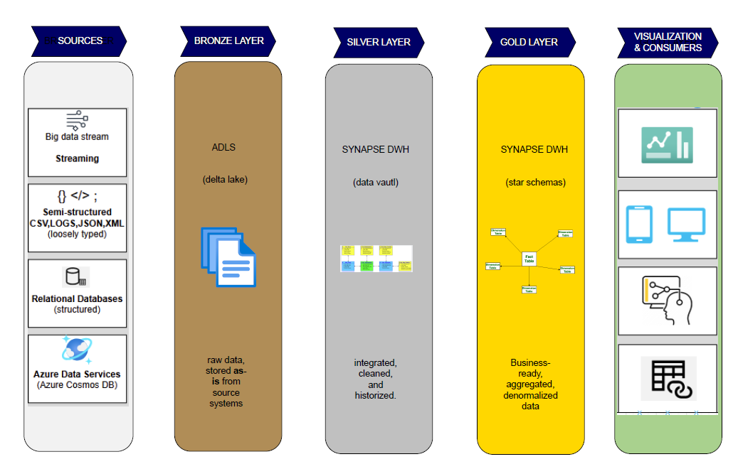
EDW Architecture Layers & Technical Design
Data Architect Assesment - Rosa Mestres | June 2025

Slide 7
EDW Architecture DataOps Efficiency & Control
CI/CD
Observability
GitHub Actions
GitHub Runners
Jira for backlog & sprint management
Confluence for project documentation
Automated deployement of: Data pipelines, Ml models, Power BI content
Azure Monitor
Dynatrace
Log Analytics
Unified logs, metrics and health across all data services
DataOps Efficiency & Control
Governance & Security
Reusable Artifacts
Cost Optimization
IDMC (Informatica)
Azure Purview
Azure Key Vault
Data Lineage, Access control, and credential management
Pipelines, notebooks, models & datasets as modular building blocks , linked services, db objects, scripts SQL if required, ML models
Promotes modularity, accelerates delivery, and reduces maintenance efforts.
Auto-pause SQL Pools
Tiering policies in ADLS
Light Power BI versiones for self-sevice
Smart resource use, cost control and elasticity
Data Architect Assesment - Rosa Mestres | June 2025

Slide 8
Content
Data-Driven Platform to Accelerate AI-Powered Sales Intelligence
EDW Architecture
E2E Sales Dashboard Design
Data Architect Assesment - Rosa Mestres | June 2025

Slide 9
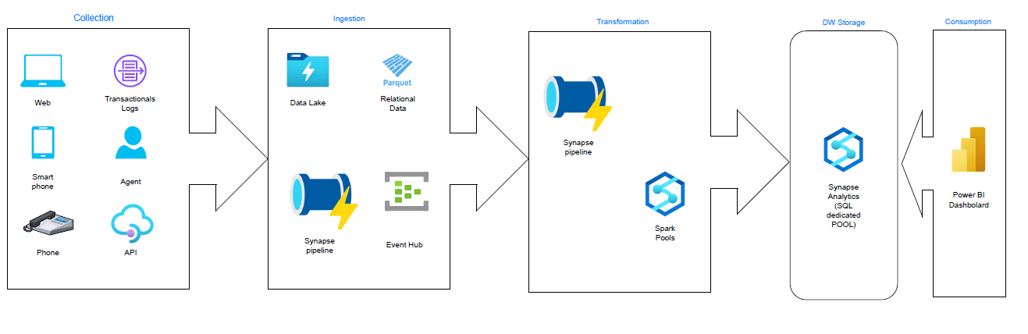
E2E Sales Dashboard Design Technical Pipeline Architecture
Data Architect Assesment - Rosa Mestres | June 2025

Slide 10
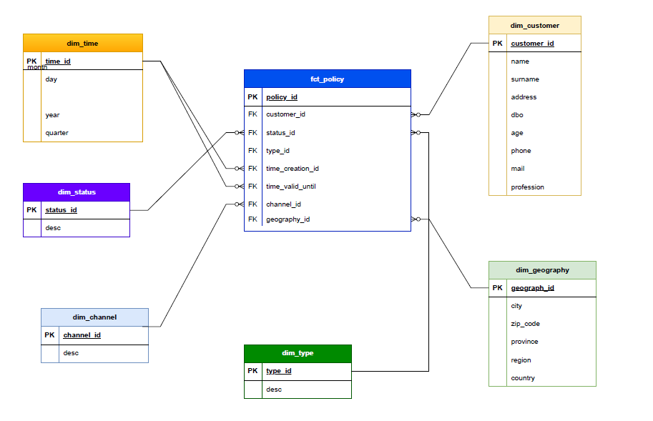
E2E Sales Dashboard Design Sales Policy Data Model
Data Architect Assesment - Rosa Mestres | June 2025

Slide 11

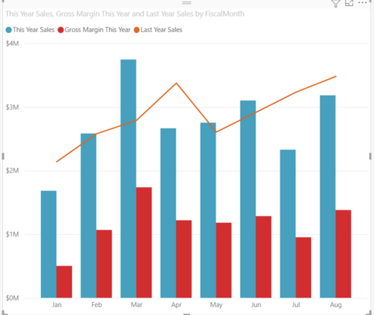
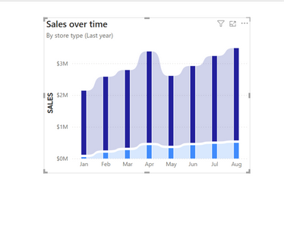
E2E Sales Dashboard Design Dashboard KPIs and Features
Filters
Data Range
Total Policies Sold
Revenue by Region & Channel
Conversion Rate by Channel
Monthly Sales Forecast (AI)
Sales Channel
1,800
1,800
1,800
1,800
Geography
AI Insights
Product/
Insurance Type
Data Architect Assesment - Rosa Mestres | June 2025

