Slide 1

Data Architect Assesment
Rosa Mestres
June 2025

Slide 2
Content
Enterprise Data Platform: Driving AI-Enhanced Sales Intelligence
Enterprise Data Warehouse Architecture
E2E Sales Dashboard Design
Data Architect Assesment - Rosa Mestres | June 2025

Slide 3

Data-Driven Platform to Accelerate AI-Powered Sales Intelligence
💼
Strategic Business Goals
📊
Expected Business Impact
+20% efficiency in strategic reporting
Grow top-line above market
Technical excellence to increase business margin
30% reduction in data operation costs
Time-to-insight reduced from days to minutes
Best in class service levels
Enablement of AI models for sales and churn prediction
Apply process automation
Next level
💰
Estimated Investment
👥
Core Team Structure
1Mn€ for the Cloud Platform
3 Data Architects (high knowledge of the Azure data platform)
3 Data Engineers
(medium knowledge of the Azure data platform)
2Mn€ for External Development / Consultancy
Data Architect Assesment - Rosa Mestres | June 2025

Slide 4
Data-Driven Platform to Accelerate AI-Powered Sales Intelligence
💼
Strategic Business Goals
📊
Expected Business Impact
Grow top-line above market
+ 20% efficiency in strategic reporting
Technical excellence to increase business margin
30% reduction in data operation costs
Best in class service levels
Time-to-insight reduced from days to minutes
Apply process automation
Enablement of AI models for sales and churn prediction
Next level
💰
Estimated Investment
👥
Core Team Structure
1Mn€ for the Cloud Platform
3 Data Architects (high knowledge of the Azure data platform)
3 Data Engineers
(medium knowledge of the Azure data platform)
2Mn€ for External Development / Consultancy
Data Architect Assesment - Rosa Mestres | June 2025

Slide 5





Data-Driven Platform to Accelerate AI-Powered Sales Intelligence
01 Strategic Business Target
02 Expected Business Impact
Grow top-line above market
Technical excellence to increase business margin
Best in class service levels
Apply process automation
+ 20% efficiency in strategic reporting
30% reduction in data operation costs
Time-to-insight reduced
Enablement of AI models for sales and churn prediction
03 Estimated investiment
04 Core Team Structure
1Mn€ for the Cloud Platform
2Mn€ for External Development / Consultancy
3 Data Architects (high knowledge of the Azure data platform)
3 Data Engineers
(medium knowledge of the Azure data platform)
Data Architect Assesment - Rosa Mestres | June 2025

Slide 6
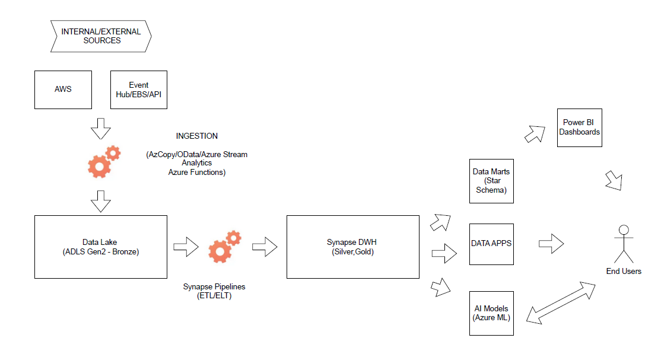
Enterprise Data Warehouse Architecture Logical Architecture
Data Architect Assesment - Rosa Mestres | June 2025

Slide 7
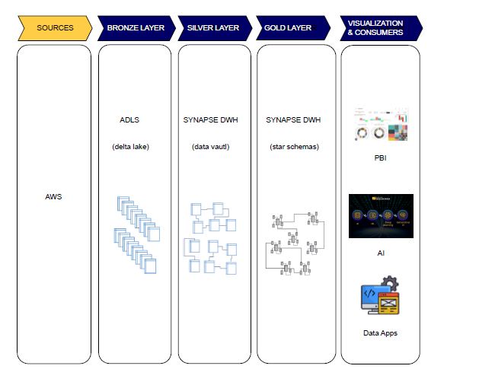
Enterprise Data Warehouse Architecture Layers & Technical Design
Data Architect Assesment - Rosa Mestres | June 2025

Slide 8
Enterprise Data Warehouse Architecture DataOps & Optimization
CI/CD
Observability
GitHub Actions
GitHub Runners
Automated deployement of: Data pipelines, Ml models, Power BI content
Azure Monitor
Dynatrace
Log Analytics
Unified logs, metrics and health across all data services
DataOps Efficiency & Control
Governance & Security
Cost Optimization
IDMC (Informatica)
Azure Purview
Azure Key Vault
Data Lineage, Access control, and credential management
Auto-pause SQL Pools
Tiering policies in ADLS
Light Power BI versiones for self-sevice
Smart resource use, cost control and elasticity
Data Architect Assesment - Rosa Mestres | June 2025

