Slide 1

Data Architect Assesment
Rosa Mestres
June 2025

Slide 2
Content
Introduction to Data-Driven Company
Data-Driven Platform to Accelerate AI-Powered Sales Intelligence
EDW Architecture
E2E Sales Dashboard Design
Data Architect Assesment - Rosa Mestres | June 2025

Slide 3
Content
Introduction to Data-Driven Platform Company
Data-Driven Platform to Accelerate AI-Powered Sales Intelligence
EDW Architecture
E2E Sales Dashboard Design
Data Architect Assesment - Rosa Mestres | June 2025

Slide 4





Data-Driven Platform to Accelerate AI-Powered Sales Intelligence
01 Strategic Business Target
02 Expected Business Impact
Grow top-line above market
Technical excellence to increase business margin
Best in class service levels
Apply process automation
Enablement of AI models for sales and churn prediction
Increase 20% efficiency in strategic reporting
30% reduction in data operation costs
Global revenues increased by 5%
Time-to-insight reduced
03 Estimated investiment and time
04 Core Team Structure
1Mn€ for the Cloud Platform
2Mn€ for External Development / Consultancy
Three-year execution period."
3 Data Architects (high knowledge of the Azure data platform)
3 Data Engineers
(medium knowledge of the Azure data platform)
Data Architect Assesment - Rosa Mestres | June 2025

Slide 5
Content
Introduction to Data-Driven Company
Data-Driven Platform to Accelerate AI-Powered Sales Intelligence
EDW Architecture
E2E Sales Dashboard Design
Data Architect Assesment - Rosa Mestres | June 2025

Slide 6
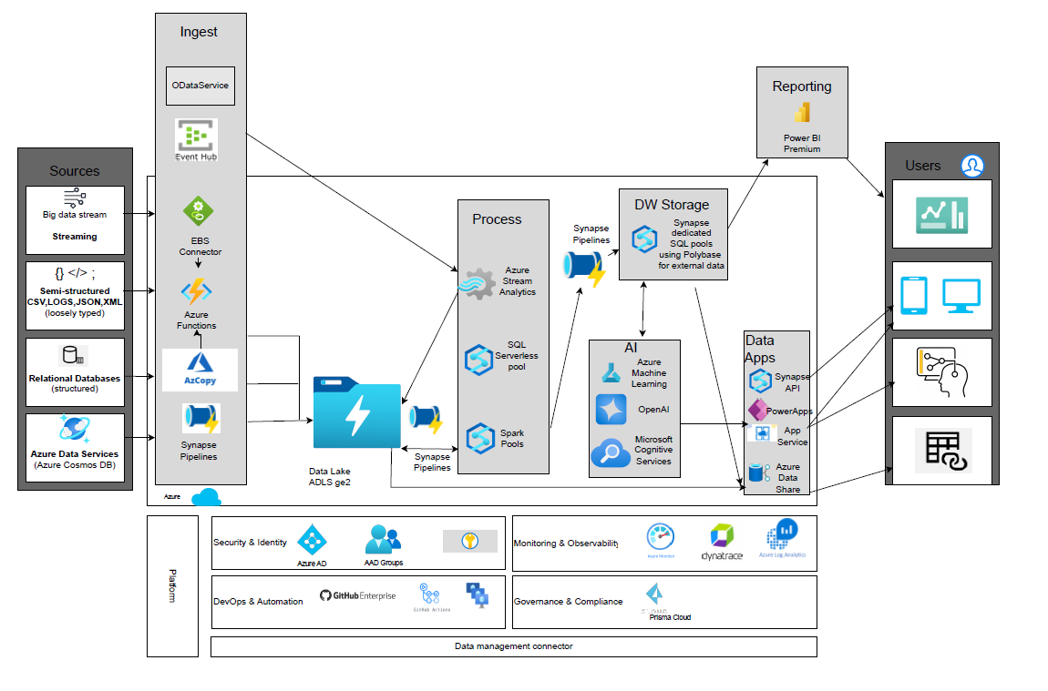
EDW Architecture Logical Architecture based on Azure
Data Architect Assesment - Rosa Mestres | June 2025

Slide 7
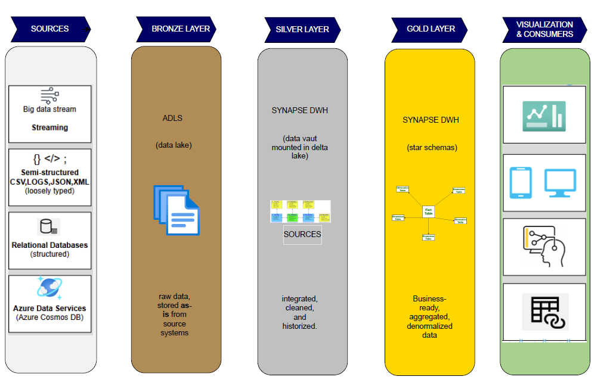
EDW Architecture Layers & Technical Design
Data Architect Assesment - Rosa Mestres | June 2025

Slide 8
EDW Architecture DataOps Efficiency & Control
CI/CD
Reusable Artifacts
Observability
GitHub Actions
GitHub Runners
Jira for backlog & sprint management
Confluence for project documentation
Automated deployement of: Data pipelines, Ml models, Power BI content
Pipelines, notebooks, models & datasets as modular building blocks , linked services, db objects, scripts SQL if required, ML models and other components of azure.
Promotes modularity, accelerates delivery, and reduces maintenance efforts.
Azure Monitor
Dynatrace
Log Analytics
Unified logs, metrics and health across all data services
Governance & Security
Cost Optimization
IDMC (Informatica)
Azure Key Vault
AD and AAD
Data Lineage, Access control, and credential management
Auto-pause SQL Pools, use of Azure Cost Management + Billing
Tiering policies in ADLS
Light Power BI versiones for self-sevice
Smart resource use, cost control and elasticity
Data Architect Assesment - Rosa Mestres | June 2025

Slide 9
Content
Introduction to Data-Driven Company
Data-Driven Platform to Accelerate AI-Powered Sales Intelligence
EDW Architecture
E2E Sales Dashboard Design
Data Architect Assesment - Rosa Mestres | June 2025

Slide 10
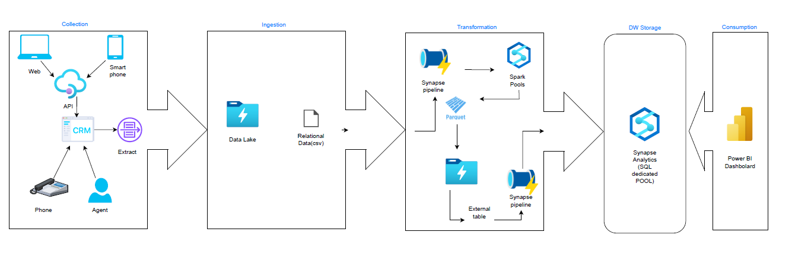
E2E Sales Dashboard Design Technical Pipeline Architecture
Created or updated day berfore, extract executed at 00.00am
Detection of new files and trigger ingestion in ADLS using AzCopy
Data is transformed in parquet and processed in spark pool
Data is cleaned ,historized and ingested in Synapse Analytics by DB procedure and after modelled in star schema, data is ready
Data Architect Assesment - Rosa Mestres | June 2025

Slide 11
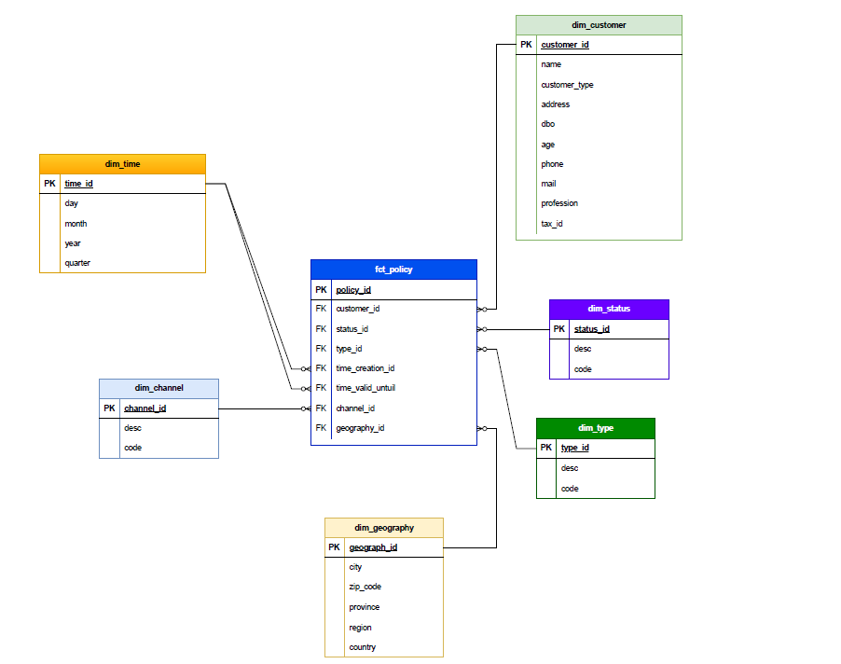
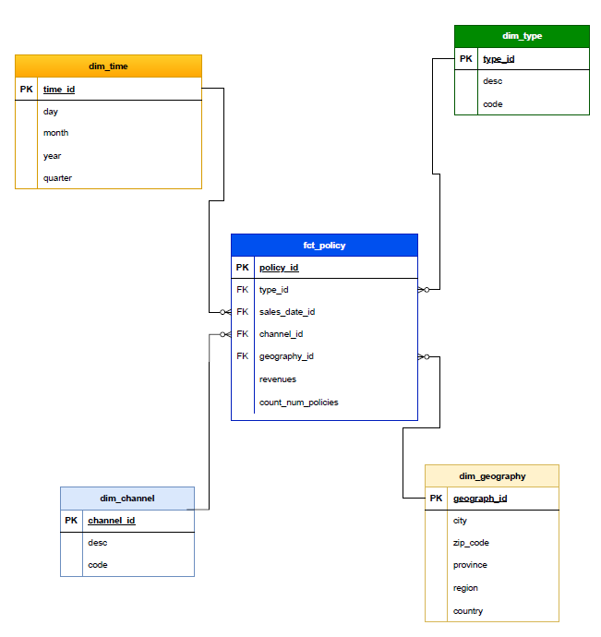
E2E Sales Dashboard Design Sales Policy Data Model
Star Model – Higher Granularity
Star Model – Lower Granularity
Data Architect Assesment - Rosa Mestres | June 2025

Slide 12
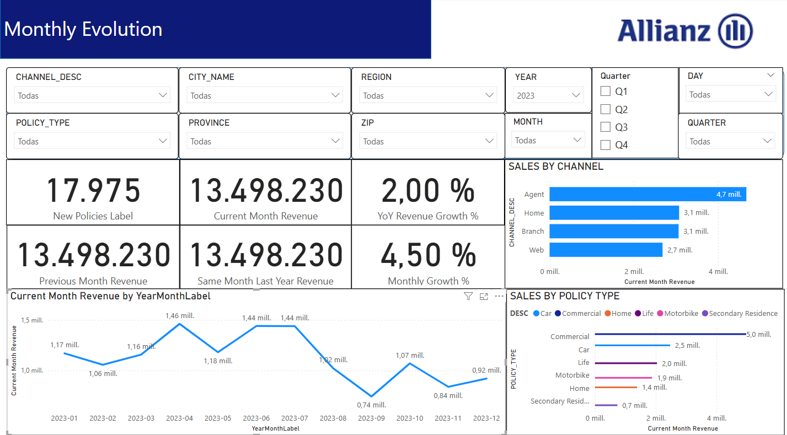
E2E Sales Dashboard Design Dashboard KPIs and Features
Created Mesures
Current Month Sales
Previous Month Sales
Same Month Last Year Sales
Monthly Growth
Data Architect Assesment - Rosa Mestres | June 2025

