Slide 1

Data Architect Assesment
Rosa Mestres
June 2025

Slide 2
Content
Enterprise Data Platform: Driving AI-Enhanced Sales Intelligence
Enterprise Data Warehouse Architecture
E2E Sales Dashboard Design
Data Architect Assesment - Rosa Mestres | June 2025

Slide 3





Data-Driven Platform to Accelerate AI-Powered Sales Intelligence
01 Strategic Business Target
02 Expected Business Impact
Grow top-line above market
Technical excellence to increase business margin
Best in class service levels
Apply process automation
+ 20% efficiency in strategic reporting
30% reduction in data operation costs
Time-to-insight reduced
Enablement of AI models for sales and churn prediction
03 Estimated investiment
04 Core Team Structure
1Mn€ for the Cloud Platform
2Mn€ for External Development / Consultancy
3 Data Architects (high knowledge of the Azure data platform)
3 Data Engineers
(medium knowledge of the Azure data platform)
Data Architect Assesment - Rosa Mestres | June 2025

Slide 4
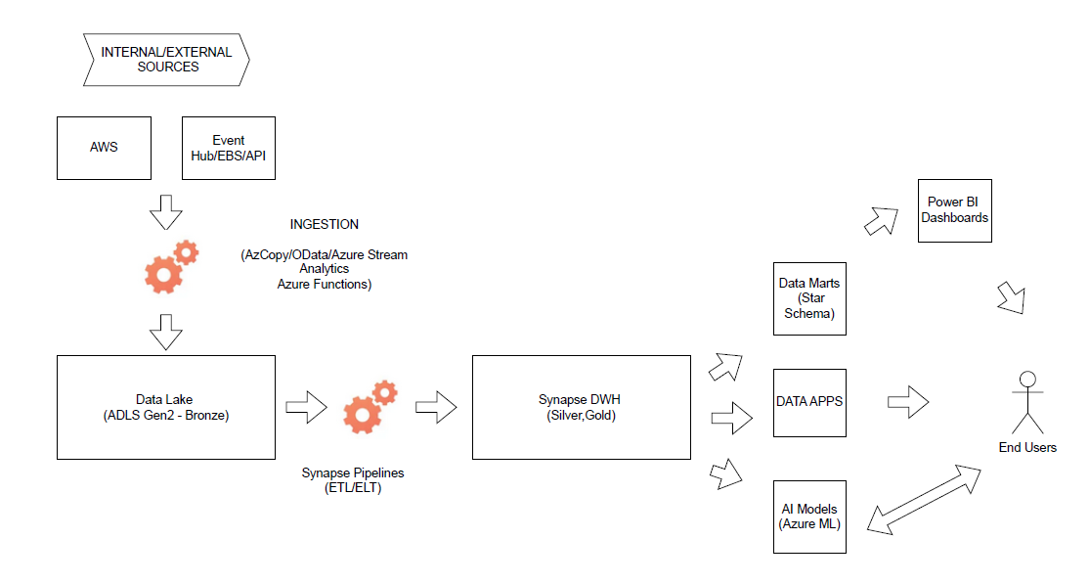
Enterprise Data Warehouse Architecture Logical Architecture
Data Architect Assesment - Rosa Mestres | June 2025

Slide 5
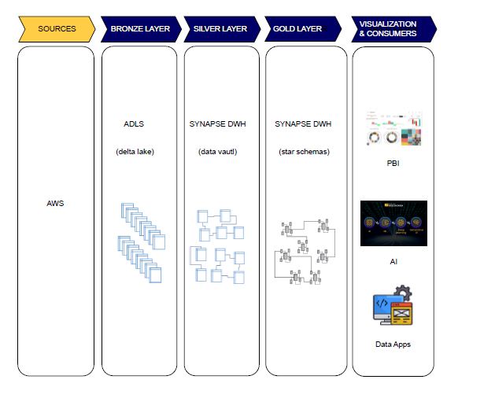
Enterprise Data Warehouse Architecture Layers & Technical Design
Data Architect Assesment - Rosa Mestres | June 2025

Slide 6
Enterprise Data Warehouse Architecture DataOps Efficiency & Control
CI/CD
Observability
GitHub Actions
GitHub Runners
Automated deployement of: Data pipelines, Ml models, Power BI content
Azure Monitor
Dynatrace
Log Analytics
Unified logs, metrics and health across all data services
DataOps Efficiency & Control
Governance & Security
Cost Optimization
IDMC (Informatica)
Azure Purview
Azure Key Vault
Data Lineage, Access control, and credential management
Auto-pause SQL Pools
Tiering policies in ADLS
Light Power BI versiones for self-sevice
Smart resource use, cost control and elasticity
Data Architect Assesment - Rosa Mestres | June 2025

Slide 7
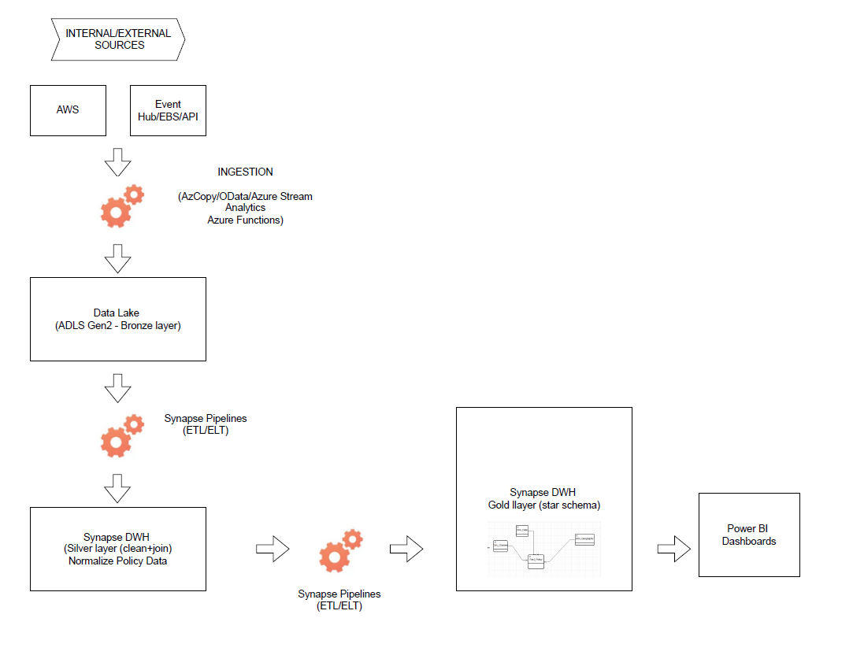
E2E Sales Dashboard Design Technical Pipeline Architecture
Data Architect Assesment - Rosa Mestres | June 2025

Slide 8
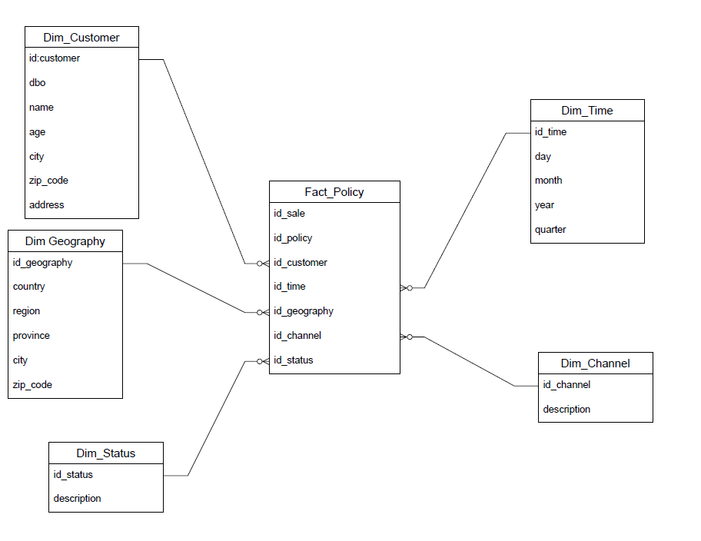
E2E Sales Dashboard Design Sales Policy Data Model
Data Architect Assesment - Rosa Mestres | June 2025

Slide 9

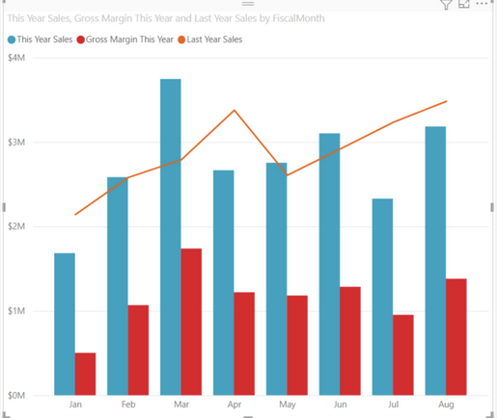
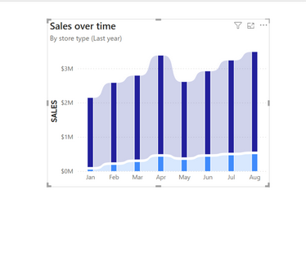
E2E Sales Dashboard Design Dashboard KPIs and Features
Filters
Data Range
Total Policies Sold
Revenue by Region & Channel
Conversion Rate by Channel
Monthly Sales Forecast (AI)
Sales Channel
1,800
1,800
1,800
1,800
Geography
AI Insights
Product/
Insurance Type
Data Architect Assesment - Rosa Mestres | June 2025

