Slide 1

Data Architect Assesment
Rosa Mestres
June 2025

Slide 2
Content
Introduction to Data-Driven Company
Data-Driven Platform to Accelerate AI-Powered Sales Intelligence
EDW Architecture
E2E Sales Dashboard Design
Data Architect Assesment - Rosa Mestres | June 2025

Slide 3
Content
Introduction to Data-Driven Platform Company
Data-Driven Platform to Accelerate AI-Powered Sales Intelligence
EDW Architecture
E2E Sales Dashboard Design
Data Architect Assesment - Rosa Mestres | June 2025

Slide 4


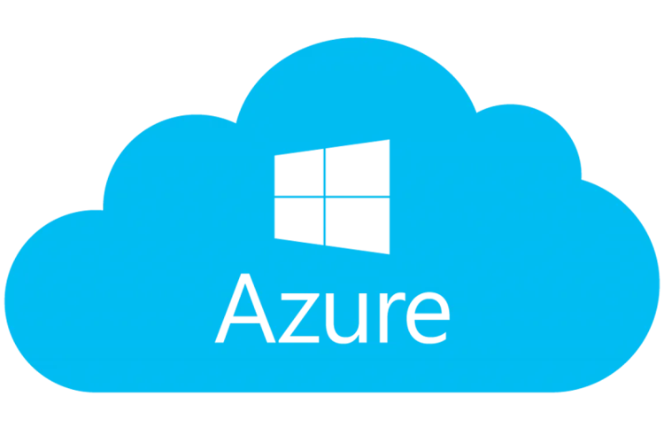


Data-Driven Platform to Accelerate AI-Powered Sales Intelligence
01 Strategic Business Target
02 Expected Business Impact
Grow top-line above market
Technical excellence to increase business margin
Best in class service levels
Apply process automation
Enablement of AI models for sales and churn prediction
Increase 20% efficiency in strategic reporting
30% reduction in data operation costs
Global revenues increased by 5%
Time-to-insight reduced
03 Estimated investiment and time
04 Core Team Structure
1Mn€ for the Cloud Platform
2Mn€ for External Development / Consultancy
Three-year execution period."
3 Data Architects (high knowledge of the Azure data platform)
3 Data Engineers
(medium knowledge of the Azure data platform)
Data Architect Assesment - Rosa Mestres | June 2025
Notes:
Good afternoon everyone, and thank you for attend this meeting.
Today, we are gathered to present the project we are about to implement, as part of Allianz’s transformation into a data-driven company.
The goal of this presentation is to walk you through the proposed solution, its architecture, sales implementation, the key design decisions we've made,
and the value it will bring to the business.
first of all, let me introduce you the concept of data driven company.
what it means data driven company?
it means empowering business to make smarter, faster and more confident decisions, decisions not based on intuition, but on trusted, anaylzed and timely data.
to achieve this, Allianz needs a modern cloud based analytics architecture, secure and scalable, buit for supporting advanced analytics and automation at scale.
first of all, let's to review which are the targets of the company wants to accomplish throughy this transformacion?
our first point to review is Strategic business impact
first grow the top line above market: how ?
→ by identifying new revenue opportunities through customer and market insights
second achieve technical excellence to increase business margin:
→ by optimizing operations and reducing innefiencies.
third deliver best class in service levels:
→ by ensuring data quality and availability to support real time customer interaction
last, but not least is Apply process automation
→ by creating the right conditions for AI to help automate repetitive and manual work.
once we have seen the targets, let's to know about the expected impact if we successfully meet these targets
First Deployment of AI models for sales forecasting and churn prediction
→ Allowing teams to focus on value-added analysis rather than manual reporting.
Second 20% increase in efficiency in strategic reporting is another impact in business
→ By streamlining data infrastructure and removing process redundancies.
Third 30% reduction in data operations costs
→ Through automation of data workflows, improved governance, and cloud optimization.
Four 5% increase in global revenues
→ Enabled by data-driven decision making and faster go-to-market strategies.
Firve time-to-insight reduced
→ Thanks to a modernized data pipeline and the adoption of self-service analytics tools.
The third point Estimated investment and time
============================
We have already discussed the business targets and the expected impact of this initiative.
But to actually deliver this impact, we need to ensure the right level of investment is in place."
"This project is planned over a 3-year timeline. The total investment required is 3 million euros: 1 million allocated to maintaining the Azure platform
and covering pay-as-you-go cloud usage, and 2 million dedicated to external development and consultancy services."
"This investment will allow us to keep the platform operational and scalable, bring in the expertise we need,
and accelerate delivery while managing risk.“
Our four point is about Core Team Structure
============================
"Finally, we have a solid core team in place: 3 senior data architects with deep expertise in Azure, and 3 data engineers with intermediate-level skills on the platform.
This internal team will be key to driving the project forward, ensuring knowledge retention, and collaborating effectively with external partners."

Slide 5
Content
Introduction to Data-Driven Company
Data-Driven Platform to Accelerate AI-Powered Sales Intelligence
EDW Architecture
E2E Sales Dashboard Design
Data Architect Assesment - Rosa Mestres | June 2025

Slide 6
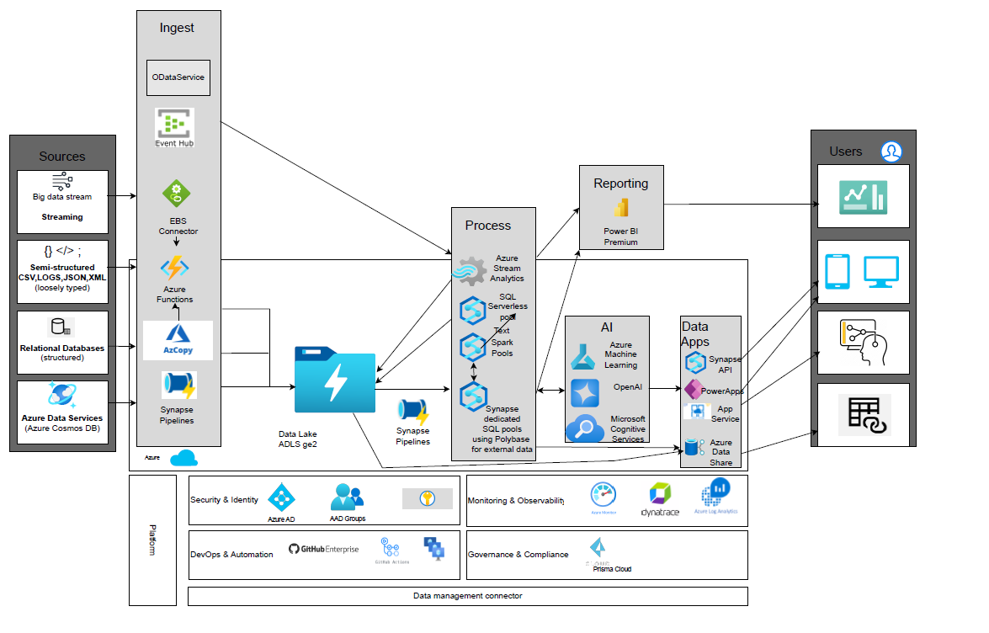
EDW Architecture Logical Architecture based on Azure
Data Architect Assesment - Rosa Mestres | June 2025
Notes:
===============
==slide 2==
================
🔹 [Opening – Overview]
“This slide represents the logical architecture of our end-to-end data platform built on Microsoft Azure. It’s designed to support ingestion, storage, processing, analytics,
machine learning, and data consumption in a scalable, secure, and modular way.”
🔹 [1. Data Sources]
“Starting on the left, we ingest data from a wide range of sources:
Real-time streams via Event Hub for telemetry, or logs.
Semi-structured data like CSV, JSON, XML, or system logs.
Structured relational databases cloud-hosted.
Azure-native sources like Cosmos DB for globally distributed NoSQL data.
This hybrid ingestion approach allows us to cover both batch and streaming use cases.”
data is ingested in azure,🔹 [2. Ingestion Layer]
“For ingestion, we leverage several Azure services:
Event Hub for high-throughput streaming.
Azure Functions and the EBS Connector for real-time transformation and lightweight orchestration.
Synapse Pipelines and AzCopy for bulk or scheduled batch data loads.
All data lands into a centralized Data Lake (ADLS Gen2), which serves as the raw data zone — enabling schema-on-read, separation of storage and compute, and data lifecycle control.”
let's have to take a look on processing layer 🔹 [3. Processing Layer]
“In the processing layer, we use different compute engines based on the workload:
Azure Stream Analytics for near-real-time analytics.
SQL Serverless Pools and Apache Spark Pools in Synapse for ad-hoc querying and distributed transformations.
Synapse Dedicated SQL Pools for high-performance querying, particularly using PolyBase to virtualize external data.
This architecture supports both ELT and real-time processing, enabling flexibility in data modeling and transformation pipelines.”
let's go now to check how AI is implemented 🔹 [4. AI & Machine Learning]
“Processed and enriched data is consumed by our AI/ML layer:
Azure Machine Learning for model training and deployment.
OpenAI integration for generative AI use cases.
Cognitive Services to plug in pre-built capabilities such as text analysis, computer vision, and language understanding.”
how data is exposed 🔹 [5. Data Serving & Application Layer]
“Insights are then exposed through various serving layers:
Power BI Premium for enterprise-scale business intelligence and self-service analytics.
PowerApps, App Services, and the Synapse SQL API to build operational applications or expose APIs.
Azure Data Share allows secure external data distribution across domains or business units.”
🔹 at last but no least [6. Consumers]
“Our end users include:
Data analysts and business users using Power BI
Business applications and microservices that consume processed data through APIs.
Automated systems and AI agents that consume insights directly.”
🔹, [7. Underlying Platform Services]
“ finally, Supporting all layers is the Azure platform foundation we can see
Security & Identity with Azure Active Directory and RBAC.
DevOps & Automation using GitHub Actions, CI/CD pipelines, and Infrastructure as Code.
Monitoring via Azure Monitor, Log Analytics, and Dynatrace for observability.
Governance & Compliance with tools like Purview, tagging, data lineage, and access policies.
This ensures the entire platform is secure, observable, and governed from end to end.”
“To sum up, this architecture provides a robust and scalable framework for enterprise data workloads — from ingestion to AI —
enabling data-driven decision-making, operational intelligence, and innovation through modern cloud-native components.”

Slide 7
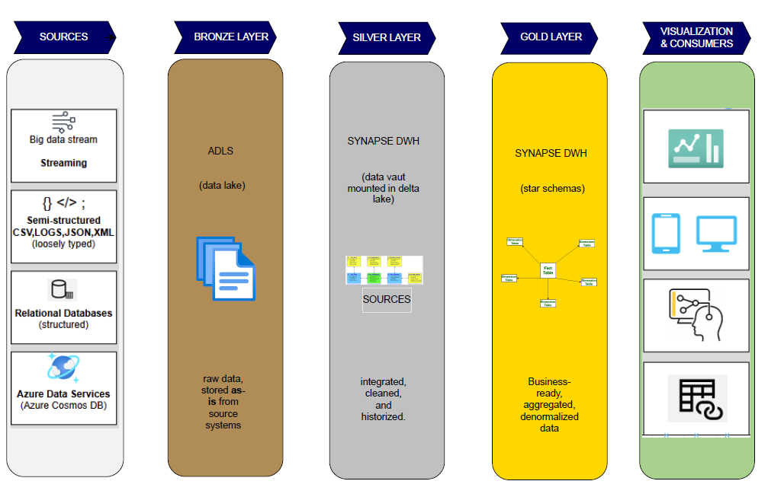
EDW Architecture Layers & Technical Design
Data Architect Assesment - Rosa Mestres | June 2025
Notes:
================
==slide 3==
================
Sources Layer
On the left, we start with the data sources.
We collect data from multiple origins, including:
Streaming data from big data sources
Semi-structured files such as CSV, logs, JSON, and XML
Relational databases, providing structured transactional data
And native Azure data services, like Azure Cosmos DB
This allows us to support both batch and real-time ingestion scenarios.
🟫 Bronze Layer – Raw Data
The first stop in our platform is the Bronze Layer, which resides in ADLS – Azure Data Lake Storage.
Here, we store the raw data exactly as received from the source systems, without transformation or filtering.
This layer ensures we keep an immutable copy of the original data for auditability and future reprocessing.
🪙 Silver Layer – Data Vault in Delta Lake
Next, we move to the Silver Layer, where the data is cleaned, integrated, and historized.
This layer follows a Data Vault modeling approach, and it's mounted over Delta Lake, which brings ACID transactions, schema evolution, and time travel capabilities to our lakehouse.
It acts as our trusted, governed layer where all business logic starts to take shape.
🟨 Gold Layer – Business Model
From there, we populate the Gold Layer, which is hosted in Azure Synapse Dedicated SQL Pools.
Here, we transform the Data Vault entities into Star Schemas, which are business-friendly, aggregated, and denormalized.
These are designed specifically for performance and analytics, and they power downstream reporting tools.
📊 Visualization & Consumers
Finally, we have the consumer layer.
This is where different tools and users access the data for:
Dashboards and reports (e.g., Power BI)
Mobile and web applications
Advanced analytics and AI models
And external exports or APIs
This architecture allows multiple consumers to work on the same unified and trusted data platform.
✅ Summary
This layered approach ensures that we maintain data integrity, traceability, and scalability—from raw ingestion to business-ready insights.

Slide 8
EDW Architecture DataOps Efficiency & Control
CI/CD
Reusable Artifacts
Observability
GitHub Actions
GitHub Runners
Jira for backlog & sprint management
Confluence for project documentation
Automated deployement of: Data pipelines, Ml models, Power BI content
Pipelines, notebooks, models & datasets as modular building blocks , linked services, db objects, scripts SQL if required, ML models
Promotes modularity, accelerates delivery, and reduces maintenance efforts.
Azure Monitor
Dynatrace
Log Analytics
Unified logs, metrics and health across all data services
Governance & Security
Cost Optimization
IDMC (Informatica)
Azure Purview
Azure Key Vault
Data Lineage, Access control, and credential management
Auto-pause SQL Pools
Tiering policies in ADLS
Light Power BI versiones for self-sevice
Smart resource use, cost control and elasticity
Data Architect Assesment - Rosa Mestres | June 2025
Notes:
“This slide presents the operational and governance pillars that support our EDW architecture, enabling efficiency, control, and scalability across the data lifecycle.
These enablers are key for sustaining enterprise-grade DataOps practices.”
🔹 [CI/CD – Automation & DevOps]
“We start with CI/CD practices to ensure repeatable and automated deployments:
We leverage GitHub Actions and GitHub Runners to orchestrate build and release pipelines.
Jira is used for backlog and sprint tracking, and Confluence supports project documentation and knowledge sharing.
CI/CD pipelines are responsible for deploying data pipelines, machine learning models, and Power BI content automatically, ensuring consistency across environments.”
🔹 [Observability – Monitoring & Telemetry]
“On the observability front:
We use Azure Monitor, Dynatrace, and Log Analytics for centralized telemetry.
This setup enables unified logs, health metrics, and alerts across all data services — providing full transparency and proactive incident management.”
🔹 [Governance & Security – Control & Compliance]
“For data governance and security:
We integrate IDMC (Informatica) for enterprise data management.
Azure Purview ensures data cataloging and lineage tracking.
Azure Key Vault provides secure secrets and credentials management.
Together, these tools deliver robust access control, traceability, and compliance with data regulations.”
🔹 [Reusable Artifacts – Accelerating Delivery]
“To increase delivery speed and reduce maintenance:
We adopt a modular approach using reusable artifacts like pipelines, notebooks, datasets, ML models, SQL scripts, and linked services.
These are treated as composable building blocks, promoting standardization and reuse across teams.”
🔹 [Cost Optimization – Elasticity & Governance]
“Finally, for cost efficiency:
We implement auto-pause SQL pools, ADLS tiering policies, and Power BI lightweight versions for self-service analytics.
These measures ensure optimal resource utilization, elasticity, and proactive cost control without compromising performance.”
🔹 [Closing – Benefits]
“Altogether, these six pillars of DataOps—automation, observability, governance, reuse, and cost control—enable us to scale our data platform reliably, securely,
and efficiently, while meeting the evolving needs of business and compliance.”

Slide 9
Content
Introduction to Data-Driven Company
Data-Driven Platform to Accelerate AI-Powered Sales Intelligence
EDW Architecture
E2E Sales Dashboard Design
Data Architect Assesment - Rosa Mestres | June 2025

Slide 10
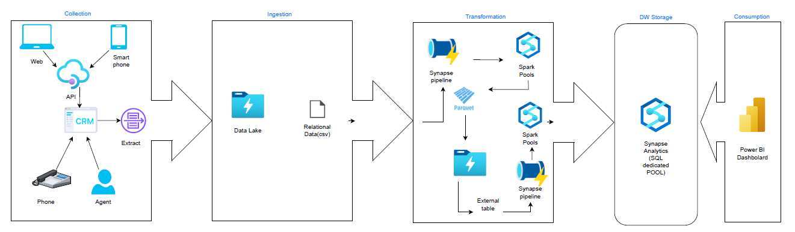
E2E Sales Dashboard Design Technical Pipeline Architecture
Created or updated day berfore, extract executed at 00.00am
Detection of new files and trigger ingestion in ADLS using AzCopy
Data is transformed in parquet and processed in spark pool
Data is cleaned ,historized and ingested in Synapse Analytics and after modelled in star schema. Data is ready
Data Architect Assesment - Rosa Mestres | June 2025
Notes:
================
==slide 5==
================
Let me walk you through the end-to-end architecture we've implemented for our Sales Dashboard, covering everything from data collection to business insights.
🟦 1. Collection
We begin with data collection from various touchpoints:
Web and mobile applications
APIs
CRM systems
Phone or agent-based channels
Every day, any data created or updated the day before is extracted at midnight (00:00). This ensures we're always working with the most recent data snapshot.
🟦 2. Ingestion
Next, the extracted data is ingested into Azure Data Lake Storage (ADLS).
This includes CSV files with relational structure.
We use AzCopy to detect new files and trigger ingestion automatically, keeping the pipeline event-driven and scalable.
🟦 3. Transformation
Once in the data lake, we begin the transformation process:
Data is converted to Parquet format for efficient storage and query performance.
We use Spark Pools within Azure Synapse to process and transform the data in a distributed, scalable way.
This data can also be exposed as external tables via Synapse pipelines, creating a bridge between data lake and Synapse SQL.
This stage ensures the data is cleaned, structured, and analytics-ready.
🟦 4. DW Storage (Data Warehouse)
Transformed data is then loaded into Synapse Analytics (Dedicated SQL Pool).
Here, we:
Clean and historize the data
Model it into star schemas, which are ideal for analytical queries and BI consumption
At this point, the data is fully business-ready.
🟦 5. Consumption
Finally, the data is consumed via Power BI dashboards.
Thanks to the well-modeled star schema, business users can explore the data with high performance and clear dimensional understanding, enabling data-driven decision-making.
✅ Summary
This pipeline provides a robust, automated, and scalable architecture to transform raw CRM data into valuable sales insights, visualized in Power BI — with full traceability,
governance,
and performance at every step.
================

Slide 11
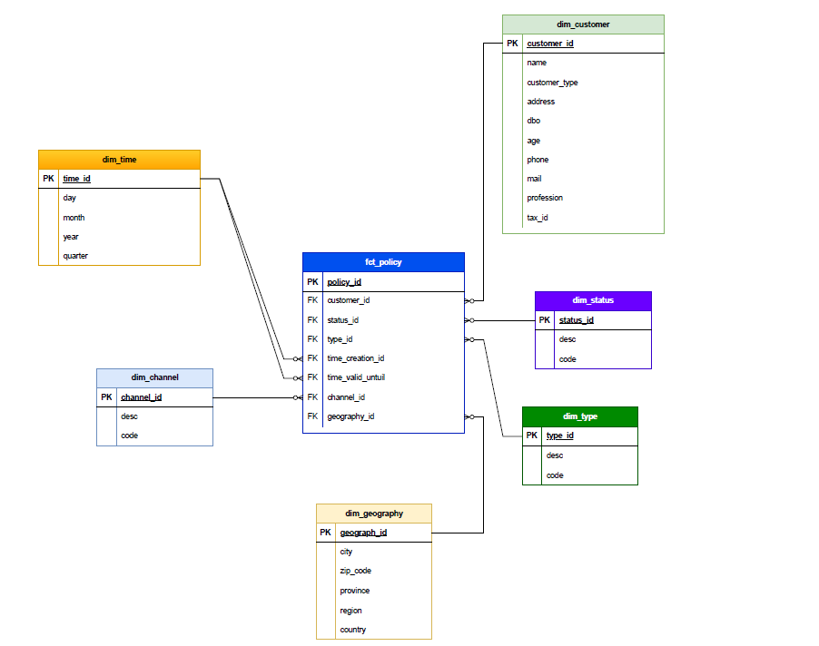
E2E Sales Dashboard Design Sales Policy Data Model
Data Architect Assesment - Rosa Mestres | June 2025
Notes:
================
==slide 6==
================
Let’s now take a look at the Sales Policy Data Model that supports our end-to-end dashboard.
This is a classic star schema designed to optimize performance and usability for reporting and analysis in Power BI.
🟦 1. Fact Table – fct_policy
At the center of the model is our fact table: fct_policy.
Each row represents a sales policy, uniquely identified by policy_id.
It includes foreign keys to several dimensions, capturing:
The customer who owns the policy (customer_id)
The status of the policy (status_id)
The type of the policy (type_id)
The creation and expiration dates (time_creation_id, time_valid_until)
The channel through which the policy was sold (channel_id)
And the geographical location (geography_id)
This table provides the quantitative and transactional core of our model.
🟩 2. Dimension – dim_customer
This dimension describes each customer:
Name, address, type, date of birth, and contact details (phone, email)
As well as demographic or segmentation fields like profession and tax ID
This enables slicing the data by customer profile.
🟪 3. Dimension – dim_status
This small dimension classifies each policy by its current status – such as active, cancelled, or expired.
It includes a code and description for better filtering and aggregation.
🟩 4. Dimension – dim_type
This describes the type of policy — for example: auto, home, or health insurance — again including a code and description.
🟦 5. Dimension – dim_channel
The channel dimension indicates how the policy was acquired:
Web, phone, in-person agent, etc.
Each with a code and textual description.
🟨 6. Dimension – dim_time
This standard time dimension is used twice in the fact table — once for policy creation, and once for valid until.
It supports analysis by day, month, quarter, and year.
🟨 7. Dimension – dim_geography
Finally, we have the geography dimension, which breaks down location into:
City, ZIP code, province, region, and country
This supports geo-based segmentation and regional reporting.
✅ Summary
This star schema is optimized for business-friendly exploration, fast querying, and clear relationships between policies and their attributes.
It’s the foundation of the Power BI sales dashboard, supporting insights like policy volume by customer type, sales trends over time, or revenue by geography and channel.

Slide 12

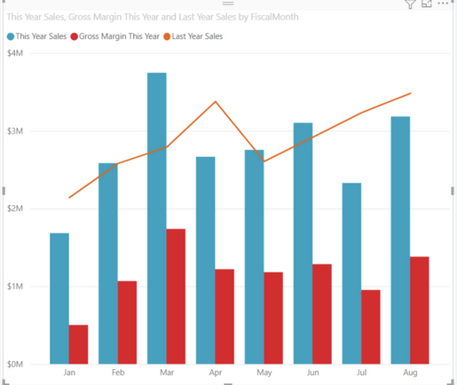
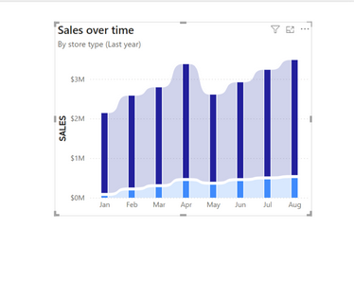
E2E Sales Dashboard Design Dashboard KPIs and Features
Filters
Data Range
Total Policies Sold
Revenue by Region & Channel
Conversion Rate by Channel
Monthly Sales Forecast (AI)
Sales Channel
1,800
1,800
1,800
1,800
Geography
AI Insights
Product/
Insurance Type
Data Architect Assesment - Rosa Mestres | June 2025
Notes:
================
==slide 7==
================

