Slide 1
Software and Programming II
Testing
Department of Computer Science and Information Systems
Birkbeck, University of London
keith@dcs.bbk.ac.uk and oded@dcs.bbk.ac.uk
Tuesday, 14th October, 2014

Slide 2
Testing, WHY?
Me?
I write all the required code,
then compile
AND IT WORKS
EVERY SINGLE TIME
(that is why I teach)
You?
Notes:
2

Slide 3
Regression Testing
Notes:
3

Slide 4
Regression Testing
A set of tests for checking that the existing functionality works.
Executed every time that the application is changed as a safety measure against the introduction of new bugs.
Includes: tests using tools such as Cucumber, Selenium etc.
Notes:
4

Slide 5
Cucumber
Notes:
5

Slide 6
What is Cucumber?
An acceptance testing tool
Cucumber is used for converting plain text functional descriptions (Gherkin) into tests
How?
Cucumber parses a feature and generates a test template. The developer needs to insert the missing details.
Notes:
6

Slide 7
Gherkin – feature (vending machine, feature file)
Feature: Dispensing
Check that dispenses the correct item
Scenario : buy item from vending machine
Given The vending machine is turned on
And the vending machine is fully loaded
When I have inserted <input_1> pence into vending machine
And I have pressed option <input_2>
And I press select
Then the result should be <output>
Examples:
input_1 | input_2 | output
75 | Chocolate Bar | Chocolate Bar
50 | Chocolate Bar | insufficient money
50 | Flapjack | Flapjack
Notes:
7

Slide 8
Given, When & Then (And But)
Given – is used in order to describe the state of the system
When – describes the key action that the user performs
Then – describes the expected outcomes
And, But – in order to enable several Given, When, Then
Notes:
8

Slide 9
Good features for feature files
Should be from the user perspective and should not contain implementation issues
Treat the feature files as part of the project documentation
Feature files should be written as part of a collaboration
Feature files should contain examples
Notes:
9

Slide 10
In Java
public class VendingSteps extends VMTestCase {
@Given(“The vending machine is turned on”)
public void turnOnVendingMachine() throws exception {
this….
}
@When(“I have inserted <input_1> pence into vending machine”)
public void insertMoneyIntoVM(int input_1) {
this….
}
@Then(“the result should be <output>”)
public void testVM(int output) {
assertEquals(…
}
}
Notes:
10

Slide 11
Selenium
Notes:
11

Slide 12
What is Selenium?
Web application automation tool for testing purposes
Why do you we need this?
Imagine that you want to check that your web application works.
What’s wrong with doing this manually?
Would you like to automate?
If you would like to automate, what would you like to automate.
Notes:
12

Slide 13
Selenium IDE
A Firefox add-on
Features: (from http://seleniumhq.org/projects/ide/)
Easy record and playback
Intelligent field selection will use IDs, names, or XPath as needed
Autocomplete for all common Selenium commands
Walk through tests
Debug and set breakpoints
Save tests as HTML, Ruby scripts, or any other format
Support for Selenium user-extensions.js file
Option to automatically assert the title of every page
NEW! Easy customization through plugins
Notes:
13

Slide 14
Selenium IDE plugins
A Firefox add-on
Plug in system: (from http://seleniumhq.org/projects/ide/)
Adding new functionality to the API
Changing existing functionality
Custom formats and export capabilities
Hosting of plugin update.rdf files
Adding new locator strategies (coming soon)
Notes:
14

Slide 15
Summarizing
We would like to have
Easy to create and recreate tests
Introduce test automation
Regression testing
By-product – use selenium not just for testing! (when you get fed up of doing the exact same thing again and again)
Remark: Selenium is aimed towards more than one crowd
To-do: if your project is a web app use Selenium (rumours say it is good for your CV).
Notes:
15

Slide 16
Unit Testing
Notes:
16

Slide 17
Unit Testing
Unit – a piece of code with a single concern, usually a method (Java), function (procedural language).
Unit test – a piece of code that invokes the unit and checks that it produces the expected result.
Goal: to check that every unit of code is correct
(Does not imply that larger pieces of code are correct)
Unit tests usage:
Coding stage
Every time the code is changed
Notes:
17

Slide 18
A Good Unit Test
Easy to understand
Avoid wasting time understanding them every time something goes wrong
Simple (actually almost trivial)
So it’s clear that the right thing is tested
Efficient
There will be a massive number of them, and they will be executed numerous times
Independent
Should not be influenced by changes to other unit test and units
Notes:
18

Slide 19
Test Driven Development
(TDD)
Notes:
19

Slide 20
Test Driven Development (TDD)
Philosophy
Untested code is “not code”
Short development cycle
Testing is understanding
Notes:
20

Slide 21
TDD Cycle
Write Test
Pass
Run
Test
Write Production
Code
Refactor
Fail
Fail
Run
All Tests
Write Code
Properly
Fail
New feature, write a test
to make sure you
understand
Pass
Test should fail, since
there is no implementation
Run
All Tests
Notes:
21

Slide 22
TDD benefits
Less Debugging (debugging is tedious and expensive)
Small steps – easier to backtrack (less debugging)
Small pieces drive developers towards modularity
Bugs caught earlier
Testing is understanding
Notes:
22

Slide 23
TDD vulnerabilities
Developer writing tests for his own code
Checking private variables may require dedicated “hacks” that may remain in the code.
More code
Longer time to write
Over reliance on unit testing
Test may restrict code
Notes:
23

Slide 24
Our First Test
Meet
Junit 4
http://junit.sourceforge.net/javadoc/
Notes:
24

Slide 25
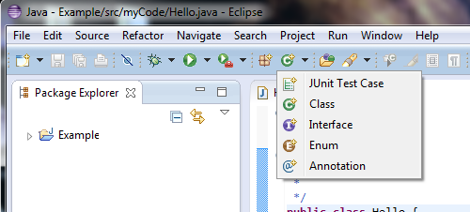
Welcome to Eclipse
2. Select
1. Select
Notes:
25

Slide 26
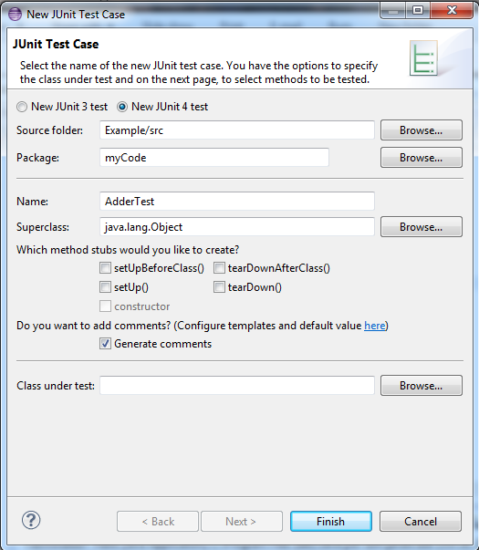
Junit Test Case
1. Fill In
2. Select
3. Select
We are following TDD, so we write the test before we write the actual code
Notes:
26

Slide 27
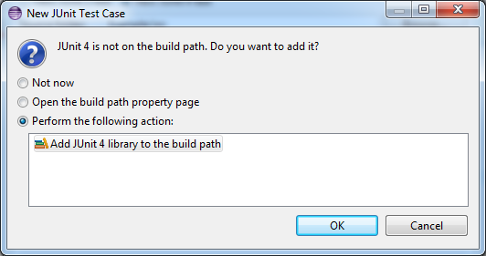
Add JUnit 4 to the library build path
1. Select
JUnit is a library that the complier has to know. Part of the eclipse support for JUnit, is to add the JUnit library to the build path (if we want it to).
Notes:
27

Slide 28
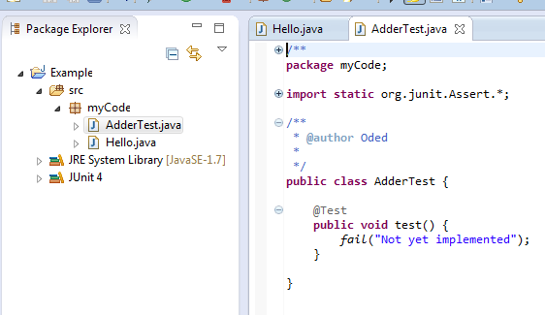
What happened?
Observe, new class
Observe, Junit
import
Observe,
Annotation that says this is a test method
Observe,
Assertion that causes a failed test
Observe, Junit was added to build path
Notes:
28

Slide 29
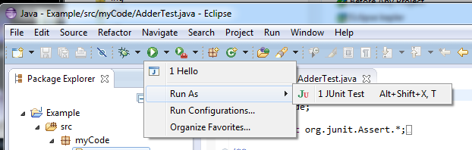
Running your first JUnit test
1. Select
2. Select
3. Select
Notes:
29

Slide 30
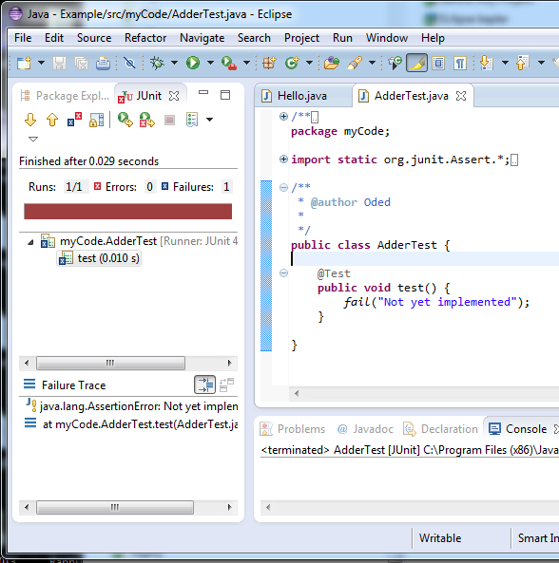
Welcome to Eclipse
Observe, 1 test failure
Observe, failed test identity
Observe, failed test information
Notes:
30

Slide 31
Using Eclipse to Generate Code
Notes:
31

Slide 32
Eclipse Generating Code
Replace the following line (in method named test of AdderTest class) :
fail("Not yet implemented");
With
int input1 = 3;
int input2 = 5;
int expectedOutput = 9;
Adder addObj = new Adder();
int actualOutput = addObj.add(input1,input2);
assertEquals("Wrong answer!", expectedOutput, actualOutput);
Notes:
32

Slide 33
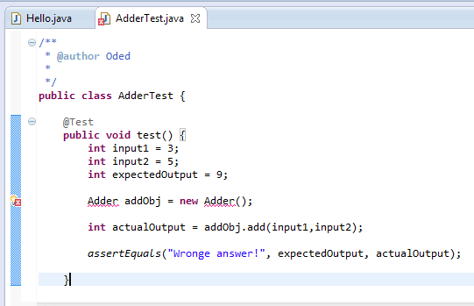
After adding new code
1. Select
Always select, if something like this occurs.
Red means is trouble - this will probably have compilation errors
Yellow is a warning - code will run but suggested to make some changes
Notes:
33

Slide 34
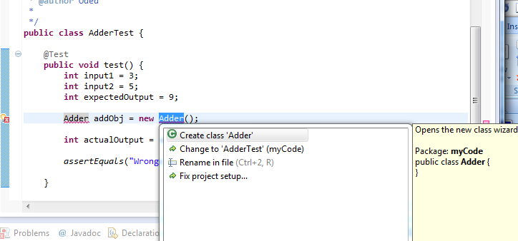
Create Adder Class
1. Select
Eclipse will create the adder class for you
Notes:
34

Slide 35
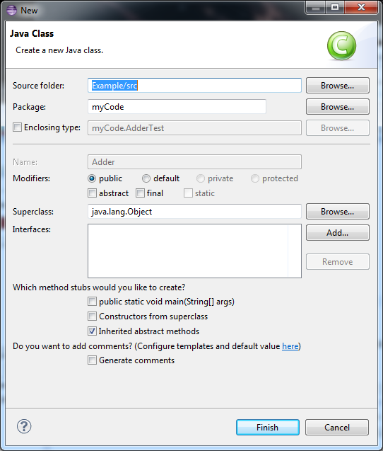
New Java Class
Observe, filled in for you
1. Select
Notes:
35

Slide 36
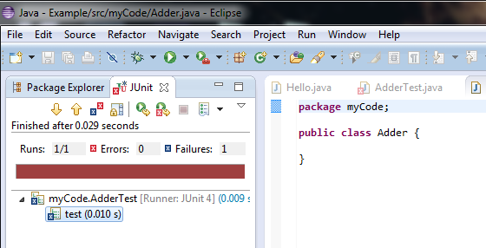
The new adder class
1. Select
Observe, adder class generated for you
Notes:
36

Slide 37
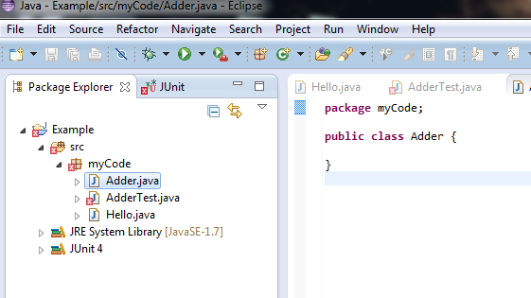
The AdderTest class has a problem
1. Select
Observe, AdderTest
has a problem
Notes:
37

Slide 38
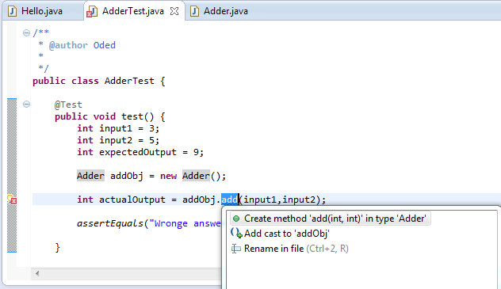
Missing add method
1. Select
2. Select
add method not implemented yet, lets get Eclipse to write a stub for us
Notes:
38

Slide 39
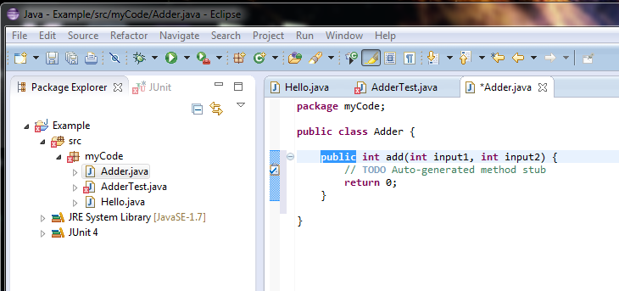
method stub auto-generated
Observe, method stub auto generated for us.
Observe, there still seems to be a problem
Notes:
39

Slide 40
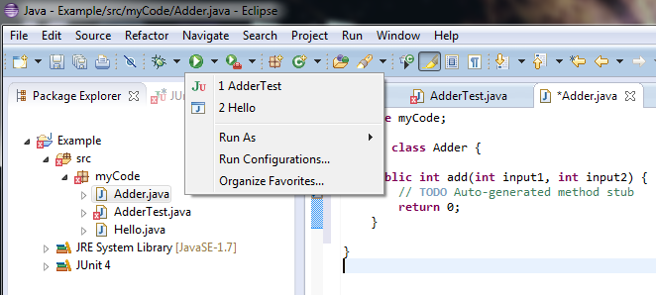
Run test
2. Select
1. Select
Notes:
40

Slide 41
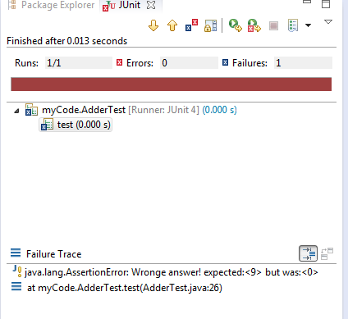
Result
Observe, test fail
Notes:
41

Slide 42
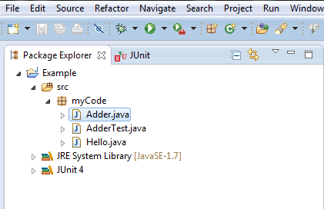
Warning disappeared
The warning has disappeared. This happened because the file was saved. The save operation triggers an update.
Notes:
42

Slide 43
Another test
Add the following method to the AdderTest class, and then run the tests
@Test
public void test2() {
int input1 = 7;
int input2 = 3;
int expectedOutput = 11;
Adder addObj = new Adder();
int actualOutput = addObj.add(input1,input2);
assertEquals("Wrong answer!", expectedOutput, actualOutput);
}
Note that the name of this method is test2.
You must also add the @Test annotation for this to work.
Notes:
43

Slide 44
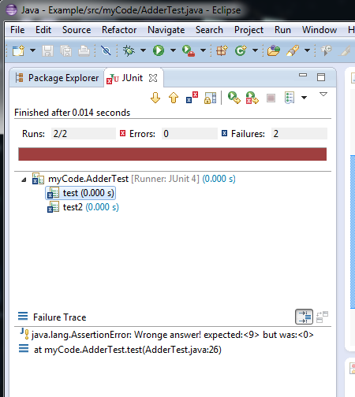
Result
1. Select
Observe that both tests fail and only the warning for the first appeared
Notes:
44

Slide 45
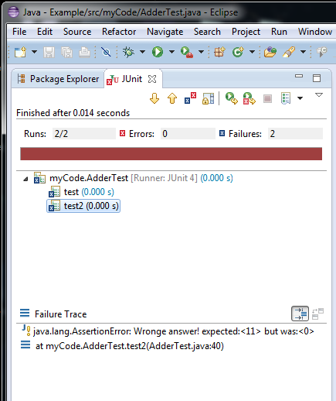
Result2
The other result
Notes:
45

Slide 46
To-do
Fix test and add method so that they both path
Add two more test methods one the fails and one that passes
Create a class named Subtractor with a subtract method and four test methods.
Notes:
46

Slide 47
Back to Junit 4
Annotations
Notes:
47

Slide 48
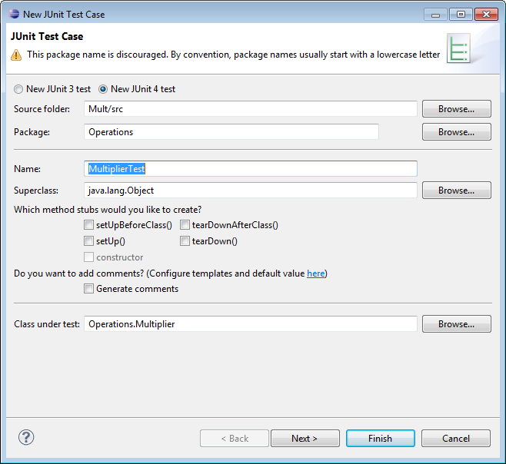
Annotations
setUpBeforeClass() – adds a method that is performed before all tests (we can run more than one test at a time) we might want to set up a database etc.
setUp() – adds a method that
is performed before every test
Notes:
48

Slide 49
Annotations
tearDownAfterClass() – adds a method that is performed after all tests
tearDown() – adds a method that is performed after each test
Notes:
49

Slide 50
Annotations
@Test - this is a test method
@Before - this is a before method
@After - this is teardown method
@BeforeClass - this a before class method
@AfterClass - this is teardown after class
@Ignore – ignore this method, when you don’t want one of the above executed
@Test(expected=IllegalArgumentException.class) - does the method throw the named exception (Exception?)
@Test(timeout=10) fail after 10 millisecond – so the test does not run forever
(add timeout to your code)
Notes:
50

Slide 51
setUp()
Add the following code to your AdderTest, and run test and then make it work
private int expected;
@Before
public void setUp() throws Exception {
expected =1;
}
@Test
public void testWithSetUp() {
int input1 = 3;
int input2 = 5;
int expectedOutput = expected;
Adder addObj = new Adder();
int actualOutput = addObj.add(input1,input2);
assertEquals("Wronge answer!", expectedOutput, actualOutput);
}
Notes:
51

Slide 52
setUpBeforeClass()
Add the following code to your AdderTest, and run test and then make it work
private static int firstInput;
@BeforeClass
public static void setUpBeforeClass() throws Exception {
firstInput = 1;
}
@Test
public void testWithSetUpBeforeClass() {
int input1 = firstInput;
int input2 = 5;
int expectedOutput = 12;
Adder addObj = new Adder();
int actualOutput = addObj.add(input1,input2);
assertEquals("Wrong answer!", expectedOutput, actualOutput);
}
Note that, setUpBeforeClass(), and hence all the fields it uses must also be static (firstInput).
Notes:
52

Slide 53
More about the annotations
It is common practice in large projects to store and run the unit tests at an integration level.
The @Before, @BeforeClass, @After, @AfterClass annotations are there in order to support things such as creating mock objects, setting up a database and cleaning it up etc.
The @Test(timeout=10) is especially critical in order to avoid getting the integration testing stuck.
Notes:
53

Slide 54
To-do
Use a combination of setUp() and setUpBeforeClass() methods both using the same variable
Add a tearDown() also using the same variable
Notes:
54

Slide 55
Assertions
Notes:
55

Slide 56
Assertions
fail([String])- test failed
assertTrue(true)- test passed
assertsEquals([String], expected, actual)- Check if values of expected and actual are the same.
assertNull([String], object) – Check reference null
assertNotNull([String], object) – Check if reference not null
assertSame([String], expected, actual) – Check if reference to the same object
assertNotSame([String], expected, actual) - Check if reference to different objects
assertTrue([String], boolean condition) – Check if Boolean condition is true
Check out: http://junit.sourceforge.net/javadoc/org/junit/Assert.html
Notes:
56

Slide 57
Using Assertions
If there is more than one assertion in a test and the first assertion fails, then the rest of these assertions never get checked. Hence,
It is recommended to use one assertion per test!
Notes:
57

Slide 58
Todo
For each of the assertions in the previous slides write tests that demonstrate how they work (tests that fail and tests that pass)
Notes:
58

Slide 59
More than One Test Class.
Test Suite
Notes:
59

Slide 60
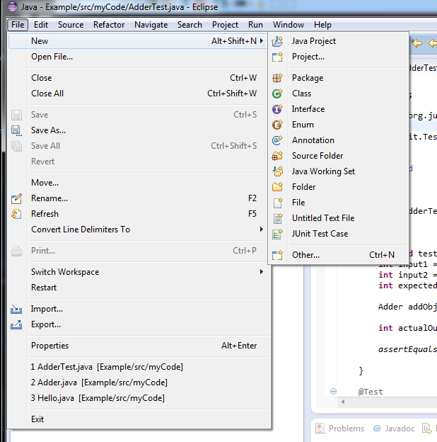
Test Suite
1. Select
2. Select
3. Select
Notes:
60

Slide 61
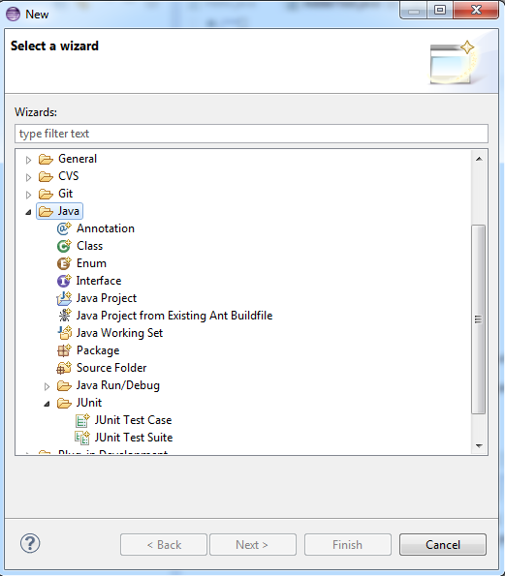
Test Suite
1. Select
2. Select
3. Select
Notes:
61

Slide 62
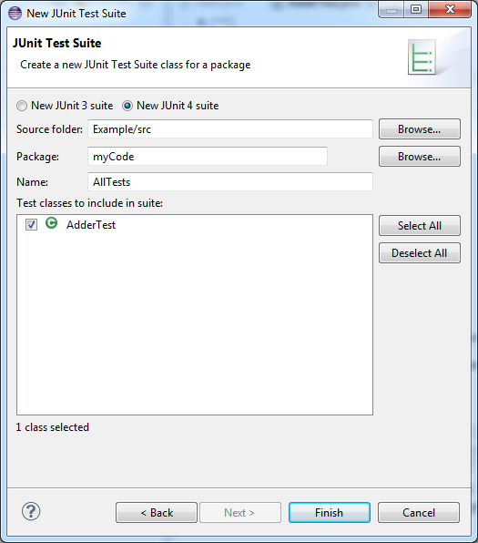
Test Suite
If you have more than one test class you can choose the ones you want
1. Select
Notes:
62

Slide 63
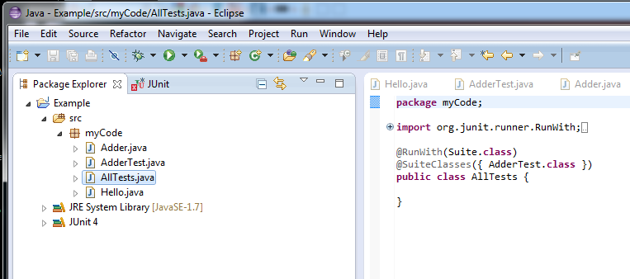
Test Suite code
Observe, new file added
The first annotations indicates that this a test suite class.
The second indicates which classes of tests should be used.
Notes:
63

Slide 64
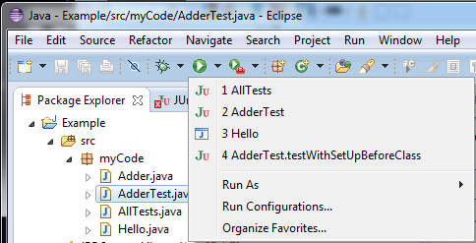
Running Test Suite
1. Select
2. Select
Notes:
64

Slide 65
To-do
Create more test classes, and pick only some of them for the test suite.
Remove one of the test classes from the test suite
Write another test suite and run it
Notes:
65

Slide 66
Things to Notice
We are writing classes
We did not bother with the main method
We do not have any of these annoying
“print commands”
Notes:
66

Slide 67
Mocking
Notes:
67

Slide 68
Why do we need to mock?
Recall:
Programming begins when most if not all of the code has yet to be written.
Problem:
How can we do anything more than trivial testing?
Solution:
Do something to the classes not yet implemented
Why not? Some of them may not be yours, so writing them is waste of time
Mock objects
Notes:
68

Slide 69
So we need to mock?
What do we want?
Simple
Fast
Easy to learn
How:
Mockito - framework for creating mock objects
Remember there are other options such as: Jmock, EasyMock,...
Notes:
69

Slide 70
Why choose Mockito?
Can easily tell mock methods what to return when invoked
Has easily accessible mechanisms for checking how the mocked object was treated
Mockito can be used for spying on implemented objects
Notes:
70

Slide 71
Code for Mockito Example
Code for ‘counter’ class
public class Counter {
private Integer count;
public Counter() {
super();
this.count = 1;
}
public Integer getValue() {
return count++;
}
}

Slide 72
Mockito Example Code
@Test
public void test() {
Integer first,mockedFirst;
Counter count = new Counter();
Counter mockedCounter = mock(Counter.class);
when(mockedCounter.getValue()).thenReturn(1);
first = count.getValue();
mockedFirst = mockedCounter.getValue();
assertEquals("Wronged Answer !",first , mockedFirst);
}

Slide 73
Other Mock Libraries
EasyMock
PowerMock
JMock
JMockit
More Mockito information
http://docs.mockito.googlecode.com/hg/latest/org/mockito/Mockito.html#3
Notes:
73

