Slide 1
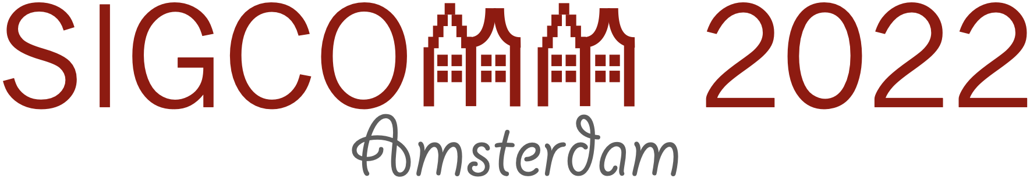
µFAB
Predictable vFabric on Informative Data Plane
Shuai Wang
Kaihui Gao, Kun Qian, Dan Li, Rui Miao, Bo Li, Yu Zhou, Ennan Zhai, Chen Sun, Jiaqi Gao,
Dai Zhang, Binzhang Fu, Frank Kelly, Dennis Cai, Hongqiang Harry Liu, Ming Zhang
Tsinghua University
Alibaba Cloud
Zhongguancun Lab
University of Cambridge
Notes:
Hello, everyone. I am Shuai Wang from Tsinghua University. And in this talk, I am going to present our work on how to build a predictable virtualized fabric in multi-tenant data centers. This is a joint work with our collaborators from Alibaba cloud, zhongguancun laboratory, and University of Cambridge.

Slide 2

Expectations on the next generation of DCN
High-performance storage
Distributed ML
Resource disaggregation
compute
compute
compute
C
C
C
G
G
G
network
Network IO
storage
storage
M
M
M
M
HDD -> SSD -> Persistent memory
Higher throughput, lower latency
1M IOPS / 10~100us
CPU -> GPU, TPU, DPU, FPGA
Faster compute, ﻿faster bandwidth provision
e.g. 100K Accelerators, response time <1ms
Remote Memory Access (RMA)
More network load
Need ultra-lower latency: 3~5us
Applications become increasingly sensitive to
DCN performance anomaly at micro-second granularity

Slide 3
Existing practices in DCN
Burst traffic causes tail latency spikes
Load imbalance hinders abstraction of ideal pipe
50x
10x
DCN capacity is largely over-provisioned
to handle dynamic traffic
Multi-path DCN is designed to support high capacity, and ECMP is used to split traffic

Slide 4
“Best-effort” network service
Huge Effort
No guarantee on bandwidth
The deployments of applications are physically isolated
Infeasible in VM tenants
No guarantee on latency
Congestion control transforms in applications
Limited gains

Slide 5



Next generation DCN service
I promise your available bandwidth and latency.
Tenants
Predictable
DCN operator
Best-effort
Tenants
I‘ll just do my best to transmit your packets.
The next generation of DCN should
not provide just a “best-effort”
but a “predictable” service
for applications
DCN operator
Notes:
Today’s DCN only does its best to transmit packets, so the quality of network service is not guaranteed.
The next generation of DCN should provide a predictable network service for applications.
So, tenants can enjoy the guaranteed bandwidth and latency, simplifying the application design. Also, DCN operators benefit from the predictable network service, due to the performance improvement of the share cloud.

Slide 6
Predictable DCN service model
Host1
DCN
Host3
A1
NIC
r1
NIC
A3
B1
B2
Hose model
r2
r3
r4
Host2
A3
Virtual Fabric A
A1
A2
A2
NIC
r5
B2
Virtual Fabric B
B1
1. Bandwidth guarantee
A virtual fabric quickly provisions the guaranteed bandwidth if traffic demand is sufficient
2. Work-conservation
Idle resources can always be highly utilized by applications that have demands
3. Bounded tail latency
End-to-end latency between vNICs is always bounded to a low level
Notes:
In this work, our goal is to provide predictable DCN service for multi-tenant data centers.
We use hose model to abstract tenant’s virtual fabric. Each group of VMs can view their own network as if they are in a dedicated fabric, though these tenants share the same physical network infrastructure.
Specifically, a predictable virtual fabric should provide bandwidth guarantee, the guaranteed bandwidth can be quickly provisioned if the tenant has sufficient traffic demand.
and it also can achieve work conservation, a tenant can use more than its bandwidth guarantee to fully utilize network resources if other tenants do not have sufficient traffic demands.
Finally, it can bound the end-to-end tail latency. For predictable DCN service, all three goals should be achieved simultaneously.

Slide 7
Existing efforts in both industry and academia
Static bandwidth reservation
SecondNet[CoNEXT’10], Oktopus[SIGCOMM’11], CloudMirror[HotCloud’13], Silo[SIGCOMM’15]
Strong guarantees but low resource utilization
Traffic admission control at the end-host
PicNIC[SIGCOMM’19], EyeQ[NSDI’13], GateKeeper[WIOV’11]
Bandwidth guarantee at edges, but cannot handle congestion in the fabric
Weighted congestion control (WCC)
Seawall[NSDI’11], FairCloud[SIGCOMM’12], ElasticSwitch[SIGCOMM’13]
Runtime fabric bandwidth allocation but with slow convergence
We use PicNIC + WCC+ Clove (PWC) for the state-of-the-art performance
PicNIC [SIGCOMM’19] for edge-based traffic admission control
WCC with Swift [SIGCOMM’20] for fabric congestion control
Clove [CoNEXT’17] for flowlet-based load balancing

Slide 8
Not easy to achieve latency guarantees
﻿Larger incast would exaggerate the upper bound of the burst
2to1
8to1
﻿Existing congestion control heuristically evolves flow rate to achieve full network utilization
Notes:
We take an incast example to show that it is not easy for the PWC combination to achieve latency guarantees.
﻿Existing congestion control heuristically evolves flow rate to achieve full network utilization.
So, more active flows in the network would exaggerate the upper bound of the burst and finally lead to unbounded queuing latency. In contrast, uFAB can bound the tail latency even as the incast degree increases.
6:17

Slide 9
Not easy to achieve bandwidth guarantees
PicNIC +WCC + Clove
µFAB (close to ideal)
﻿Link utilization misleads VF-4 to perceive the essential bandwidth contention
﻿Bandwidth isolation in multi-path architectures is
not orthogonal to load balancing

Slide 10
Reconstructing DCN Service with Programmability
Long time to perceive the path’s quality and converge to demanded bandwidth
heuristic rate adjustment & path selection
Traditional
DCN fabric
Sender
Receiver
Programmable data plane
deterministic rate adjustment & path selection
Next generation
DCN fabric
Sender
Receiver
fine-grained network status
Sub-ms to perceive the path’s quality and converge to demanded bandwidth
Notes:
The insight here is that the traditional DCN fabric is a black box for the end hosts. So, end hosts do not know what is going on in network fabric, and they typically use heuristic for the rate adjustment and path selection.
As a result, it takes a long time to perceive the path’s quality, and converge to the demanded bandwidth.
In recent years, programmable network devices are deployed in data centers,
and ﻿they bring possibilities to obtain real-time and precise network information.
With these information, senders can adjust rate and select path more accurately and rapidly.
That opens up new opportunities for the sender to perceive the path’s quality and converge to demanded bandwidth in sub millisecond.

Slide 11








The architecture of µFAB
DCN
Network Info |  |  | Tenant Info
link capacity | link utilization | … | bandwidth guarantee | …
Host3
Host1
A1
$μ$FAB-E
prob
$μ$FAB-E
A3
Path1
B1
prob
$μ$FAB-C
B2
prob
r1
r2
r3
r4
resp
Host2
$μ$FAB-C
$μ$FAB-C
$μ$FAB-C
A3
A1
A2
$μ$FAB-E
A2
B1
B2
$μ$FAB-C
r5
uFAB-E:
Send probes with fetch core information back
Schedule packets to paths
Control sending rate of each path
uFAB-C:
Extract the VF information in probes
Summarize total bandwidth subscription on each link
Piggyback the preceding information with INT
Notes:
This is the architecture of uFAB.
Each host has an active edge, uFAB-E.
And, the switches are the informative core, uFAB-C.
When the sender sends traffic to the receiver, it generates probe packets and sends them to network.
Every time the probe packets reach a switch, the switch will insert virtual fabric information into probe packets,
including not only network information but also tenant information, such as link capacity, link utilization, bandwidth guarantee, etc. The tenant information enables uFAB to perform tenant-level network isolation.
In this way, when the probe packets reach the receiver, all necessary information will be collected in the probe packets, and then will be piggybacked to the sender. Based on the feedback, the sender can schedule packets to different paths, and control sending rate of each path.

Slide 12
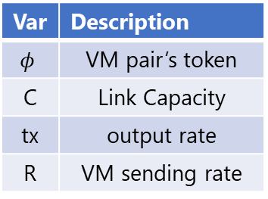
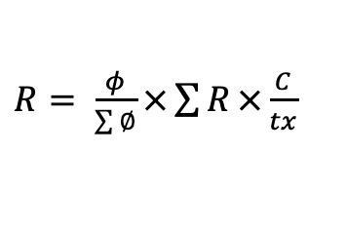
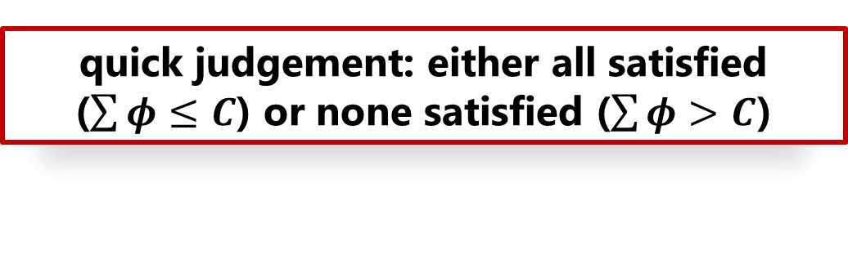
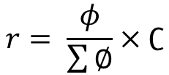
How does µFAB achieve bandwidth guarantee with work conservation?
quick judgement: either all satisfied ($\sum{φ}≤C$) or none satisfied ($\sum{φ}>C$)
Var | Description
$$φ$$ | VM pair’s token
C | Link Capacity
tx | output rate
R | VM sending rate
Proportional sharing：
$$r= \frac{φ}{\sum{∅}}×∁$$
Fabric
A1
∑∅ is total token of all active VM-pairs
A3
What if some senders have insufficient traffic?
A2
B2
$R= \frac{φ}{\sum{∅}}×\sum{R}×\frac{C}{tx}$
B1
Proportional sharing
High utilization
𝑟 serves as the lower bound, R servers as the expected rate
Notes:
So, how uFAB achieve bandwidth guarantee with work conservation.
With the VM pair’s token and link capacity recorded in the switches,
different VM-pairs can use proportional sharing to allocate bandwidth,
because proportional sharing based on vm pairs’ guarantees provide a very quick judgement about the overall bandwidth guarantee. That is, either every vm pair‘s bandwidth can be guaranteed, or none can be guaranteed.
But what if some senders do not have sufficient traffic demand?
To solve this problem, we also record the switch’s output rate and the vm pairs’ sending rates.
If some senders have insufficient traffic, total tx rate will be less than the link capacity, and lead to the increase of the expected sending rate.
We use uppercase R as the expected rate, and lowercase r as the lower bound, and allow the expected rate to go beyond the lower bound.
%In this way, though some senders’ sending rate is lower than the expected rate, the spare bandwidth can also be used by other VM pairs by increasing their expected rate.
$∁$ is the link bandwidth capacity, $\sum{∅}$ is total token of all active VM-pairs
$tx$ is link’s actual TX rate, $\sum{R}$ is total sending rate of all active VM-pairs

Slide 13

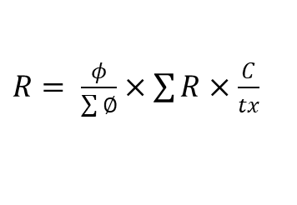
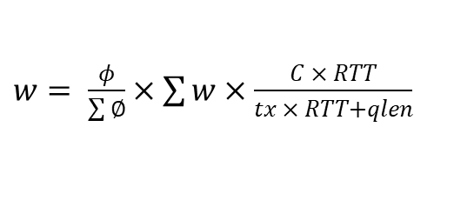
How does µFAB achieve latency guarantee?
Window-based traffic admission
limit the inflight traffic
$R= \frac{φ}{\sum{∅}}×\sum{R}×\frac{C}{tx}$
$w= \frac{φ}{\sum{∅}}×\sum{w}×\frac{C × RTT}{tx × RTT+qlen}$
handle short-term traffic bursts
Two-stage traffic admission
handle sudden conversion from under-utilization to full-utilization
work conservation
“Bonus”
What tenants
pay for
bandwidth guarantee
The maximum in-flight bytes is limited to 3 times BDP
Notes:
Further,
we use window-based traffic admission to limit the inflight traffic.
By taking queue length in switch port into consideration, we can handle short-term traffic bursts efficiently. But there is another problem .
When the link keeps being under-utilized, all VM-pairs can grow to a full line-rate, even they have only one token. Then, if multiple VM-pairs have traffic demand simultaneously, total inflight traffic and worst-case latency are still unbounded.
To solve this problem, we limit the initial bursts of each host to its bandwidth guarantee,
and then make them slowly converge to work conservation.
The intuition behind this is that tenants pay for its guarantee but the extra capacity is a “bonus”
%so we do not need to hurry to provide the extra capacity.
In this way, we can limit the maximum in-flight bytes to 3 times BDP.
Because tenants pay for its guarantee but the extra capacity is a “bonus”
2 RTT to learn the load created by the initial burst from the core and start to reduce
Each host first limits its initial bursts to its bandwidth guarantee, and then slowly converge to work conservation
When the link keeps being under-utilized (𝑡𝑥 < 𝐶), all VM-pairs can grow to a full line-rate
Then, if multiple VM-pairs have traffic demand simultaneously, total inflight traffic and worst-case latency are still unbounded

Slide 14

How does µFAB migrate to other paths?
Trigger path migration if:
Current path is incapable to satisfy minimum bandwidth guarantee
Quickly but with caution
More bandwidth in other paths for work conservation
Less frequently
Insights:
(1) Quick judgement from probes without “actual” putting traffic onto paths.
(2) Randomization and pacing techniques to avoid oscillation and reordering
$$r= \frac{φ}{\sum{∅}+φ}×∁$$

Slide 15
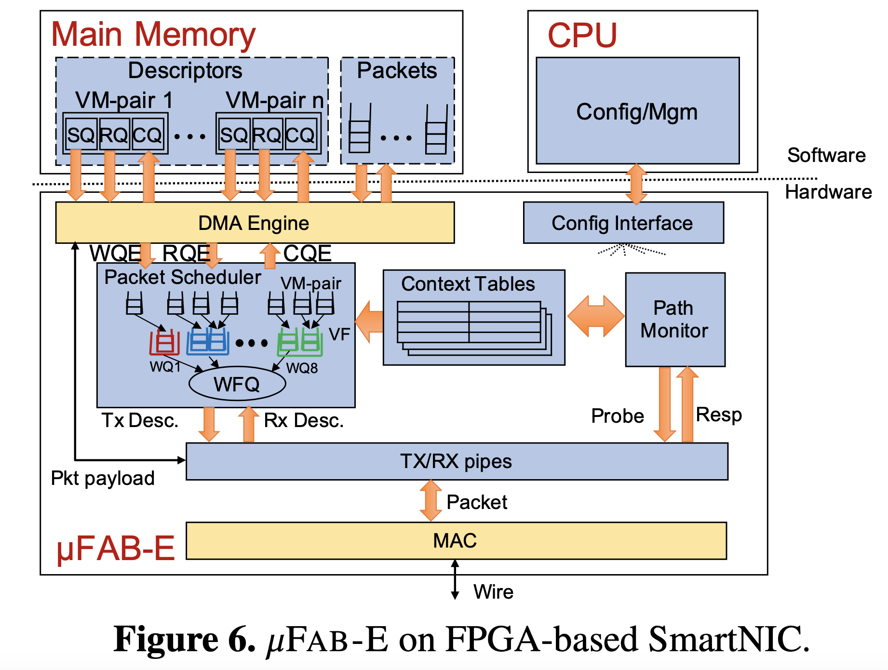
Implementation
µFAB-E on FPGA(100G) and SoC(10G) SmartNICs
µFAB-C on Tofino
10% extra hardware resource
Tradeoff in supporting many VFs
Using Bloom Filter to track active VM-pairs
False positive in Bloom Filter have limited impact

Slide 16
Evaluation

Slide 17
Micro-benchmarks
Rate evolution of across PoD VFs (SoC SmartNIC)
Hardware evaluation (FPGA SmartNIC)
(a) µFAB
(b) PicNIC+WCC+Clove
Better
Better
Bandwidth dissatisfaction
Notes:
We generate traffic from the left Pod to the right Pod,
with three kinds of bandwidth guarantees. uFAB can converges to the bandwidth guarantee quickly and steady. However, the PWC combination causes rate fluctuation,
and cannot satisfy the bandwidth guarantee. Besides, uFAB can achieve close to zero queue length.
With the FPGA testbed result, we can see that uFAB can converge to the bandwidth guarantee very quickly, even with a failure. Also, the queue length is very short, and no more than 3 times BDP.

Slide 18
Application-level performance
MongoDB + Memcached
Elastic Block Storage (EBS)
Better
ElasticSwitch+Clove
ElasticSwitch+Clove
Storage Agent
Block Agent
ElasticSwitch+Clove
Better
Storage Agent
Block Agent
Notes:
We run bandwidth hungry mongodb application and latency sensitive Memcached simultaneously. In both scenarios, uFAB can achieve close to ideal performance in query per second and query completion time, because it can provide predictable network services for both mongoDB and memcached. For elastic block storage application, we also find the similar observations.
14:15

Slide 19

Conclusion
Future DCN demands predictable performance at µs
Network Servitization
(virtual fabric)
Edge-Core Fusion
(programmable data plane)
µFAB is a concrete technology that leverages edge-core fusion to realize a predictable fabric service:
Bandwidth guarantee
Work conservation
bounded tail latency
µFAB
Notes:
To conclude,
in the next generation of data center, the applications demand predictable network performance at micro second granularity. We have two takeaways.
First, the network should provide their predictable services to applications, and this service has to be built in the fabric layer. So, we can avoid the infeasible VM modification.
Second, edge-core fusion with programmable data plane can help to get fine-grained network information and guide the sender to make smart decisions.
Together, this is uFAB, which provides bandwidth guarantee, work conservation, and bounded tail latency simultaneously.

Slide 20
Thanks

