Slide 1
Dilated Convolution with d = 2^(l-1) for l>0; Residual Blocks
L = 4, k = 3, d = 8
L = 3, k = 3, d = 4
L = 2, k = 3, d = 2
L = 1, k = 3, d = 1
L = 0, k = 3, d = 0
30
25
20
15
10
5
1
1
3
7
15
31

Slide 2
Dilated Convolution with d = 2^(l-1) for l>0
k = 3 = const.
N = 2, l = 4, d = 2
N = 2, l = 3, d = 2
N = 1, l = 2, d = 1
N = 1, l = 1, d = 1
N = 0, l = 0, d = 0
30
25
20
15
10
5
1

Slide 3
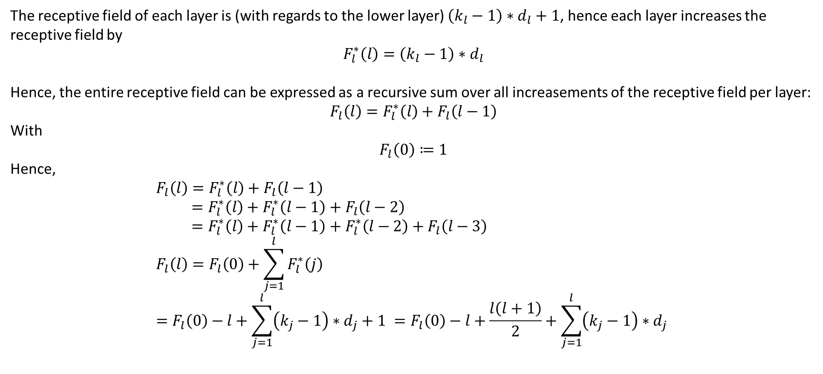
Receptive Field Calculation (general)
The receptive field of each layer is (with regards to the lower layer) $\left(k_{l}−1\right)∗d_{l}+1$, hence each layer increases the receptive field by
$$F_{l}^{∗}\left(l\right)=\left(k_{l}−1\right)∗d_{l}$$
Hence, the entire receptive field can be expressed as a recursive sum over all increasements of the receptive field per layer:
$$F_{l}\left(l\right)=F_{l}^{∗}\left(l\right)+F_{l}\left(l−1\right)$$
With
$$F_{l}\left(0\right)≔1$$
Hence,
$$F_{l}\left(l\right)=F_{l}^{∗}\left(l\right)+F_{l}\left(l−1\right) \\ =F_{l}^{∗}\left(l\right)+F_{l}^{∗}\left(l−1\right)+F_{l}\left(l−2\right) \\ =F_{l}^{∗}\left(l\right)+F_{l}^{∗}\left(l−1\right)+F_{l}^{∗}\left(l−2\right)+F_{l}\left(l−3\right) \\ F_{l}\left(l\right)=F_{l}\left(0\right)+\sum_{j=1}^{l}{F_{l}^{∗}\left(j\right)} \\ =F_{l}\left(0\right)−l+\sum_{j=1}^{l}{\left(k_{j}−1\right)∗d_{j}+1 }=F_{l}\left(0\right)−l+\frac{l\left(l+1\right)}{2}+\sum_{j=1}^{l}{\left(k_{j}−1\right)∗d_{j} }$$
Summenformel

Slide 4

Receptive Field Calculation (general), ctd.
$$F_{l}\left(l\right)=F_{l}\left(0\right)+\frac{l\left(l−1\right)}{2}+\sum_{j=1}^{l}{\left(k_{j}−1\right)∗d_{j} }$$
With $k_{l}=k=const.$:
$$F_{l}\left(l\right)= F_{l}\left(0\right)+\frac{l\left(l−1\right)}{2}+\left(k−1\right)\sum_{j=1}^{l}{d_{j} } \\ =1+\frac{l\left(l−1\right)}{2}+\left(k−1\right)\sum_{j=1}^{l}{d_{j} }$$

Slide 5
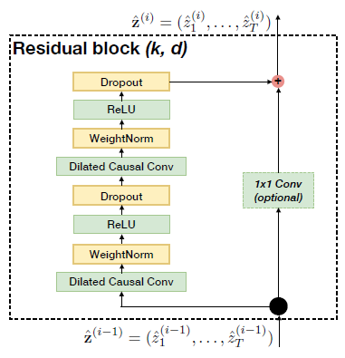
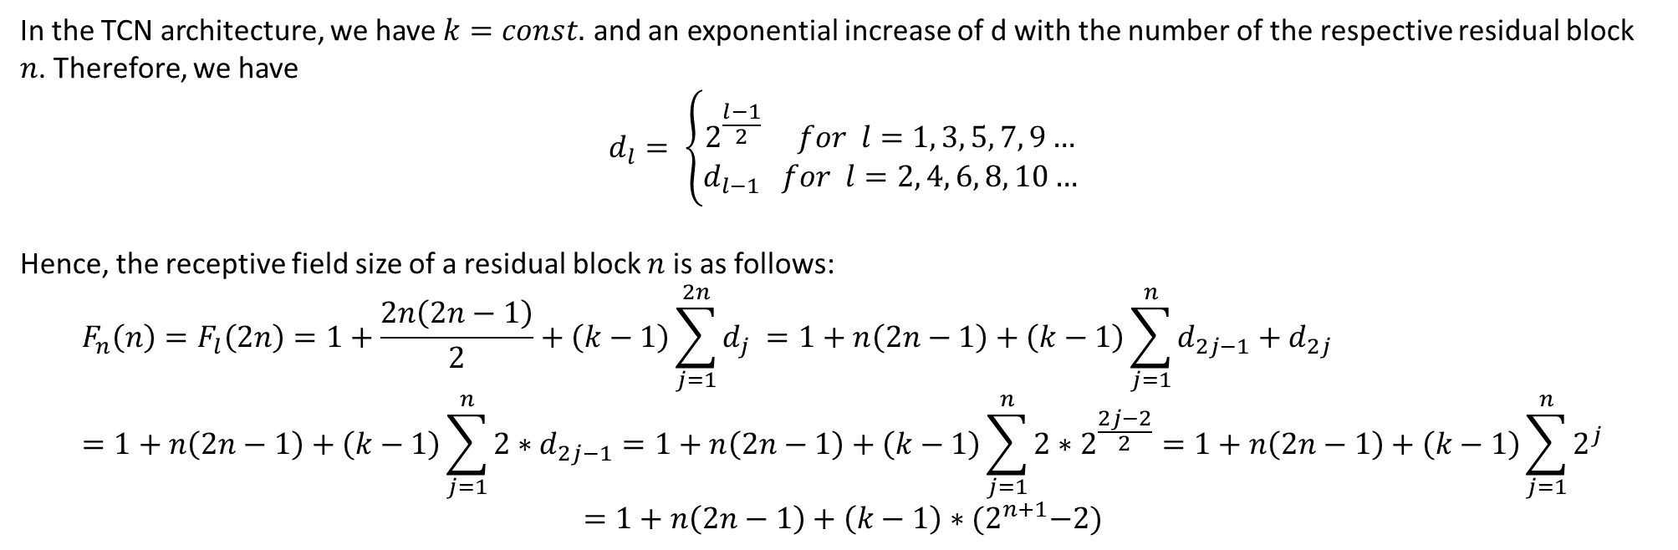

Receptive Field Calculation (Res Blocks)
$$F_{l}(l)=1+\frac{l\left(l−1\right)}{2}+\left(k−1\right)\sum_{j=1}^{l}{d_{j} }$$
In the TCN architecture, we have $k=const.$ and an exponential increase of d with the number of the respective residual block $n$. Therefore, we have
$$d_{l}= \left\{\begin{aligned}2^{\frac{l−1}{2}} for l=1, 3, 5, 7, 9… \\ d_{l−1} for l=2, 4, 6, 8, 10…\end{aligned}\right.$$
Hence, the receptive field size of a residual block $n$ is as follows:
$$F_{n}\left(n\right)=F_{l}\left(2n\right)=1+\frac{2n\left(2n−1\right)}{2}+\left(k−1\right)\sum_{j=1}^{2n}{d_{j} }=1+n\left(2n−1\right)+\left(k−1\right)\sum_{j=1}^{n}{d_{2j−1}+d_{2j}} \\ =1+n\left(2n−1\right)+\left(k−1\right)\sum_{j=1}^{n}{2∗d_{2j−1}}=1+n\left(2n−1\right)+\left(k−1\right)\sum_{j=1}^{n}{2∗2^{\frac{2j−2}{2}}}=1+n\left(2n−1\right)+\left(k−1\right)\sum_{j=1}^{n}{2^{j}}$$
$$=1+n\left(2n−1\right)+\left(k−1\right)∗{(2}^{n+1}−2)$$

Slide 6
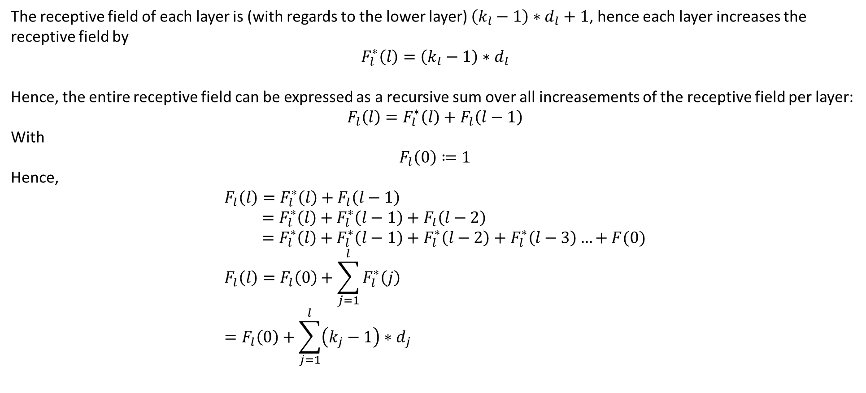
Receptive Field Calculation (general)
The receptive field of each layer is (with regards to the lower layer) $\left(k_{l}−1\right)∗d_{l}+1$, hence each layer increases the receptive field by
$$F_{l}^{∗}\left(l\right)=\left(k_{l}−1\right)∗d_{l}$$
Hence, the entire receptive field can be expressed as a recursive sum over all increasements of the receptive field per layer:
$$F_{l}\left(l\right)=F_{l}^{∗}\left(l\right)+F_{l}\left(l−1\right)$$
With
$$F_{l}\left(0\right)≔1$$
Hence,
$$F_{l}\left(l\right)=F_{l}^{∗}\left(l\right)+F_{l}\left(l−1\right) \\ =F_{l}^{∗}\left(l\right)+F_{l}^{∗}\left(l−1\right)+F_{l}\left(l−2\right) \\ =F_{l}^{∗}\left(l\right)+F_{l}^{∗}\left(l−1\right)+F_{l}^{∗}\left(l−2\right)+F_{l}^{∗}\left(l−3\right)…+F(0) \\ F_{l}\left(l\right)=F_{l}\left(0\right)+\sum_{j=1}^{l}{F_{l}^{∗}\left(j\right)} \\ =F_{l}\left(0\right)+\sum_{j=1}^{l}{\left(k_{j}−1\right)∗d_{j} }$$

Slide 7

Receptive Field Calculation (general), ctd.
$$F_{l}\left(l\right)=F_{l}\left(0\right)+\sum_{j=1}^{l}{\left(k_{j}−1\right)∗d_{j} }$$
With $k_{l}=k=const.$:
$$F_{l}\left(l\right)= F_{l}\left(0\right)+\left(k−1\right)\sum_{j=1}^{l}{d_{j} } \\ =1+\left(k−1\right)\sum_{j=1}^{l}{d_{j} }$$

Slide 8
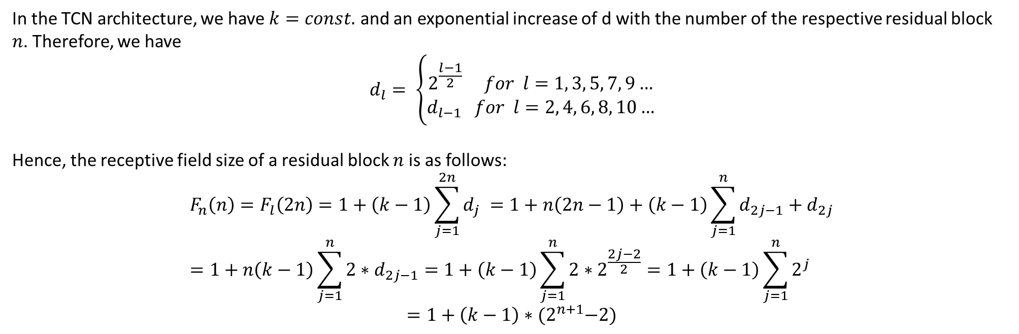

Receptive Field Calculation (Res Blocks)
$$F_{l}(l)=1+\left(k−1\right)\sum_{j=1}^{l}{d_{j} }$$
In the TCN architecture, we have $k=const.$ and an exponential increase of d with the number of the respective residual block $n$. Therefore, we have
$$d_{l}= \left\{\begin{aligned}2^{\frac{l−1}{2}} for l=1, 3, 5, 7, 9… \\ d_{l−1} for l=2, 4, 6, 8, 10…\end{aligned}\right.$$
Hence, the receptive field size of a residual block $n$ is as follows:
$$F_{n}\left(n\right)=F_{l}\left(2n\right)=1+\left(k−1\right)\sum_{j=1}^{2n}{d_{j} }=1+n\left(2n−1\right)+\left(k−1\right)\sum_{j=1}^{n}{d_{2j−1}+d_{2j}} \\ =1+n\left(k−1\right)\sum_{j=1}^{n}{2∗d_{2j−1}}=1+\left(k−1\right)\sum_{j=1}^{n}{2∗2^{\frac{2j−2}{2}}}=1+\left(k−1\right)\sum_{j=1}^{n}{2^{j}}$$
$$=1+\left(k−1\right)∗{(2}^{n+1}−2)$$

