Slide 1
Transfer Learning for Temporal Convolutional Networks
Hinweis
Um die Gestaltungsmöglichkeiten bei der Arbeit mit unseren IAV-Präsentationsvorlagen optimal auszuschöpfen und Designvorgaben einzuhalten, finden Sie im Intranet wichtige Gestaltungstipps und Beispielfolien:
https://intranet.iavgroup.local/c-cm1/de/leistungen/powerpoint/gestaltungsregeln.html
Master‘s Thesis – Topic Presentation
Robin Middelanis, Berlin, April 2019

Slide 2
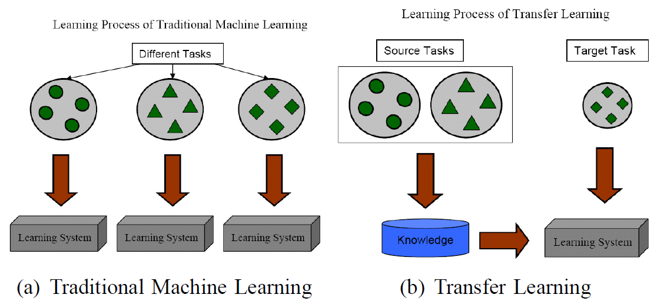
Transfer Learning [1] Idea and Motivation
Traditional ML:
Assumption: training and test data are drawn from the same feature space and distribution
One model is trained from scratch for each task and domain
Transfer Learning:
Starting Point:
Not enough training data with the same distribution as test data
Much effort to train a model from scratch for a different task
Obtain a model for a new task (inductive) or domain (transductive) with low training effort / without overfitting
→ Need to transfer knowledge from an existing model to a different domain (distribution) or task
Pan, S. J., & Yang, Q. (2010). A survey on transfer learning. IEEE Transactions on knowledge and data engineering, 22(10), 1345-1359.

Slide 3
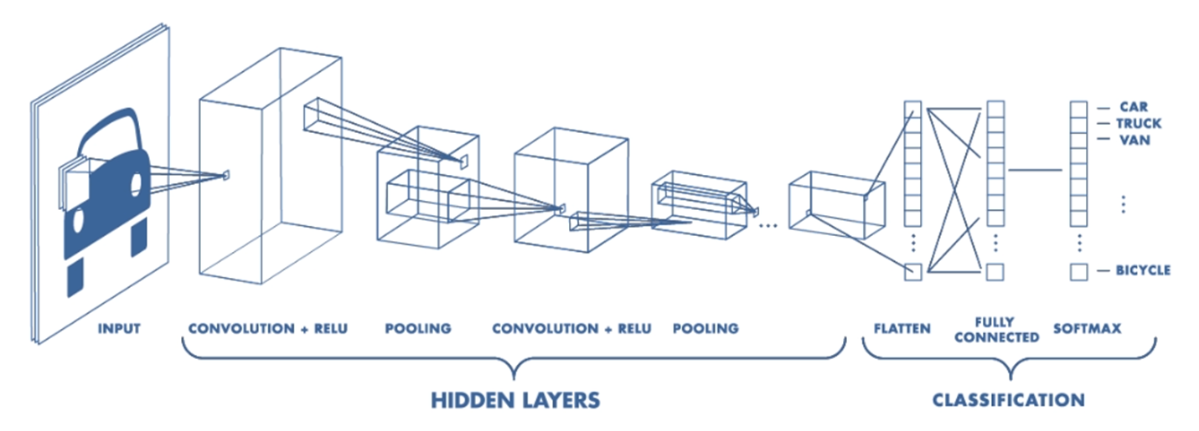
Convolutional Neural Networks [1],[2] Architecture and Transfer Learning approaches
Activation map /
Feature map
Purpose and Architecture
Typical approach for machine vision tasks
Convolutional layers for feature extraction
ReLU layers as activation function
Pooling layers for dimensionality reduction, noise reduction
Transfer Learning
Lower layers learn general features, e.g. edge detection → can be transferred
Higher layers learn more specific features → less transferrable
Knowledge transfer through weight transfer
Weight Initialization (‚fine-tune‘)
Feature Extractor (‚freeze‘)
Input
Filter kernel
1 | 2 | 3
4 | 5 | 6
7 | 8 | 9
1 | 1 | 0 | 1 | 1 | 1
0 | 1 | 1 | 0 | 0 | 0
1 | 0 | 1 | 1 | 1 | 0
1 | 1 | 0 | 1 | 0 | 1
1 | 1 | 1 | 0 | 1 | 0
0 | 1 | 1 | 0 | 1 | 1
30 | 30 | 33 | 21
30 | 30 | 24 | 25
37 | 30 | 27 | 21
35 | 28 | 28 | 26
+ ReLU
+ Pooling
https://www.mathworks.com/videos/introduction-to-deep-learning-what-are-convolutional-neural-networks--1489512765771.html

Slide 4
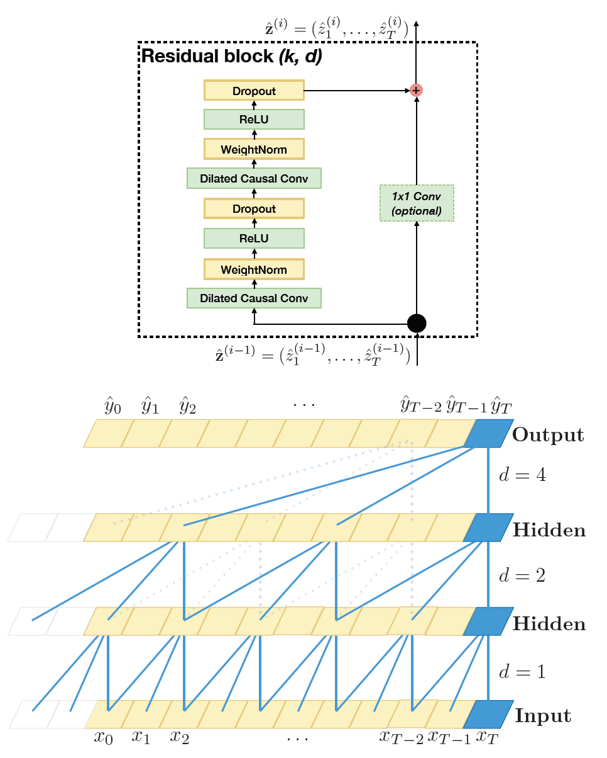
Temporal Convolutional Neural Networks [3] Series Modeling
Idea
Model needs to look into the past → Memory requirement
Typical approach are recurrent architectures, e.g. LSTMs / GRUs
Alternative approach: Temporal Convolutional Network (TCN)
Architecture
Similar to a (simplified) WaveNet architecture
Filter dilation for increased receptive field
Stacked Residual Blocks:
Stack of two Dilated Causal Convolution, ReLU and Dropout
A parallel path directly from the input (→ learn modifications instead of transformations)
Exponential Dilation with each Residual Block for larger receptive field
Paper evaluation shows competitive results with LSTMs, GRUs
→ „convolutional networks should be regarded as a natural starting point and a powerful toolkit for sequence modeling.
Traditional Transfer Learning approaches from CNNs for TCNs?
Shaojie Bai, J Zico Kolter, and Vladlen Koltun. An empirical evaluation of generic convolutional and recurrent networks for sequence modeling.

Slide 5
Research Questions
Is the knowledge learned in a TCN transferable to other tasks or domains?
Does the TCN, like CNNs, learn filters in some layers that can be considered as general and if so, what kind of features are learned?
To what degree is the knowledge transferrable to other domains and tasks?
Qualitative Statement
Visualization
Quantitative Analysis

Slide 6
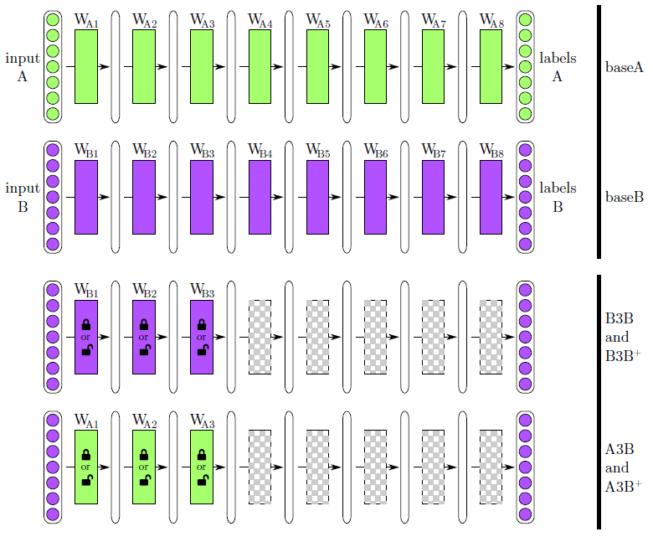
1 - Evaluation of Transferability [4] Qualitative Analysis
Idea
Successively transfer different layers and evaluate the performance
Approach
Split dataset in two similar / dissimilar parts A + B
Train one model on each part A, B
Randomly reinitialize all layers > n
Retrain both models on B and compare performance on task B
Adaptation
Forecast on different data series (same task, different domain)
Data:
Use two synthetically generated series
Vary similarity of series by superimposing different signals (e.g. sine)
Yosinski, J., Clune, J., Bengio, Y., & Lipson, H. (2014). How transferable are features in deep neural networks?. In Advances in neural information processing systems (pp. 3320-3328).

Slide 7
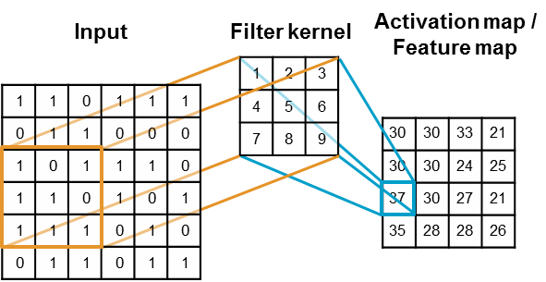
2 - Layer Visualization [5] Activation Visualization
Idea
Visualize the activation of each filter given some input
Approach
Feed some input into the network (forward path) → input specific
Interpret the activation of a chosen layer as pixel values
Typically, low layer activations contain edges, higher layer more abstract features
Adaptation
Feed synthetic or real-world time series into the network and plot activation of different filters
Francois, C. (2017). Deep learning with Python. Manning.

Slide 8
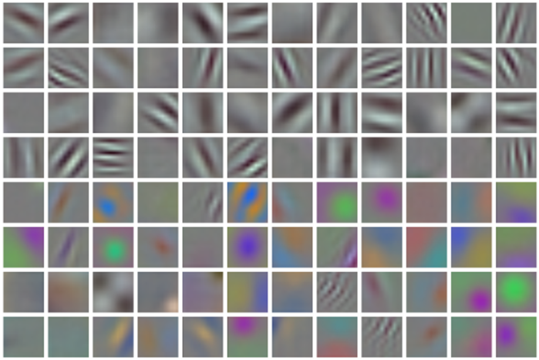
2 - Layer Visualization [6] Filter Visualization
Idea
Visualize the learned filters (independent of the input)
Approach
Interpret filter weights as pixel values
Usually most interpretable for the first layer that is looking directly at raw pixels
Low-layer filters often represent generic filters like edge filters
Adaptation
Plots of series filter weights might not be directly interpretable
Visualize filters with bode plots in frequency space
Castelluccio, M., Poggi, G., Sansone, C., & Verdoliva, L. (2015). Land use classification in remote sensing images by convolutional neural networks. arXiv preprint arXiv:1508.00092.

Slide 9
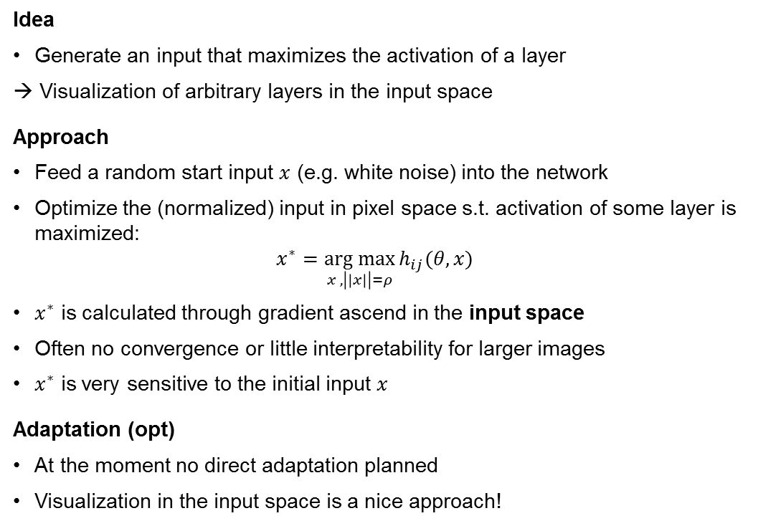
2 - Layer Visualization [7] Activation Maximization
Idea
Generate an input that maximizes the activation of a layer
→ Visualization of arbitrary layers in the input space
Approach
Feed a random start input $x$ (e.g. white noise) into the network
Optimize the (normalized) input in pixel space s.t. activation of some layer is maximized: $x^{∗}=\underset{x , \left|\left|x\right|\right|=ρ}{arg max}{h_{ij}(θ,x)}$
$x^{∗}$ is calculated through gradient ascend in the input space
Often no convergence or little interpretability for larger images
$x^{∗}$ is very sensitive to the initial input $x$
Adaptation (opt)
At the moment no direct adaptation planned
Visualization in the input space is a nice approach!
Erhan, D., Bengio, Y., Courville, A., & Vincent, P. (2009). Visualizing higher-layer features of a deep network. University of Montreal, 1341(3), 1.

Slide 10
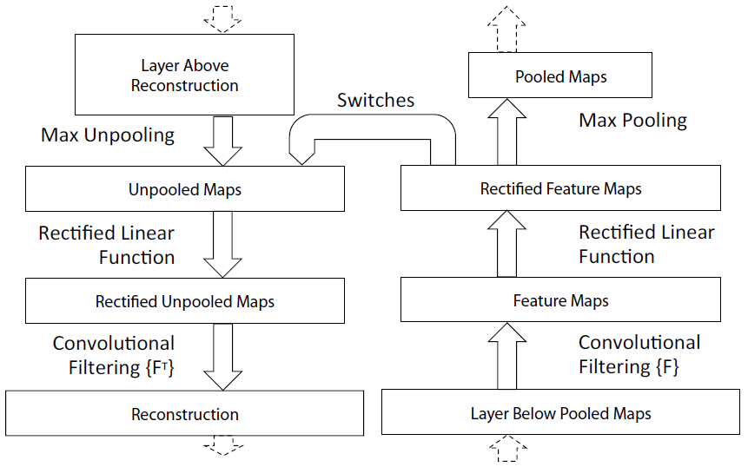
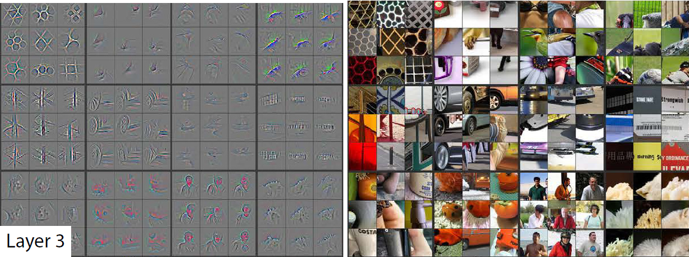
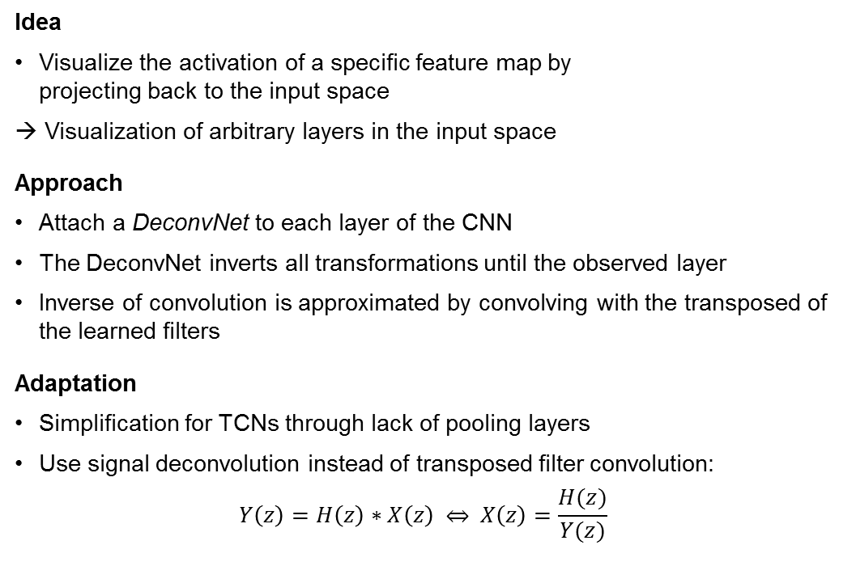
2 - Layer Visualization [8] Deconvolutional Networks
Idea
Visualize the activation of a specific feature map by projecting back to the input space
→ Visualization of arbitrary layers in the input space
Approach
Attach a DeconvNet to each layer of the CNN
The DeconvNet inverts all transformations until the observed layer
Inverse of convolution is approximated by convolving with the transposed of the learned filters
Adaptation
Simplification for TCNs through lack of pooling layers
Use signal deconvolution instead of transposed filter convolution: $Y\left(z\right)=H\left(z\right)∗X\left(z\right) \underset{⇔}{ } X\left(z\right)=\frac{H(z)}{Y(z)}$
Zeiler, M. D., & Fergus, R. (2014, September). Visualizing and understanding convolutional networks.

Slide 11
3 – Degree of Transferability [9] Quantitative Analysis
The qualitative approach only targets one example of a domain transfer case
Task transfer is not considered
Idea
Universal Language Model transfer method
Approach
Train a general-domain model on a large dataset, capturing general series modeling properties
Fine-tune the model with data from the target domain
Train a classifier for the target task
Adaptation
Find (assume) a general series model (well-suited dataset and task!)
Define / generate datasets with different degrees of similarity → domain transfer
Task Transfer, e.g. regression to classification
General-domain Model pretraining
Knowledge base -
Target-domain model fine-tuning
Domain Transfer -
Target-domain classifier training
…
Task Transfer -
Forecast
Regression
Classification
1
0
Own representation based on: Howard, J., & Ruder, S. (2018). Universal language model fine-tuning for text classification. arXiv preprint arXiv:1801.06146.
Domain similarity

Slide 12
Timeline and Tasks
Main Tasks:
Implement and train a TCN for experiments
Investigate the transferability of learned weights
Implement and evaluate visualizations (activation, filter and DeconvNet visualizations)
(opt) Evaluate the degree and limits of transferability
Write a Master‘s Thesis
Week 1 | Week 2 | Week 3 | Week 4 | Week 5 | Week 6 | Week 7 | Week 8 | Week 9 | Week 10 | Week 11 | Week 12 | Week 13 | Week 14 | Week 15 | Week 16 | Week 17 | Week 18 | Week 19 | Week 20 | Week 21 | Week 22 | Week 23 | Week 24 | Week 25
25. Feb. | 4. Mrz. | 11. Mrz. | 18. Mrz. | 25. Mrz. | 1. Apr. | 8. Apr. | 15. Apr. | 22. Apr. | 29. Apr. | 6. Mai. | 13. Mai. | 20. Mai. | 27. Mai. | 3. Jun. | 10. Jun. | 17. Jun. | 24. Jun. | 1. Jul. | 8. Jul. | 15. Jul. | 22. Jul. | 29. Jul. | 5. Aug. | 12. Aug.
TCN Reserach and Implementation
 |  |  | Research Question Definition Literature Research
 |  |  |  |  |  | Transferability Investigation
 |  |  |  |  |  |  |  |  |  | Layer Visualization
 |  |  |  |  |  |  |  |  |  |  |  |  |  |  |  | (opt) Evaluation of degree of Transferability
 |  |  |  |  |  |  |  |  |  |  |  |  |  |  |  |  |  |  |  | Master's Thesis
Today

Slide 13
Thanks!

Slide 14
References
[1] Pan, S. J., & Yang, Q. (2010). A survey on transfer learning. IEEE Transactions on knowledge and data engineering, 22(10), 1345-1359.
[2] Patel, S. & Pingel, J. (n.d.). Introduction to Deep Learning: What Are Convolutional Neural Networks? MathWorks. Available at https://www.mathworks.com/videos/introduction-to-deep-learning-what-are-convolutional-neural-networks--1489512765771.html
[3] Bai, S., Kolter, J. Z., & Koltun, V. (2018). An empirical evaluation of generic convolutional and recurrent networks for sequence modeling. arXiv preprint arXiv:1803.01271.
[4] Yosinski, J., Clune, J., Bengio, Y., & Lipson, H. (2014). How transferable are features in deep neural networks?. In Advances in neural information processing systems (pp. 3320-3328).
[5] Francois, C. (2017). Deep learning with Python. Manning.
[6] Castelluccio, M., Poggi, G., Sansone, C., & Verdoliva, L. (2015). Land use classification in remote sensing images by convolutional neural networks. arXiv preprint arXiv:1508.00092.
[7] Erhan, Dumitru, et al. "Visualizing higher-layer features of a deep network." University of Montreal 1341.3 (2009)
[8] Zeiler, M. D., & Fergus, R. (2014, September). Visualizing and understanding convolutional networks.
[9] Howard, J., & Ruder, S. (2018). Universal language model fine-tuning for text classification

