Slide 1
Robert Minkler
DevOps csd 380 - Assignment 1.2
The Technology Value Stream
March 19, 2025

Slide 2
What is a value stream?
"a value stream is all the activities or processes you use to deliver value (Value streams in software: A definition and detailed guide 2019).”
The most successful businesses are the ones that can deliver the most value quickly and affordably.

Slide 3


Lead time is king
Lead time is the time from the initial request until the product is delivered.
That might be the time between ordering and receiving your meal from a restaurant. It doesn’t matter how the meal was prepped as long as it is delivered promptly, tastes good, and is safe to eat.
Photo by Martin Widenka on Unsplash

Slide 4
Lead time is king
Customers expect to receive value quickly. Those who can deliver value quickly will win.
"Nimble companies with digital products and services that delight customers capture market share and increase revenue, while less responsive enterprises struggle (Takakura)."
Photo by Martin Widenka on Unsplash

Slide 5
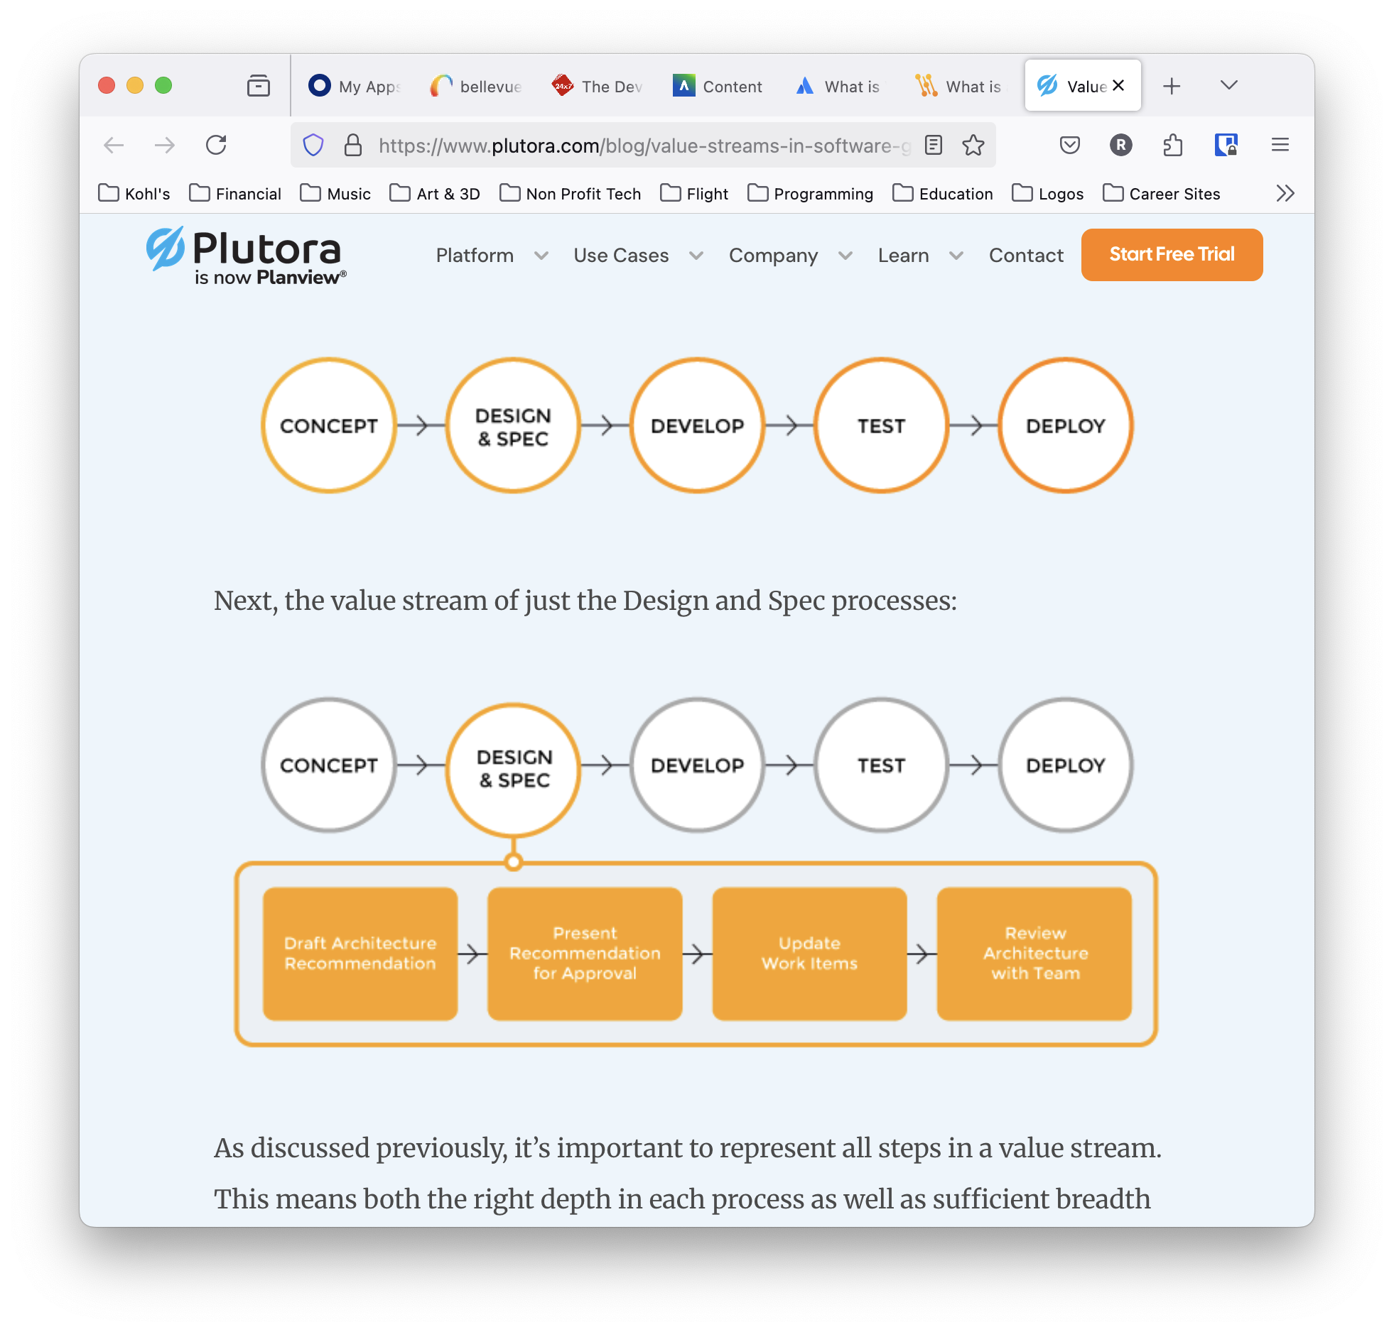
Processing time
Processing time is all of the time performing work. This includes every stage of the process while work is occurring.
(Value streams in software: A definition and detailed guide 2019)

Slide 6
Lead Time vs processing time
Processing Time
Customer Request
Work Begins
Product Delivered
Lead Time
Lead time is what the customer observes, including time in the queue when no work is occurring.

Slide 7
Long Lead times
It is common for organizations to have long lead times where deploying changes can take months. Long, manual testing requirements, complex approval processes, delays in generating test environments, and other delays can easily cause months-long lead times. Delays in testing compound as developers reacquaint themselves with the flawed code section.

Slide 8
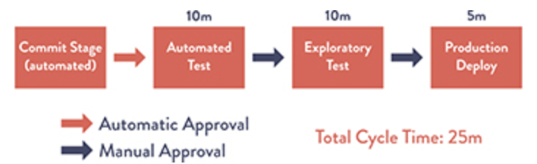
DevOps ideal lead time of minutes
Reducing the lead time to minutes rather than months significantly improves the value stream and customer perception. Using automated systems to test and deploy solutions speeds delivery exponentially, increasing customer satisfaction.
(Kim et al., 2021)

Slide 9
Managing the value stream
increased productivity
reduced costs
increased customer satisfaction
increased predictability
improved software
increased end-to-end visibility
boosted morale and innovation
(Takakura)

Slide 10
Mapping the value stream
Mapping out each step in the value stream is critical to understanding what processes exist and identifying roadblocks, dependencies, and inefficiencies.
It is impossible to improve what we cannot measure.

Slide 11
Measuring the flow
Measuring the flow of items through the value stream allows a team to assess progress
Flow velocity: number of items completed in a set time.
Flow efficiency: proportion of time that units of value are actively worked on.
Flow time: time a unit of value takes to progress through the value stream.
Flow load: a measure of work in progress.
Flow distribution: the proportion of each flow item type in a value stream.
(Kim et al., 2021) & (Takakura)

Slide 12
Resources
Takakura, T. (n.d.). What is value stream management?. Atlassian. https://www.atlassian.com/agile/value-stream-management
Plutora. (2019, December 27). Value streams in software: A definition and detailed guide. Plutora. https://www.plutora.com/blog/value-streams-in-software-guide
Kim, G., Humble, J., Debois, P., Willis, J., & Forsgren, N. (2021). The DevOps Handbook, Second Edition: How to Create World-Class Agility, Reliability, & Security in Technology Organizations (Second Edition). IT Revolution Press.

