Slide 1

Pager Rotation Duties
Robert Minkler
CSD 380 Mod7.2
4/27/2025

Slide 2

You built it, you maintain it.
Atlassian

Slide 3


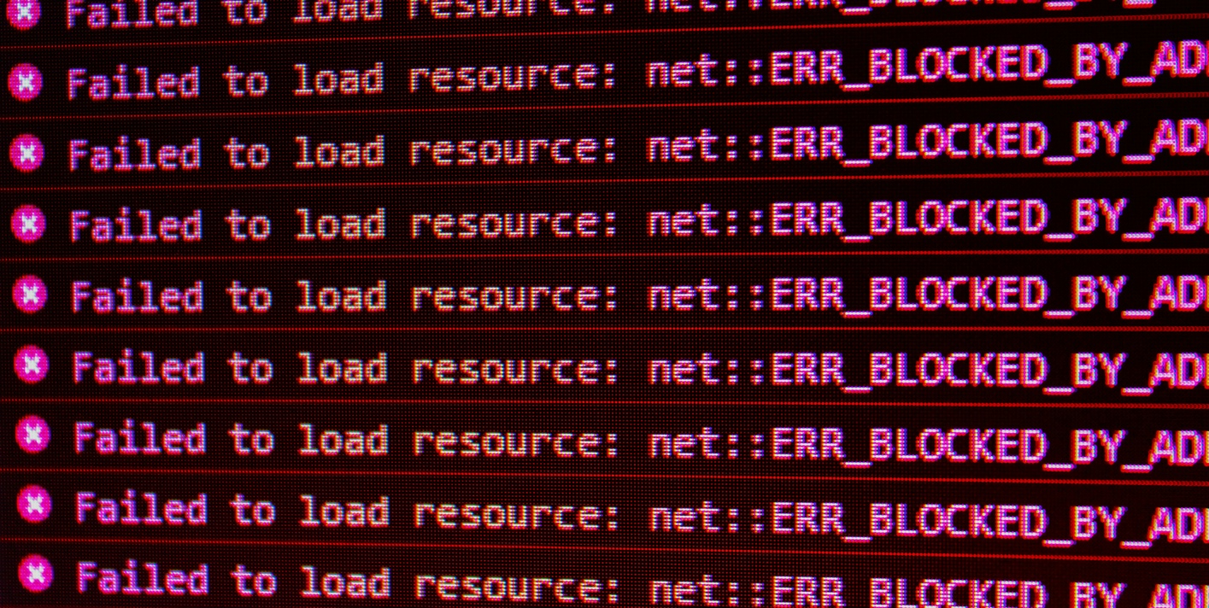
Introduction
Not too long ago, incident response and On-Call Pager Duty were relegated to the operations team. Today, with DevOps teams bearing the responsibility for their own applications, developers and operations share the responsibility of responding to incidents.

Slide 4




Benefits of a Good On-Call System
Employee Satisfaction
Improved Service
Improved Reliability
Customer Satisfaction
Accountability
Transparency
CORTEX

Slide 5
Pager Duty Best Practices

Slide 6
Best Practices
DevOps practices
Assign roles
Automate tasks
Remove communication barriers by placing developers on pager rotation.
Transfer issues to the appropriate team.
Assign teams for pager duty for every service.
Ensures the right engineer is accessible.
Ensures the right team is notified.
Use scheduling software to ensure shifts are covered by the right team.
Use tools to track who to contact and how.
Transfer issues to the appropriate team.

Slide 7
Best Practices
Create and follow escalation Policies
Proactively discover incidents
Determine who should be called when and what their responsibilities include.
Establish time limits and enforce them automatically to maintain an availability SLA.
Automatically escalate if the first responder doesn’t respond by the established time.
Use telemetry to detect incidents before customers notice. Then automatically notify the appropriate team.

Slide 8

Summary
Effectively managing pager duty removes communication barriers, places the correct team on an incident response, improves system performance and reliability, and increases product ownership among the team.

Slide 9

References
https://www.atlassian.com/incident-management/on-call/improving-on-call#you-built-it-you-maintain-itWhen
https://www.cortex.io/post/best-practices-for-on-call-rotations
https://www.pagerduty.com/resources/incident-management-response/learn/call-rotations-schedules/

