Slide 1
Artificial Intelligence
Machine Learning
Deep Learning

Slide 2
Machine Learning
Query
Decision
Model
Fit
Predict
Data
Application

Slide 3
Model
Fit
Predict

Slide 4
Supervised Learning
Regression
Classification
Unsupervised Learning
Clustering
Machine Learning
Dimensionality Reduction

Slide 6
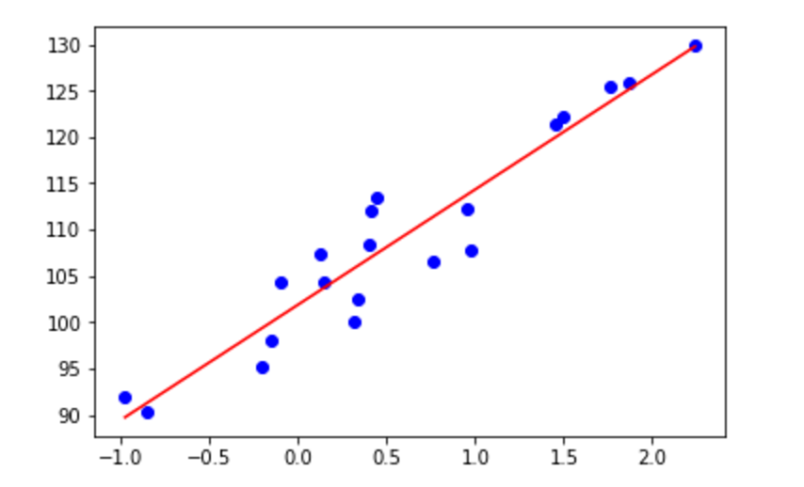

Slide 7
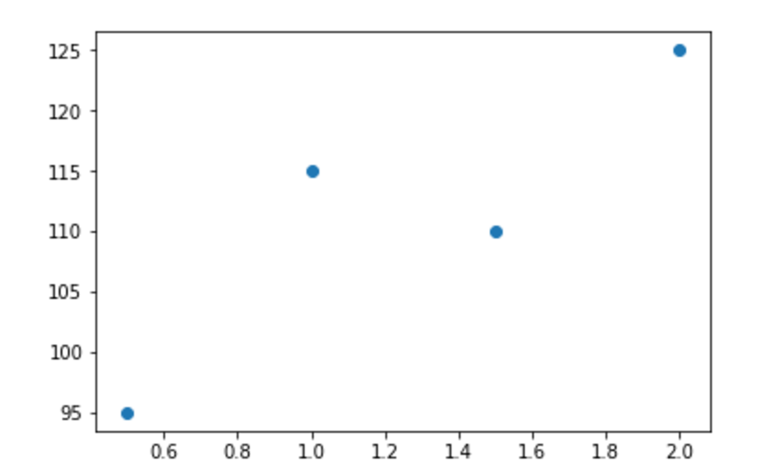
Error
y = wX + b

Slide 8

Home Price
Square Ft. (k)

