Slide 1

BANK CUSTOMER RETENTION & ATTRITION ANALYSIS
A Data-Driven Analysis of Customer Behavior
‘Customer attrition is impacting revenue and growth!’
Goal
Identify key factors influencing churn and propose data-driven retention strategies.
PRESENTED BY
RAHUL MISHRA

Slide 2

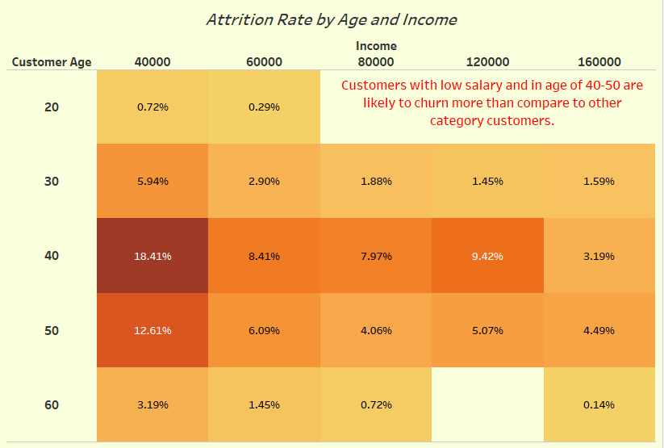
IDENTIFY VULNERABLE SEGMENTS
Key Insights
Customers aged 40-50 with lower incomes have the highest churn rates.
Higher-income customers show lower attrition.

Slide 3
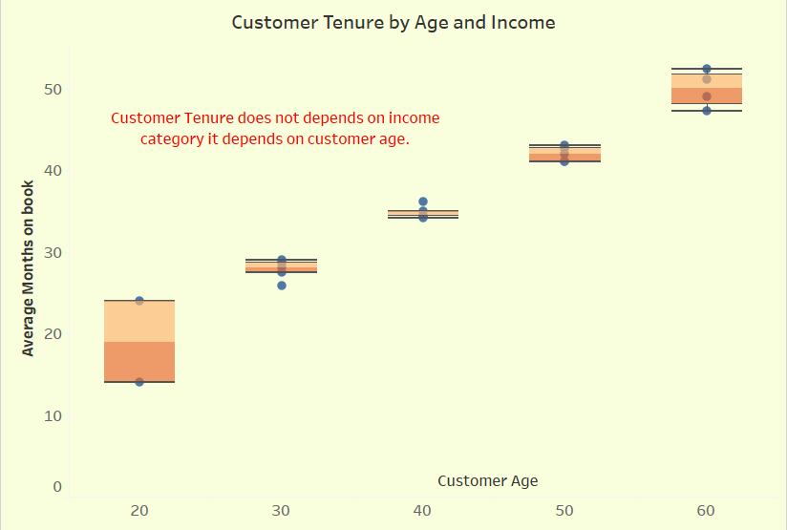
LONGER TENURE DOESN’T ALWAYS MEAN LOYALTY
Key Insights
Older customers tend to have longer tenure.
Income has limited impact on tenure length.

Slide 4
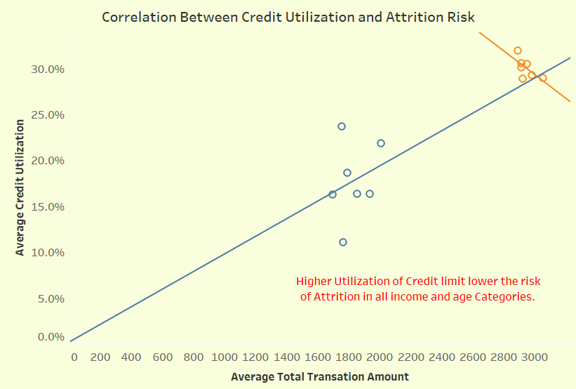
CREDIT UTILIZATION IMPACTS RETENTION
Key Insights
Higher credit utilization often correlates with lower attrition risk.

Slide 5
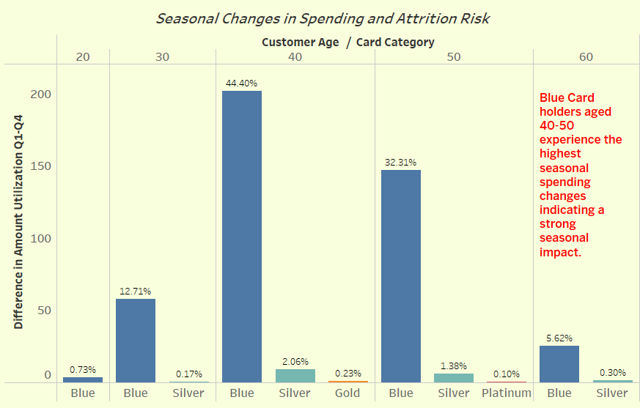
SEASONAL SPENDING PATTERNS REVEAL CHURN RISKS
Key Insights
Seasonal patterns of customers holding Blue card correlate with higher churn.

Slide 6
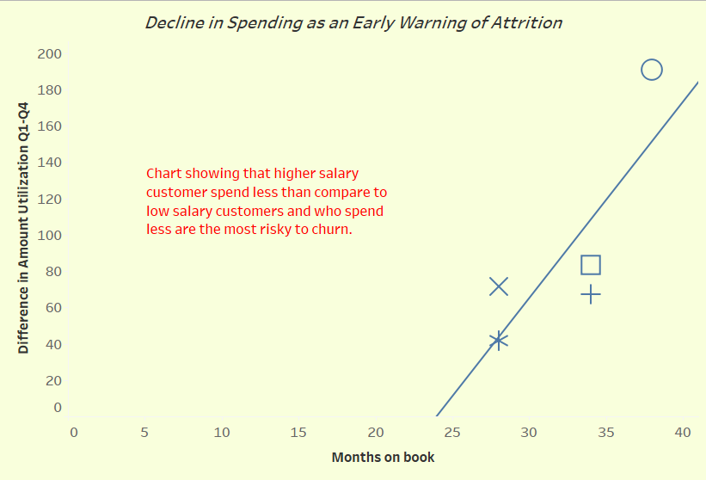
PROACTIVE INTERVENTION IS THE KEY
Key Insights
Reduced spending often signals potential churn.

Slide 7
Big Idea Restatement Lower-income customers aged 40-50 show higher churn and seasonal spending changes, while higher-income customers have more stable retention
Key Finding
Age, income, credit utilization, and seasonal behavior influence churn.
Recommendations
Target retention campaigns for low-income customers aged 40-50.
Implement loyalty programs and personalized offers for older customers.
Monitor utilization patterns. Encourage responsible credit usage through financial education and targeted campaigns.
Launch targeted marketing campaigns during peak seasons.
Focus retention and marketing efforts on Blue Card holders aged 40-50 due to their high seasonal spending fluctuations.
Establish a customer engagement program.
Detect early warning signs and respond with targeted offers.

