Slide 1
Menti Web application

Slide 2
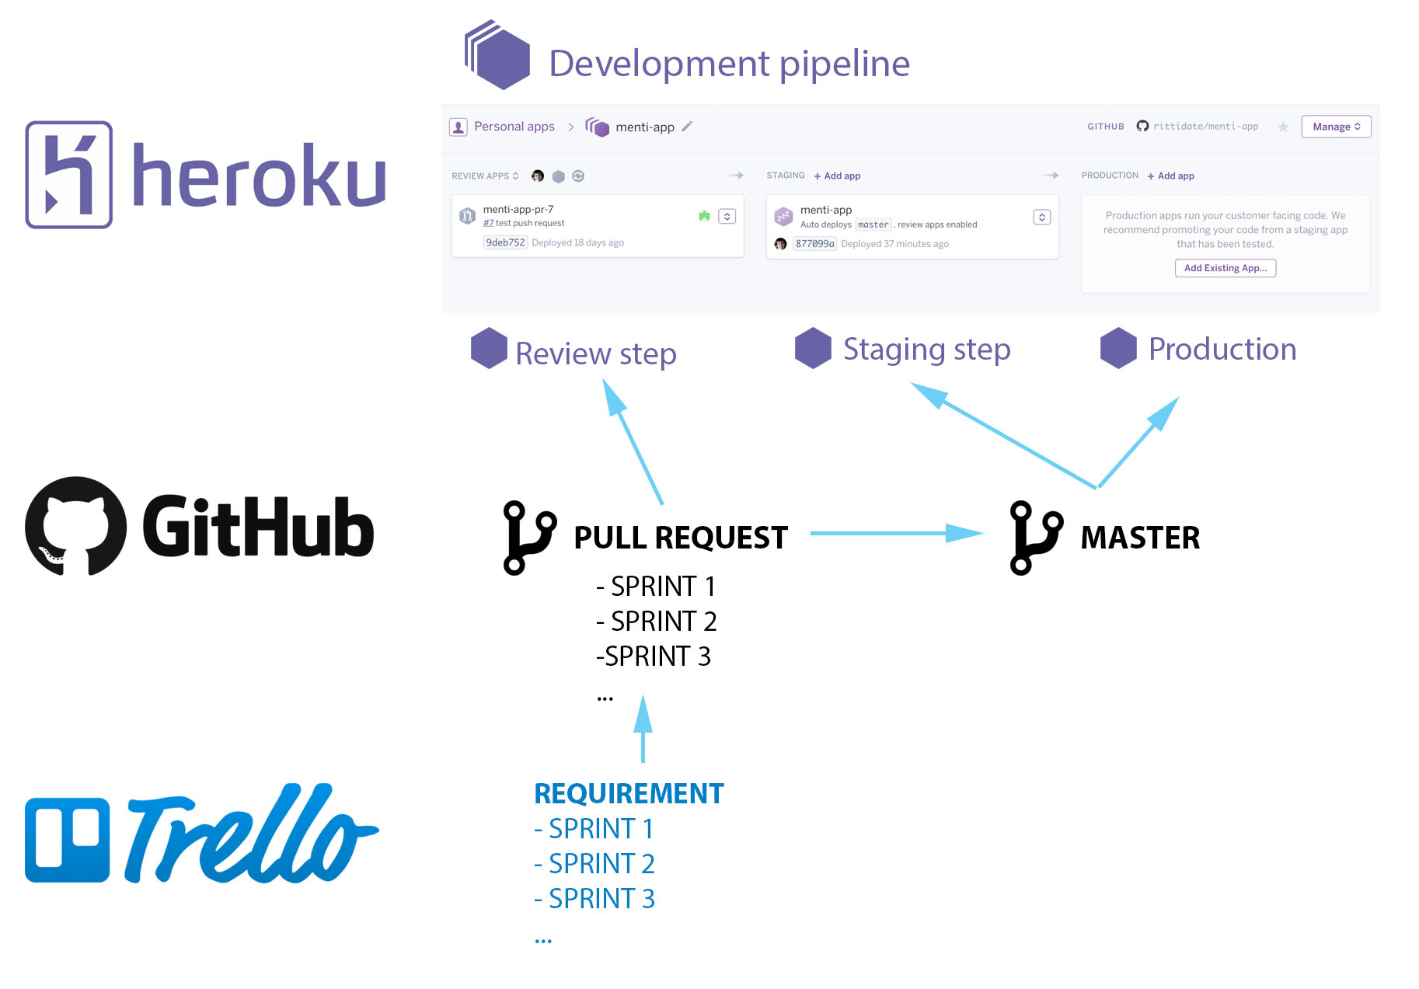
Development workflow

Slide 3
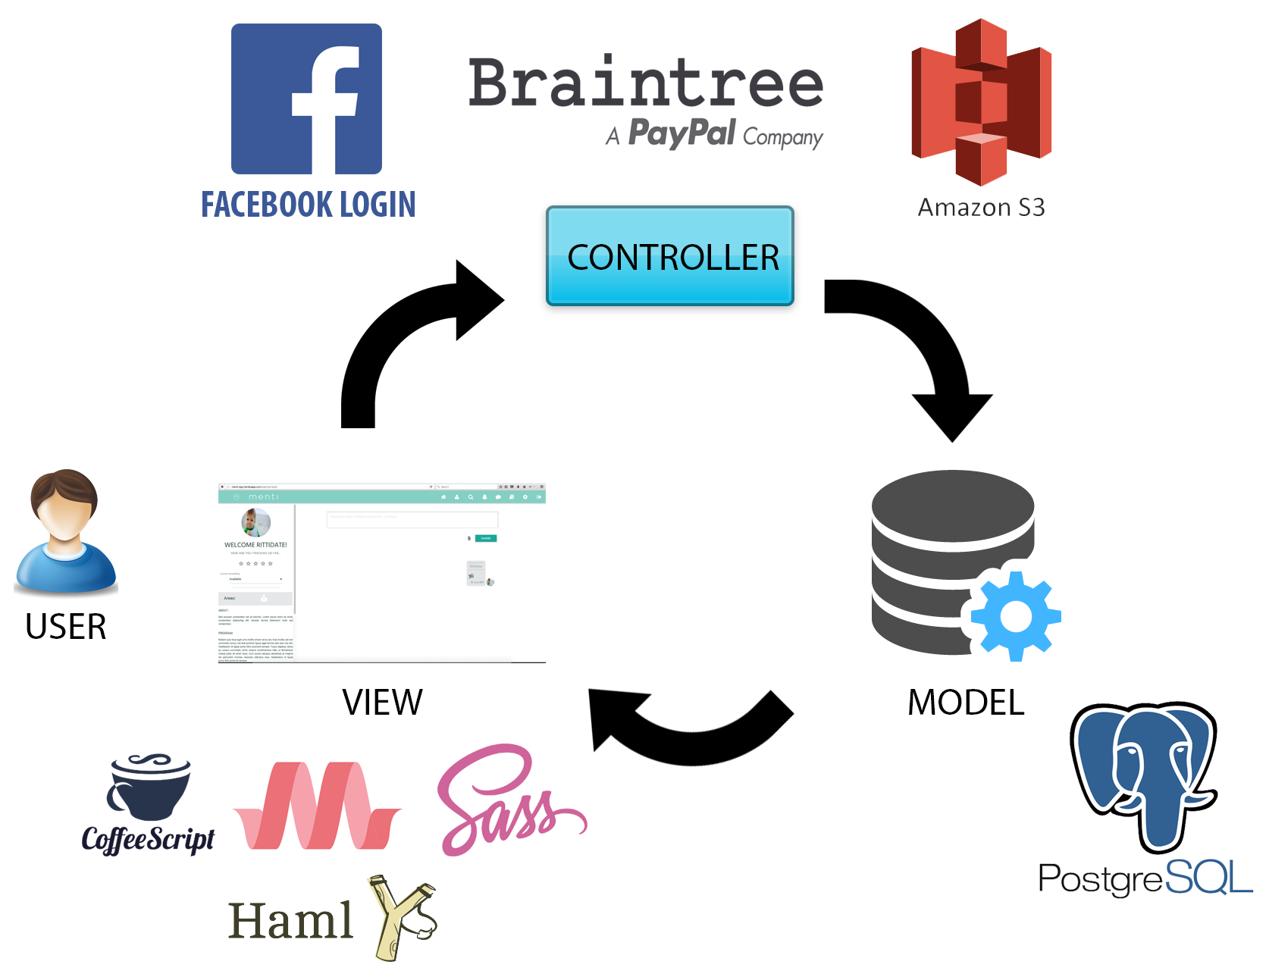
Ruby On Rails framework

Slide 4
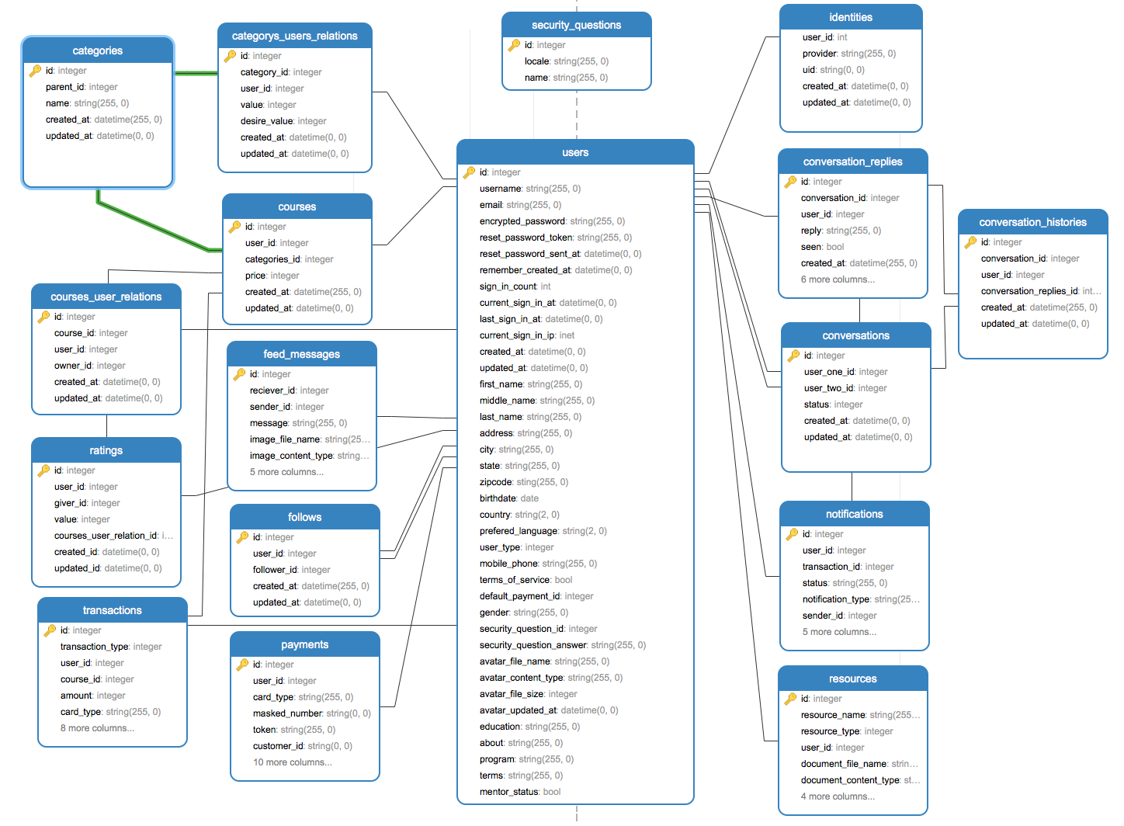
Database Structure

