Slide 1


Slide 2
Mid- Project Progress Presentation
Team Members
- Karthikey Surineni
- Phatsakon Unsoda
- Liang Lyu
- Zi Yang

Slide 3
Project Concept
Building a data lake comprising of data such as weather information, health conditions and drug data from pharmacies
Leverage the power of Big Data platforms using Hadoop used in conjunction with Hive and HortonWorks
On-demand data availability for analysis
Develop and test hypotheses and arrive at conclusions backed by rigorous training and analysis
Find patients at high-risk, manage their health and maybe even save lives!

Slide 4
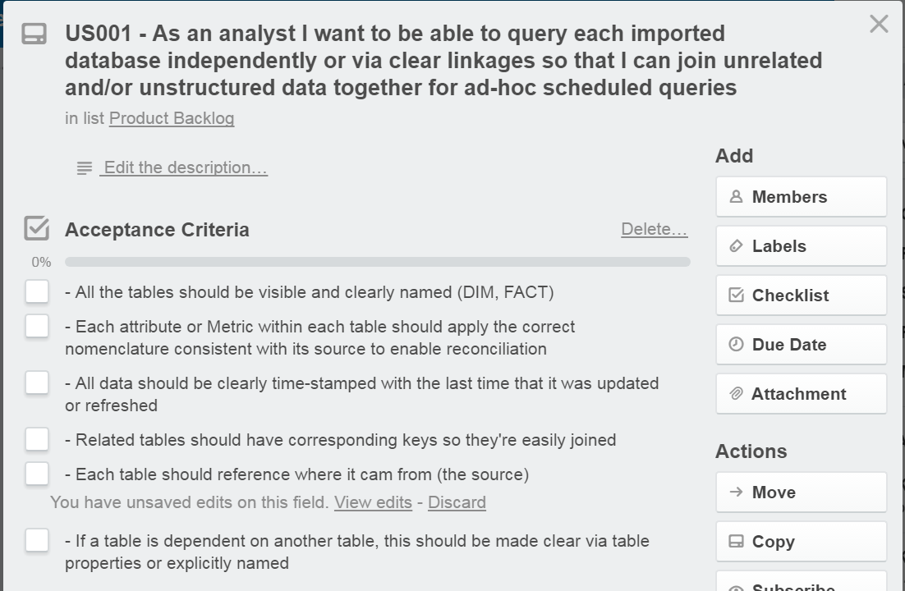
Work in Progress

Slide 5
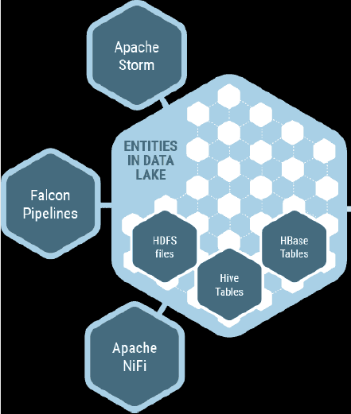
Work Performed
Data Source and format analysis (Health websites, Weather websites)
Data Source Freeze
Data linkage for deciding relationships and building schema
Data Processor for managing data flow
Writing Python scripts for formatting data and pull requests

Slide 6
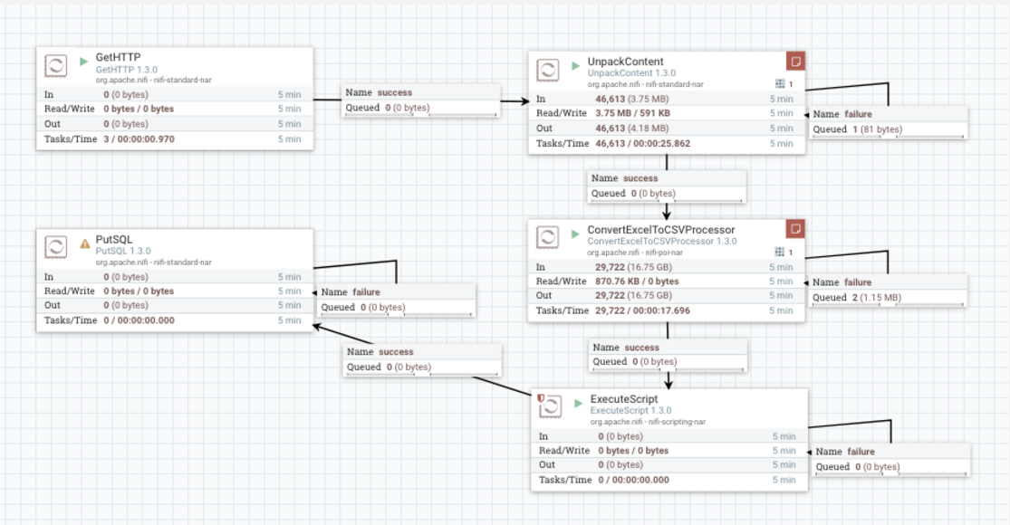
NiFi Data Processor
Process to get a http request and format the file from the request

Slide 7
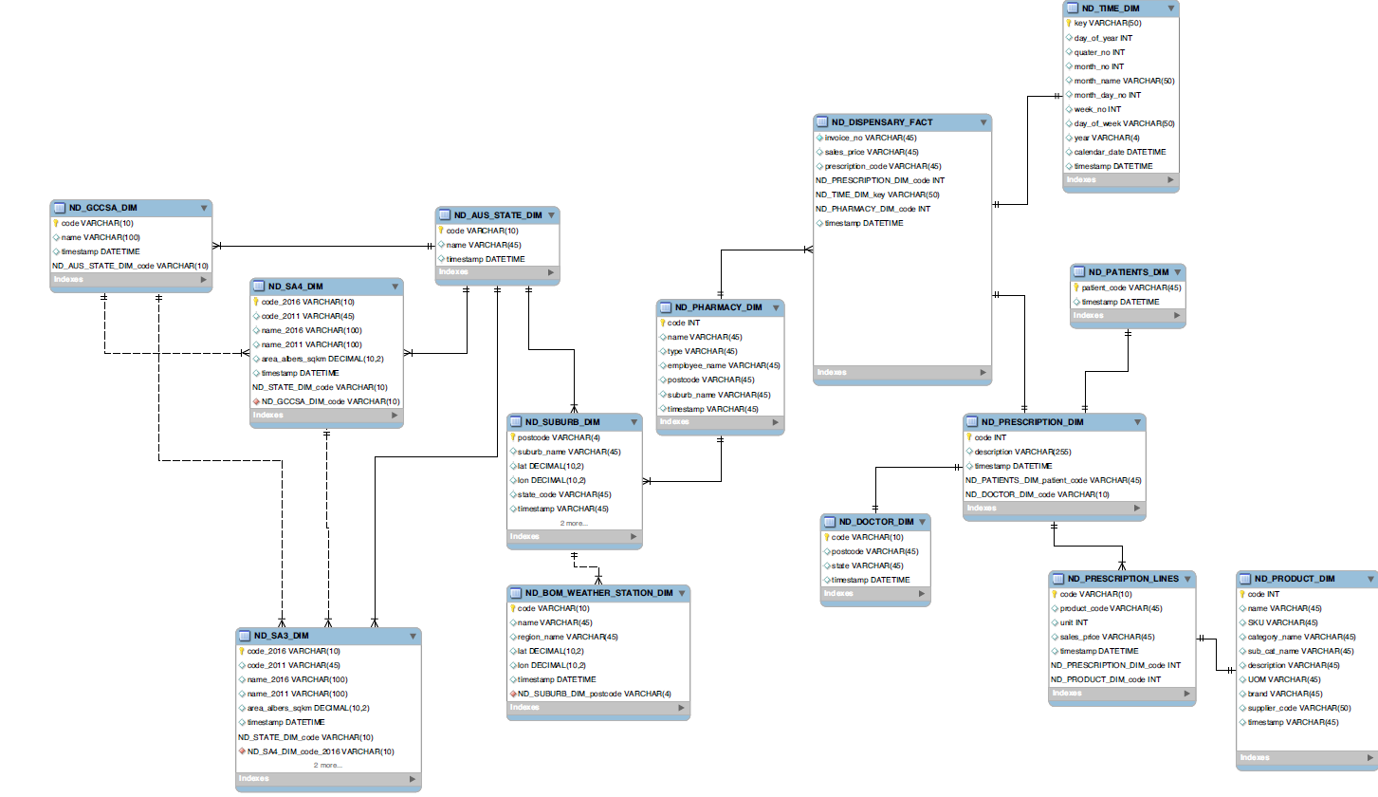
DataBase Schema
Schema mapping the different relations for feeding data into the database

Slide 8
Work Ahead..
Push data into SQL Server
Query database and test integrity
Feed data into HDFS (Hadoop File System)
Query execution and summarization through Hive
Possible data visualization using R

Slide 9
Thank You!

