Slide 1

Connecting pen-pals in the modern world

Slide 2
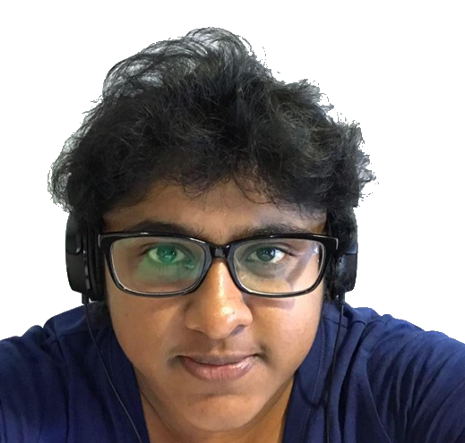
Meet Osheen
Stay-at-home mother
2 young children
Can’t go out much
Husband works long hours
Doesn’t have a very big social network
Lonely

Slide 3
Current Solution
Facebook → links only if you know each other
LinkedIn → work-oriented
Meet-ups → specific place and time
Luck/mutual acquaintances

