Slide 1

Analyzing the impact of energy efficient home upgrades.

Slide 2
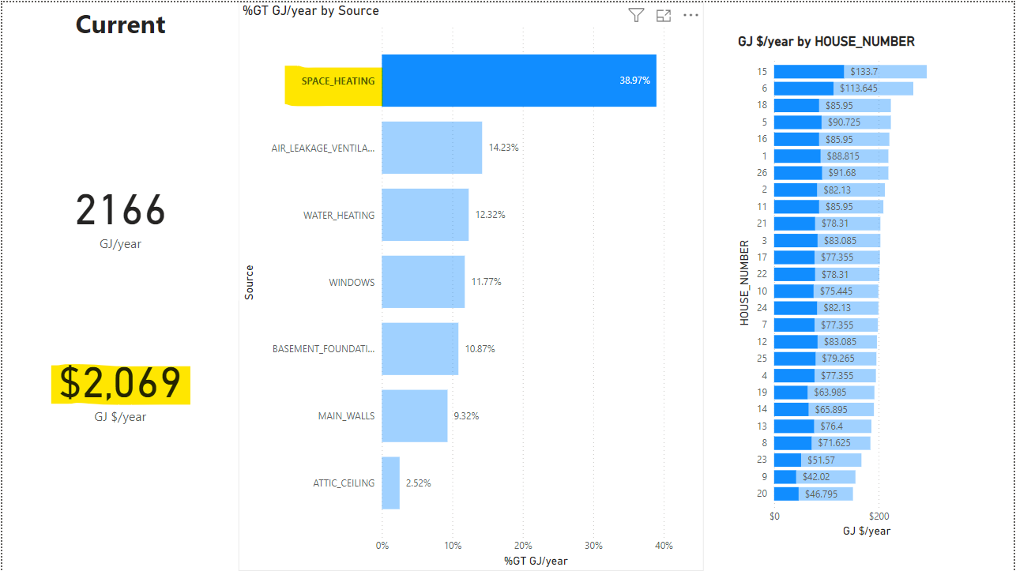
How much is spent on space heating?
Before any upgrades the current amount being spent to run a space heater each years is $2069.

Slide 3
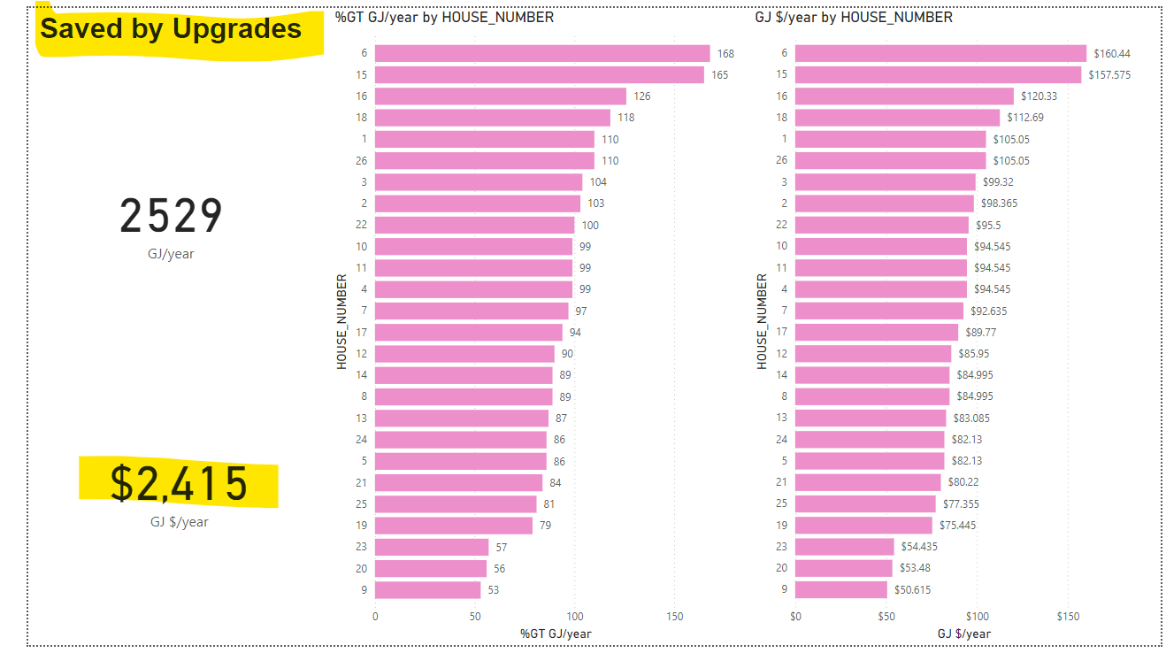
How much money could be saved if all houses upgraded to a new furnace?
If all 26 houses upgraded their furnace, they would save $2415.

Slide 4
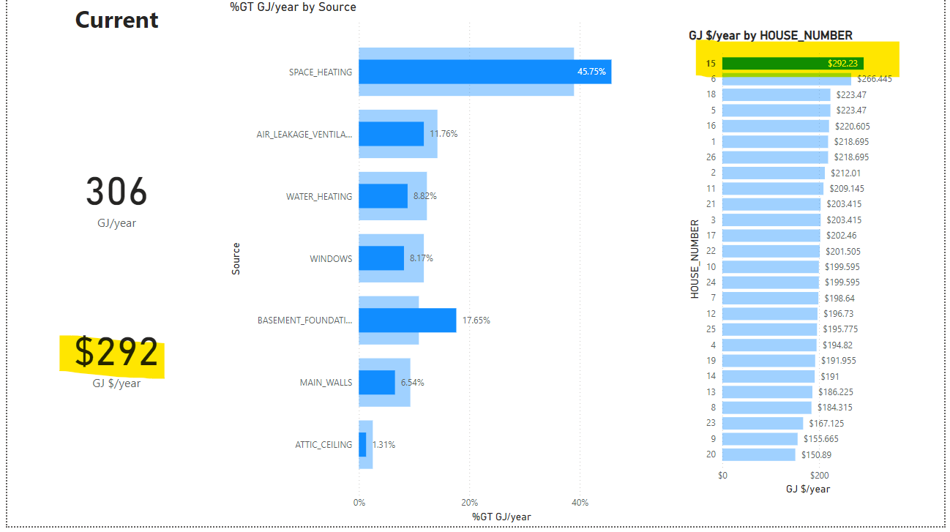
What house uses the most energy?
House number 15 uses the most amount of energy. They spend $292 per year.

Slide 5
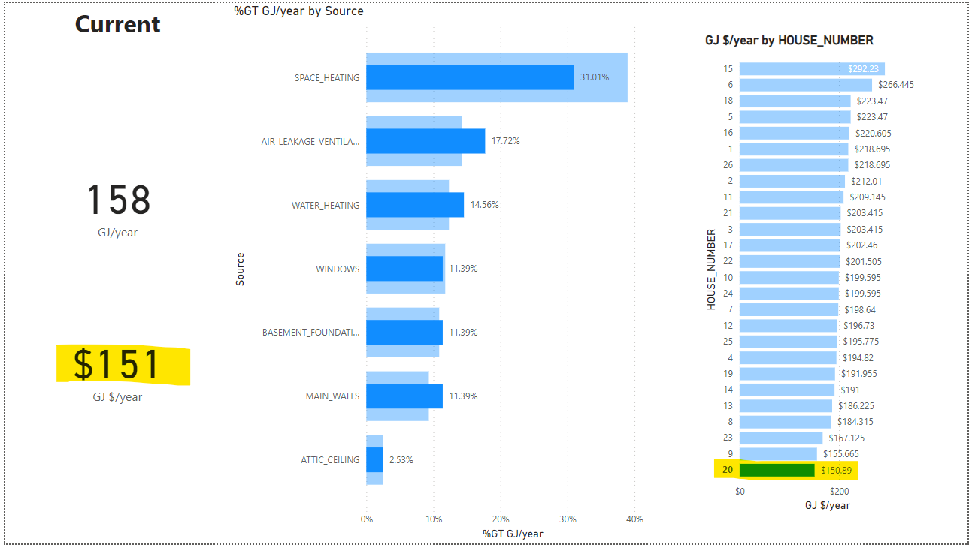
Which house uses the least amount of energy?
House number 20 uses the least amount of energy. They spend $151 per year.

Slide 6
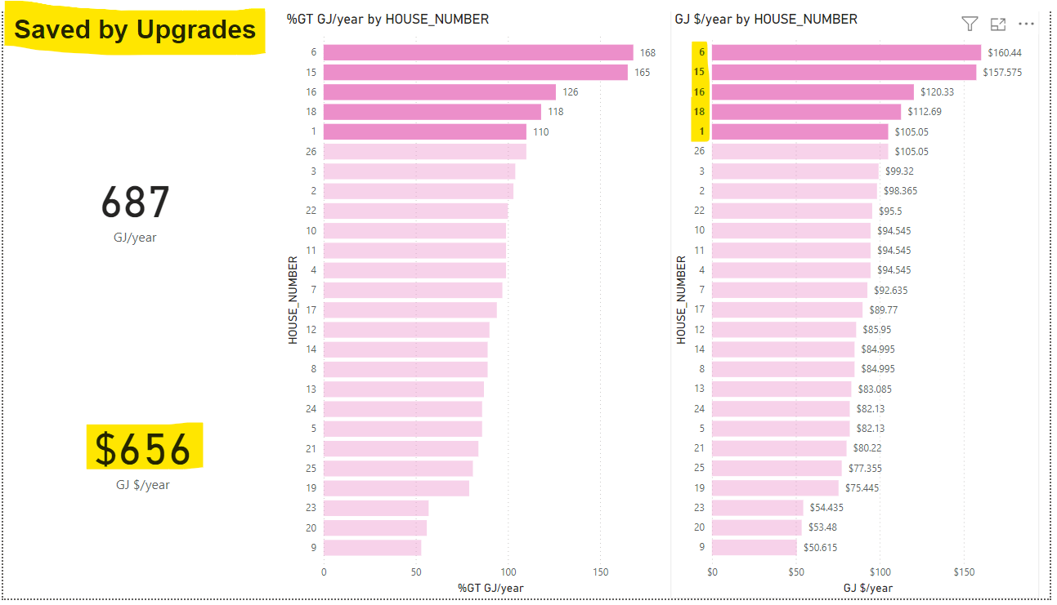
Which 5 houses would save the most if they installed new furnaces?
House numbers 1, 6, 15, 16, and 18 would save the most amount of money if they upgraded to a new furnace. They would save $656 per year.

