Slide 1

The role of Ai in healthcare
Bridging the gap between technology and healthcare

Slide 2
What is the role of ai in healthcare?
AI is revolutionizing healthcare in several ways, it improves speed, accuracy, and efficiency of the medical process.
Leading to more effective treatment plans, better outcomes, and improved survival rate.
The use of AI is becoming integrated into the healthcare field and the way that we interact with the healthcare system and the way that professionals deliver care.
Notes:
Talk about some aspects of AI in healthcare such as improved diagnostics for things like skin cancer, early detection of breast cancer based on mammograms.

Slide 3
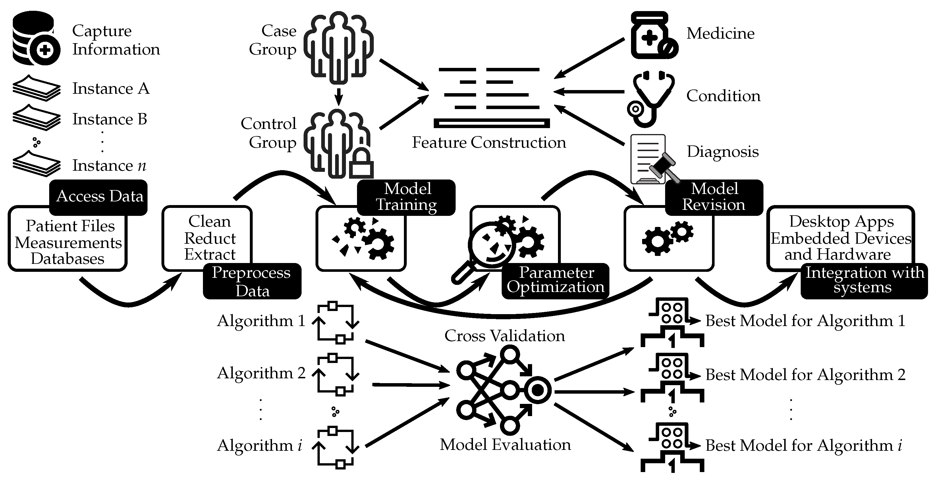
How is AI transforming healthcare?
Artificial intelligence (AI) employs a structured approach to incorporate external data, using complex algorithms to generate accurate predictions for specific cases. This process involves advanced methods like artificial neural networks and deep learning. By carefully selecting and applying the appropriate algorithm for the given technique, AI has proven highly effective in predictive modeling, particularly in the medical field. Figure 1 illustrates the application of neural networks in supporting medical decision-making. The process typically involves several steps, including data collection and preprocessing, model training, refining the model through cross-validation, selecting the best model, and integrating it into systems such as desktop applications or embedded devices.
Figure 1
¹ Bekbolatova et. al,2024
Notes:
AI is unbiased and able to look at data without letting external factors such as gender, ethnicity ect influence their diagnosis.

Slide 4
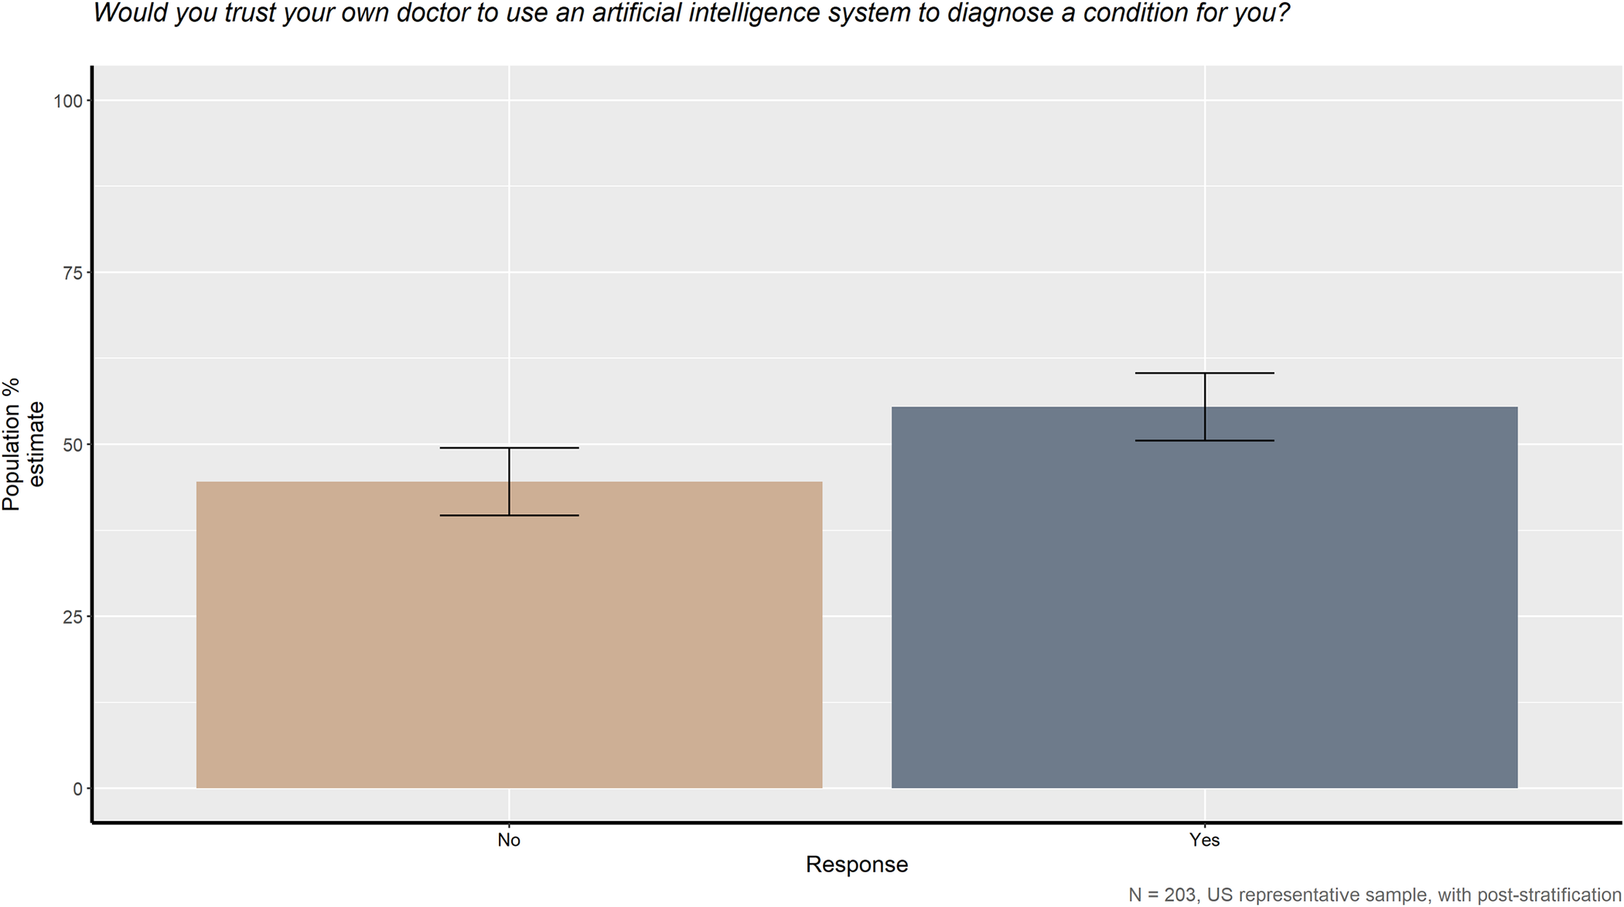
How does the public perceive AI in healthcare?
The American public shows mixed feelings towards AI in healthcare. While many recognize AI's potential to reduce bias and improve medical treatment, there is a strong preference for human decision-making in healthcare settings. Jessica Rojahn et al., 2023
Figure 2
Jessica Rojahn et al., 2023
Notes:
The public is split on AI entering the healthcare field. On some aspects such as would you trust your own doctor to use an AI system to diagnose a condition for you the majority of the public surveyed would.

Slide 5
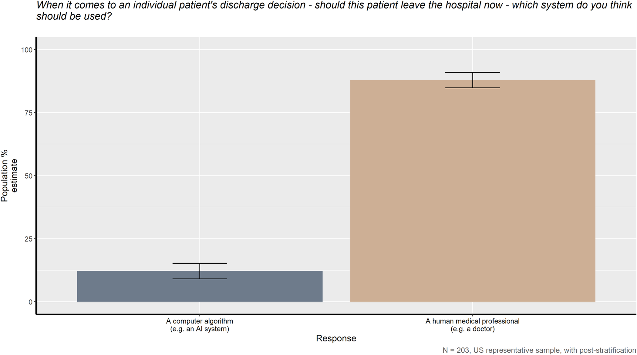
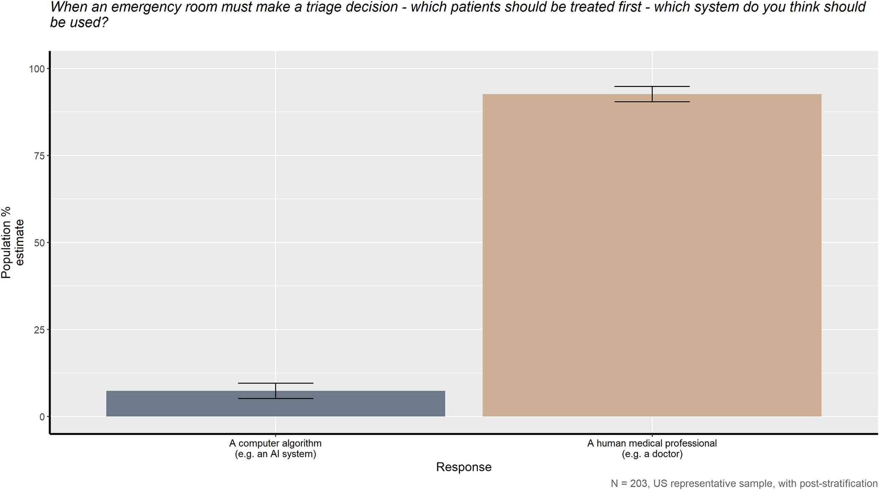
Public perception cont.
Notes:
Conversely when asked if AI or a human (dr) should make the decision whether to discharge a patient the vast majority agreed that should be left to a dr. Similarly the same sentiment is shared when it comes to triaging patients in an emergency room.

Slide 6
References
Bekbolatova, M., Mayer, J., Ong, C. W., & Toma, M. (2024, January). Transformative potential of AI in Healthcare: definitions, applications, and navigating the ethical Landscape and Public perspectives. In Healthcare (Vol. 12, No. 2, p. 125). MDPI.
Rojahn, J., Palu, A., Skiena, S., & Jones, J. J. (2023). American public opinion on artificial intelligence in healthcare. PLOS ONE, 18(11), e0294028.

Slide 7

Thank You
rmitra@norquest.ca

