Slide 1
t-SNE: Assisted Parameter Optimization by Approximating Neighbourhood Similarity
P1 | VDA Research Group
Raphael Mitsch
University of Vienna

Slide 2
I. Motivation
Context: Master thesis on PSA for word embeddings
  How to visualize single WE model with all records?
  Reduce dim. with t-SNE to d_{low} << d_{high} so that d_{low} can be reasonably interpreted in a SPLOM
  How to choose hyperparameters for t-SNE?
Constraint: DR is implicit step in the pipeline; user shouldn‘t have to invest cognitive effort

Slide 3
II. Approach
Hyperparameter optimization:
  Grid search, random., Bayesian, grad.-based, evolutionary, ...
Questions:
  How fast does BO converge?
  Does it yield useful results for t-SNE?
  Exploration vs. exploitation
Build application tracking BO of t-SNE for word embeddings; evaluate efficacy and convergence behaviour

Slide 4
III. Concept & Prototype
Different quality metrics (weighted average):
  Faithfulness to original topology
  Usefulness for domain tasks
Plot convergence of hyperparameters and evolution of quality metrics
Enable user to assess model quality; suggest rating
Notes:
Allow static hyperparameters, initial sampling (Sobol sequence)

Slide 5
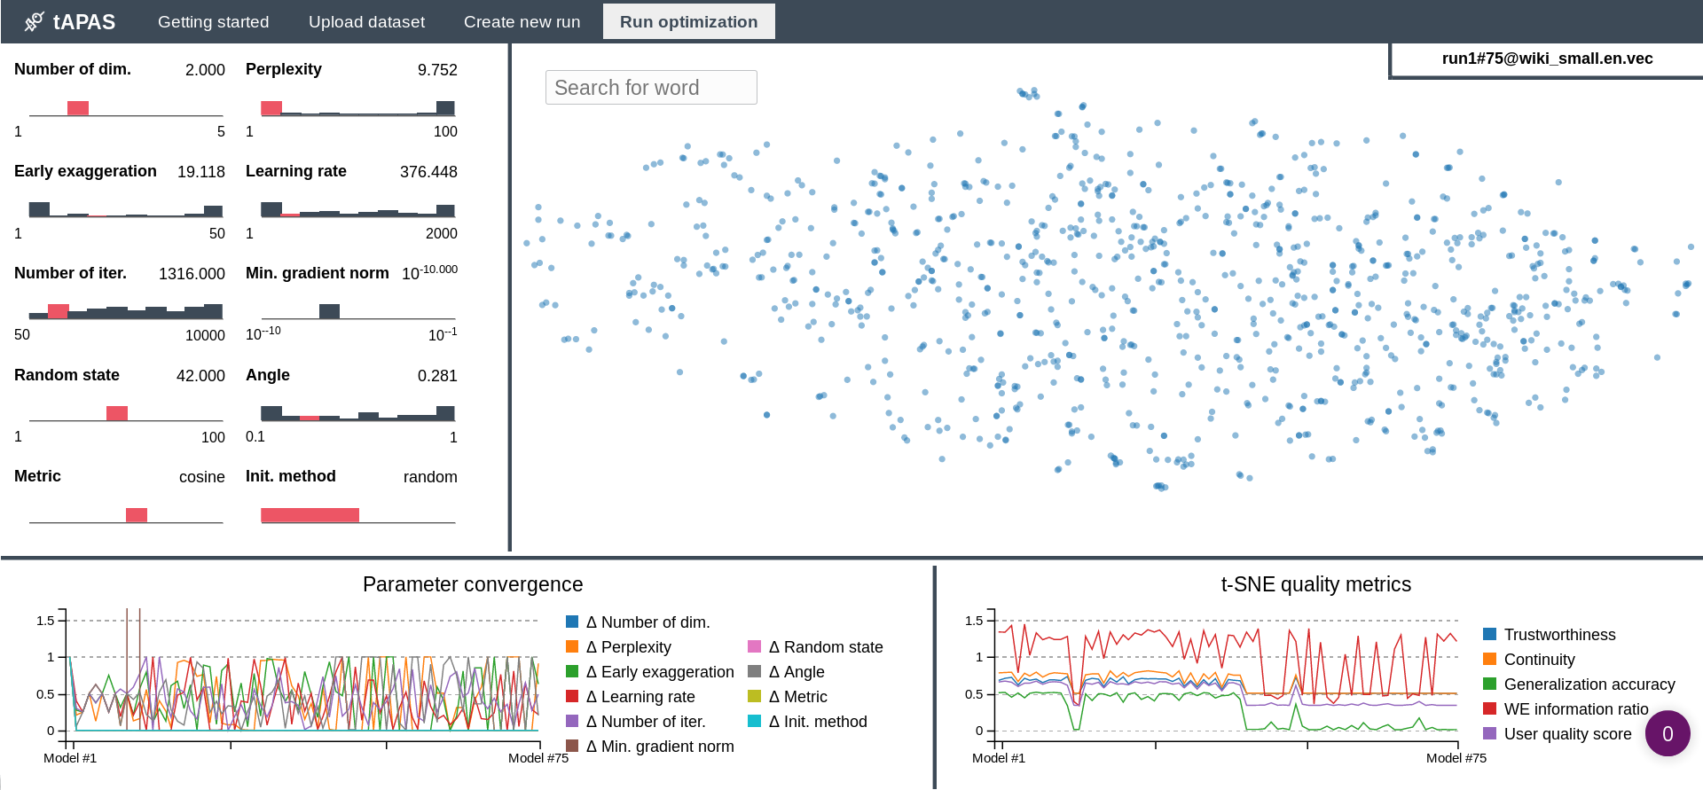
III. Concept & Prototype

Slide 6
IV. Evaluation
Results so far show no consistent (positive) tendency – more runs & metric tuning necessary
Exploring dimensionality reduction algorithms warrants dedicated investigation. Thus: Abandon original idea for thesis in favor of VPSA for DR algorithms
Notes:
First prototype; first dataset
Issues apart from non-consistent evolution:
Ability to navigate and compare multiple iterations missing
Limit range of space to sample

Slide 7
V. Future Work
With better understanding of t-SNE after VPSA for DR: Re-evaluate design; improve prototype of optimization UI
Investigate exploitation vs. exploration parameters for BO
Ultimately: No need for human in the loop, providing BO for optimization of DR/t-SNE in the context of WE automatically

Slide 8
References
[1] https://github.com/rmitsch/tapas
[2] Y. Tsvetkov, M. Faruqui, W. Ling, G. Lample, and C. Dyer, “Evaluation of Word Vector Representations by Subspace Alignment,” 2015, pp. 2049–2054.
[3] L. J. P. van der Maaten, E. O. Postma, and H. J. van den Herik, Dimensionality Reduction: A Comparative Review. 2008.
[4] J. A. Lee and M. Verleysen, “Quality assessment of dimensionality reduction: Rank-based criteria,” Neurocomputing, vol. 72, no. 7, pp. 1431–1443, Mar. 2009.

