Slide 1

MXML
A Meta model for process mining data
Boudewijn van Dongen
Eindhoven University of Technology
Department of Information Systems
P.O. Box 513, 5600 MB Eindhoven
The Netherlands
b.f.v.dongen@tm.tue.nl
www.processmining.org

Slide 2

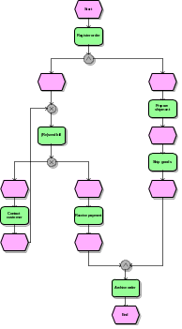
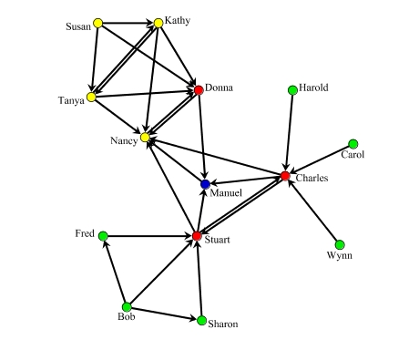
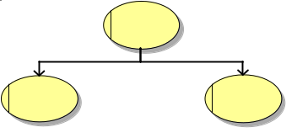



Overview Process Mining
2) Control flow rediscovery
3) organizational model
4) social network
1) basic performance metrics
5) performance characteristics
6) auditing/security
If …then …
www.processmining.org
Notes:
Next: Process Log Requirements (staffware example)

Slide 3
1) Basic Performance Metrics
Process/control-flow perspective: flow-, waiting-, processing- and sync-times.
Questions:
  What is the average flow time of orders?
  What percentage of requests is handled within 10 days?
  What is the average time between scheduling an activity and starting it?
Resource perspective: frequencies, time, utilization, and variability.
Questions:
  How many times did John withdraw activity go shopping?
  How many times did Clare suspend some running activity?
  How much time did people with role Manager work on this process?
  What is the average utilization of people with role Manager?

Slide 4
2) Control Flow Rediscovery
Try to discover a process model using nothing but the linear ordering of events in an event-log.
Minimal information in log: linearly ordered case id’s and task id’s.
Additional information: event type, time, resources, and data.

Slide 5
3) Organizational Model
Recently, we started working on the question “What if we know both the process log and the organizational units to which people belong?”.
This research is started in cooperation with:
  Dr. Stefanie Rinderle (University of Ulm, D), and
  Dr. Manfred Reichert (Twente University, NL)

Slide 6
4) Social Network
Automatically build graphs where nodes indicate actors (performers/individuals).
Questions to be answered:
Who worked together with whom?
Who has power over whom?
…
John
Mary
Bob
Clare
June

Slide 7
5) Performance Characteristics
Performance characteristics can often be formulated as “if… then…” statements.
If the “check amount” activity is delayed in the start of the process, then “pay customer” will be delayed at the end of the process.
Strongly related is the work on “case prediction”. However, this concerns real-time behaviour.

Slide 8
6) Auditing / Security
Detecting process instances that do not fit some given process model, i.e. Checking Process Conformance.
Determining how well a process model fits a log (over-fitting / under-fitting).
Checking auditing principles such as the “four eyes principle”: Two tasks A and B within one case should never be performed by the same user.
Notes:
Next: Process Log Requirements (staffware example)

Slide 9
Process Log Requirements
Each “Audit Trail Entry” should be an atomic event at a certain point in time
Each “Audit Trail Entry” should refer to one uniquely identifiable activity
Each “Audit Trail Entry” should contain a description of the event
Each “Audit Trail Entry” should refer to one specific case (process instance)
Each “process instance” should belong to exactly one process
Case 2
Diractive Description Event User yyyy/mm/dd hh:mm
---------------------------------------------------------------------------------------------------------------------------------
Start bvd@staffw_e 2002/04/16 11:06
task B Processed To bvd@staffw_e 2002/04/16 11:08
task B Expired bvd@staffw_e 2002/04/16 11:15
task B Withdrawn bvd@staffw_e 2002/04/16 12:12
task C Processed To bvd@staffw_e 2002/04/16 12:34
task C Released By bvd@staffw_e 2002/04/16 12:56
task D Processed To bvd@staffw_e 2002/04/16 13:12
task D Released By bvd@staffw_e 2002/04/16 13:32
Terminated 2002/04/16 13:40
Notes:
Next: Meta model and FSM

Slide 10
Process Mining Meta Model
UML Meta Model:
Transactional Model:
reassign
WorkflowLog
Process
ProcessInstance
schedule
assign
*
1..*
1
0..*
1
1
start
1..*
resume
AuditTrailEntry
manualskip
withdraw
suspend
1..*
+activity : WorkflowModelElement
autoskip
complete
+description : string
ate_abort
WorkflowModelElement
+timestamp : Date
+person : Originator
1
*
+...
pi_abort
Notes:
Next XML format

Slide 11
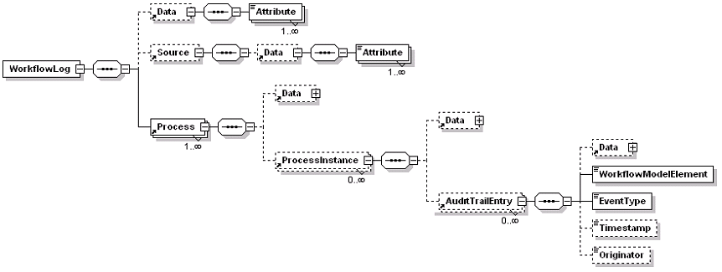
Log File Format MXML
Notes:
Next mapping staffware / mxml

Slide 12
Mapping Meta Models
Start bvd@staffw_e 2002/04/16 11:06
taskB Processed To bvd@staffw_e 2002/04/16 11:08
taskB Expired bvd@staffw_e 2002/04/16 11:15
taskB Withdrawn bvd@staffw_e 2002/04/16 12:12
task C Processed To bvd@staffw_e 2002/04/16 12:34
WorkflowLog
Process
ProcessInstance
*
1..*
1
0..*
Audit
Procedure
1
AuditTrail
1
*
1
1
0..*
1..*
1
1..*
1
*
AuditTrailEntry
Step
WorkflowModelElement
+activity : WorkflowModelElement
1
1..*
*
+description : string
+timestamp : Date
LineOfText
+person : Originator
+diractiveDescription : string
+...
AutomaticStep
ManualStep
+event : string
+timestamp : String
+Name : string
0..1
*
+user : string
Notes:
Next: ontological

Slide 13
Ontological Analysis
Construct deficit:
Staffware only shows the scheduling and completion of tasks,
not the start of tasks
Construct overload:
Staffware uses a separate step to denote the start and the end of a case
No construct redundancy
No construct excess
Notes:
Ontological incompleteness
Construct deficit exists unless there is at least one grammatical construct for each ontological one.
Ontological Clarity
Construct overload if one grammatical construct represents more than one ontological construct
Construct redundancy if more than one grammatical construct represent the same ontological construct
Construct excess if a grammatical construct exists that does not map to an ontological construct
Staffware: trivial, but not for other systems (SAP / Peoplesoft / Flower / …)
Next: ProM

Slide 14

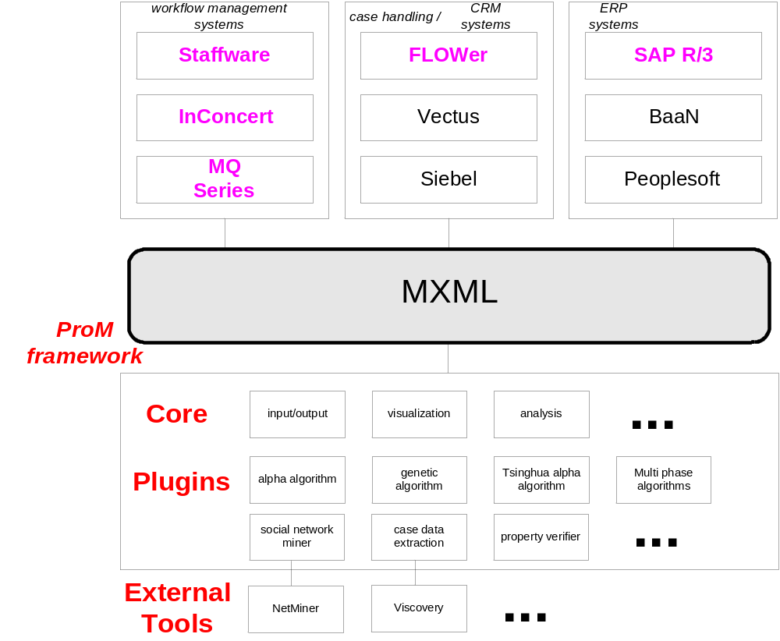
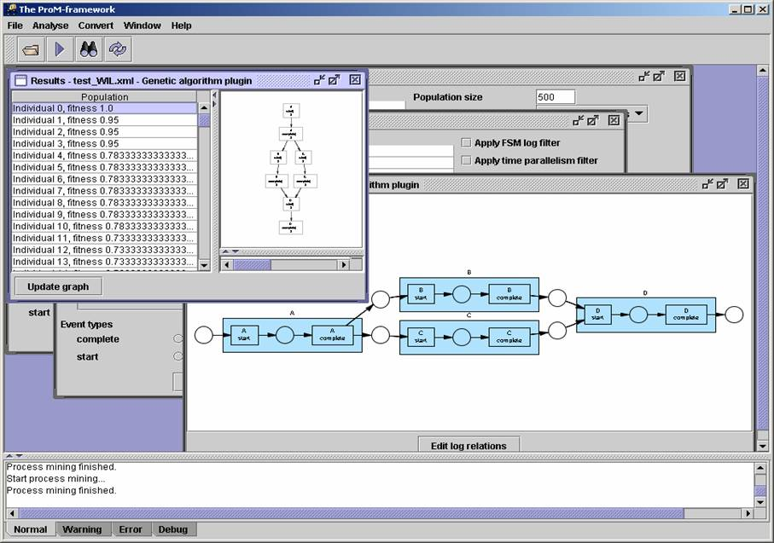
ProM
Notes:
Next: conclusions

Slide 15
Conclusions
MXML can serve as a standard for storing event logs
The ProM Framework, based on MXML enables researchers to benefit from each others ideas and implementations with little effort
MXML greatly improves applicability of process mining in business environments, through the mapping of Meta Models and ontological analysis thereof

